Slide 1
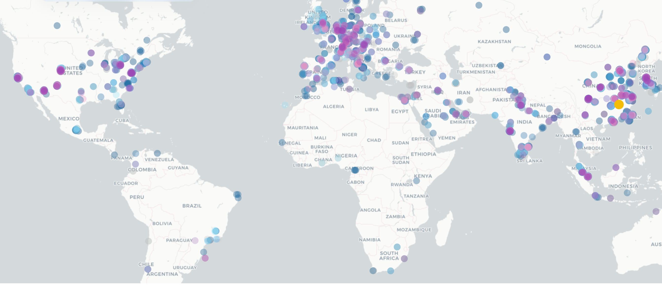
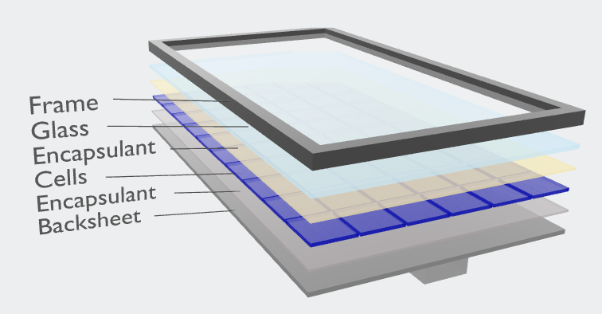
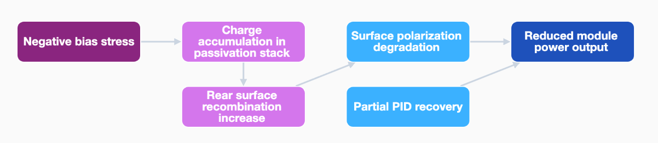

Slide 2

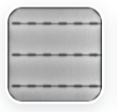
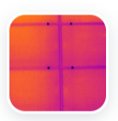
Title
STEP 1: XX
visible images
STEP 2: XX
STEP 3: XX
EL images
Upload part
GPT
GEMINI
CLAUDE
results
IR images
Image dataset
Result table

Slide 3
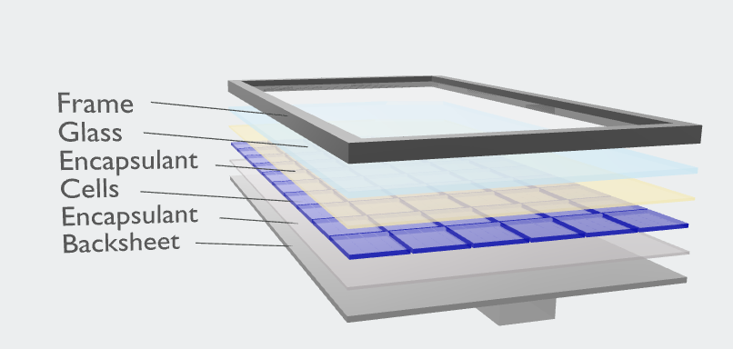

Slide 4
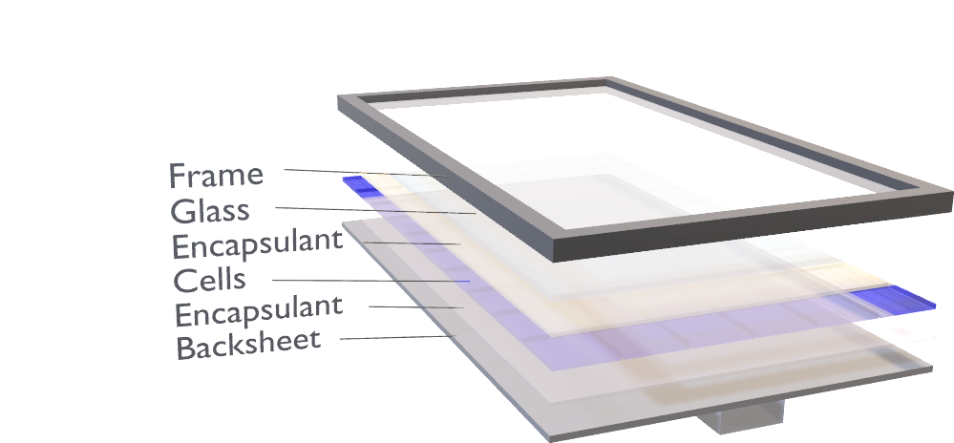

Slide 5
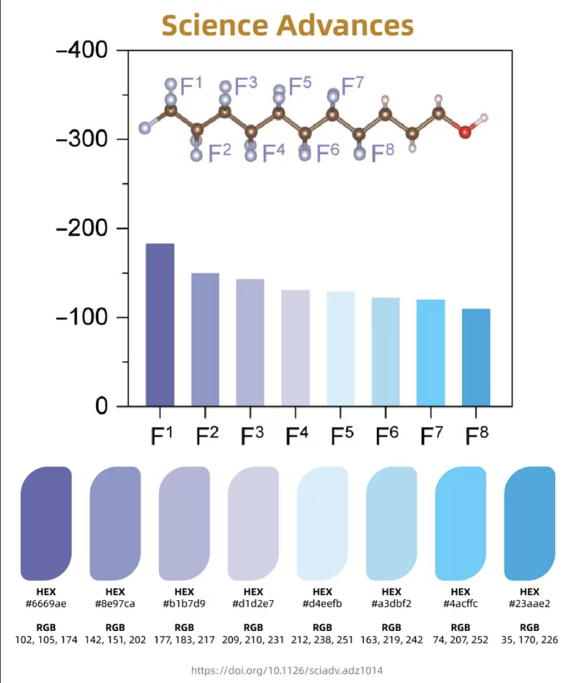

Slide 6
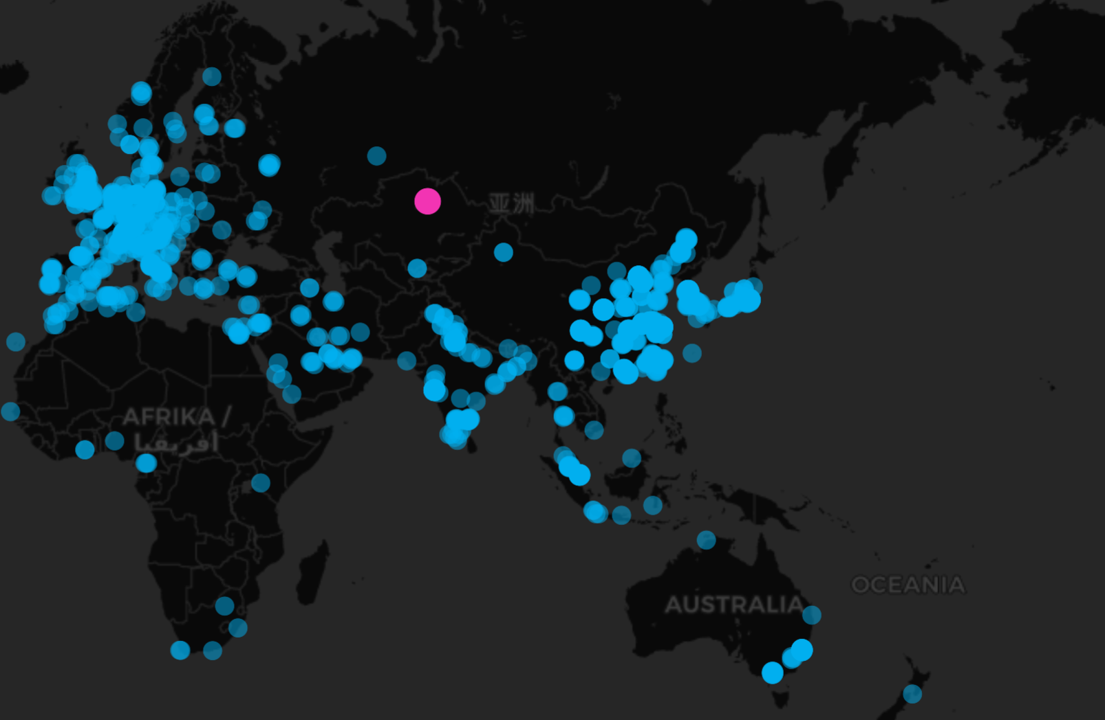
fasgaewga

Slide 7
stressor
mechanism
failure
Loss and loss
stressor
mechanism
failure
Loss and loss
stressor
mechanism
failure
Loss and loss

