Slide 1
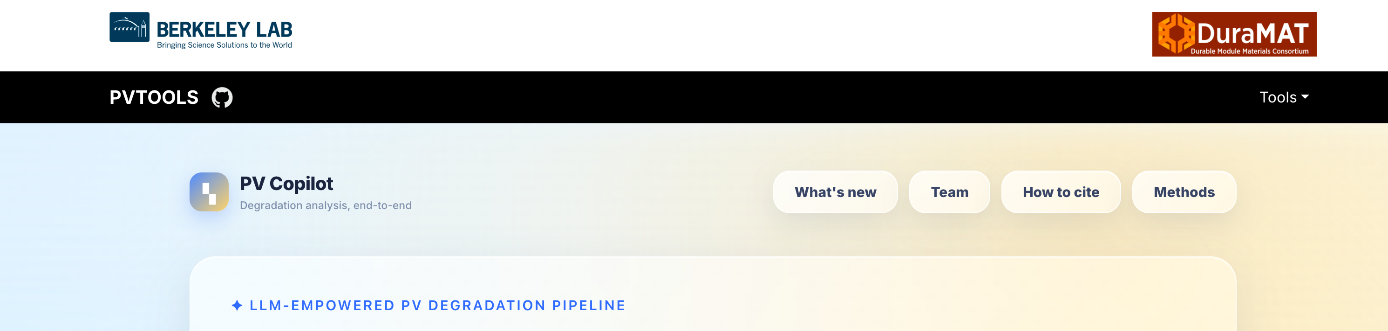

PV Copilot

Slide 2





Slide 3
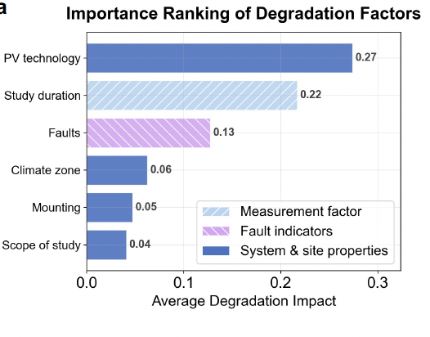
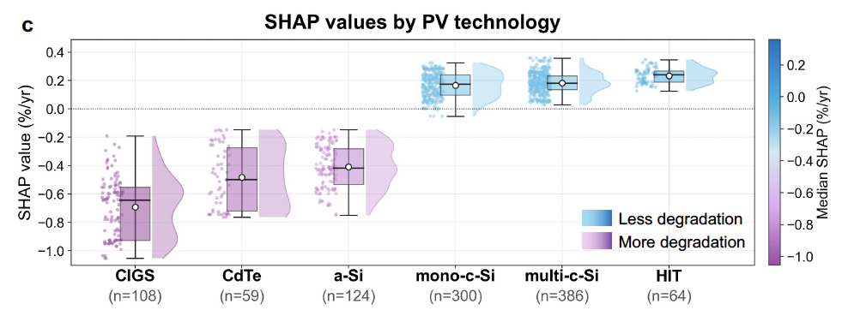
PV technology
Study duration
Fault
xx

Slide 4
PV technology
Study duration
Fault
xx

Slide 5
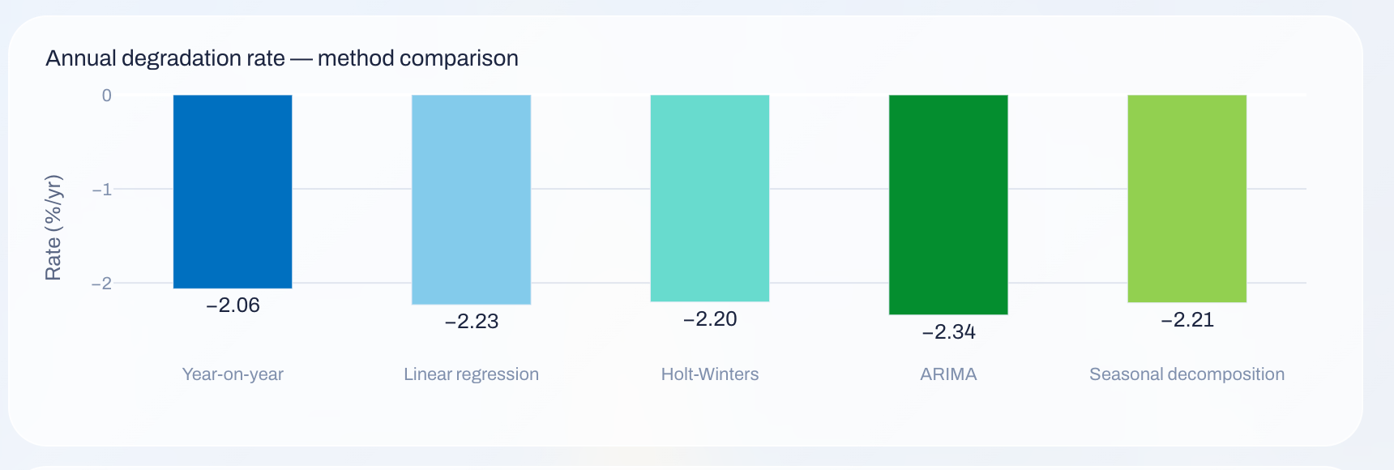
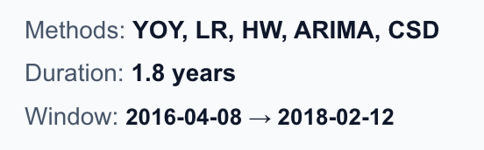
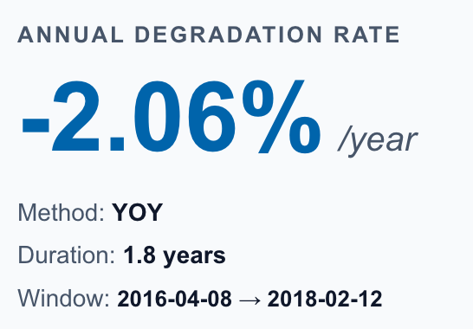

−xx$±xx$%/yr

Slide 6






Slide 8
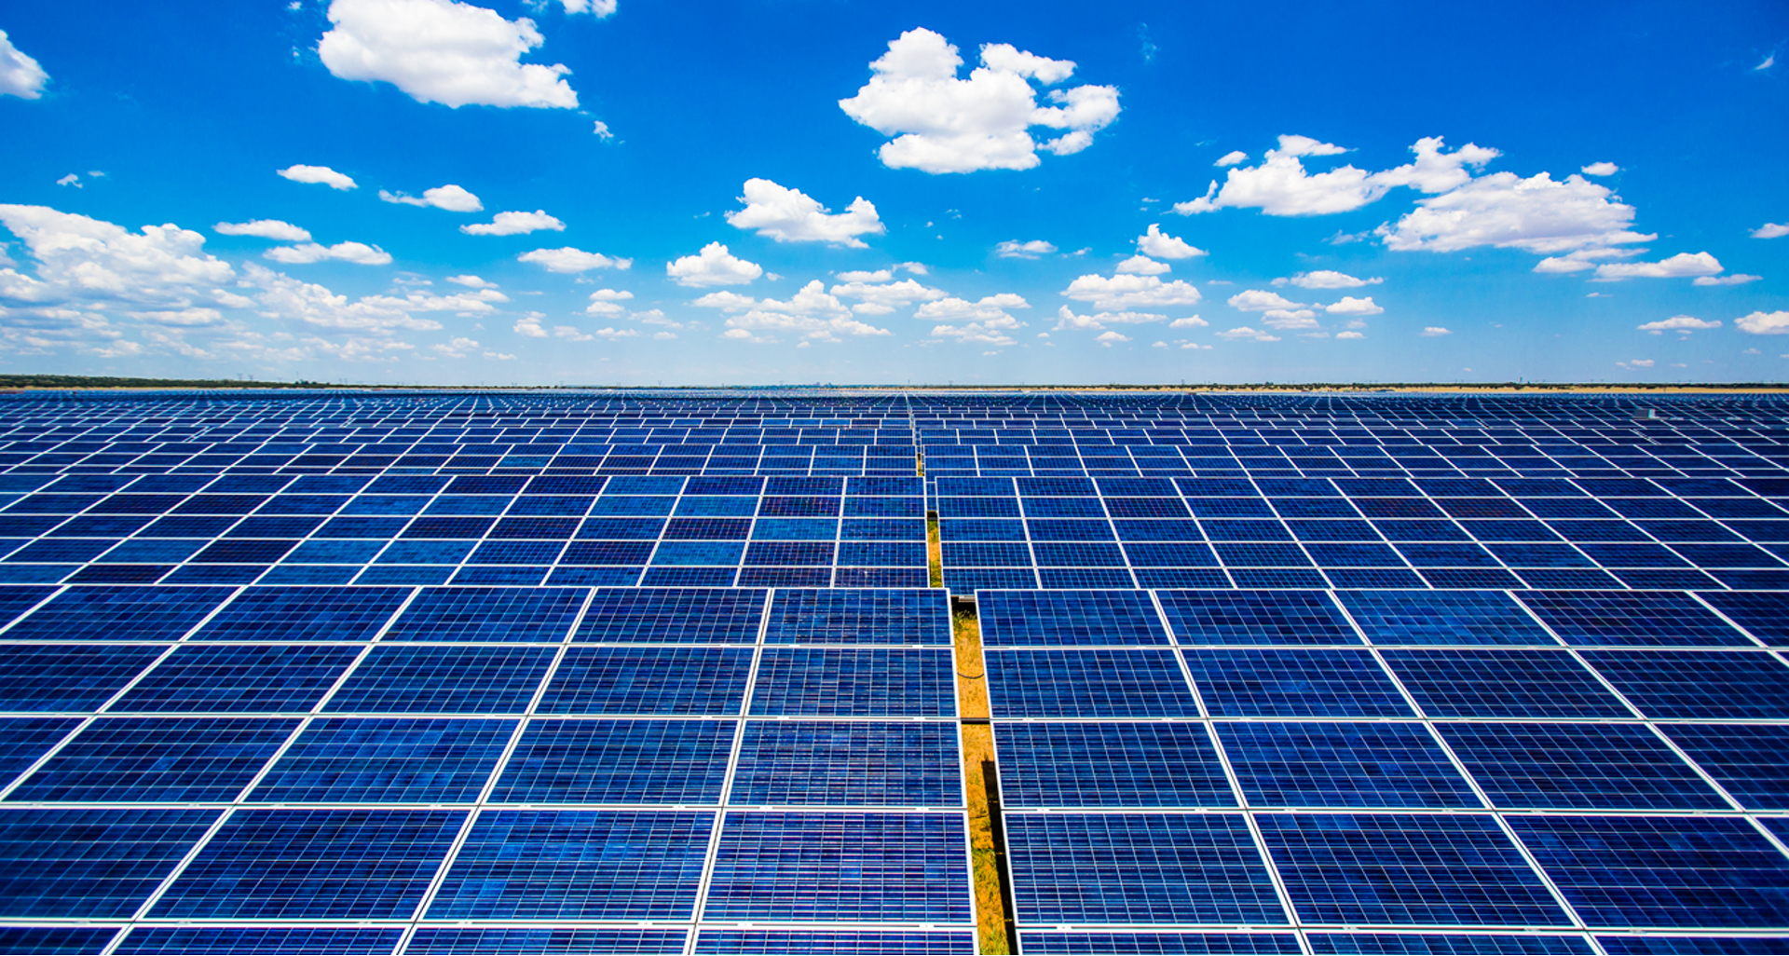

−0.09%/yr

