Slide 1
Coinage
RESTful Web Services
for OpenURL COinS
Jay Luker
Research & Practice in Software Architecture
Tufts University, Spring ‘08

Slide 2
Overview
Background & History
  OpenURL & COinS
  Current Applications
The Coinage Web Services
  Collector, CoinOp & Conjure
Architectural Details
  REST & Resource-Oriented Architecture
Project Deliverables
  Goals & Evaluation

Slide 3
Background & History

Slide 4
OpenURL
Navigation in a scholarly resource environment is hard.
OpenURLs enable context-sensitive linking between research resources.

Slide 5

OpenURL Request
Source
Link
Journal
Article
OpenURL
Inter-Tubes
OpenURL
Resolver
http://library.tufts.edu::4550/resserv
?url_ver=Z39.88-2004
&rfr_id=info:sid/firstsearch.oclc.org:MEDLINE
&rft_val_fmt=info:ofi/fmt:kev:mtx:journal
&req_id=<sessionid>fsapp2-58470-eo2540ks-9zabf6</sessionid>
&rfe_dat=<accessionnumber>16579198</accessionnumber>
&rft_id=urn:ISSN:0145-5613
&rft.aulast=Brevi
&rft.aufirst=B
&rft.atitle=Mandibular distraction osteogenesis
&rft.jtitle=Ear Nose Throat J
&rft.date=2006-02
&rft.volume=85
&rft.issue=2
&rft.spage=102
&rft.issn=0145-5613
&rft.genre=article
Requester

Slide 6
COinS
OpenURLs contain Context Objects
COinS (Context Object in Span)
is an ad hoc method for inserting “latent” OpenURLs inside HTML <span> elements.
Used by Wikipedia, CiteULike, Citebase, WordPress (via a plugin), WorldCat, more…

Slide 7



How COinS Work
From http://en.wikipedia.org/wiki/Abraham_lincoln
<span
class="Z3988"
title="ctx_ver=Z39.88-2004&amp;rft_val_fmt=info%3Aofi%2Ffmt%3Akev%3Amtx%3Abook
&amp;rft.genre=book&amp;rft.btitle=%5B%5BThe+Real+Lincoln%5D%5D
&amp;rft.aulast=DiLorenzo&amp;rft.aufirst=Thomas&amp;rft.isbn=0-7615-2646-3">
&#160;
</span>

Slide 8
Current Applications
bX & MESUR: aggregation and analysis of scholaraly usage data (i.e., link server logs)
LibX, Zotero & OpenURL Referrer: browser extensions for auto-discovery and activation of COinS
LibraryThing for Libraries: uses AJAX to deliver recommendations, tag clouds, ratings, and reviews

Slide 9
but…
bX & MESUR: data harvesting is clunky; tied to a single resolver product (SFX)
LibX, Zotero & OpenURL Referrer: “install this thingy” doesn’t scale
LibraryThing for Libraries: only for books; recommendations based on collaborative filtering—not usage

Slide 10
The Coinage Project

Slide 11
Collector
Purpose is to provide a distributed mechanism for collecting and aggregating scholarly usage data
JavaScript client engine detects COinS in web page
Client sends context objects to a central respository via an AJAX call to a web service

Slide 12
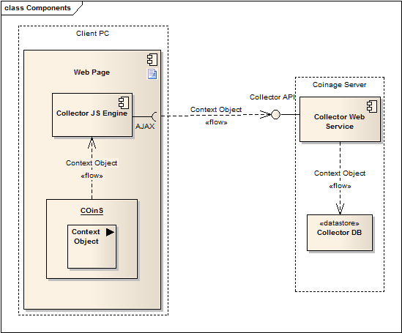

Slide 13
CoinOp
OpenURL auto-discovery
Purpose is to convert COinS into fully qualified OpenURLs
JavaScript client engine relays user’s IP address to the OCLC Resolver Registry via a web service
If an appropriate resolver is found COinS are converted to full links

Slide 14
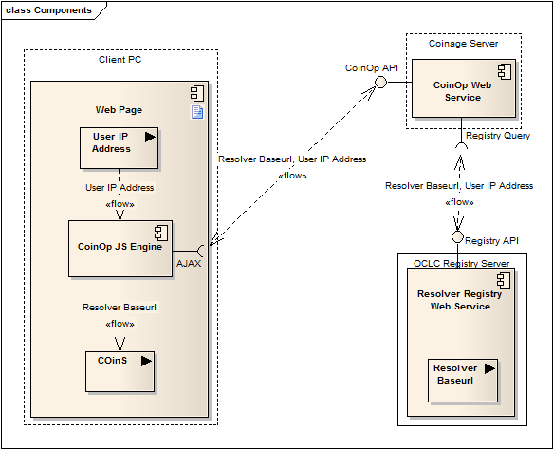

Slide 15
Conjure
Provides a recommendation generation & delivery system
JavaScript client engine transmits context objects to a central server via a web service
Recommendations are generated based on CiteULike data
Item list is returned and displayed within a widget using DHTML.

Slide 16
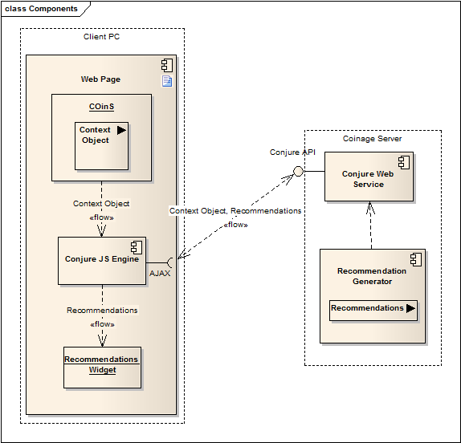

Slide 17
Architectural Details

Slide 18
The REST Style
REpresentational State Transfer
REST is an architectural style; a set of constraints and design criteria for building network-based applications
Key aspects: client-server, stateless, cacheable, uniform interface, layered, code-on-demand

Slide 19
Resource-Oriented Architecture
Resource-Oriented Architecture (ROA) is a concrete solution for arranging components and connectors in a RESTful style
An architecture can be RESTful w/o necessarily being ROA
Key concepts: addressability, statelessness, connectedness and uniform interface

Slide 20
Project Deliverables

Slide 21
Goals
Implement web services using a Resource-Oriented Architecture
JavaScript client engines as consumers of RESTful services
Server-side client for accessing the OCLC Resolver Registry
Simple recommendation generator based on CiteULike data (optional)

Slide 22
Evaluation
How well do the web services conform to the REST design criteria?
How well does the overall architecture adhere to ROA best practices?
Does it work?
Is it useful?

Slide 23


