Slide 1

Introduction to High-Performance Computing for Research Applications (Tutorial)
EWRS Seminar Fall 2026
September 24th 2026
Trevor Amestoy | Lillian Lau

Slide 2
Learning goals
1
Getting set up on Amazon AWS Cloud
2
Connecting to your instance via VS Code
3
Demo: The Mandelbrot Set
4
HPC Resources
Notes:
Serial Borg does not have runtime metric capability (unless its PyBorg)

Slide 3
Learning goals
Material adapted from Jeil Oh’s Reed Group Cloud Computing Tutorial
👈
1
Getting set up on Amazon AWS Cloud
2
Connecting to your instance via VS Code
3
Demo: The Mandelbrot Set
4
HPC Resources
Notes:
Serial Borg does not have runtime metric capability (unless its PyBorg)

Slide 4
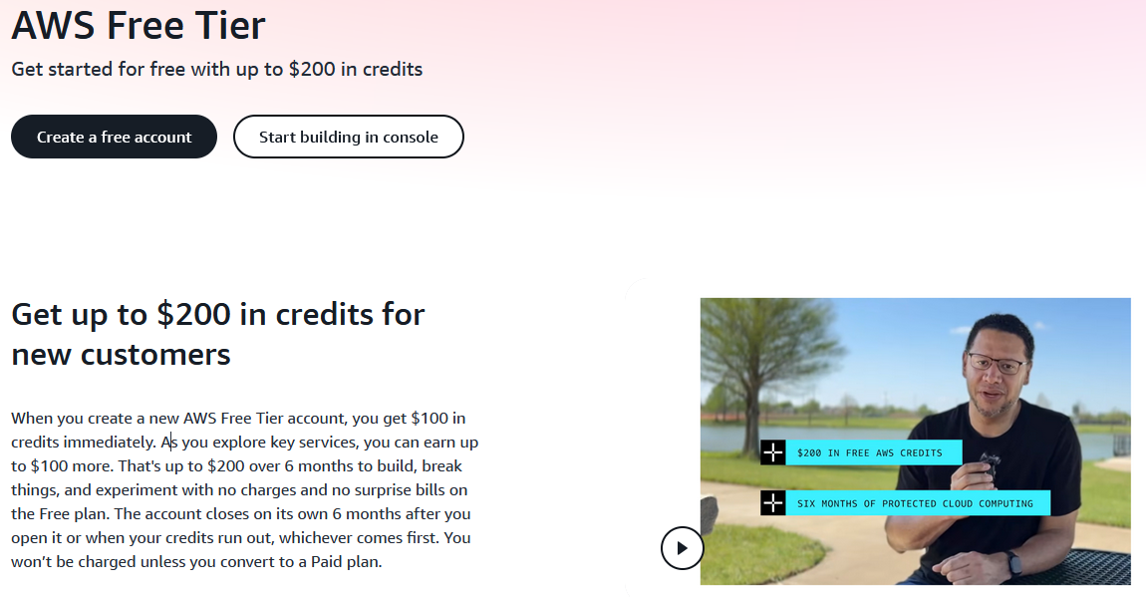
Getting set up on Amazon AWS
Why Amazon AWS?

Slide 5
Getting set up on Amazon AWS
Virtual machines (EC2)
Object storage (S3)
Two main components:
Notes:
EC2: Elastic Compute Cloud
An on-demand computing service
Calls “instances”, kind of like renting virtual servers to run applications in the cloud

Slide 6
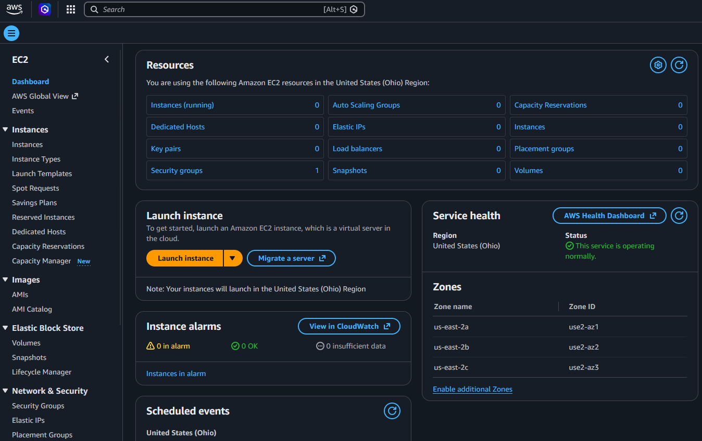
Getting set up on Amazon AWS
Step 0: Create an account
Create an AWS Account and select the “EC2” service to begin
Click on “Launch instance”
An instance is like an on-demand virtual server
Notes:
EC2: Elastic Compute Cloud
An on-demand computing service
Calls “instances”, kind of like renting virtual servers to run applications in the cloud

Slide 7
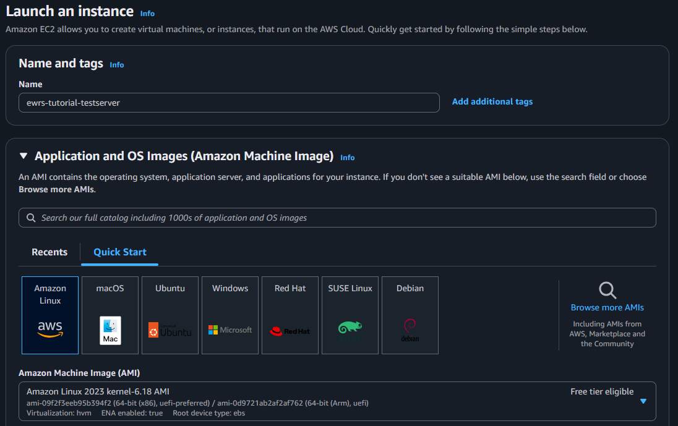
Getting set up on Amazon AWS
Step 1: Select your AMI (Amazon Machine Image)
Give your instance a name
Select “Amazon Linux” for this tutorial

Slide 8
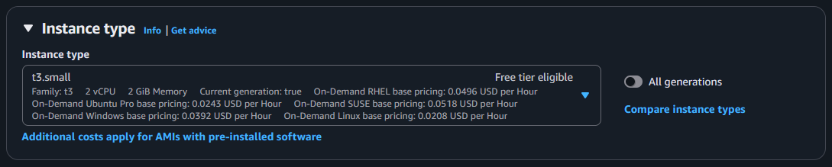
Getting set up on Amazon AWS
Step 2: Configure your instance type
The instance type determines your hardware settings (CPU, memory, storage, networking capacity, etc)
Click on “Get advice” to identify the instance type that best suits your needs
Notes:
We select the t3.small (both t3.small and t3.micro are eligible for the free tier. Will need to upgrade to the paid account to unlock more options, but this is sufficient for our demo)
You can also “Get advice” if you would like to upgrade

Slide 9
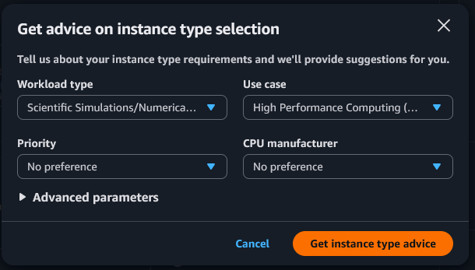
Getting set up on Amazon AWS
Step 2: Configure your instance type
The instance type determines your hardware settings (CPU, memory, storage, networking capacity, etc)
Notes:
We select the t3.small (both t3.small and t3.micro are eligible for the free tier. Will need to upgrade to the paid account to unlock more options, but this is sufficient for our demo)
You can also “Get advice” if you would like to upgrade

Slide 10
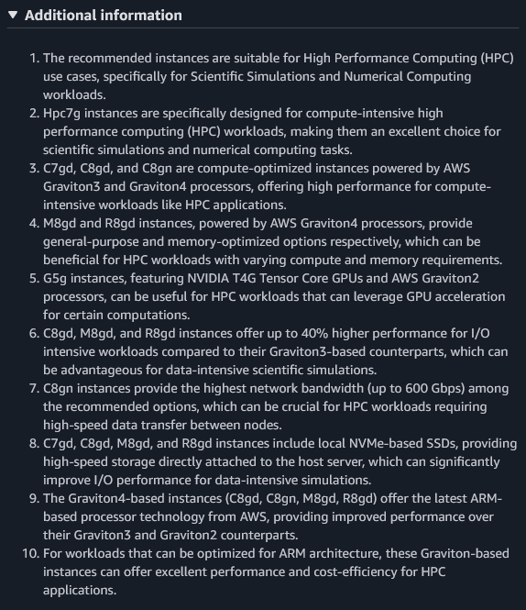
Getting set up on Amazon AWS
Step 2: Configure your instance type
The instance type determines your hardware settings (CPU, memory, storage, networking capacity, etc)
Notes:
We select the t3.small (both t3.small and t3.micro are eligible for the free tier. Will need to upgrade to the paid account to unlock more options, but this is sufficient for our demo)
You can also “Get advice” if you would like to upgrade

Slide 11
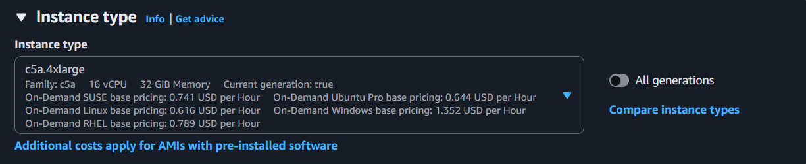
Getting set up on Amazon AWS
Step 2: Configure your instance type
The instance type determines your hardware settings (CPU, memory, storage, networking capacity, etc)
We will select the c73.4xlarge instance type for this demo (may need to upgrade to the paid version)
Notes:
We select the t3.small (both t3.small and t3.micro are eligible for the free tier. Will need to upgrade to the paid account to unlock more options, but this is sufficient for our demo)
You can also “Get advice” if you would like to upgrade

Slide 12
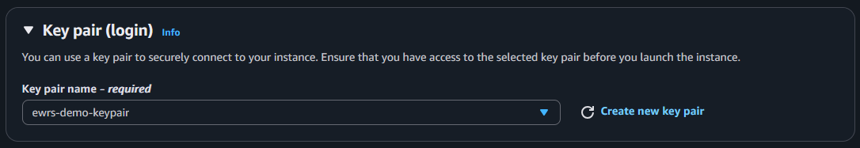
Getting set up on Amazon AWS
Step 3: Create a key pair
A set of security credentials you use to “prove your identity” when connecting to your instance
Allows secure logins to your AWS instance
Public vs private key:
  Public: Viewable on your instance (i.e. the key pair name)
  Private: Stored on your computer as a .pem file
Notes:
We select the t3.small (both t3.small and t3.micro are eligible for the free tier. Will need to upgrade to the paid account to unlock more options, but this is sufficient for our demo)
You can also “Get advice” if you would like to upgrade

Slide 13
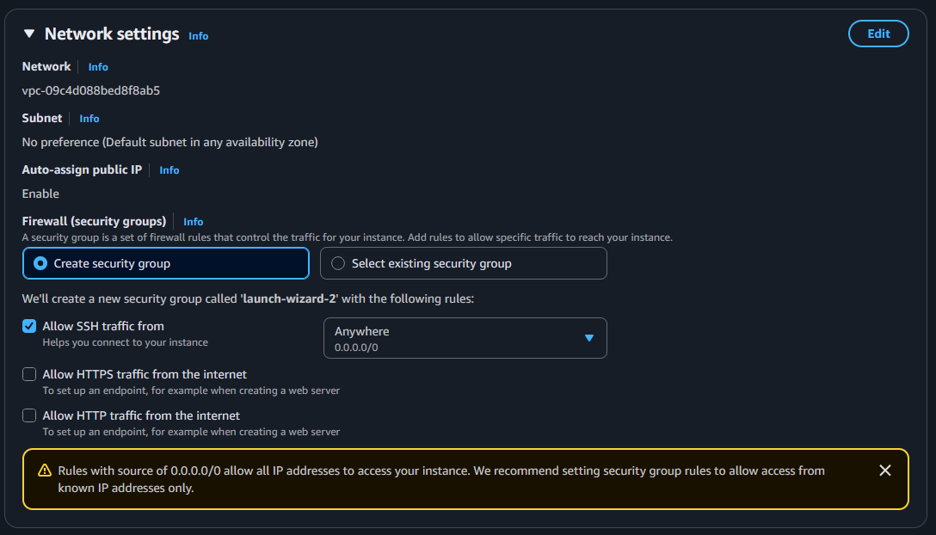
Getting set up on Amazon AWS
Step 4: Configure your network settings
This is to allow internet access
Your instance will be launched into your own virtual private cloud (VPC)
Notes:
VPC is kind of like your own “private space” within the AWS cloud system

Slide 14
Getting set up on Amazon AWS
Step 4: Configure your network settings
For this demo, select “Allow SSH traffic from Anywhere”
This will assign your instance a public IP address
Not secure – delete this instance after this demo!
Notes:
Your instance will be accessible from outside the Amazon network
Not secure, delete this instance after this demo

Slide 15
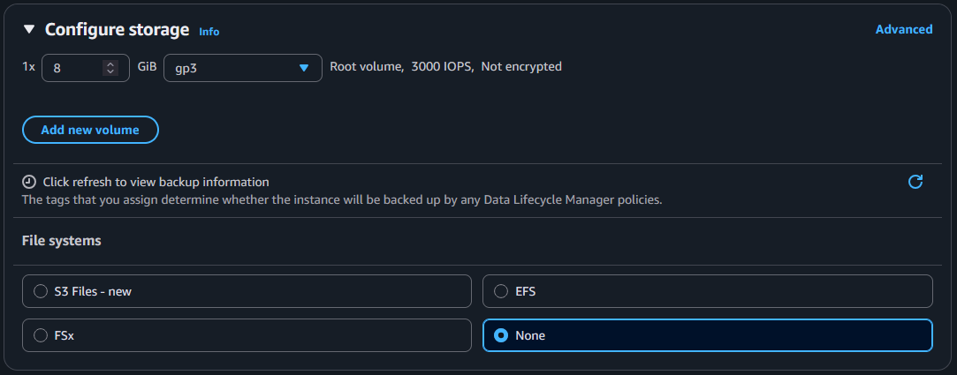
Getting set up on Amazon AWS
Step 5: Configure your storage settings
Amazon uses the EBS (Elastic Block Store) volume that acts like a flexible, virtual version of your physical hard drive
The root volume is a special EBS volume that stores your AMI
Default settings are sufficient for this demo
Notes:
AMI includes the operating system and software needed to boot your instance

Slide 16
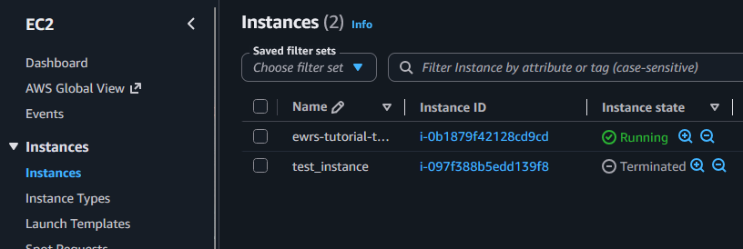
Getting set up on Amazon AWS
Step 6: Run and monitor your virtual instance
Your instance should be up and running
Click on the instance ID to monitor your instance
Notes:
AMI includes the operating system and software needed to boot your instance

Slide 17
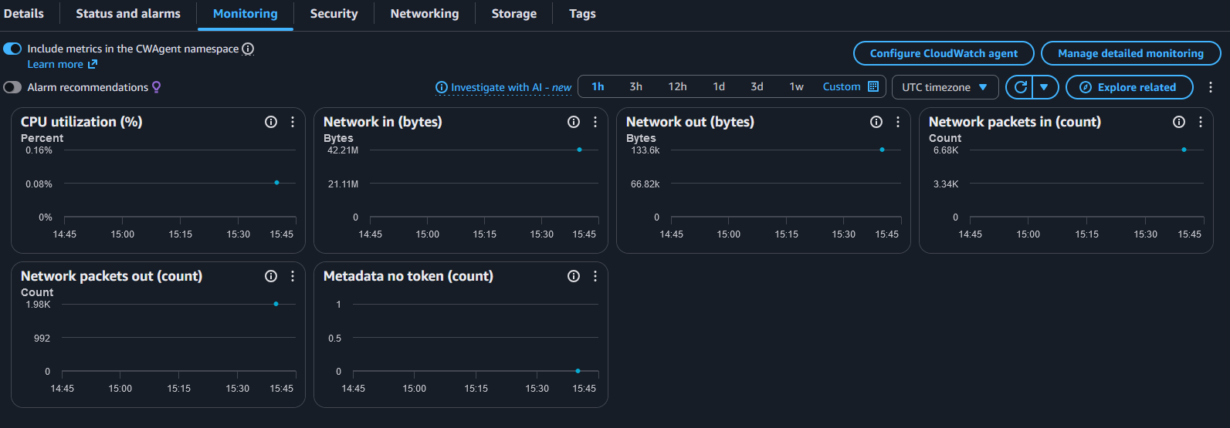
Getting set up on Amazon AWS
Step 6: Run and monitor your virtual instance
Your instance should be up and running
Click on the instance ID to monitor your instance
Access information such as instance state, CPU and memory usage, storage, failed runs
Notes:
AMI includes the operating system and software needed to boot your instance

Slide 18
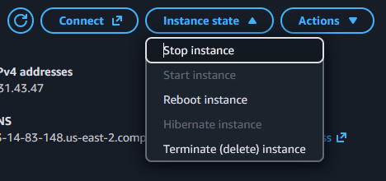
Getting set up on Amazon AWS
Step 6: Run and monitor your virtual instance
Your instance should be up and running
Click on the instance ID to monitor your instance
Access information such as instance state, CPU and memory usage, storage, failed runs
⚠️ Stop your instance once your job is done to avoid additional costs ⚠️
Notes:
AMI includes the operating system and software needed to boot your instance

Slide 19
Topics Covered
1
Getting set up on Amazon AWS Cloud
2
Connecting to your instance via VS Code
3
Demo: The Mandelbrot Set
4
HPC Resources
Notes:
Serial Borg does not have runtime metric capability (unless its PyBorg)

Slide 20
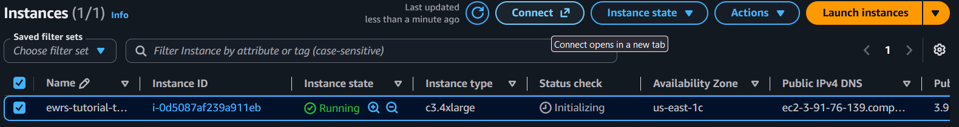
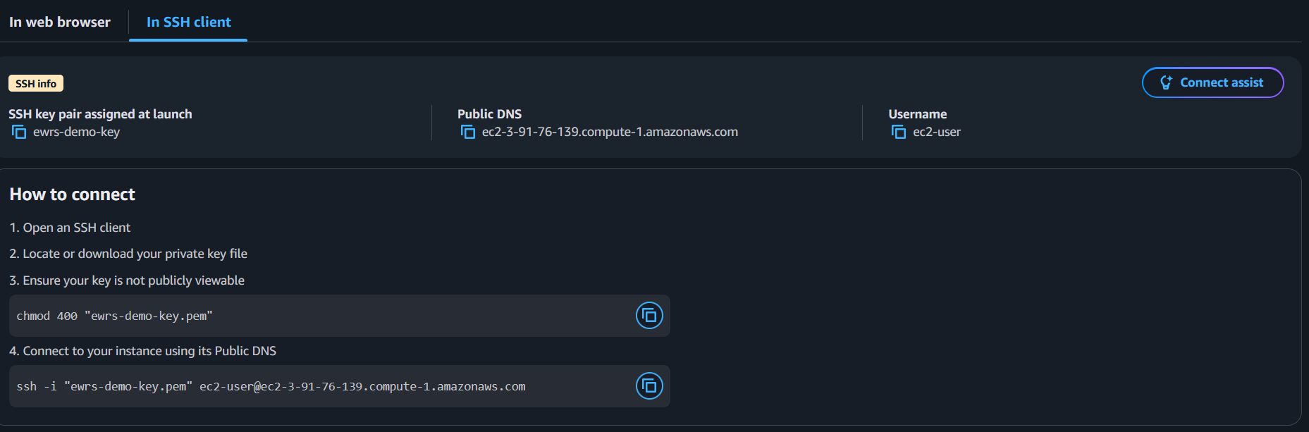
Connecting via VS Code
Step 1a: Connect to VS Code via SSH
Notes:
We select the t3.small (both t3.small and t3.micro are eligible for the free tier. Will need to upgrade to the paid account to unlock more options, but this is sufficient for our demo)
You can also “Get advice” if you would like to upgrade

Slide 21
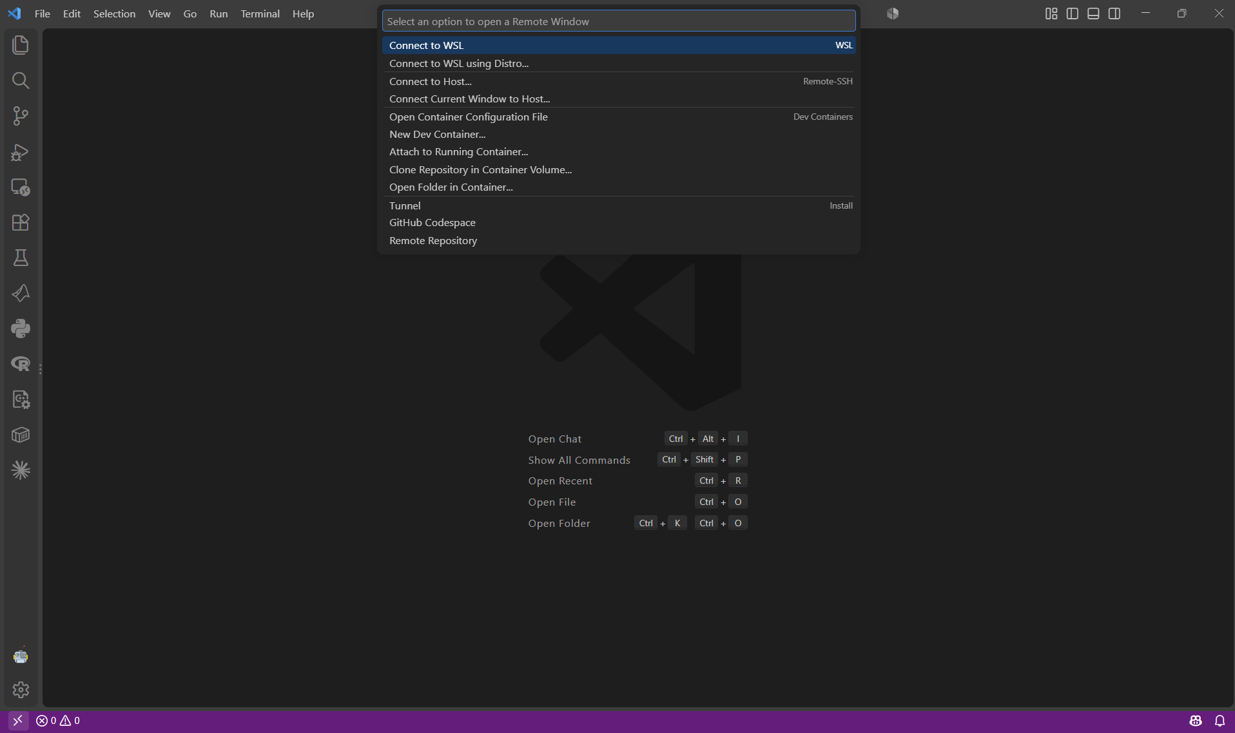
Connecting via VS Code
Step 1b: Open a Remote Window in VS Code
Notes:
We select the t3.small (both t3.small and t3.micro are eligible for the free tier. Will need to upgrade to the paid account to unlock more options, but this is sufficient for our demo)
You can also “Get advice” if you would like to upgrade

Slide 22
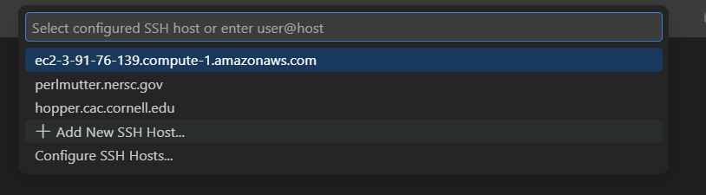

Connecting via VS Code
Step 1b: Open a Remote Window in VS Code
Copy and paste your AWS SSH key into the text box
Ensure that the correct location to your key is provided
Notes:
We select the t3.small (both t3.small and t3.micro are eligible for the free tier. Will need to upgrade to the paid account to unlock more options, but this is sufficient for our demo)
You can also “Get advice” if you would like to upgrade

Slide 23
Connecting via VS Code
Step 1b: Open a Remote Window in VS Code
Once the host has been configured, click on the new SSH host to launch
Select Linux as the operating system
Notes:
We select the t3.small (both t3.small and t3.micro are eligible for the free tier. Will need to upgrade to the paid account to unlock more options, but this is sufficient for our demo)
You can also “Get advice” if you would like to upgrade

Slide 24
Connecting via VS Code
Step 2: Configure Git on your AWS Instance and clone the repository
Update your system using
sudo dnf update –y
Install Git using
sudo dnf install git –y
Clone the repository using
git clone https://github.com/lbl59/ewrs-hpc-demo-fa26.git
Notes:
We select the t3.small (both t3.small and t3.micro are eligible for the free tier. Will need to upgrade to the paid account to unlock more options, but this is sufficient for our demo)
You can also “Get advice” if you would like to upgrade

Slide 25
Connecting via VS Code
Step 3: Configure Python and MPI
Install OpenMPI using
sudo dnf install openmpi-devel -y
Install Python using
sudo dnf install python3.12 -y
Enable pip using
sudo yum install python3-pip –y
Install Python using
sudo yum install python3-pip -y
Notes:
We select the t3.small (both t3.small and t3.micro are eligible for the free tier. Will need to upgrade to the paid account to unlock more options, but this is sufficient for our demo)
You can also “Get advice” if you would like to upgrade

Slide 26
Topics Covered
1
Getting set up on Amazon AWS Cloud
2
Connecting to your instance via VS Code
3
Demo: The Mandelbrot Set
4
HPC Resources
Notes:
Serial Borg does not have runtime metric capability (unless its PyBorg)

Slide 27
A Quick Demo

Slide 28

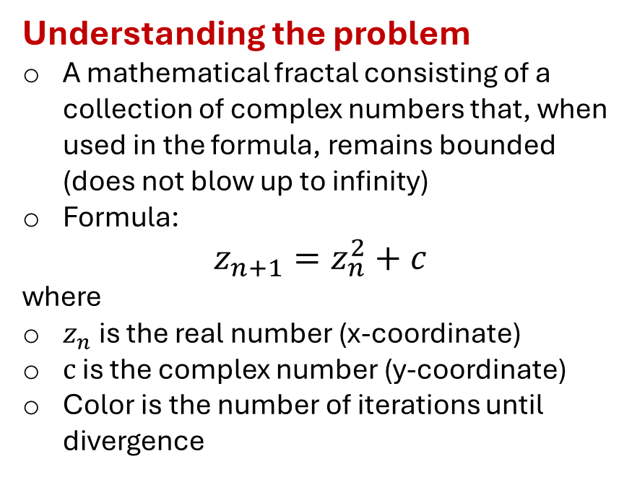
The Mandelbrot Set
Understanding the problem
A mathematical fractal consisting of a collection of complex numbers that, when used in the formula, remains bounded (does not blow up to infinity)
Formula:
$$z_{n+1}=z_{n}^{2}+c$$
where
$z_{n}$ is the real number (x-coordinate)
$c$ is the complex number (y-coordinate)
Color is the number of iterations until divergence
Notes:
We select the t3.small (both t3.small and t3.micro are eligible for the free tier. Will need to upgrade to the paid account to unlock more options, but this is sufficient for our demo)
You can also “Get advice” if you would like to upgrade

Slide 29
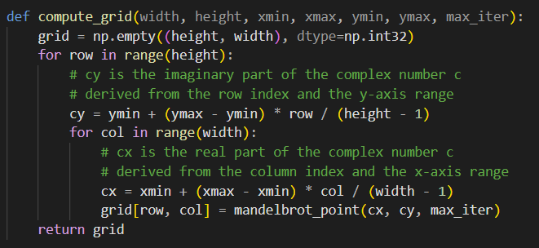
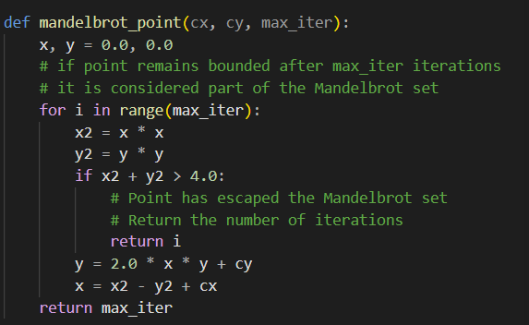
The Mandelbrot Set: AWS Example
Serial implementation
Determine if a pixel lies in the Mandelbrot set
Each pixel is independent of each other
This is therefore an embarrassingly parallelizable script
Notes:
We select the t3.small (both t3.small and t3.micro are eligible for the free tier. Will need to upgrade to the paid account to unlock more options, but this is sufficient for our demo)
You can also “Get advice” if you would like to upgrade

Slide 30
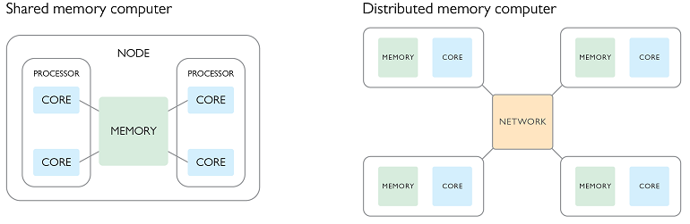
The Mandelbrot Set: AWS Example
Parallel implementation on AWS
Distribute “chunks” of the output image based on number of CPUs available (16)
Effectively a single-node, 16 core configuration
Notes:
We select the t3.small (both t3.small and t3.micro are eligible for the free tier. Will need to upgrade to the paid account to unlock more options, but this is sufficient for our demo)
You can also “Get advice” if you would like to upgrade

Slide 31
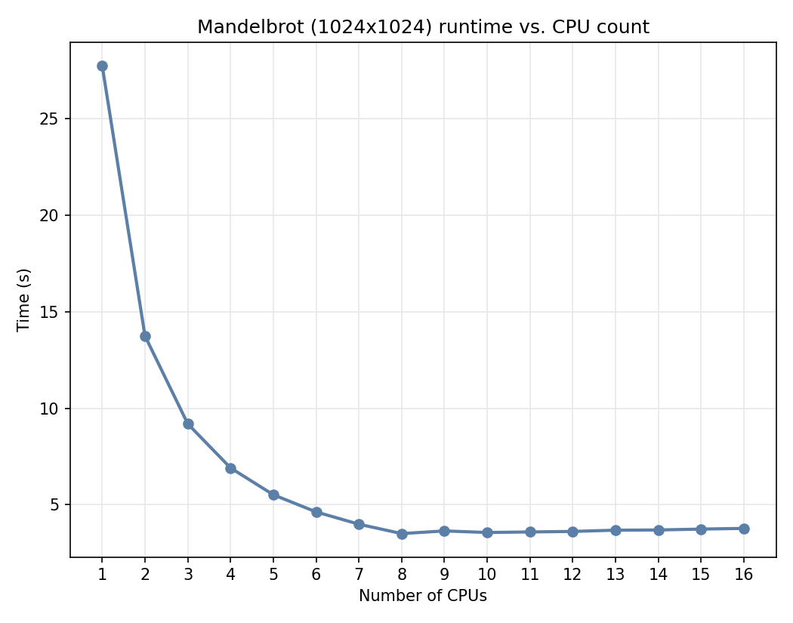
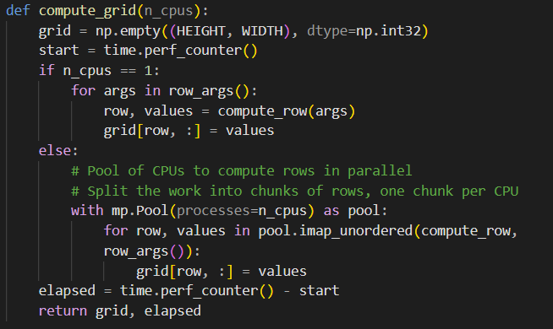
The Mandelbrot Set: AWS Example
Parallel implementation on AWS
Distribute “chunks” of the output image based on number of CPUs available (16)
Parallel work done here

Slide 32
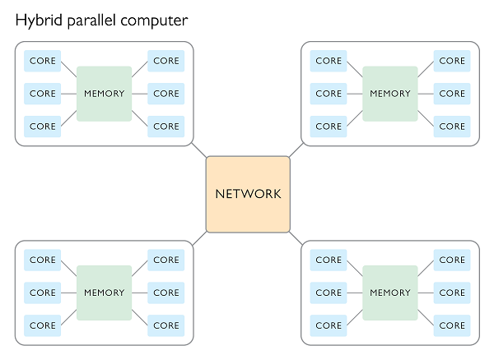
The Mandelbrot Set: Hopper Example
Parallel implementation on Hopper
26 compute nodes
  22 Intel Xeon Gold 5218R CPUs 2x20 core
  4 AMD EPYC 9454 2x48 core
Larger system than the AWS Instance
Hybrid distributed memory cluster with shared memory inside each individual node

Slide 33
The Mandelbrot Set: Hopper Example
What we will do:
Run the serial version of a scaled-up Mandelbrot plotting problem on Hopper
Run the parallel version across 1,2, and 4 nodes
Measure the following metrics:
  Parallel speedup
  Efficiency
  Memory usage
  Job/communication overhead

Slide 34
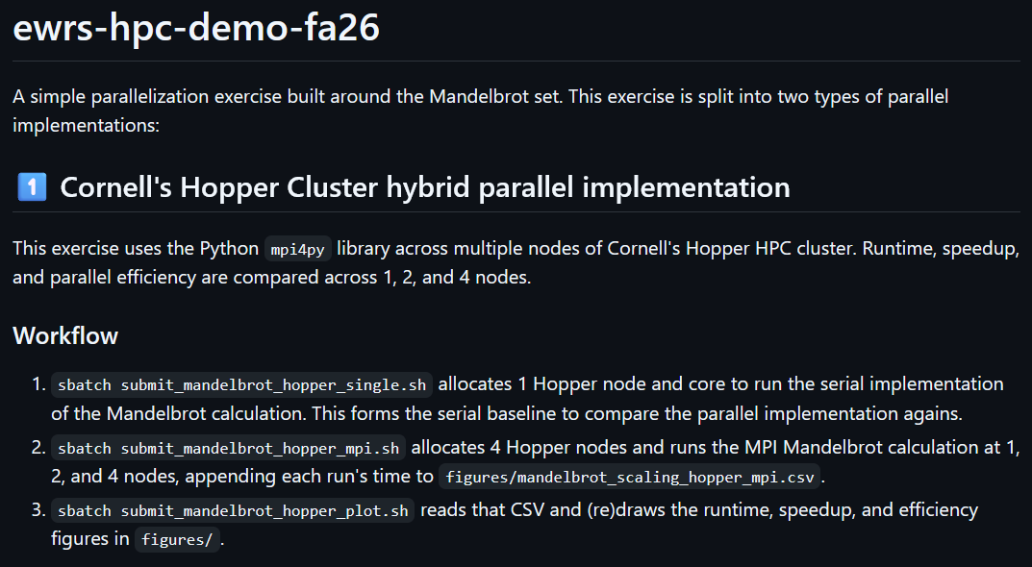

The Mandelbrot Set: Hopper Example
Clone the code repo onto Hopper
git clone https://github.com/lbl59/ewrs-hpc-demo-fa26.git
👇Scan for the Repo!

Slide 35
The Mandelbrot Set: Hopper Example
The serial implementation
Code scripts
Run sbatch ./ submit_mandelbrot_hopper_serial.sh
  mandelbrot_scaling_hopper_serial.py
Notes:
Parallel efficiency: typically <1 due to communication overhead, synchronization delays, etc
Memory efficiency: closer to one -> better (add more nodes and more work without adding more memory)

Slide 36
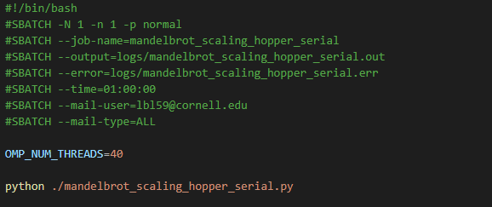
The Mandelbrot Set: Hopper Example
The serial implementation: A note on OMP_NUM_THREADS
Indicates the number of jobs you would like one core/task to launch
Good practice is to limit it to the max number of physical core you have

Slide 37
The Mandelbrot Set: Hopper Example
The parallel implementation:
Code scripts:
Run sbatch ./submit_mandelbrot_hopper_mpi.sh
  mandelbrot_scaling_hopper_mpi.py
  parallel_scaling_functions.py
Run sbatch ./submit_mandelbrot_hopper_plot.sh

Slide 38
The Mandelbrot Set: Hopper Example
The parallel implementation:
Measure the following metrics
Parallel speedup: How much less time you spend performing a task when you increase number of cores?
Efficiency: Does my speedup scale linearly when I increase the number of processors?
Memory usage efficiency: How much memory is being copied across all the nodes?
Job/communication overhead: How much time you spend performing actual computation vs communication between tasks and nodes

Slide 39
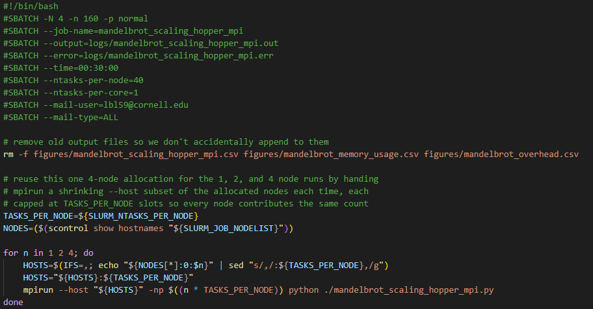
The Mandelbrot Set: Hopper Example
The parallel implementation:

Slide 40
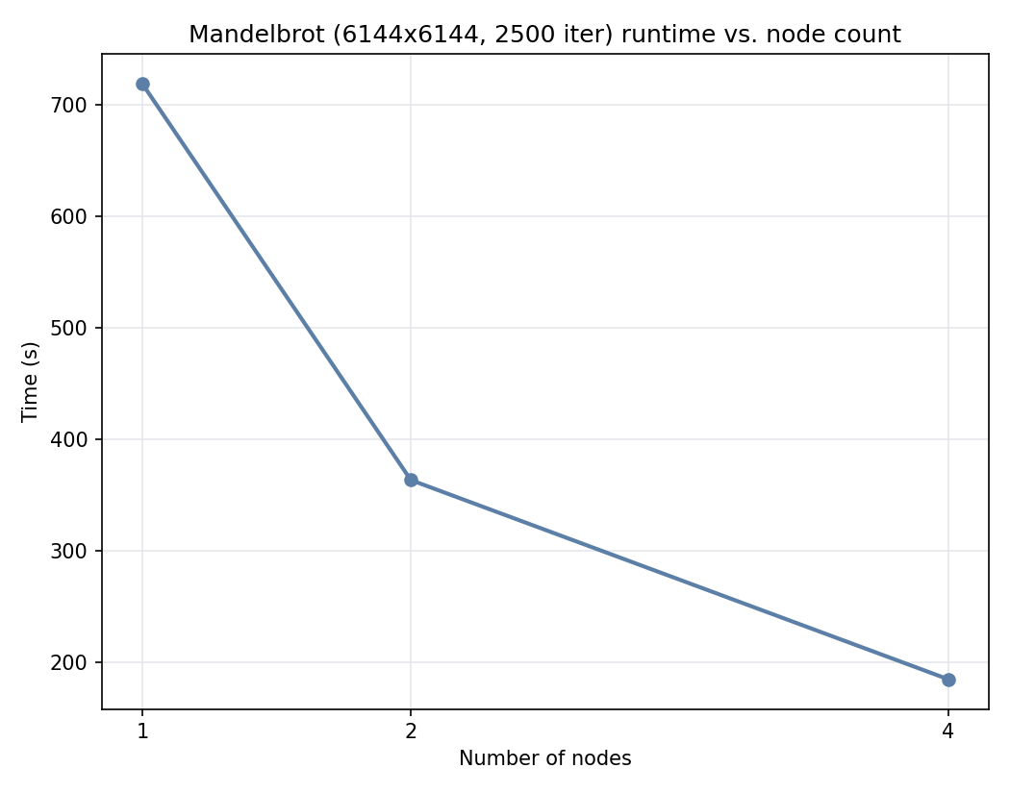
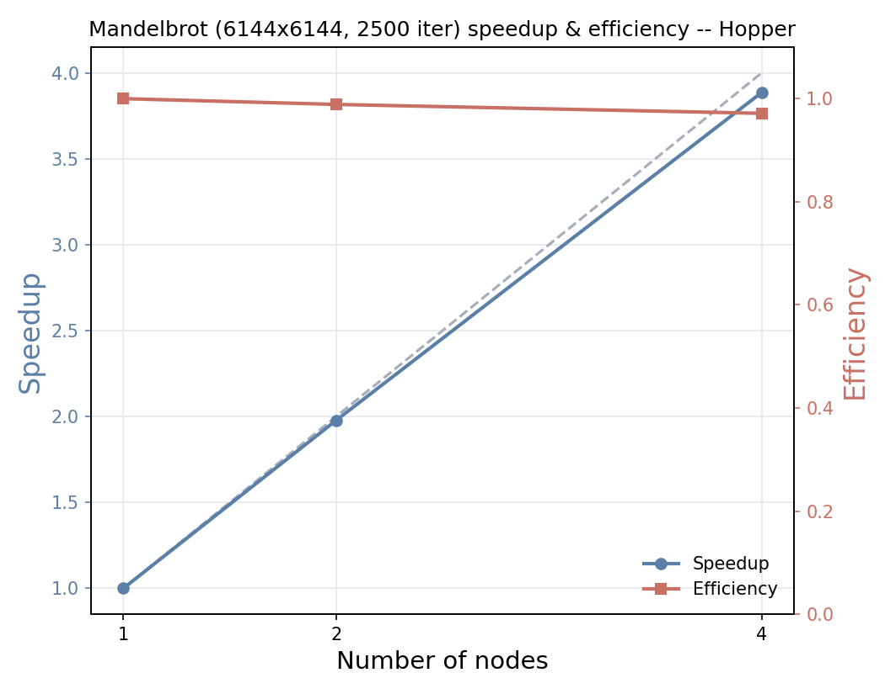

The Mandelbrot Set: Hopper Example
Constant efficiency $=$ Good!
Metrics output
Raw scaling
Parallel speedup and efficiency

Slide 41
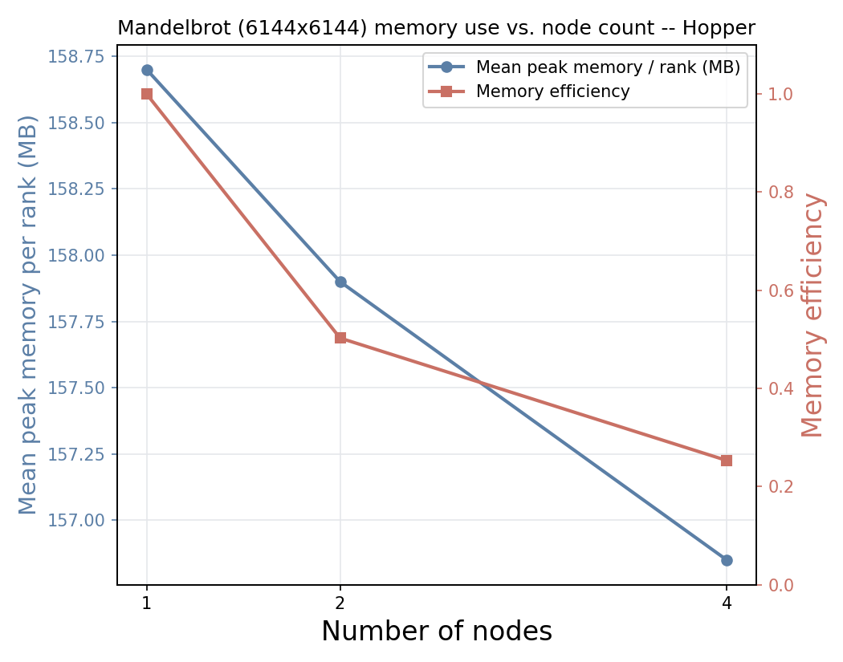
The Mandelbrot Set: Hopper Example
Metrics output
Memory use
Decreasing memory efficiency:
Not good!
Data is being duplicated across nodes/processors
Could be improved by parallelizing across the grid of pixels

Slide 42
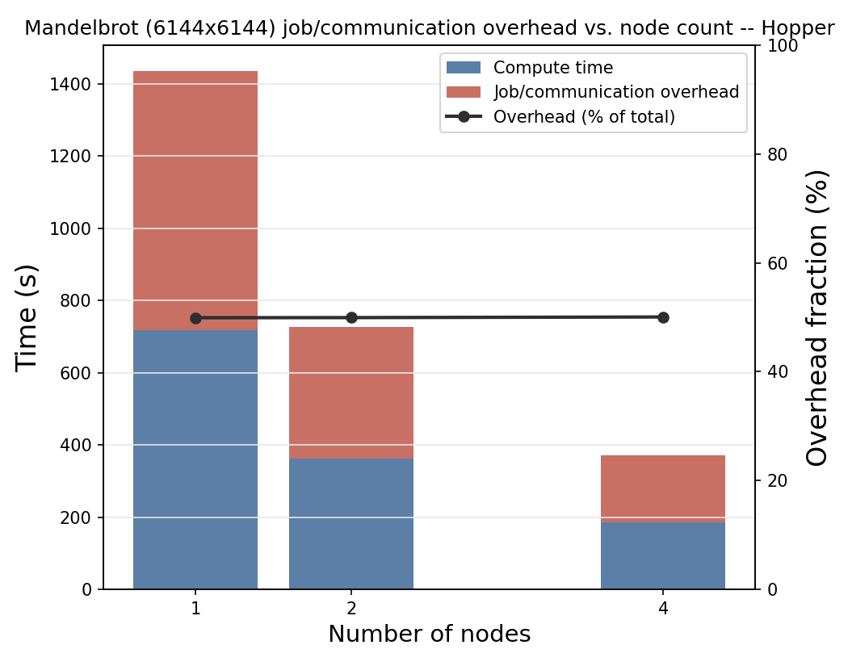
The Mandelbrot Set: Hopper Example
Metrics output
Memory use
Job/communication time

Slide 43
The Mandelbrot Set: Hopper Example
Metrics output
Memory use
Job/communication time
Constant job/communication fraction
Good!
The amount of work done vs time spend coordinating jobs across nodes is approximately constant as you increase your nodes
A sign that work is being distributed efficiently

Slide 44
Topics Covered
1
Getting set up on Amazon AWS Cloud
2
Connecting to your instance via VS Code
3
Demo: The Mandelbrot Set
4
HPC Resources
Notes:
Serial Borg does not have runtime metric capability (unless its PyBorg)

Slide 45




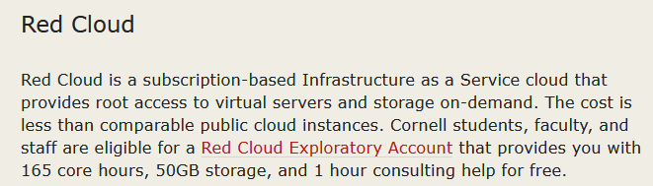

HPC Resources
Notes:
We select the t3.small (both t3.small and t3.micro are eligible for the free tier. Will need to upgrade to the paid account to unlock more options, but this is sufficient for our demo)
You can also “Get advice” if you would like to upgrade

Slide 46
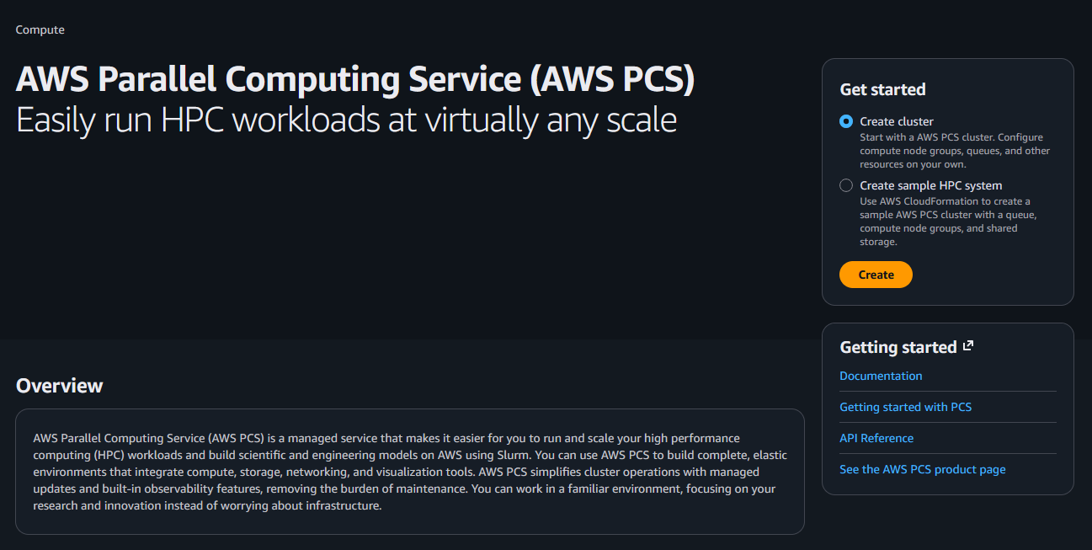
HPC Resources
Create your own Cluster on AWS
Notes:
We select the t3.small (both t3.small and t3.micro are eligible for the free tier. Will need to upgrade to the paid account to unlock more options, but this is sufficient for our demo)
You can also “Get advice” if you would like to upgrade

