Slide 1



Introduction to High-Performance Computing for Research Applications
EWRS Seminar
September 24th 2026
Trevor Amestoy | Lillian Lau

Slide 2
Outline
What is a High-Performance Computer?
HPC architecture & terminology
SLURM basics
Command line & Bash basics
Parallelization
Hopper HPC
  Overview
Etiquette & group coordination discussion

Slide 3

What is a High-Performance Computer (HPC)?
A high-performance computer (HPC) is a large cluster of compute nodes and CPUs designed to support large computational tasks.
Users can access an HPC remotely and often have a limited computational budget.
NSF-funded Frontera HPC at UTAustin.
Credit: Texas Advanced Computing Center
You may be able to gain access to an HPC through academic collaborations, research grants, or individual funding.

Slide 4
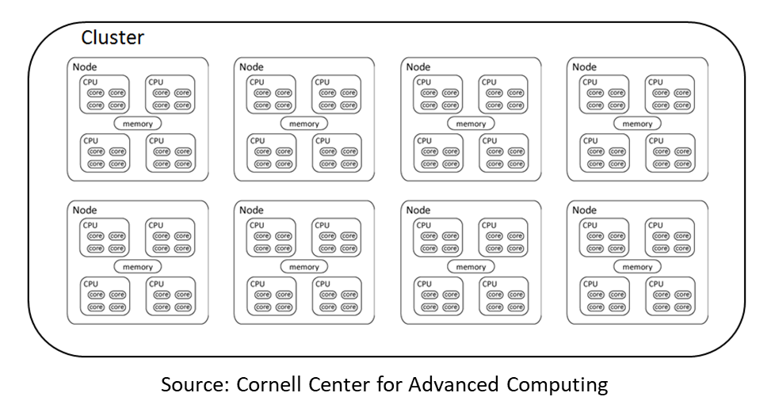
Anatomy of an HPC resource
Cluster: a group of computing nodes
Node: a discrete unit of a computer system that typically runs its own instance of an operating system. Modern nodes have multiple chips (CPUs) which may each contain multiple cores.
Core: a computing unit capable of processing a separate stream of instructions

Slide 5
SLURM
SLURM: Simple Linux Utility for Resource Management
What it is: A job scheduler which handles resource (node, core) allocation.
Node A:
Someone’s job
SLURM
Node B:
Empty
Node C:
Your job

Slide 6
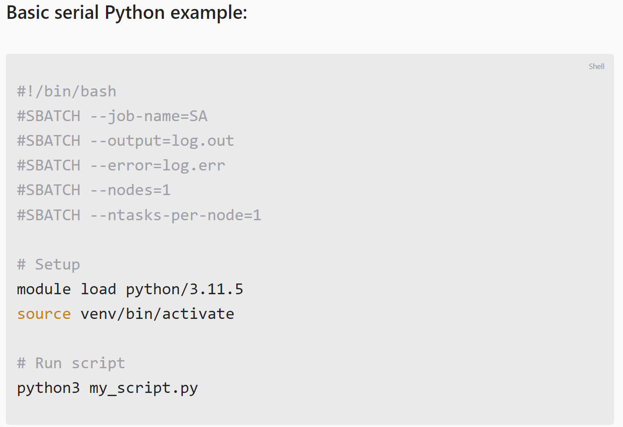
SLURM
SLURM: Simple Linux Utility for Resource Management
How does it work?
Example SLURM job file: my_job.sh
Specify SLURM settings
Include all your command line instructions
Submit the script using submit my_job.sh
SLURM directives
Load modules and environment
Run script

Slide 7
SLURM
SLURM: Simple Linux Utility for Resource Management
Essential commands:
Command | What does it do? | Example
sbatch | Submit a job | sbatch my_job.sh
squeue | View the queue status | squeue
scancel | cancel jobs | scancel -u tja73 scancel 12345
sinfo | View the cluster allocation | sinfo

Slide 8


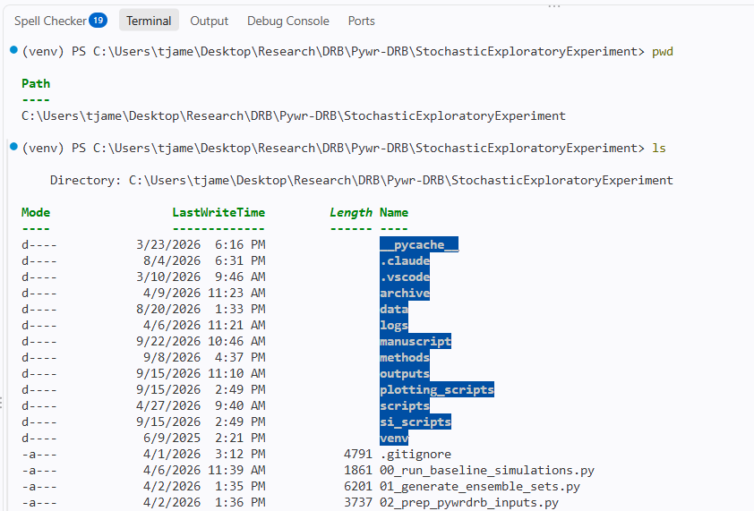
Command line & bash basics
Basic Bash skills are necessary to interact with the HPC

Slide 9
Command line & bash basics
A full Bash training is beyond the scope of this seminar, but in my experience you only need a handful of commands:
Command | What does it do? | Example
cd | Change current directory | cd ../new_folder/path/
ls | List the contents of a directory | ls
mkdir | Make a new directory | mkdir new_folder_name
cp | Copy a file | cp ./FileA ./FileA_copy

Slide 10
Parallelization
Why take the time to parallelize code?
Make your code run faster!
What are some other reasons?

Slide 11
Parallelization
Why take the time to parallelize code?
Make your code run faster!
Open new research opportunities due to your availability handle larger scale and more computationally intensive problems.
  (Don’t let your compute resource define your research potential)
Save money & resources when using a limited HPC allocation budget

Slide 12
Parallelization
Running on p processors ≠ speedup of p
Different algorithms will parallelize differently
Parallel efficiency can be difficult to achieve due to:
–Overhead costs: communication, synchronization, memory traffic
–Intrinsically serial work
–Idle time
–Contention for resources

Slide 13
Parallelization
How does a parallel code perform?
Speedup = (Serial Time) / (Parallel Time)
Example:
Serial time = 10 hr
Parallel time = 1 hr on 100 processors
Speedup = 10x

Slide 14
Parallelization
How does a parallel code perform?
Speedup = (Serial Time) / (Parallel Time)
Efficiency = Speedup / (# processors)
Example:
Serial time = 10 hr
Parallel time = 1 hr on 100 processors
Speedup = 10x
Efficiency = 10 / 100 = 0.1

Slide 15
Parallelization
How does a parallel code perform?
Speedup = (Serial Time) / (Parallel Time)
Efficiency = Speedup / (# processors)
Example:
Serial time = 10 hr
Parallel time = 1 hr on 100 processors
Speedup = 10x
Efficiency = 10 / 100 = 0.1
Example:
Serial time = 10 hr
Parallel time = 1 hr on 2 processors
Speedup = 10x
Efficiency = 10 / 2 = 5

Slide 16
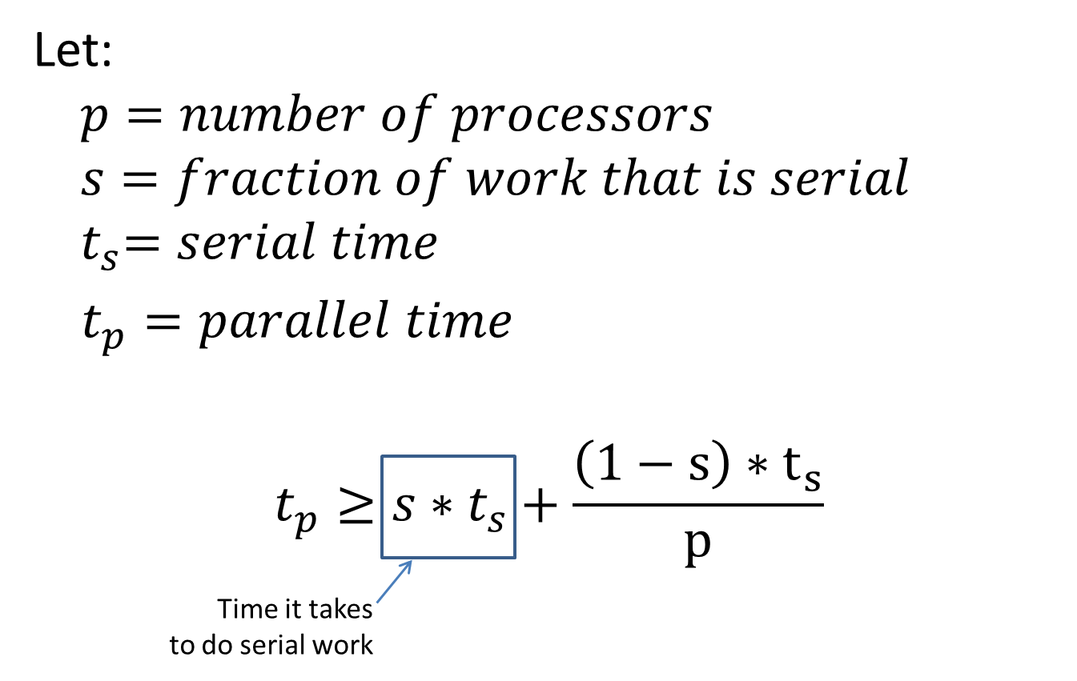
Parallelization
TEXT

Slide 17
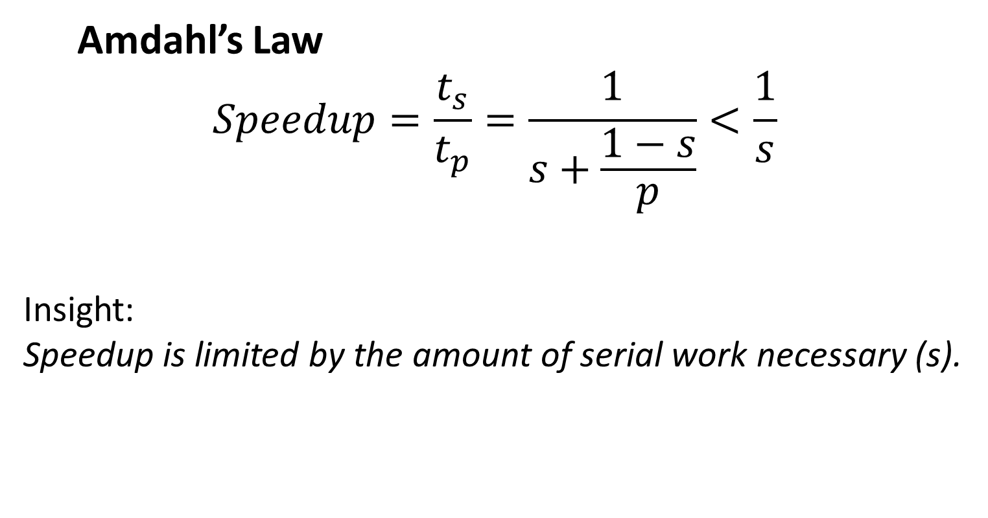
Parallelization
TEXT

Slide 18
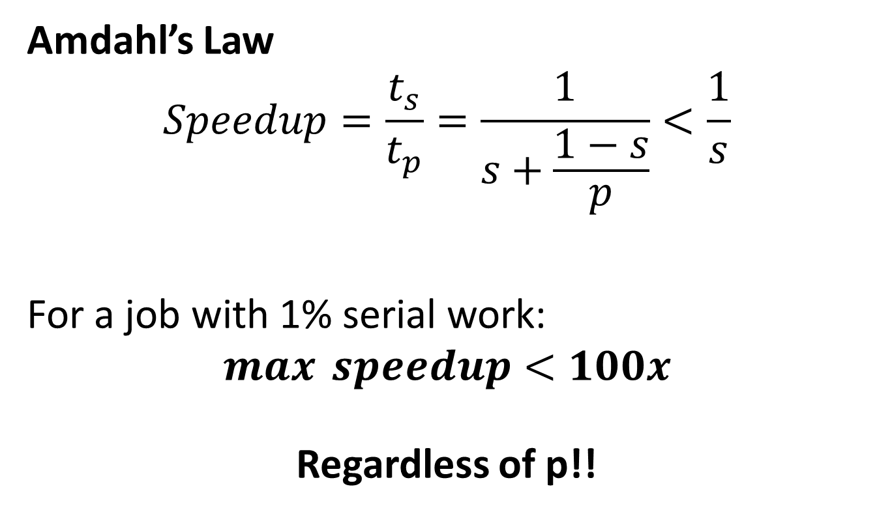
Parallelization
TEXT

Slide 19
Parallelization
Some applications require little coordination and are termed “pleasingly parallel” (also called “embarrassingly parallel”)
– Monte Carlo evaluations
– Big data computations with many independent mappings
This will be the focus for our demonstrations.

Slide 20
Parallelization: Message Parsing Interface (MPI)
MPI: Message Parsing Interface
Terminology
Communicator: Central communicator used to coordinate across ranks
Rank: Unique ID for each process (0 to n-1)
Size: Total number of processes

Slide 21
Parallelization: Message Parsing Interface (MPI)
MPI Communicator
Rank = 0
Rank = 2
Rank = 1
my_script.py
rank =0
my_script.py
rank =3
my_script.py
rank =2

Slide 22
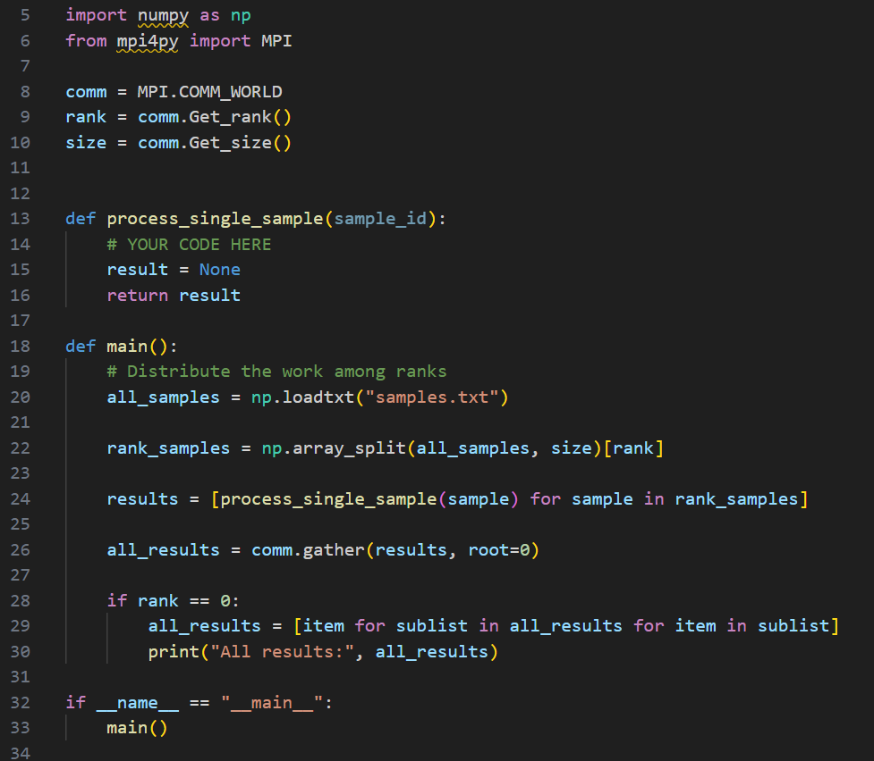
Parallelization: Message Parsing Interface (MPI)
Get the rank ID number and other MPI communication features
This function processes a single sample/realization individually.

Slide 23
Parallelization: Message Parsing Interface (MPI)
This function is the most important, and will run on each rank individually.
rank_samples will be unique based on the rank ID number.
Runs the process() function for rank-specific samples.

Slide 24
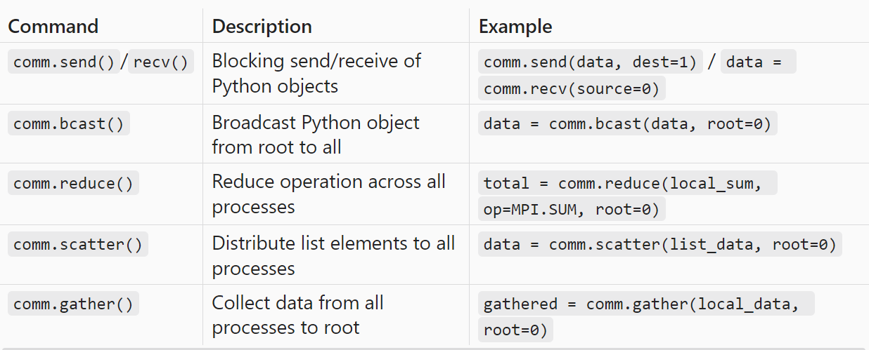
Parallelization: Message Parsing Interface (MPI)

Slide 25
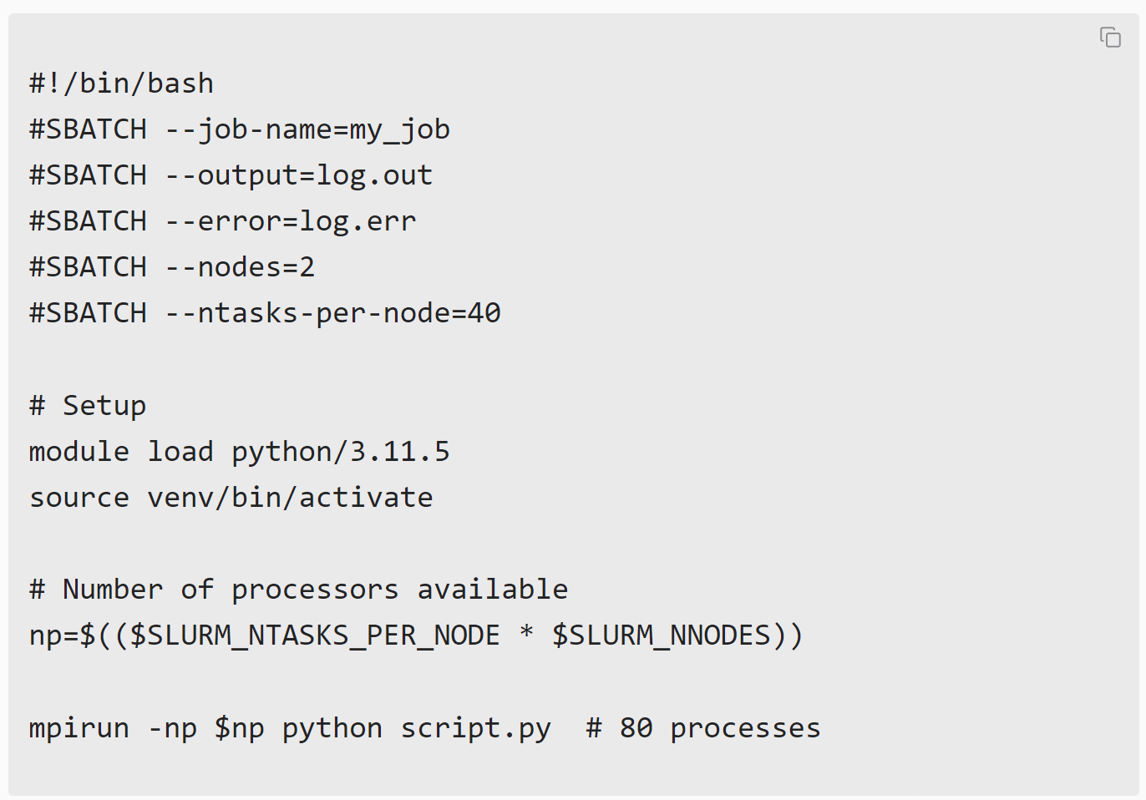
Parallelization: Message Parsing Interface (MPI)
Red = things that changed relative to the serial version

Slide 26
Summary of tips for parallelization
Plan ahead for parallelization by modularizing your code early.
Minimize the amount of serial work necessary.
Identify bottlenecks/slow-points in your code and prioritize improvements of those elements.
Set the time limit #SBATCH –time to prevent your job from running endlessly

Slide 27
Things to avoid when running on HPC
0. Don’t run computation on the head/root node!
The head node is shared by everyone on the cluster.
Editing files, moving data, and submitting jobs there is fine.
Anything that actually does compute belongs in a bash script and should be submitted using SLURM.
If you cause a crash/error on the head node then it could compromise everyone’s work.
CAC states the consequence plainly: “Users should not run codes on the head node. Users who do so will be notified and have privileges revoked.”

Slide 28
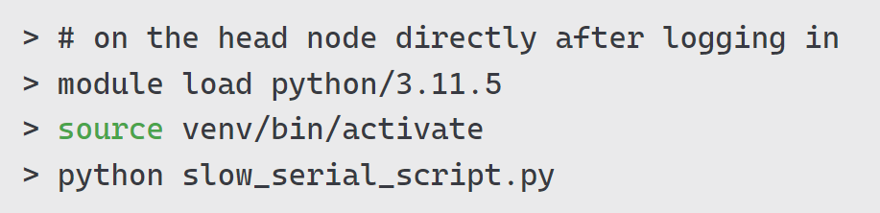
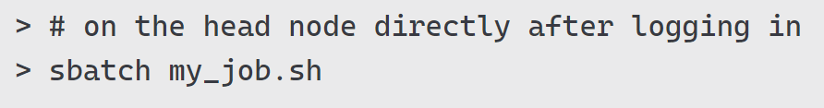
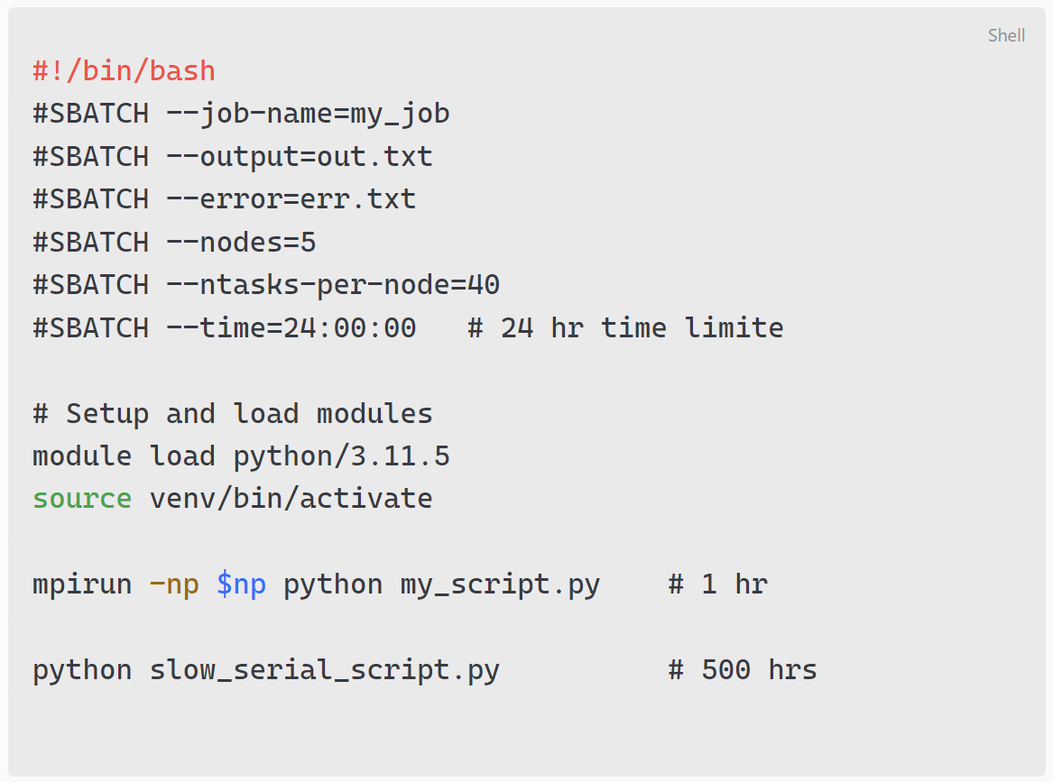
Things to avoid when running on HPC
0. Don’t run computation on the head/root node!
The wrong way
The right way
Uses SLURM
Doesn’t use SLURM
my_job.sh (separate file)

Slide 29
Things to avoid when running on HPC
When running on a large number of nodes, avoid combining fast parallel code with slow serial code in a single job.
Fast
Slow

Slide 30
Things to avoid when running on HPC
When running on a large number of nodes, avoid combining fast parallel code with slow serial code in a single job.
Avoid the #SBATCH --exclusive flag if not necessary

Slide 31
Things to avoid when running on HPC
When running on a large number of nodes, avoid combining fast parallel code with slow serial code in a single job.
Avoid the #SBATCH --exclusive flag if not necessary
Set a time limit incase your job gets stuck

Slide 32

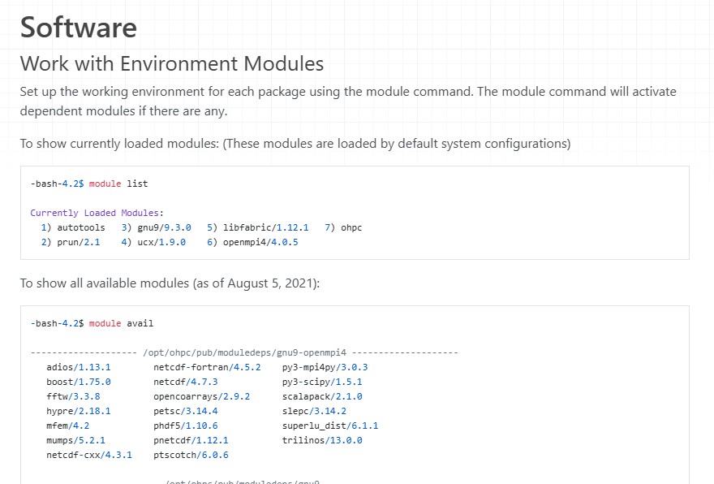
Hopper HPC
        Overview of the Hopper HPC
        26 compute nodes
        22 x 40-core Intel CPUs
        4 x 96-core AMD CPUs
        Contact Prof. Vivek Srikrishnan for access to Hopper.
        See the CAC Tech Docs for help with specific package versions or other guidance.
Source: Cornell Center for Advanced Computing (CAC)

Slide 33
Hopper HPC Ettiquette
(This is Trevor’s general understanding of etiquette, open to group discussion on this.)
Coordinate and communicate when running on more than 8+ nodes
      (New group slack? Shared spreadsheet? Should improve this standard…)
Don’t use more than 10 nodes at any given time.
Be considerate with usage during busy periods of the year.
Avoid use of the –exclusive flag if not necessary
If your job gets stuck/hung and cannot be canceled, contact CAC for help.

Slide 34
        ?
Any questions?
Transition to workshop demo…

