Slide 1
Reed Group MORDM Training II Risk of Failure
Lillian Lau

Slide 2
Recap: Synthetic streamflow generation
Previously…
Obtain a historical timeseries
Generate and validate multiple synthetic (stationary and non-stationary) timeseries using the Kirsch-Nowak method
What next?
How to use the synthetic timeseries? What is the purpose of this step?
What is the value of generating both a stationary and nonstationary timeseries?
Risk-of-failure (ROF) triggers
Uses these synthetic timeseries to determine a utility’s risk of failure for each week in a realization
Notes:
ROFs allow you to use the synthetic timeseries to their fullest potential

Slide 3

Overview
1
Relevant literature
2
Background
3
The ROF $α$ and ROF evaluation
4
Generating ROF tables
5
Reed Group resources

Slide 4
Relevant literature
Reducing the costs of meeting regional water demand through risk-based transfer agreements
(Palmer & Characklis, 2009)
Introduction of risk-of-failure (ROF) as a concept derived from risk options analysis (ROA)
Comparing ROF against traditional risk management approaches in terms of financial impacts
Impact of Contract Structure and Risk Aversion on Interutility Water Transfer Agreements
(Caldwell & Characklis, 2014)
Using ROFs alongside financial instruments to trigger short-term operations actions
Comparing the financial implication of different degrees of ROF tolerance
Cooperative drought adaptation: Integrating infrastructure development, conservation, and water transfers into adaptive policy pathways (Zeff et al, 2016)
Applying ROFs in triggering short- and long-term triggers
Identifying how short-term actions can delay expensive infrastructure projects
Direct policy search for robust multi-objective management of deeply uncertain socio-ecological tipping points (Quinn et al, 2017)
Compares the implications of the direct policy search (DPS) closed-loop control method against open-loop control
Closed-loop control is approximated by the ROF nature of accounting for feedback of the past in the present
Deeply uncertain pathways: Integrated multi-city regional water supply infrastructure investment and portfolio management (Trindade et al, 2019)
Applying long- and short-term ROF triggers in systems facing deep uncertainty
Application of synthetic records and non-stationarity
Notes:
Read to help better understand why we use ROFs instead of any other risk management method

Slide 5
Some clarification
Simulation
A hydrologic time series
Can be synthetic (stationary/non-stationary) or historical
Describes the state of the world
State of the world (SOW)
The “smallest particle”
A fully defined realization of a world that consists of:
A set of DU variables
Hydrologic simulations
Evaluation
A complete sampling of multiple SOWs
An evaluation can be:
Sampling all SOW realizations
Sampling a subset of SOW realizations
Simulation
State of the world
Evaluation
Notes:
We are going to be using some terms that might imply similar things
Here are the definitions of each term which will we be using in this context

Slide 6
Background
Origins of ROFs
Adapted from the concept of risk options analysis (ROA) in economics
Uses flexible, rule-based logic
Emphasizes near-term information to inform decisions about infrastructure planning and policy implementation
Caveats of ROA:
Unable to account for multiple stakeholders
Susceptible to the curse of dimensionality
ROFs address the issues faced by ROA:
Flexible state-aware rules overcome the curse of dimensionality
Can account for more than one stakeholder

Slide 7
Background
What is the ROF metric?
Overall, it is a probabilistic decision rule that:
Reflects time dynamics and uncertainties inherent in human-natural systems
State-aware and dependent on system characteristics (eg: demand, storage levels)
Provides tailored alternatives by:
Building rules off historical data to find triggers that are robust to future conditions
Identifying how short-term decision affect long-term planning

Slide 8
Background
Why use the ROF metric?
Reflects a water utility’s cyclical storage-to-demand dynamics
ROFs are probabilistically determined by evaluating the input (synthetic) timeseries
Past inputs affect present outputs
Enables the emulation of a closed-loop feedback system in real time
Evaluate system inputs for current timestep
Evaluate ROFs for current timestep
Take next action based on ROFs
Obtain new information about system
New information becomes new system inputs

Slide 9
Background
Why use the ROF metric? (continued)
Yields a time-continuous assessment of:
When the risks need to be addressed
How to address the risk
Allows for system planning adaptability across different time-scales
Allows for operational simplicity
Stakeholders only need to determine their threshold of risk tolerance

Slide 10
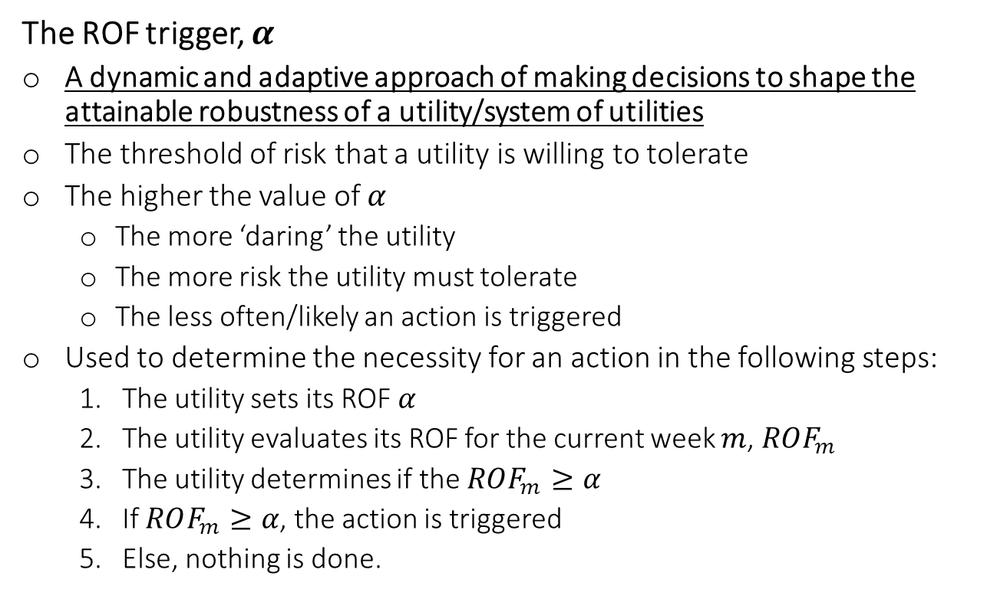

The ROF $α$
The ROF trigger, $α$
A dynamic and adaptive approach of making decisions to shape the attainable robustness of a utility/system of utilities
The threshold of risk that a utility is willing to tolerate
The higher the value of $α$
The more ‘daring’ the utility
The more risk the utility must tolerate
The less often/likely an action is triggered
Used to determine the necessity for an action in the following steps:
The utility sets its ROF $α$
The utility evaluates its ROF for the current week $m$, $ROF_{m}$
The utility determines if the $ROF_{m}≥α$
If $ROF_{m}≥α$, the action is triggered
Else, nothing is done.

Slide 11



Evaluating $ROF_{m}$
A simple analogy
You begin on a path 52 steps from its beginning, where each step represents a weekly demand $d_{j}$ where the week $j∈[1, 52]$
You also have a crystal ball which lets you peer into $n$-multiple different versions of past inflows and evaporation rates
 |  |  |  |  | X
You are here
52 ‘steps’ from the beginning of the path
Notes:
52 week = 1 year
This is where your synthetic timeseries plays its role!

Slide 12
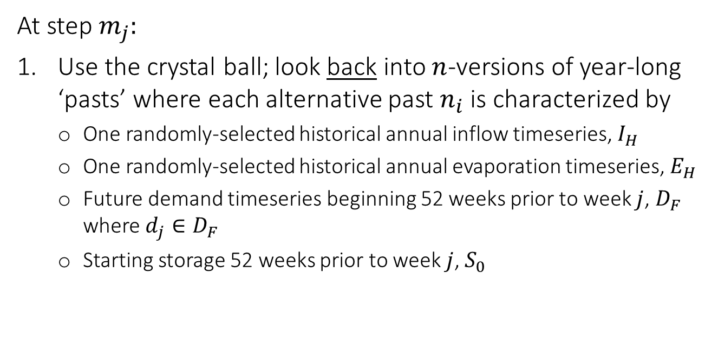
Evaluating $ROF_{m}$
 |  |  |  |  | X
At step $m_{j}:$
Use the crystal ball; look back into $n$-versions of year-long ‘pasts’ where each alternative past $n_{i}$ is characterized by
One randomly-selected historical annual inflow timeseries, $I_{H}$
One randomly-selected historical annual evaporation timeseries, $E_{H}$
Future demand timeseries beginning 52 weeks prior to week $j$, $D_{F}$ where $d_{j}∈D_{F}$
Starting storage 52 weeks prior to week $j$, $S_{0}$
Notes:
Note: storage is a function of demand, inflow and evaporation and is therefore dynamic

Slide 13
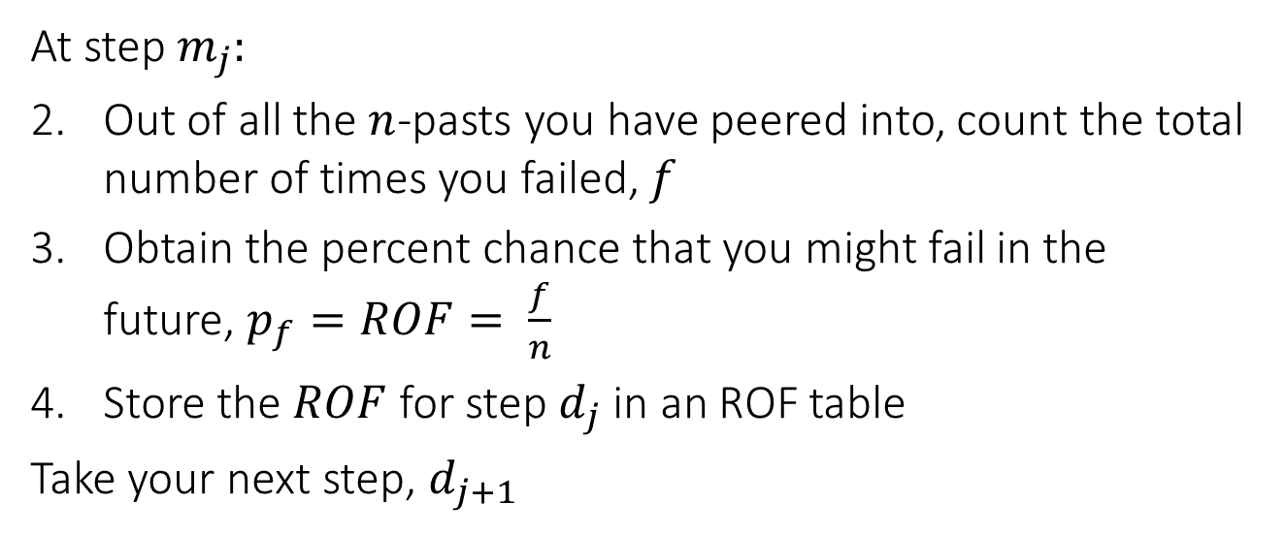
Evaluating $ROF_{m}$
 |  |  |  |  | X
At step $m_{j}:$
Out of all the $n$-pasts you have peered into, count the total number of times you failed, $f$
Obtain the percent chance that you might fail in the future, $p_{f}=ROF= \frac{f}{n}$
Store the $ROF$ for step $d_{j}$ in an ROF table
Take your next step, $d_{j+1}$
 |  |  |  |  |  | X
Shift the 52 steps 1 forward
Notes:
The metric for failure will vary and depend on stakeholder elicitation

Slide 14
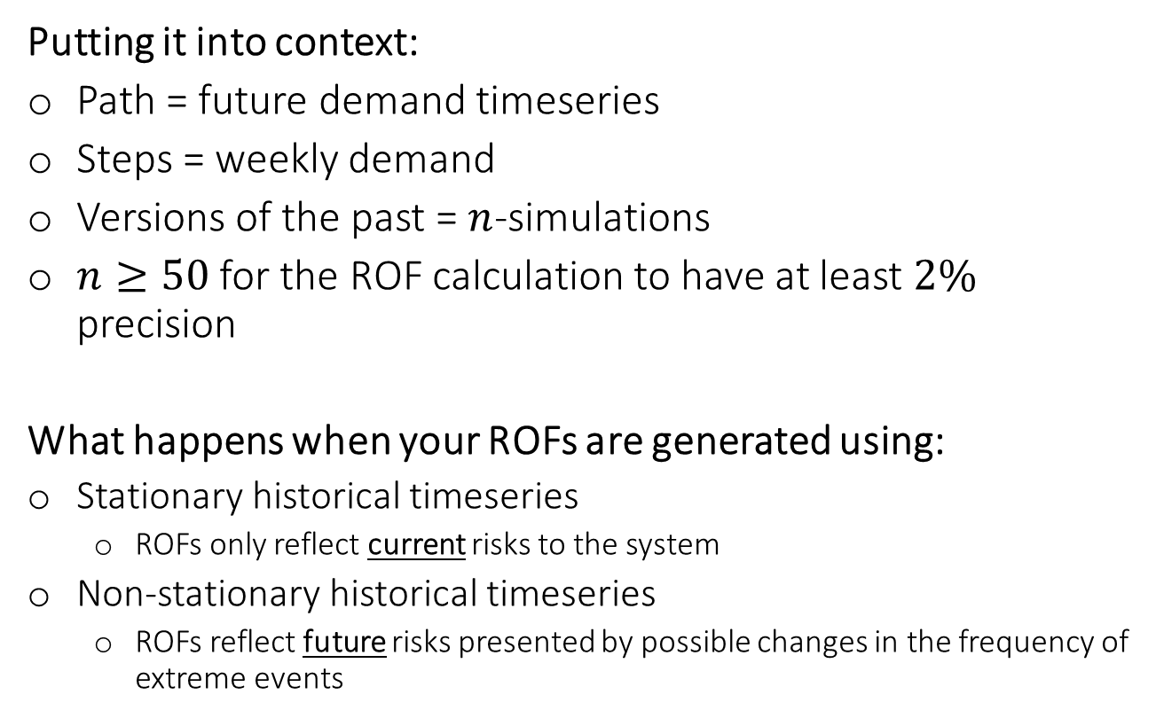
Evaluating $ROF_{m}$
Putting it into context:
Path = future demand timeseries
Steps = weekly demand
Versions of the past = $n$-simulations
$n≥50$ for the ROF calculation to have at least $2\%$ precision
What happens when your ROFs are generated using:
Stationary historical timeseries
ROFs only reflect current risks to the system
Non-stationary historical timeseries
ROFs reflect future risks presented by possible changes in the frequency of extreme events
Notes:
This is where the ROF table comes in

Slide 15
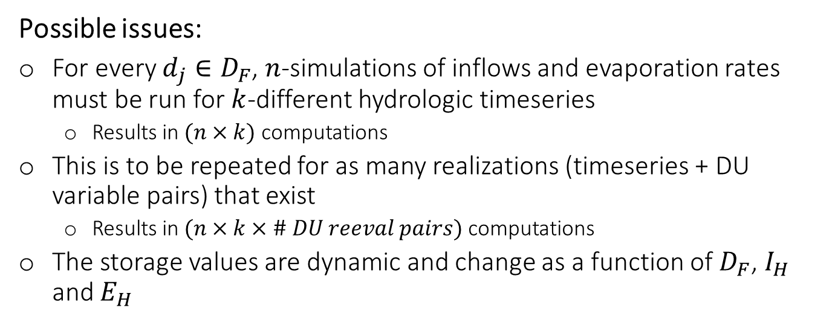
Evaluating $ROF_{m}$
Possible issues:
For every $d_{j}∈D_{F}$, $n$-simulations of inflows and evaporation rates must be run for $k$-different hydrologic timeseries
Results in $(n×k)$ computations
This is to be repeated for as many realizations (timeseries + DU variable pairs) that exist
Results in $(n×k×\# DU reeval pairs)$ computations
The storage values are dynamic and change as a function of $D_{F}$, $I_{H}$ and $E_{H}$
Notes:
It is computationally expensive to repetitively execute this step
This is where the ROF table comes in
More on DU-pairs later
K = 1000 in this case
Source: Monterrey seminar

Slide 16
Evaluating $ROF_{m}$
Questions:
Can we approximate the ROF values?
Is there a way to relate a storage level to an ROF value for a given weekly demand, inflow and evaporation rate?
How do we handle the dynamic storage levels?
How can we store these values for lookup during the deep uncertainty (DU) reevaluation?
Notes:
This is where the ROF Tables play their role

Slide 17
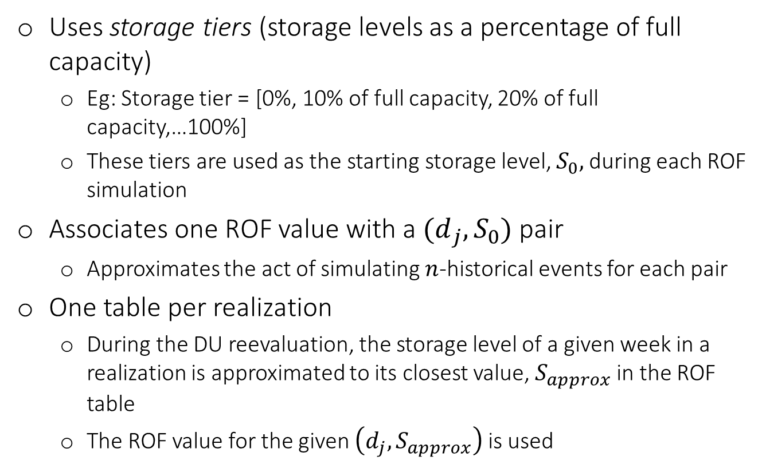
The ROF Tables
Uses storage tiers (storage levels as a percentage of full capacity)
Eg: Storage tier = [0%, 10% of full capacity, 20% of full capacity,…100%]
These tiers are used as the starting storage level, $S_{0},$during each ROF simulation
Associates one ROF value with a ${(d}_{j}, S_{0})$ pair
Approximates the act of simulating $n$-historical events for each pair
One table per realization
During the DU reevaluation, the storage level of a given week in a realization is approximated to its closest value, $S_{approx}$ in the ROF table
The ROF value for the given $\left(d_{j}, S_{approx}\right)$ is used
Notes:
Solution to the heavy computational time

Slide 18
ROF triggers in action
We will step through a toy problem to demonstrate how to generate ROF tables
Single-actor, single action
Actor: Cary, a water utility in North Carolina
Action: Implement water restrictions
Trigger: Reservoir storage is less than 20% of full capacity
Reliability metric: Percentage of all realizations in which no water restrictions are implemented
The files:
cary_demand.csv Contains 250 realizations of 26 years of projected demand
jordan_lake_evap.csv Contains 250 realizations of 98 years of synthetic stationary evaporation rates
jordan_lake_inflows.csv Contains 250 realizations of 98 years of synthetic stationary inflow
Notes:
Reliability > 99% is the ideal

Slide 19
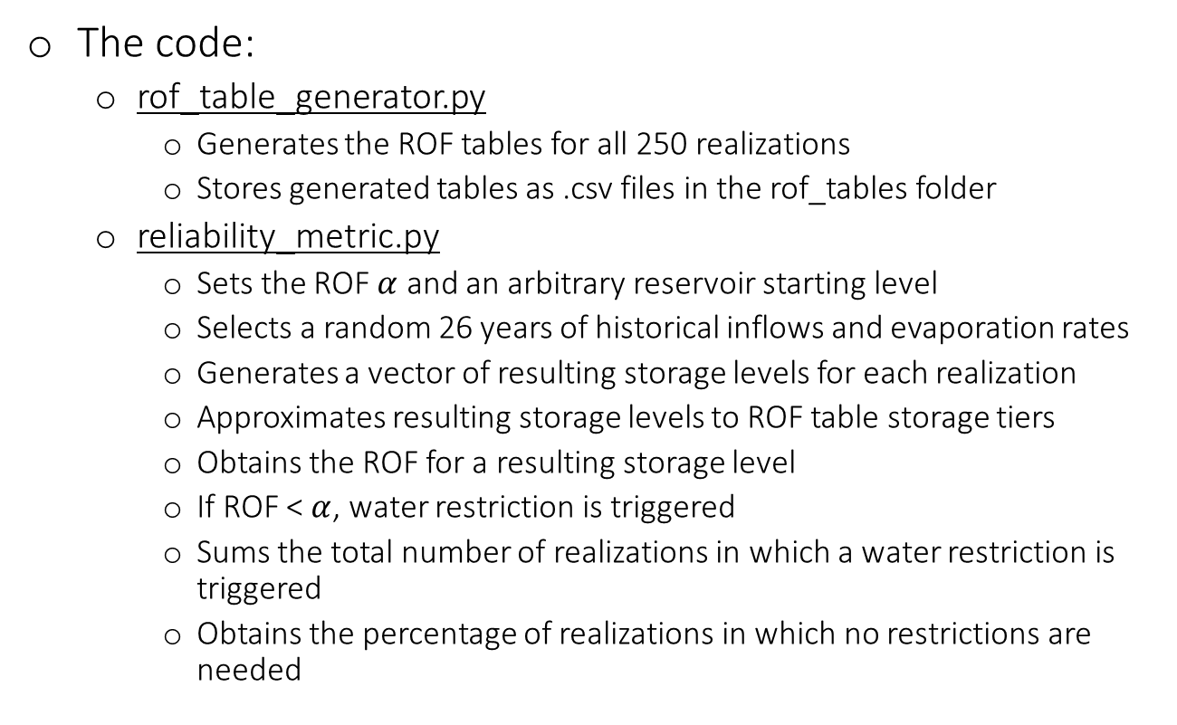
ROF triggers in action
The code:
rof_table_generator.py
Generates the ROF tables for all 250 realizations
Stores generated tables as .csv files in the rof_tables folder
reliability_metric.py
Sets the ROF $α$ and an arbitrary reservoir starting level
Selects a random 26 years of historical inflows and evaporation rates
Generates a vector of resulting storage levels for each realization
Approximates resulting storage levels to ROF table storage tiers
Obtains the ROF for a resulting storage level
If ROF < $α$, water restriction is triggered
Sums the total number of realizations in which a water restriction is triggered
Obtains the percentage of realizations in which no restrictions are needed
Notes:
Reliability > 99% is the ideal

Slide 20
ROF triggers in action
The code:
rof_table_generator.py
Generates the ROF tables for all 250 realizations
Stores generated tables as .csv files in the rof_tables folder
reliability_metric.py
Sets the ROF $α$ and an arbitrary reservoir starting level
Selects a random 26 years of historical inflows and evaporation rates
Generates a vector of resulting storage levels for each realization
Approximates resulting storage levels to ROF table storage tiers
Obtains the ROF for a resulting storage level
If ROF < $α$, water restriction is triggered
Sums the total number of realizations in which a water restriction is triggered
Obtains the percentage of realizations in which no restrictions are needed
How do we know if $α$ is optimal?
Notes:
Reliability > 99% is the ideal

Slide 21
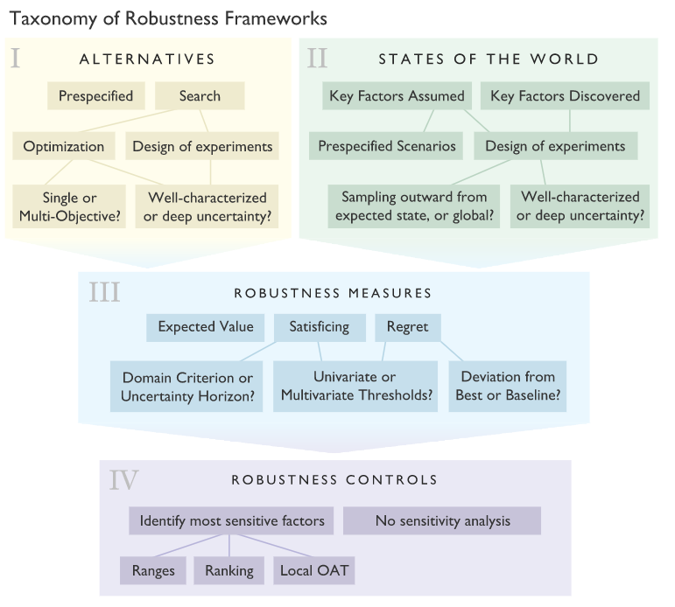
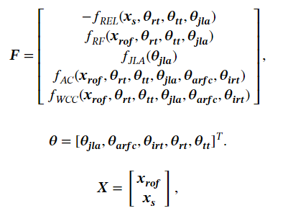
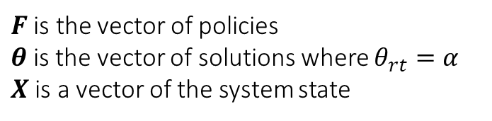
ROF triggers within MORDM
ROF triggers play a role within the first domain of the MORDM framework
They form part of a solution that maps to a Pareto-optimal policy
Source: Gold et al (2019)
$F$is the vector of policies
$θ$ is the vector of solutions where $θ_{rt}=α$
$X$ is a vector of the system state
Notes:
Focus here

Slide 22
ROF triggers within MORDM
The triggers simplify the problem formulation:
No longer ‘what is the best state for the system to be in’
Need to elicit ideal values for decision variables (eg: storage level, transfer volumes, infrastructure timelines) for each actor
Computationally expensive
Leads to tensions when multiple actors cannot agree on ideal values of decision variables
Instead, using ROF triggers ‘how much risk before the system fails’
Triggers encompass the system state and its response to DU futures
Better communicates the risk/opportunities present within the system
Notes:
This is where the true utility of using ROF triggers lie
Computationally infeasible to high dimensionality ( a lot of decision variables)

Slide 23
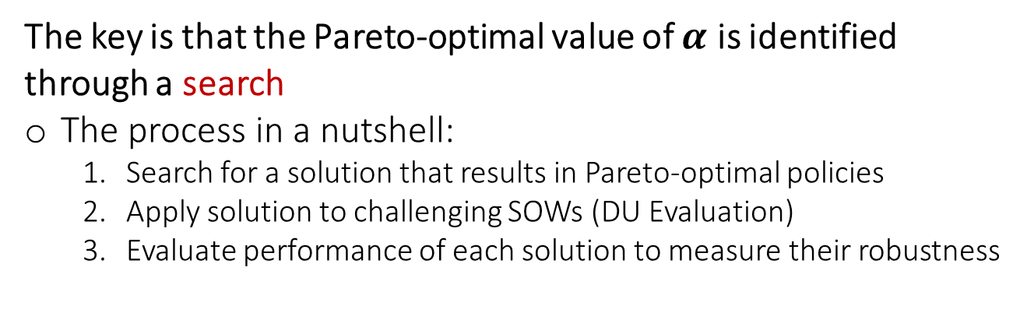
ROF triggers within MORDM
The key is that the Pareto-optimal value of $α$ is identified through a search
The process in a nutshell:
Search for a solution that results in Pareto-optimal policies
Apply solution to challenging SOWs (DU Evaluation)
Evaluate performance of each solution to measure their robustness
Notes:
No need to determine a Pareto optimal system state for each variable (eg: storage level,

Slide 24
ROF within MORDM
Hydrology 1
SOW 1
Solution i
Hydrology 2
SOW 1
5 objectives
…
…
Hydrology n
SOW 1
Hydrology 1
SOW 2
Calculate Robustness
Solution i
Hydrology 2
SOW 2
5 objectives
Satisficing Criteria
…
…
Hydrology n
SOW 2
Hydrology 1
SOW 3
Solution i
Hydrology 2
SOW 3
…
…
5 objectives
Hydrology n
SOW 3
Source: Reed (2021), Monterrey Seminar
Notes:
Struggling here, need help

Slide 25

ROF within MORDM
The key is that the Pareto-optimal value of $α$ is identified through a search
The process in a nutshell:
Search for a solution that results in Pareto-optimal policies
Apply solution to challenging SOWs (DU Evaluation)
Evaluate performance of each solution to measure their robustness
Identify solutions that are robust under deep uncertainty
(DU Optimization)
Hydrology 1
SOW 1
Solution i
Hydrology 2
SOW 2
5 objectives
…
…
Hydrology n
SOW 3
Source: Reed (2021), Monterrey Seminar
Notes:
Struggling here, need help

Slide 26
Next steps
1
Connecting ROF triggers to water portfolio planning
2
Cleanup of toy problem code
Notes:
No need to determine a Pareto optimal system state for each variable (eg: storage level,

Slide 27
References
Caldwell, C., & Characklis, G. W. (2014). Impact of contract structure and risk aversion on Interutility water transfer agreements. Journal of Water Resources Planning and Management, 140(1), 100-111. doi:10.1061/(asce)wr.1943-5452.0000317
Gold, D. F., Reed, P. M., Trindade, B. C., & Characklis, G. W. (2019). Identifying actionable compromises: Navigating multi‐city robustness conflicts to discover cooperative safe operating spaces for regional water supply portfolios. Water Resources Research, 55(11), 9024-9050. doi:10.1029/2019wr025462
Palmer, R. N., & Characklis, G. W. (2009). Reducing the costs of meeting regional water demand through risk-based transfer agreements. Journal of Environmental Management, 90(5), 1703-1714. doi:10.1016/j.jenvman.2008.11.003
Quinn, J. D., Reed, P. M., & Keller, K. (2017). Direct policy search for robust multi-objective management of deeply uncertain socio-ecological tipping points. Environmental Modelling & Software, 92, 125-141. doi:10.1016/j.envsoft.2017.02.017
Trindade, B., Reed, P., & Characklis, G. (2019). Deeply uncertain pathways: Integrated multi-city regional water supply infrastructure investment and portfolio management. Advances in Water Resources, 134, 103442. doi:10.1016/j.advwatres.2019.103442
Trindade, B., Reed, P., Herman, J., Zeff, H., & Characklis, G. (2017). Reducing regional drought vulnerabilities and multi-city robustness conflicts using many-objective optimization under deep uncertainty. Advances in Water Resources, 104, 195-209. doi:10.1016/j.advwatres.2017.03.023
Zeff, H. B., Herman, J. D., Reed, P. M., & Characklis, G. W. (2016). Cooperative drought adaptation: Integrating infrastructure development, conservation, and water transfers into adaptive policy pathways. Water Resources Research, 52(9), 7327-7346. doi:10.1002/2016wr018771
Notes:
No need to determine a Pareto optimal system state for each variable (eg: storage level,

