Slide 1
PV is conserved is our strongest statement to explain weather But then where does PV come from?
ATM 405/561
Brian Mapes, Univ of Miami

Slide 2
Outline
Read this brief review of our journey from not-at-all-conserved momentum, to sorta-conserved relative vorticity, to more- conserved absolute vorticity, to most-conserved potential vorticity.
https://www.notion.so/miamimapes/Horizontal-vorticity-and-PV-as-explanations-for-cyclones-anticyclones-2e6d2c075dba44699dc822ca5748e2e8

Slide 3
Questions about it: write answers
1. Using the concepts from the reading, and earlier homework, explain how patches or elements of relative vorticity advect other patches of relative vorticity, under the assumption that relative vorticity is sorta almost conserved. What curves up must also curve back down (mostly) (also same with shear), therefore patches of RV advect other patches of RV. It is also conserved through the addition of convergence/divergence.
2. Using the concepts from the reading, and earlier homework, explain how planetary vorticity is converted to relative vorticity, so that their sum, the absolute vorticity, is almost conserved. Consider a loop of air moving in latitude, and explain how the different Coriolis force felt by its northern and southern edges acts as a torque on the fluid loop. As you change latitude, you change PV through stretching and divergence, thus you change RV oppositely, which almost conserved AV.
3. Using the concepts from the reading, and the reading, explain how static stability is converted to absolute vorticity, so that potential vorticity, their product, arguably the truest essence of vortices (cyclones and anticyclones) is really really almost conserved. Static stability is the impact of gravity and when taken over a pressure gradient, it impacts the theta surfaces, which can be used to conserve PV.
4. Based on the end of the reading, what you will look for in vertically resolved data about diabatic heating rate in the atmosphere to explain the ultimate source of PV? Changes in heating rates/temperature with height

Slide 4
PV is conserved -- almost
APPROXIMATE term that generates PV on the Earth
Mostly, you are looking for WHERE THE DIABATIC OR PHYSICAL HEATING RATE INCREASES OR DECREASES WITH HEIGHT, weighted by (f+𝜁). In both hemispheres… so be careful with ”cyclonic”.

Slide 5
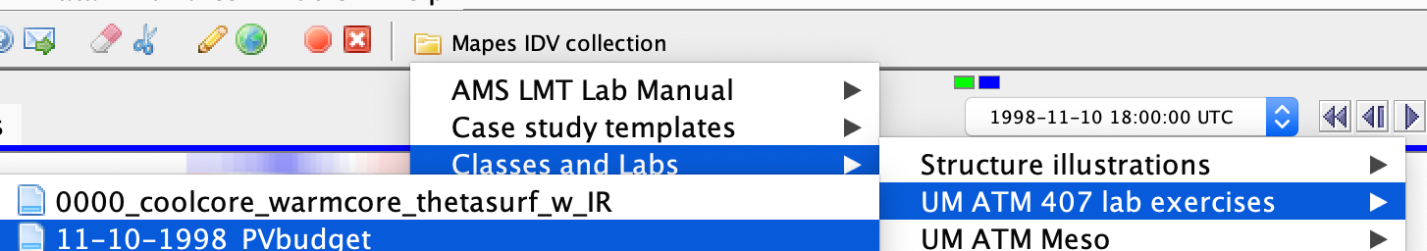
Assignment part 1: global view
Open the bundle 11-10-98 PV budget
Orient yourself to its displays, in both windows
a pole-to-pole transect of the zonal mean heating rates (averaged around the whole Earth)
A map view with many displays (including movable cross sections).

Slide 6
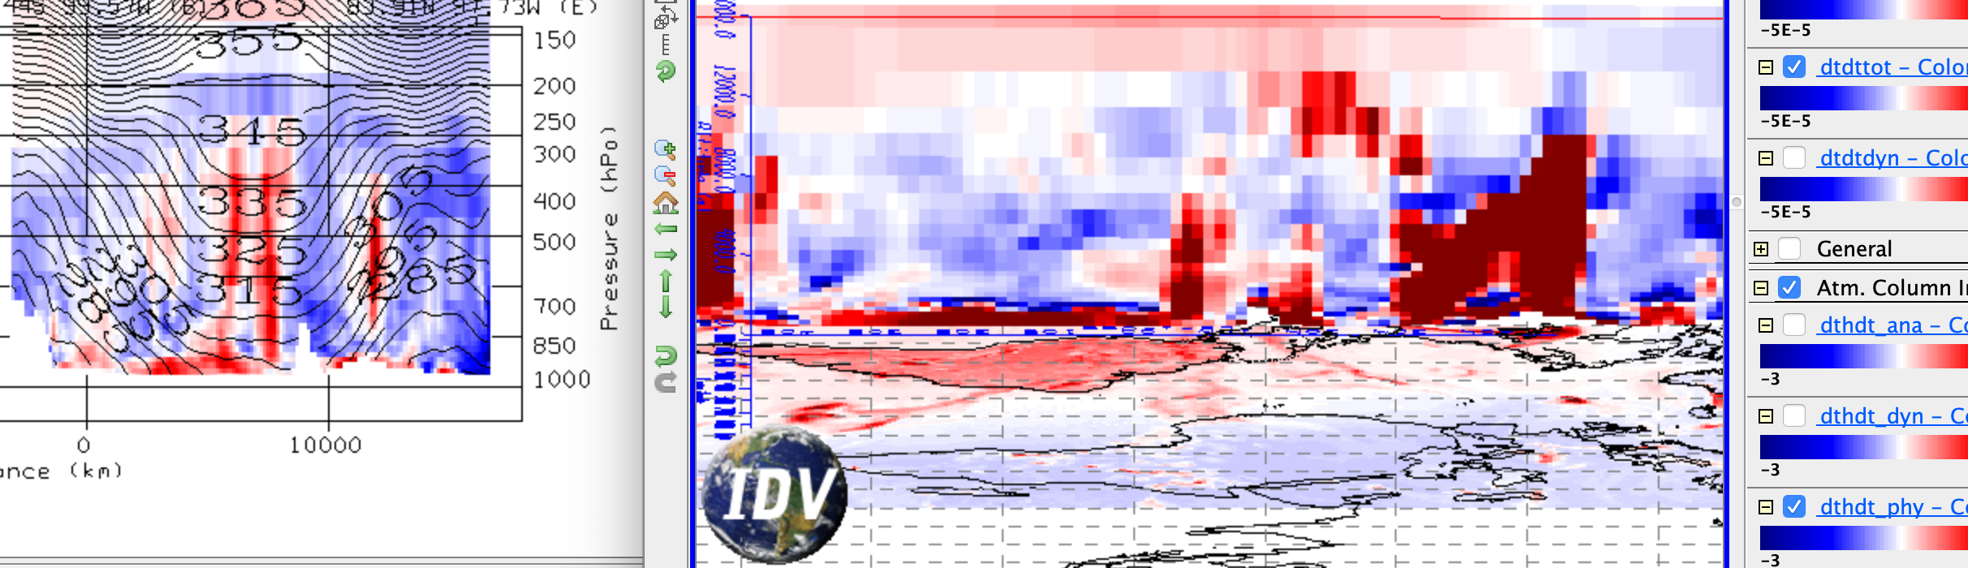
transect of zonal mean diab. heating, cross section of total diab. heating, map of column integral diab. heating

Slide 7
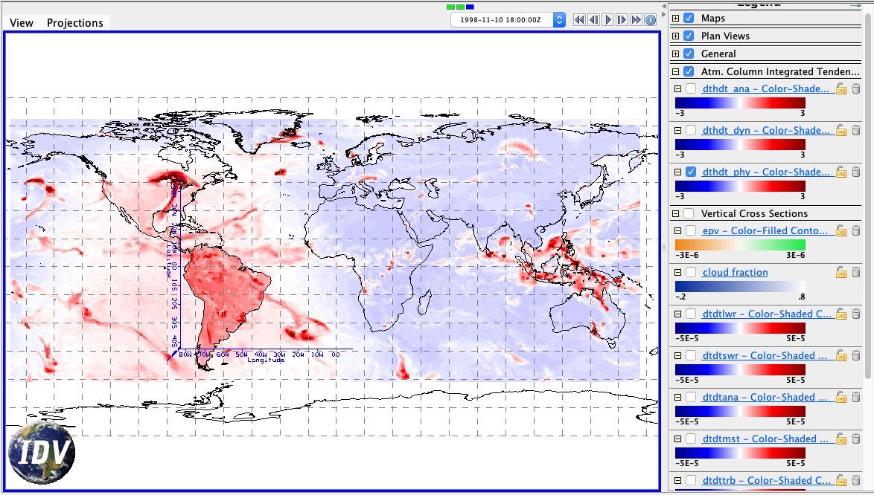
Assignment part 1: global view
What time of year is it? How can you see that in the column-integrated heating rate map dthdt_phy, or other radiative heating rates?
It is winter time, since there is significantly more heating in the southern hemisphere than the northern, especially in land masses.

Slide 8
Assignment part 1: global view
Now turn to the Transect View window, showing average cross sections all around the Earth. Create a slide showing the transect of total diabatic heating. Label it: where is the south pole, the north pole? Hint: Antarctica is mountainous.
The units of all heating rates are are K/s. What is the color range in K/day?

Slide 9
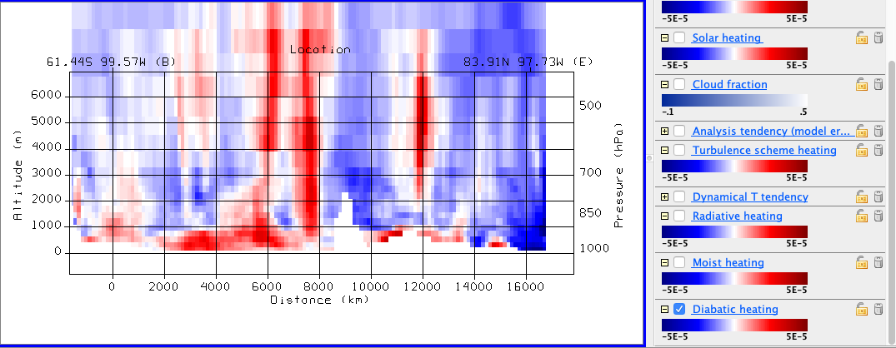
Assignment part 1: global view
North
If the units were changed from K/s to K/day, the color range would just become dampened, yet if the colorbar was scaled as well, you would not notice any change.

Slide 10
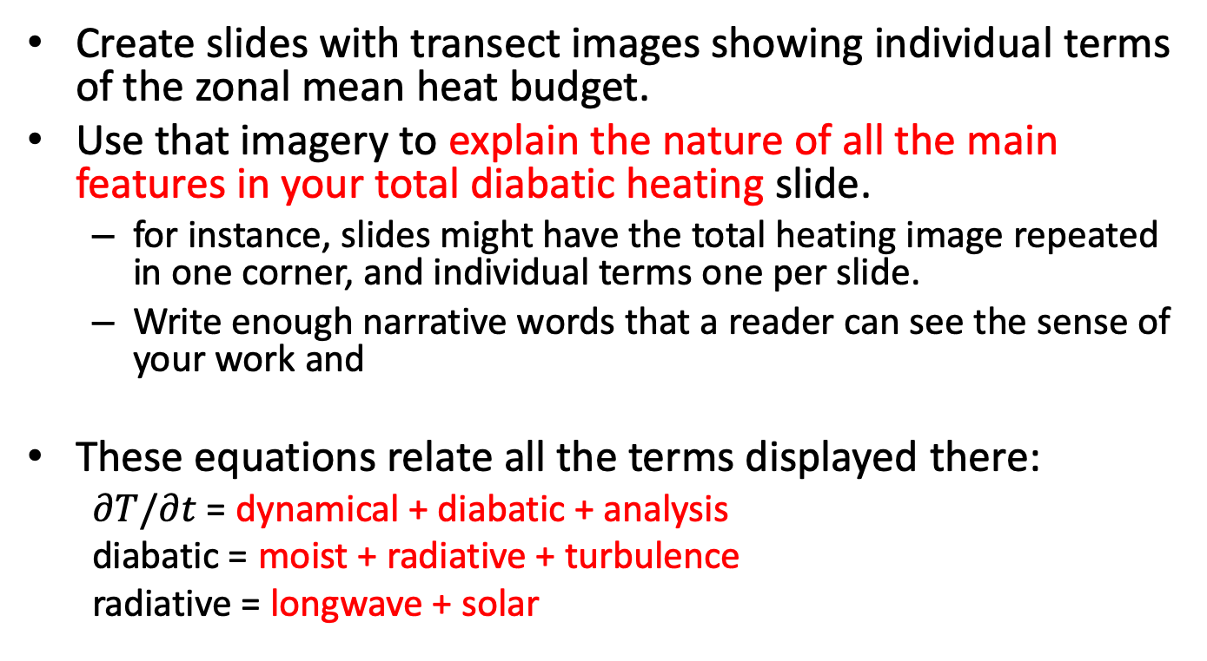
Assignment part 1: global view
Create slides with transect images showing individual terms of the zonal mean heat budget.
Use that imagery to explain the nature of all the main features in your total diabatic heating slide.
for instance, slides might have the total heating image repeated in one corner, and individual terms one per slide.
Write enough narrative words that a reader can see the sense of your work and
These equations relate all the terms displayed there:
$∂T/∂t$ = dynamical + diabatic + analysis
diabatic = moist + radiative + turbulence
radiative = longwave + solar

Slide 11
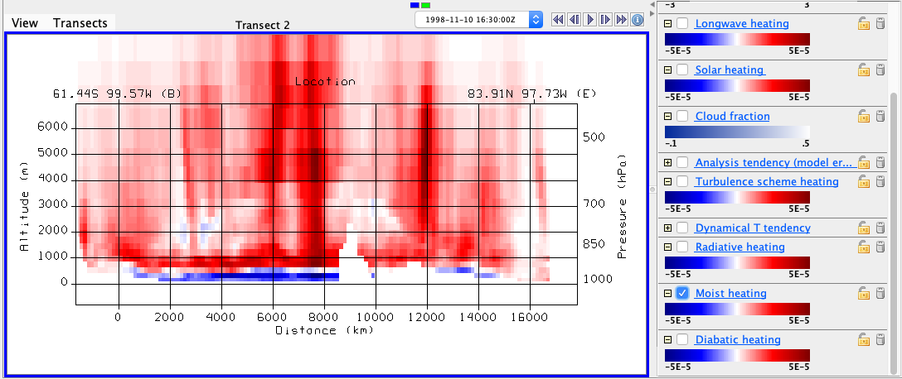
Assignment part 1: global view
moist
North
With the moisture component of the diabatic heating, it is apparent that there are clear vertical maximums, where there are strong positive vertical lines are select locations. This accounts for those lines are in the overall diabatic heating.

Slide 12
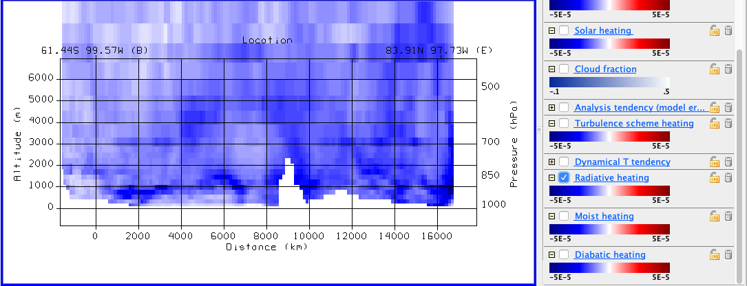
Assignment part 1: global view
radiative
North
With the radiative component of the diabatic heating, it is apparent that there is only negative, which exists fairly evenly spread throughout the transect. This accounts for the overall negative component of heating in the atmosphere with diabatic heating. When combining this and moisture, it accounts for everything in the upper air (mostly negative with strong positive vertical lines).

Slide 13
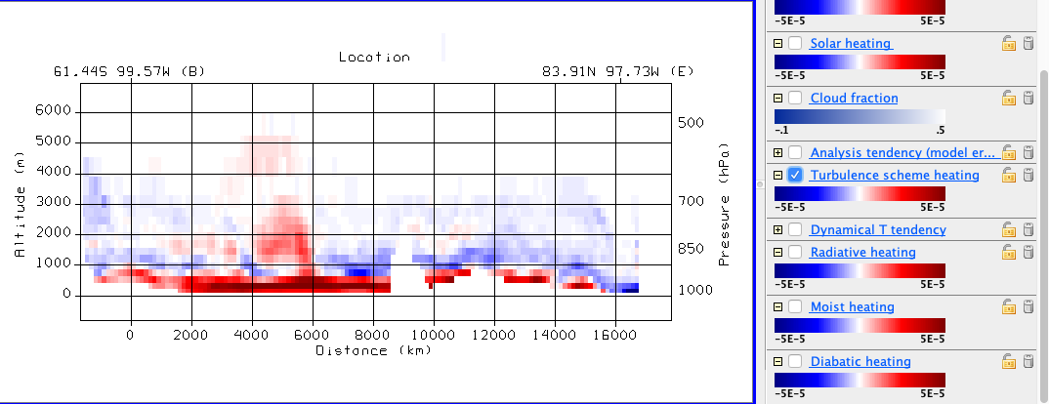
Assignment part 1: global view
turbulence
North
With the tuburlence component of the diabatic heating, it is apparent that there is primarily strong positive along the surface. This accounts for the positive heating along surface in overall diabatic heating. When comparing the three total, it is clear on how they combine to make the overall image, with mostly negative in upper air (from radiative), strong vertical maximums (moisture), and on surface positives (turbulence).

Slide 14
Assignment part 1: global view
Radiation and clouds:
Toggle the cloud fraction display with the radiative heating rate displays. Can you see any features that clearly indicate how clouds affect radiation?
clouds scatter solar photons, which are absorbed by vapor, especially at low levels.
clouds cool by emitting longwave from their tops
clouds absorb upwelling longwave from the surface at their bases (hard to see in the zonal mean, clearer in individual cross sections in Part 2)
Yes, it is very clear

Slide 15
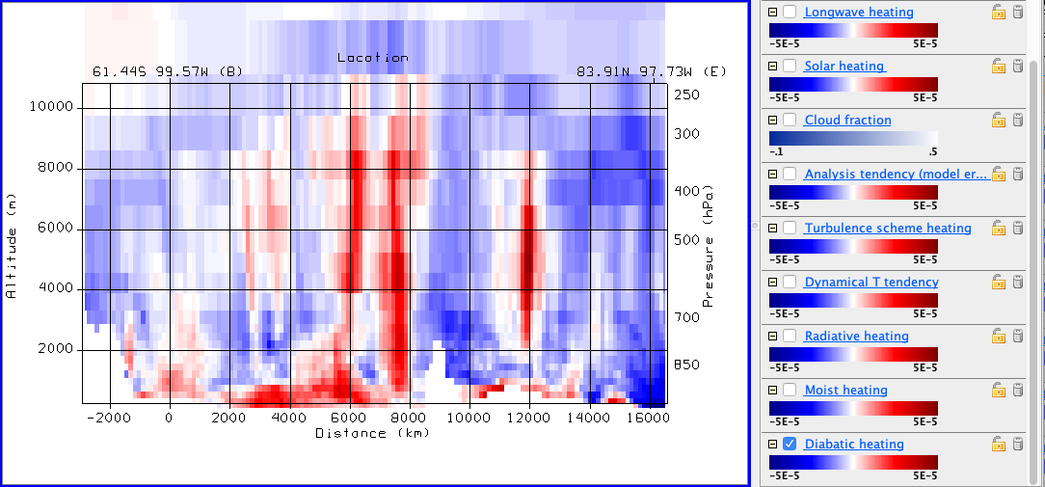
Assignment part 1: global view
From your total diabatic heating, indicate areas where PV tendency is positive and negative. Also label these areas as cyclonic or anticyclonic tendencies.
“PV tendency is positive where heating rate increases with height.” This tells us that where there are changes in heating with height, there will be vorticity. The changes in heating are strongest at the poles, and minimal at the equator. This implies that there should be positive PV tendency near the poles. Where PV is positive, that is known as cyclonic flow. Where PV is negative, that is anticyclonic. There are areas of “noise” where we see negative PV tendency, which implied anticyclonic tendencies.

Slide 16
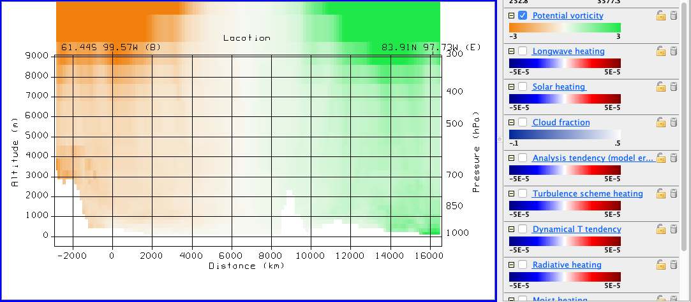
Assignment part 1: global view
Does the zonal mean PV transect resemble areas where your PV tendency is strong? It’s not so simple: PV has a long lifetime in the stratosphere, so a large source is not required to explain a large value.
Somewhat, the zonal mean PV transect matches where it PV tendency is in the Northern hemisphere. In the southern hemisphere, there in negative PV, which means that planetary vorticity dominates the flow, since that should show the opposites around the equator.

Slide 17
Assignment part 1: global view
How does this zonal-mean PV show the imprint of both its vorticity factor and its static stability factor? Label an image to explain your answer.
The zonal-mean PV eliminates much of the noise so that it is almost completely planetary vorticity that dominates, not the local PV tendencies due to heating. The static stability part shows that there is a maximum nearish the Earth, but if zoomed out, then PV would decrease with height.

Slide 18
Assignment part 2: Local sections
Now explore the cross section displays in the Map View window.
You can drag the cross section around to storms or other features. Drag them to north-south positions that slice through tropical and higher latitude weather features that interest you (perhaps guided by other displays).

Slide 19
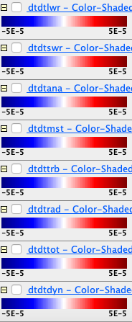
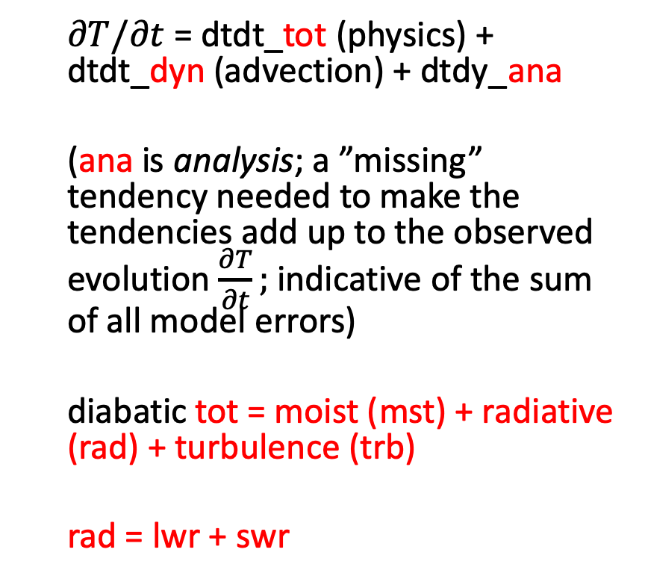
Legend explanation for cross sections
longwave
shortwave
$∂T/∂t$ = dtdt_tot (physics) + dtdt_dyn (advection) + dtdy_ana
(ana is analysis; a ”missing” tendency needed to make the tendencies add up to the observed evolution $\frac{∂T}{∂t};$ indicative of the sum of all model errors)
diabatic tot = moist (mst) + radiative (rad) + turbulence (trb)
rad = lwr + swr
analysis
(0 for perfect model)
moist mst
(convection & cloud cond. )
turbulence
(PBL)
SW+LW radiation
total physics (”diabatic”)
dynamic (advective)

Slide 20
Assignment part 2: Local view
Make comparison slides juxtaposing the zonal-mean transects and your local cross-sections, like in slide 6 above.
Toggle the various terms making up the total diabatic heating, in order to explain
Which is more variable (more spatially concentrated): radiative or moist heating? Illustrate your answer with images.

Slide 21
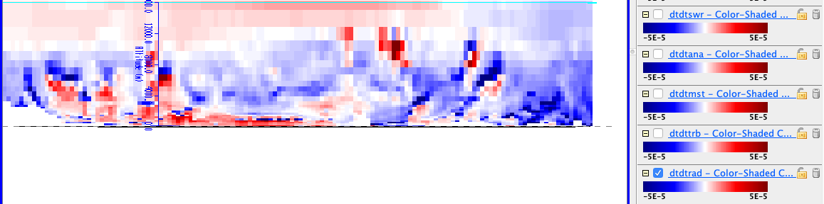
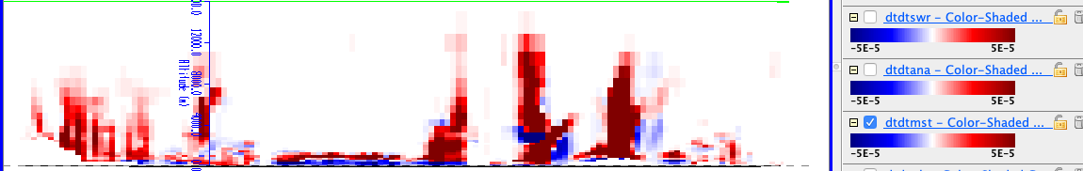
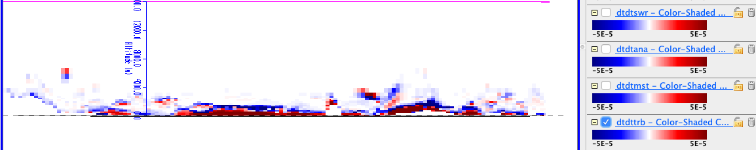
Zonal-Avg Total Diabatic
Total Radiative
Total Moist
Total Turbulence

Slide 22
Assignment part 2: Local view
Toggle the various terms making up the total diabatic heating, in order to explain
Which is more variable (more spatially concentrated): radiative or moist heating? Illustrate your answer with images.
As can be observed in the previous slide, diabatic heating from moisture is more spatially concentrated, with the moisture “bombs” that appear. Turbulence is also concentrated, but solely along surface.

Slide 23
Assignment part 2: Local view
Revisit cloud-radiative interactions
LW radiation can be understood as water vapor cooling, cloud top cooling, and cloud base warming. Toggle the layers to find a good example, then juxtapose cloud fraction and radiative heating cross-section images to show an example of a place where cloud effects are dominant

Slide 24
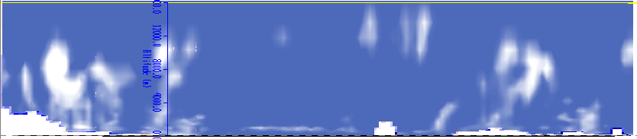
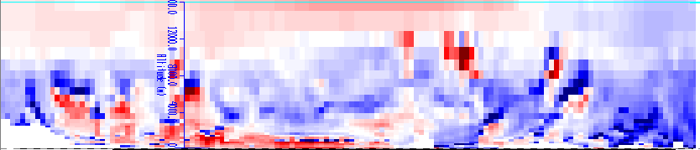
Assignment part 2: Local view
Cloud fraction
Radiative heating
Clearly, at the bottom of these clouds, there is positive radiative heating, then at the top is it negative, or cooling

Slide 25
Assignment part 2: Local view
Where does the vertical gradient of heating imply large PV sources? Use arrows to annotate a couple positive and negative source regions.
Positive PV
Negative PV
Positive PV
Negative PV

Slide 26
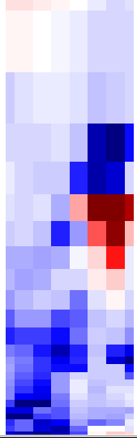

Assignment part 2: Local view
Can you find a weather situation where this source term is a positive feedback on PV?
In this warm core cyclone, you can see that there is no PV where the negative gradient in radiative heating is, yet where there is positive, there is PV.

Slide 27
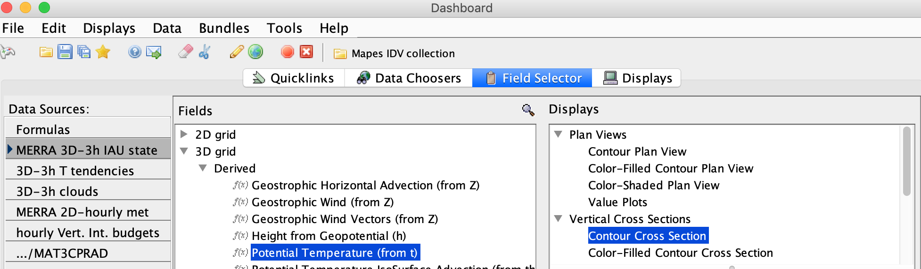
Create a new cross section of potential temperature contours

Slide 28
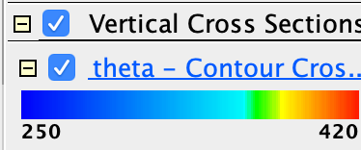
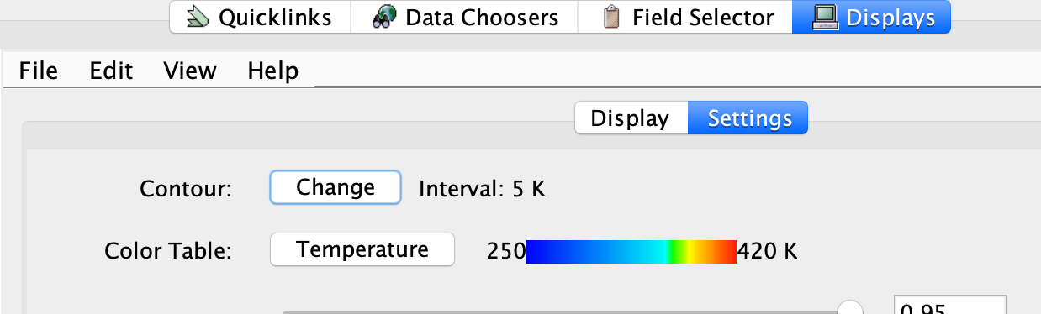
Create a new cross section of potential temperature contours
Now click its Legend entry to pop up its Display Controls.
Change the contour interval to 5K. Change the Color to Black. Change their label size to 20.

Slide 29
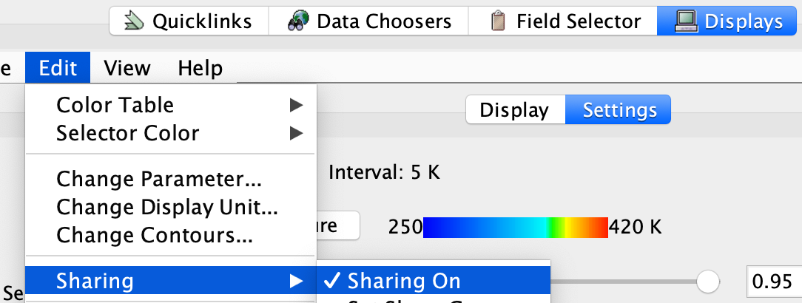
Create a new cross section of potential temperature contours
Again click the Legend entry to pop up the Display Controls.
Under the Edit menu, turn on Sharing
Move the main north-south cross section slightly. This will make your new theta contour section snap into place with it.

Slide 30
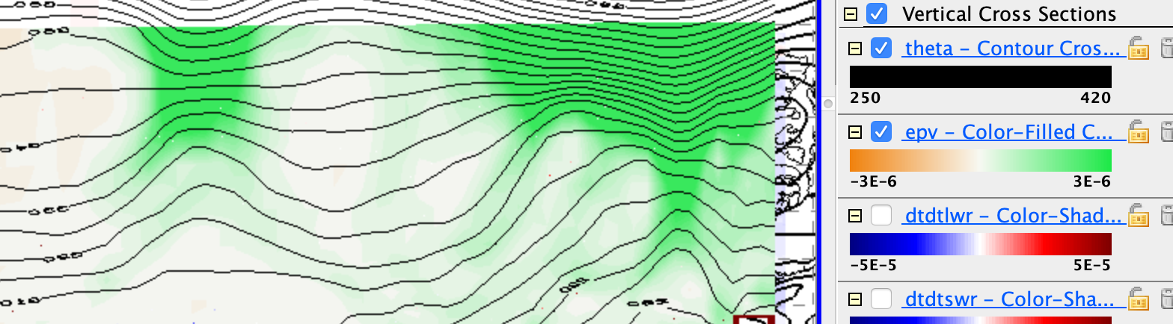
Create a new cross section of potential temperature contours
You should see our familiar relation between theta surfaces and (most clearly) upper-level cool core cyclones:

Slide 31
Warm and cool cores & condensation heating
Use the cross section with theta contours and the moist-processes heating rate (dtdtmst) to find an example
with the condensation heating in a warm core storm, like the one halfway to Ireland
how does the PV source term from latent heating feed back on such a warm core storm?
See next slide

Slide 32
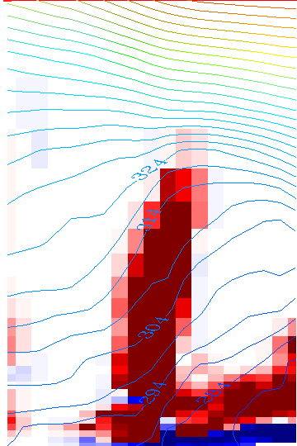
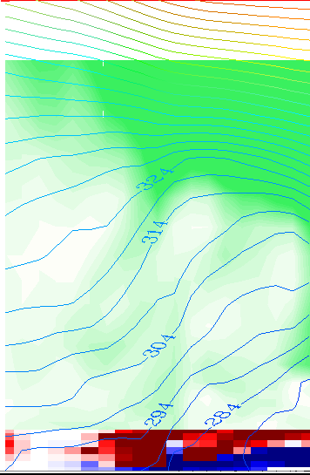
how does the PV source term from latent heating feed back on such a warm core storm?
The PV seems to be fairly limited in such a warm core storm. It looks like the PV is reduced where the latent heat is so high

Slide 33
Warm and cool cores & condensation heating
Use the cross section with theta contours and the moist-processes heating rate (dtdtmst) to find an example
where a cool core cyclone (lifted isentropes, cyclonic PV aloft; a tentacle of the polar vortex) may be gently lifting air to its condensation level, releasing some latent heating
how does the PV source term from latent heating feed back on such a cool core storm?
See next slide

Slide 34
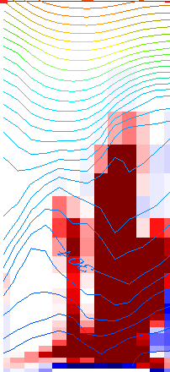
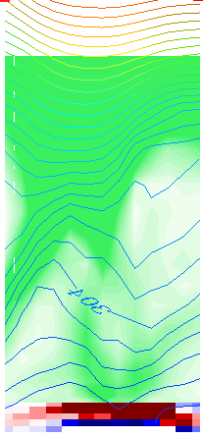
how does the PV source term from latent heating feed back on such a cool core storm?
The PV seems to be fairly limited in such a cold core storm. It looks like the PV is reduced where the latent heat is so high.

