Slide 2
Guideline human validation tool
LBRON-1520

Slide 3
Ghent

Slide 4

AGENDA
Example decision of Ghent
What gets annotated by AI
Step-by-step Human Validation Tool (HVT)

Slide 5

2026_CBS_01699 - 15438/M/3 - Geluidsuitzending

Slide 6
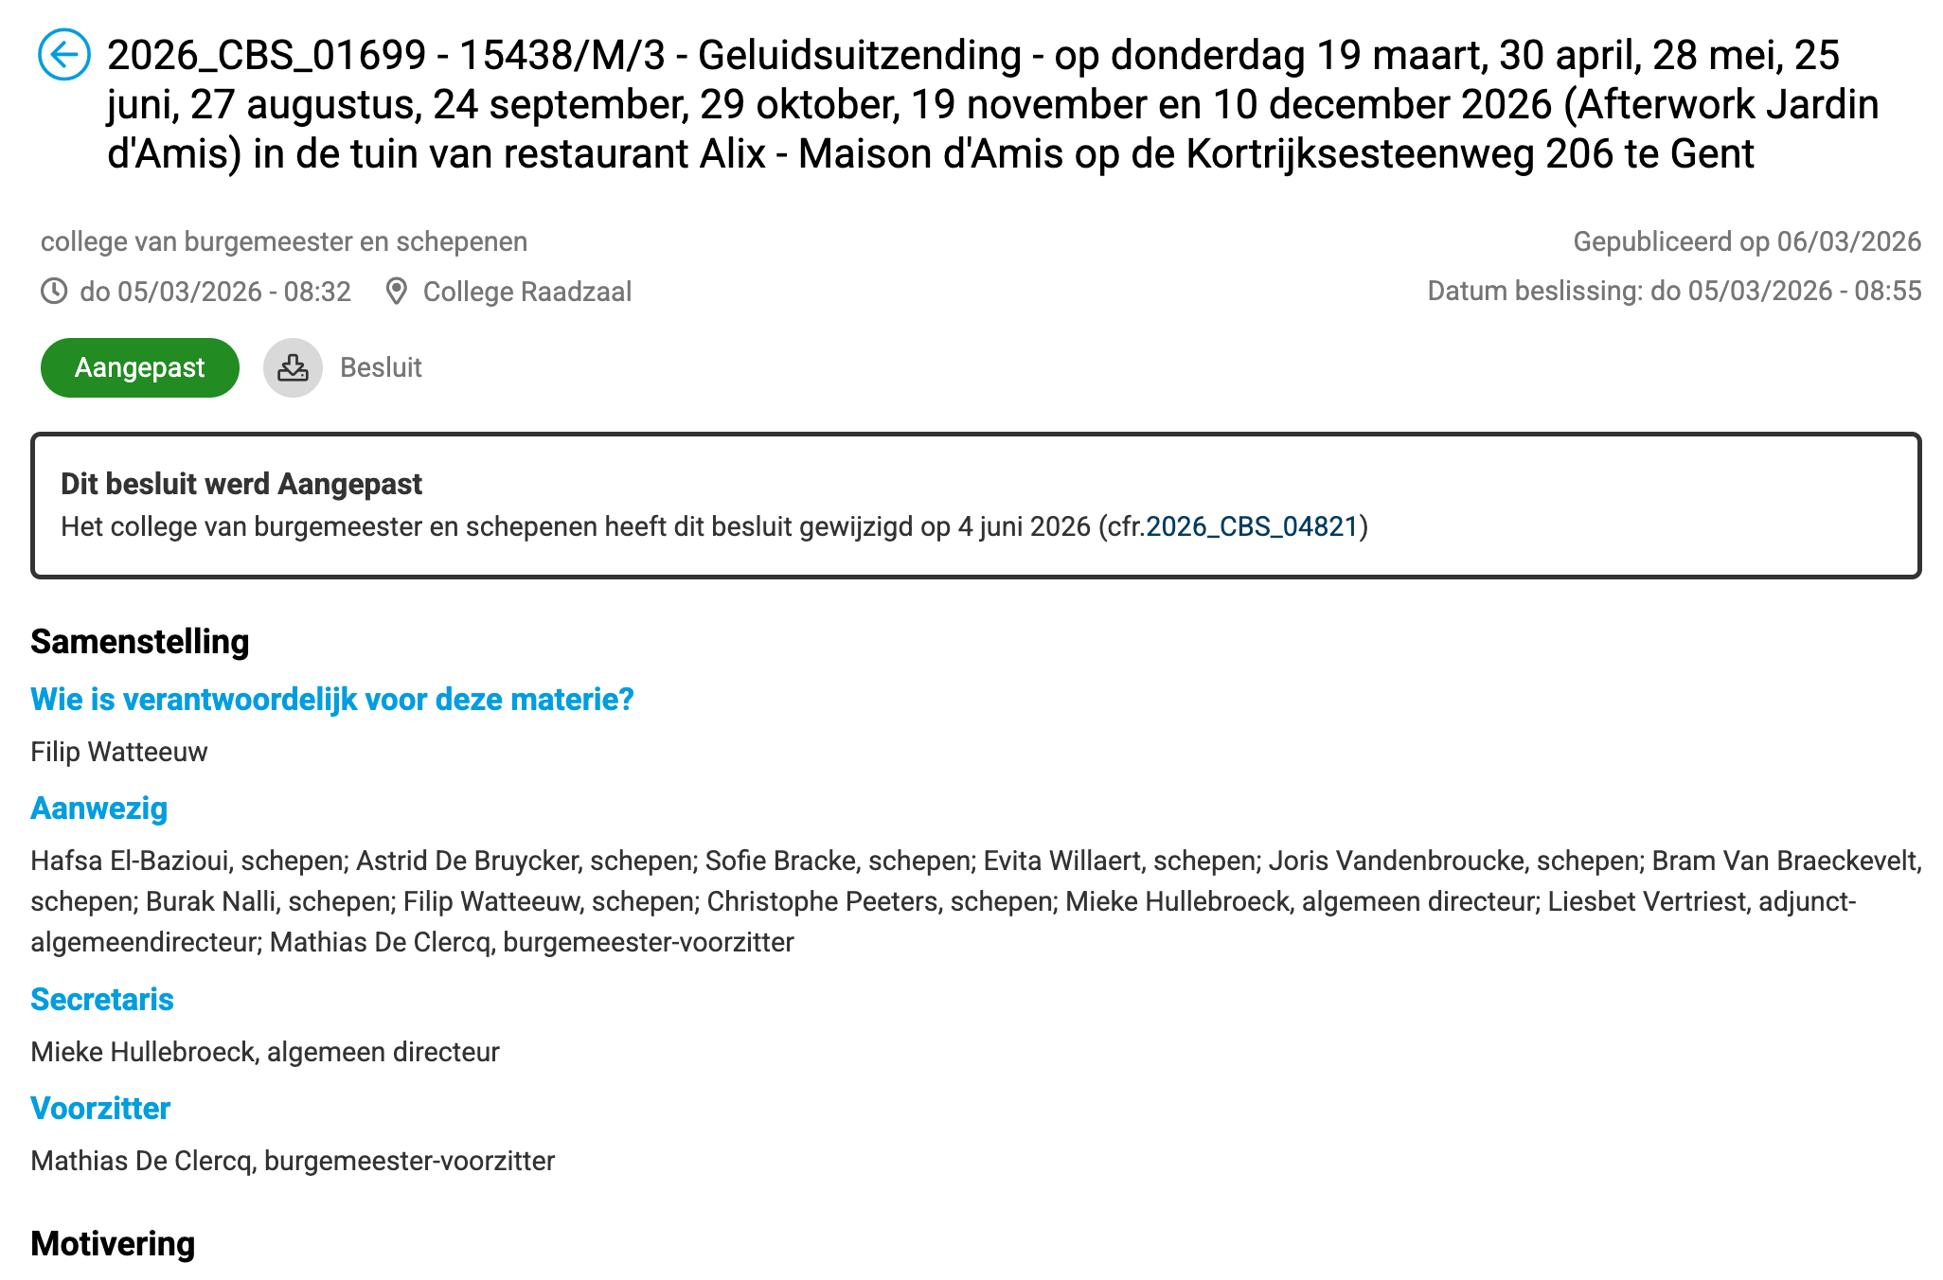
Context
https://ebesluitvorming.gent.be/zittingen/25.1008.8498.4082/agendapunten/26.0226.7125.3102
college of mayor and aldermen
Session: Thursday 05/03/2026
Published on 06/03/2026
Restaurant
Allowance increased noise level

Slide 7
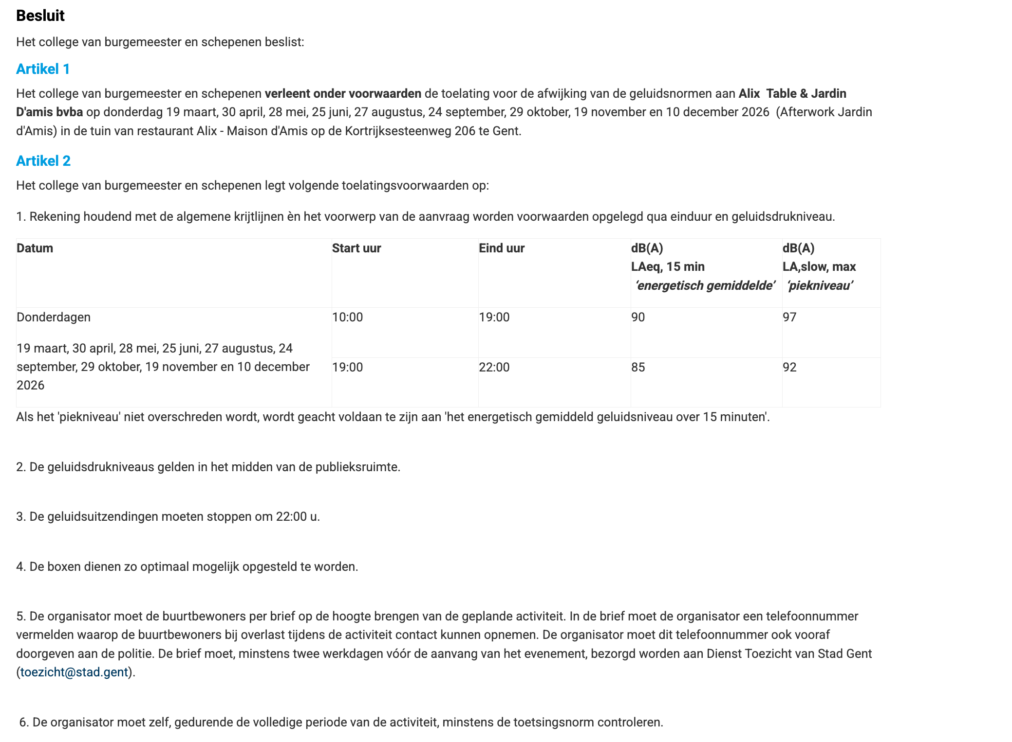
AI annotates ELI Expression Content = sum of article content
--> No motivation, participants, date publication... annotated

Slide 8
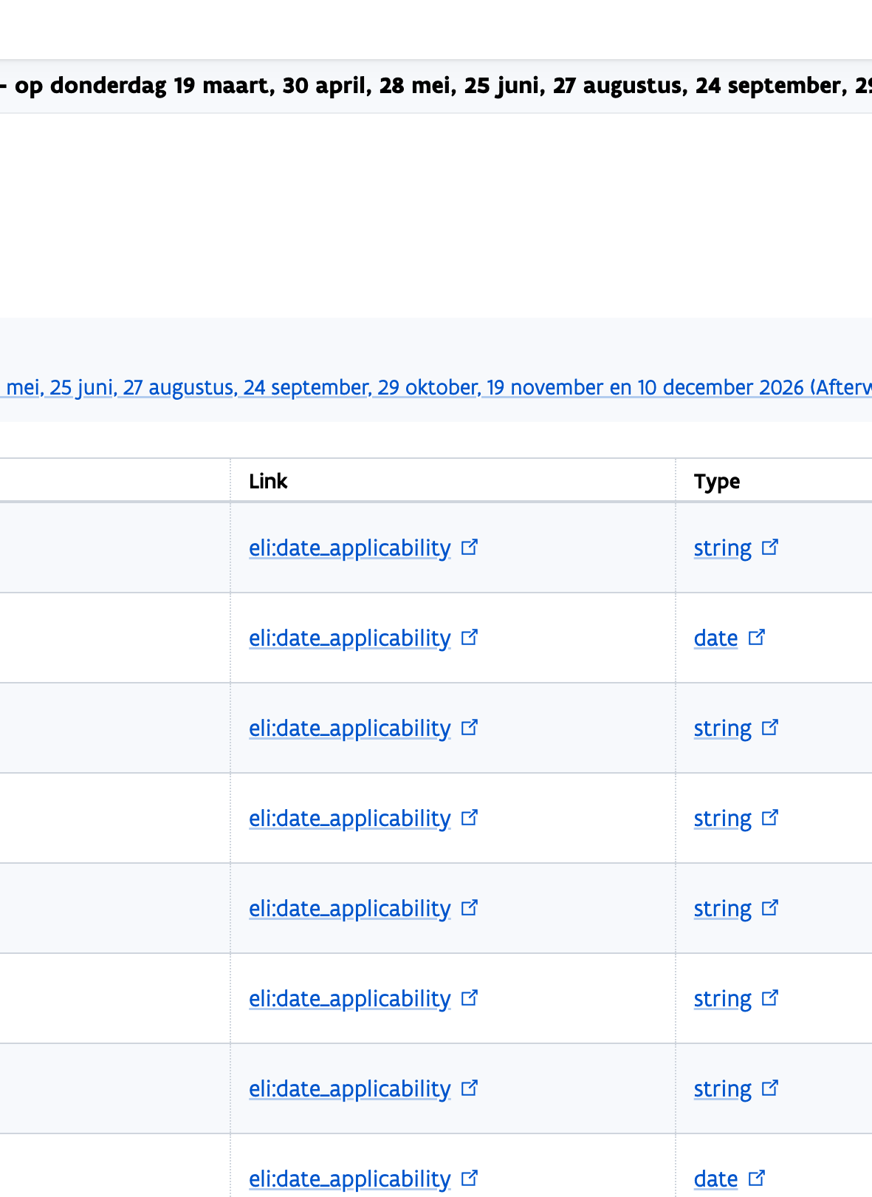
Human Validation Tool
https://human-validator.decide.lblod.info/validate/eb5456e5-72e8-5e4f-bf32-af0d5e63dbf2

Slide 9
Title (eli:title)
Result in HVT
2026_CBS_01699 - 15438/M/3 - Geluidsuitzending...
Expected
2026_CBS_01699 - 15438/M/3 - Geluidsuitzending...
Title originates from the LBLOD data source
Not visible as annotation to review

Slide 10
Motivation (ext:motivering)
Result in HVT
No annotation
Expected
Not expected, because we are annotating content of decision

Slide 11
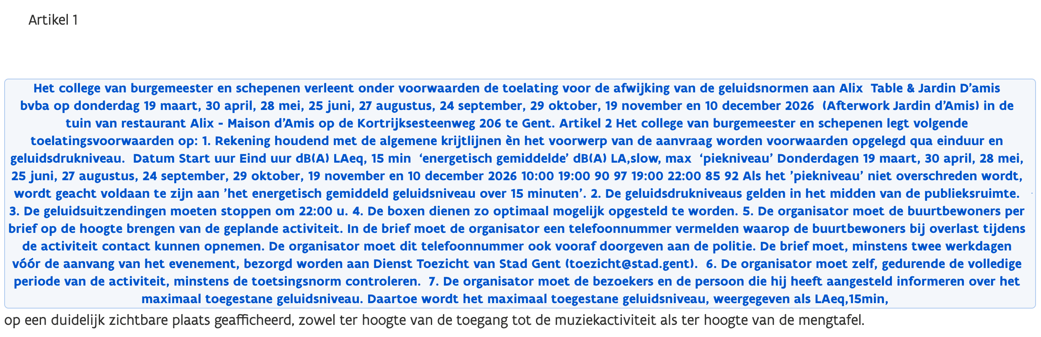

Content (ext:decision)
Result in HVT
Expected
Artikel 1 Het college van burgemeest en schepenen... ter hoogte van de mengtafel.
Note
Will be investigated (segmentation service)

Slide 12

Context date (dct:date)
General date that is not an impact date (about the content of the decision)
Result in HVT
No annotation
Expected
Not expected

Slide 13
Context period (dct:date)
General period (start and end) that is not an validity period (about the content of the decision)
Result in HVT
No annotation
Expected
Not expected

Slide 14
Entry date (eli:first_date_entry_in_force)
The first date any part of the legal resource came into force
Result in HVT
No annotation
Expected
Not expected
PDF flow should capture this date: 2026-03-05 (date of decision)

Slide 15
Impact date (eli:date_applicability)
The date at which the legislation becomes applicable. This is distinct from the date of entry into force : a text may come in force today, and state it will become applicable in 3 months.
Result in HVT
9 maart
30 april
28 mei
25 juni
27 augustus
24 september
29 oktober
19 november
2026-12-10
Expected
2026-03-19
2026-04-30
...
2026-12-10

Slide 16
Expiry date (eli:date_no_longer_in_force)
The last date any part of the legislation is in force, if the date is known.
Result in HVT
No annotation
Expected
Not expected
Should be derived from decision that changes this decision

Slide 17

Legal basis date (eli:date_document)
Date of adoption or signature (of the form yyyy-mm-dd)
Result in HVT
No annotation
Expected
Not expected
PDF flow should capture this date: 2026-03-05 (date of decision)

Slide 18

Publication date (eli:date_publication)
Date of publication of the official version of the legislation (yyyy-mm-dd)
Result in HVT
No annotation
Expected
Not expected
PDF flow should capture this date: 2026-03-06 (date of publication)

Slide 19

Session date (eli-dl:activity_date)
Date of meeting
Result in HVT
No annotation
Expected
Not expected
PDF flow should capture this date: 2026-03-05

Slide 20
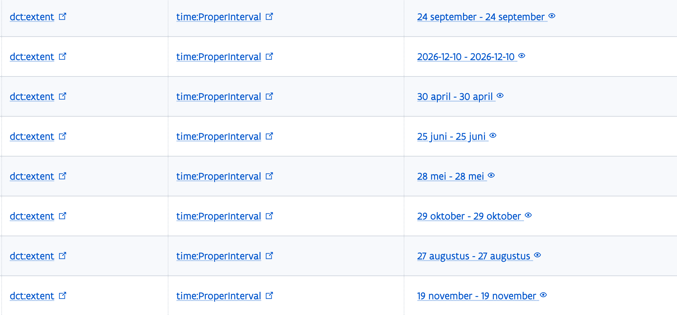
Validity period (dct:extent)
The time frame of the Normatieve provision, when something is allowed. Same as impact date.
Result in HVT
Expected
yyyy-mm-dd of start and end

Slide 21

Mandatary / participant (eli-dl:had_participant_person)
Result in HVT
No annotation
Expected
Not expected
PDF flow should capture
A person participating in an activity.

Slide 22

Voting (ext:voting)
A Vote activity
Result in HVT
No annotation
Expected
Not expected
PDF flow should capture

Slide 23
Legal framework (ext:legal_framework)
Result in HVT
No annotation
Expected
Not expected
PDF flow should capture:
VLAREM II, artikel 5.32.2.2bis
hoofdstuk 6.7 (artikels 6.7.1 tot en met 6.7.4)

Slide 24
Previous decisions (ext:previousDecisions)
Result in HVT
No annotation
Expected
Not expected

Slide 25
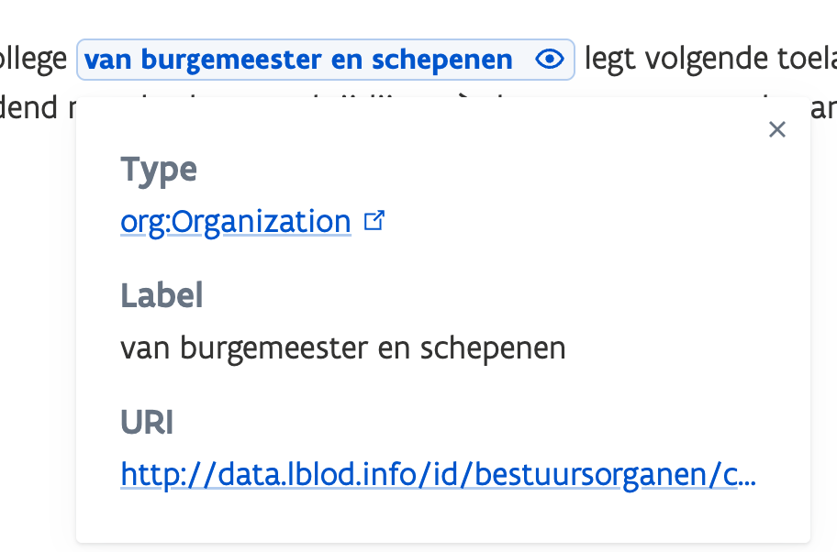
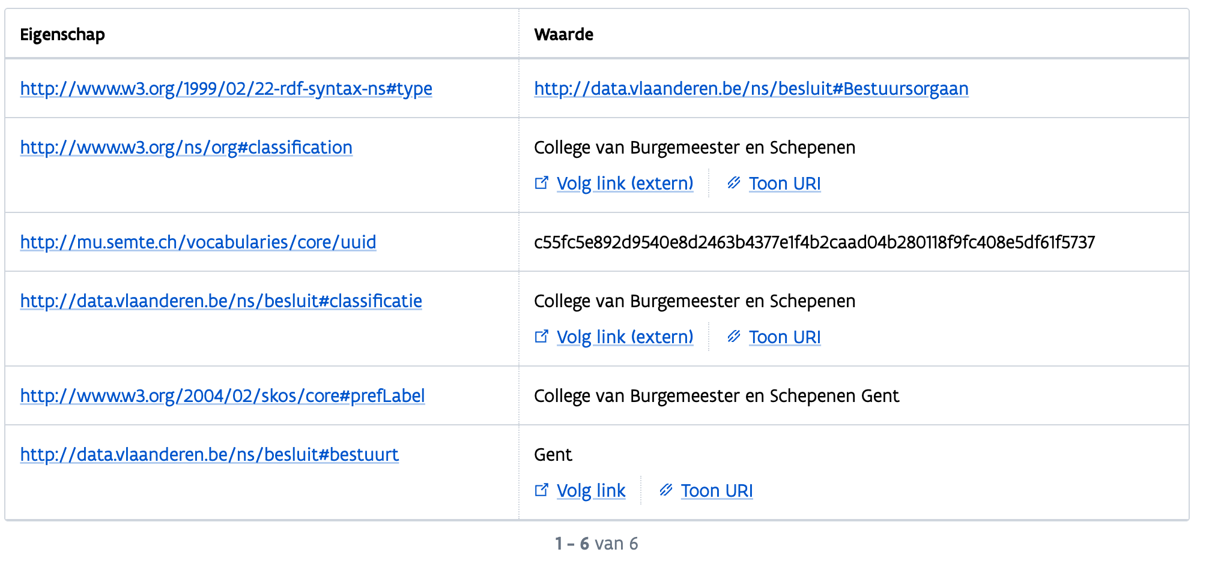
Administrative body
(eli:passed_by)
Result in HVT
van burgemeester en schepenen
Expected
College van burgemeester en schepenen

Slide 26
Context location (dct:spatial)
General location that is not the impact location (where the decision has impact on)
Result in HVT
No annotation
Expected
Not expected

Slide 27
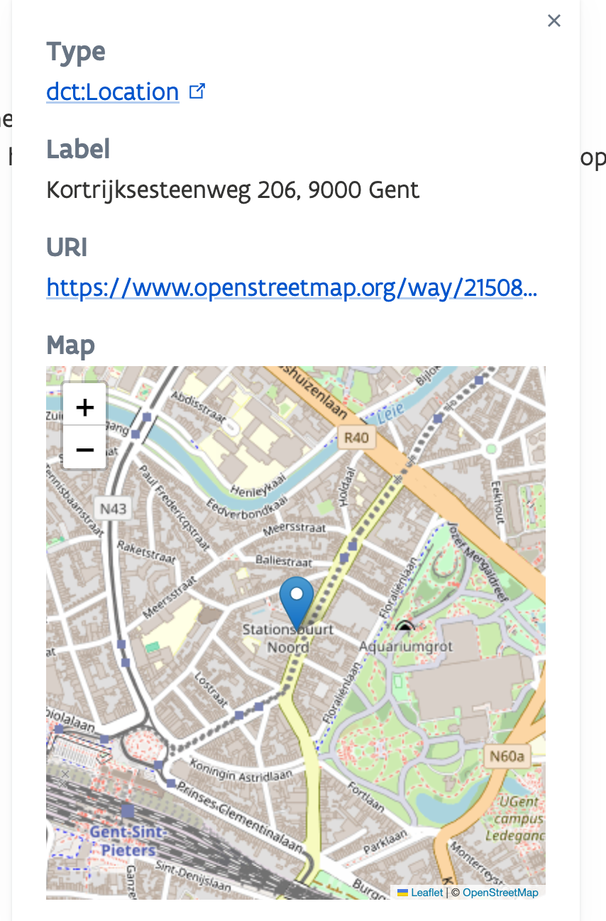
Impact location (prov:atLocation)
Result in HVT
Kortrijksesteenweg 206 te Gent
25 juni
28 mei
Expected
Kortrijksesteenweg 206 te Gent

Slide 28


Article (ext:article)
Indicates the article content
Result in HVT
Artikel 1
Artikel 2
Expected
Artikel 1 Het college van burgemeester en schepenen verleent onder voorwaarden de toelating...
Artikel 2 Het college van burgemeester en schepenen legt volgende toelatingsvoorwaarden op ...

Slide 29
Guideline human validation tool
LBRON-1520

Slide 30
Freiburg

Slide 31

AGENDA
Example decision of Freiburg
What gets annotated by AI
Step-by-step Human Validation Tool (HVT)

Slide 32
G-25/160

Slide 33
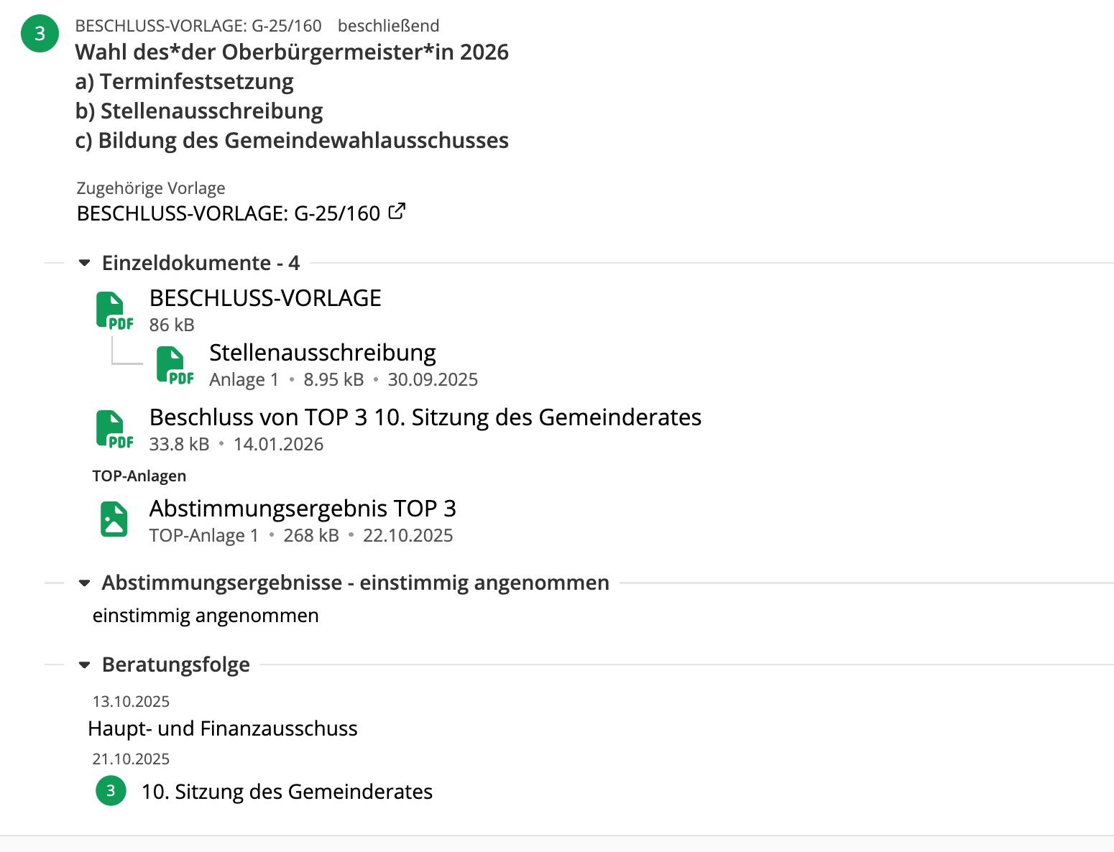
Context
https://ris.freiburg.de/submission?id=5681308100162
BESCHLUSS-VORLAGE G-25/160
City council
Session: 21th October 2025
Published on 1th October 2025
Election of the Mayor 2026

Slide 34
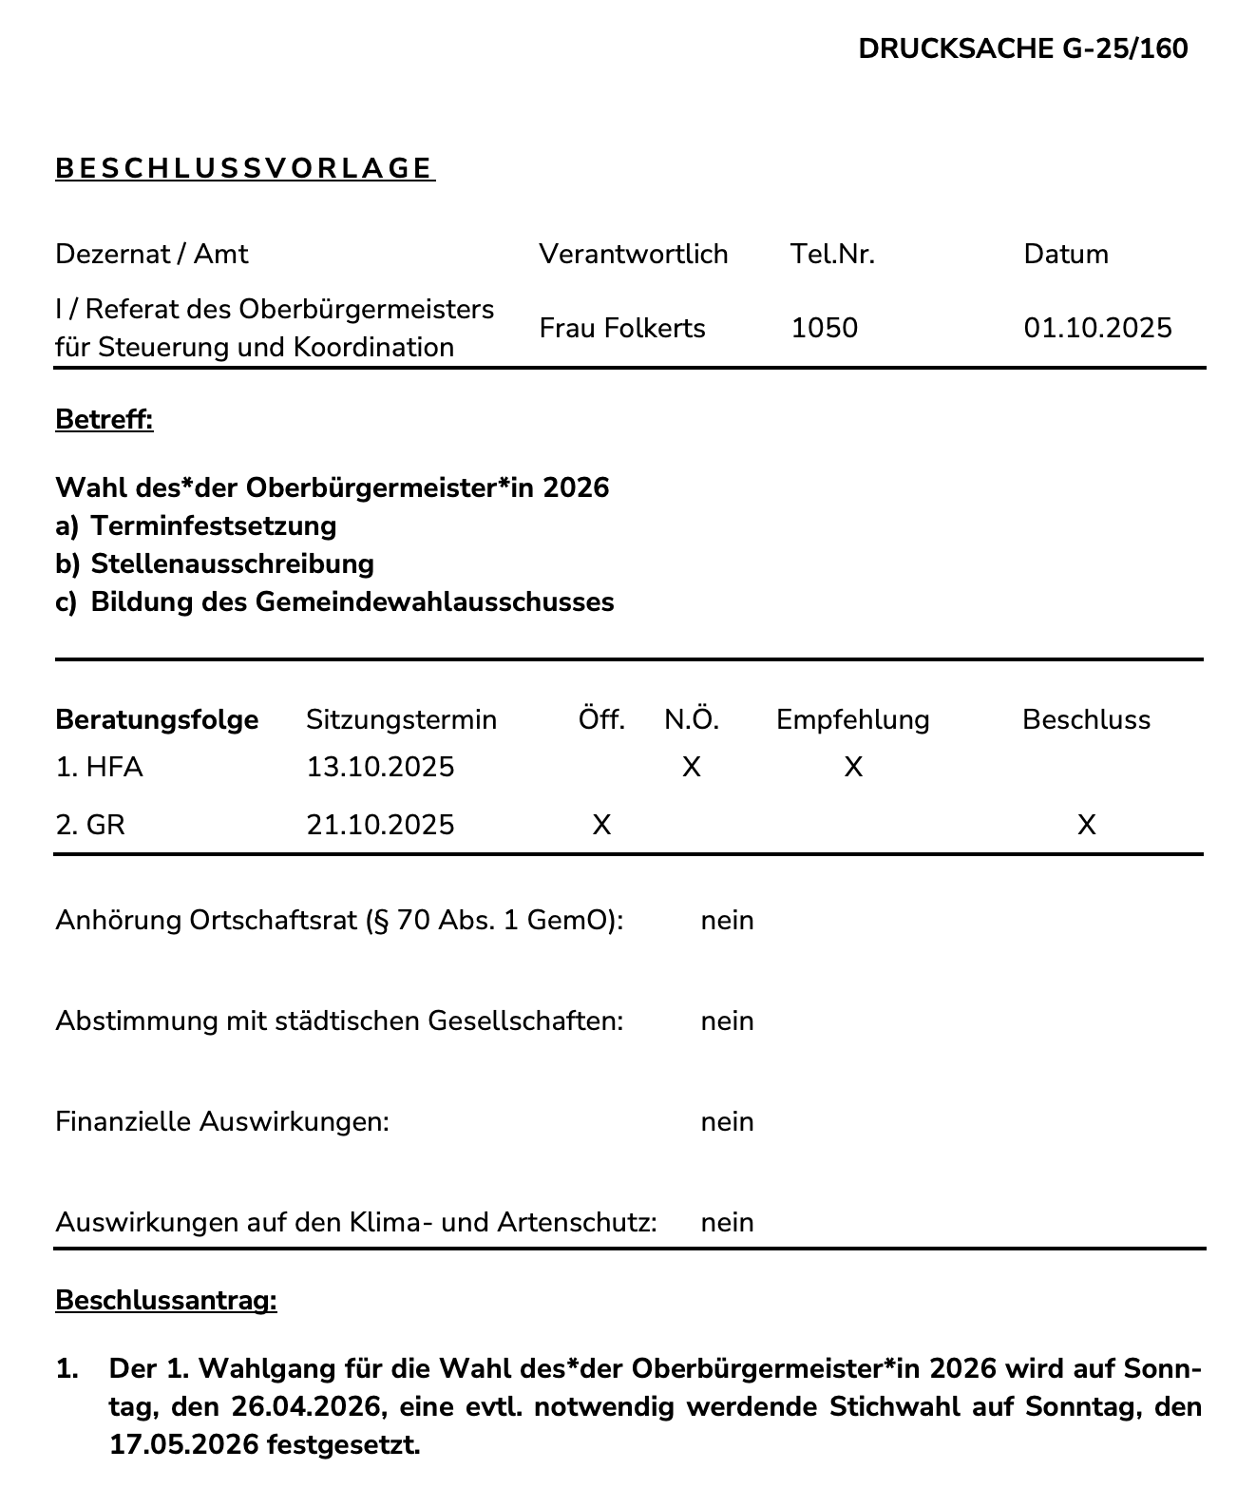
AI annotates ELI Expression Content = OParl File (Main) (Beschlussvorlage)
--> No motivation, participants, date session...

Slide 35
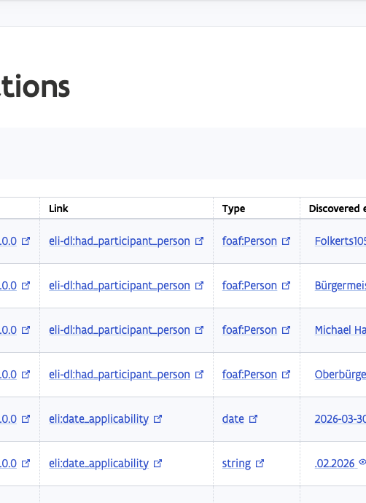
Human Validation Tool
https://human-validator.decide.lblod.info/validate/f9131e75-b2d4-5b27-a97a-3dcef8631afd

Slide 36
Title (eli:title)
Result in HVT
G-25/160
Expected
G-25/160
Title originates from the OParl data source (name of Paper)
Not visible as annotation to review

Slide 37
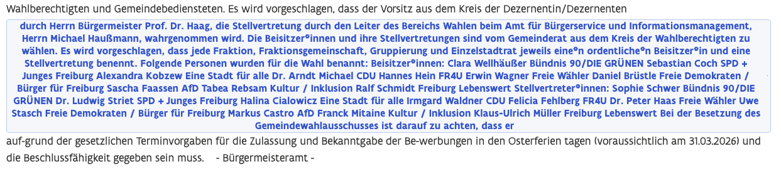
Motivation (ext:motivering)
Result in HVT
Expected
Not expected (separate motivation section is probably not used in Freiburg?)

Slide 38
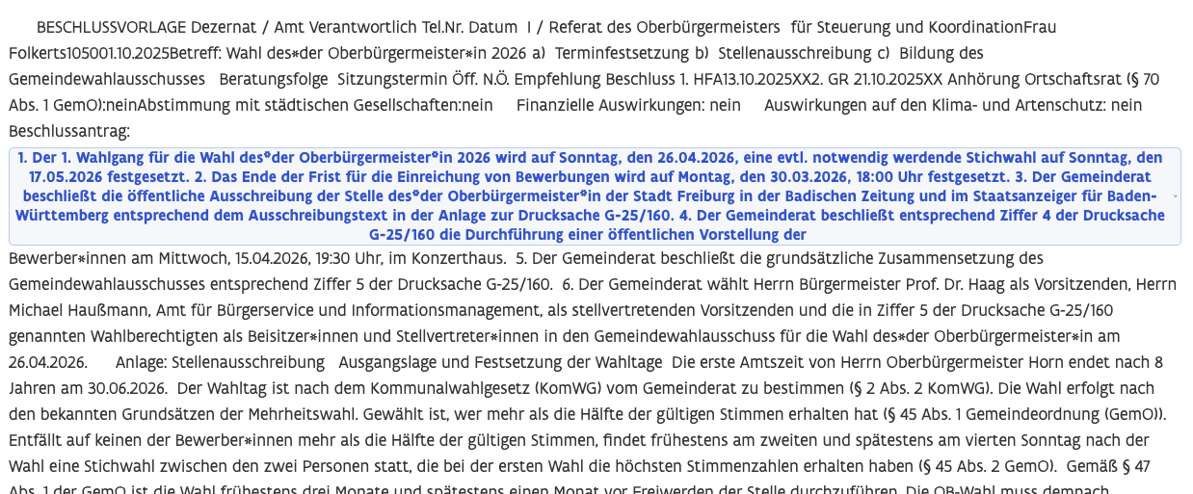
Content (ext:decision)
Result in HVT
Expected
The last part is missing:
1. Der 1. Wahlgang für die Wahl...
...
6. Der Gemeinderat wählt Herrn Bürgermeister Prof. Dr. Haag als Vorsitzenden, Herrn Michael Haußmann, Amt für Bürgerservice und Informationsmanagement, als stellvertretenden Vorsitzenden und die...
Note
Will be investigated (segmentation service)

Slide 39
Context date (dct:date)
General date that is not an impact date (date of activity that is allowed/declined by the decision)
Result in HVT
2026-04-26
2026-05-17
2026-03-31
April
HFA13.10.
21.10.
.02.2026 - .02.2026
2026-04-01
Expected
26th April 2026 (first voting)
17th May 2026 (second voting)
30th March 2026 (deadline candidates)
15th April 2026 decision city council

Slide 40
Context period (dct:date)
General period (start and end) that is not an validity period (of activity that is allowed/declined)
Result in HVT
2026-03-31 - 2026-03-31
Expected
Not expected

Slide 41
Entry date (eli:first_date_entry_in_force)
The first date any part of the legal resource came into force
Result in HVT
2026-04-15
.02.2026
2026-02-21
2026-04-26
2026-04-15
Expected
Not expected, because not part of beschlussvorlage
PDF flow should capture this date: 2025-10-21 (date of decision in meeting)

Slide 42
Impact date (eli:date_applicability)
The date at which the legislation becomes applicable. This is distinct from the date of entry into force : a text may come in force today, and state it will become applicable in 3 months.
Result in HVT
2026-03-30
.02.2026
02.2026
2026-03-31
2026-04-15
.02.2026
2026-03-30
26.02
2026-02-21
2026-04-15
Expected
None expected

Slide 43
Expiry date (eli:date_no_longer_in_force)
The last date any part of the legislation is in force, if the date is known.
Result in HVT
26.02
.02.2026
02.2026
2026-03-30
2026-03-30
Expected
Not expected

Slide 44

Legal basis date (eli:date_document)
Date of adoption or signature (of the form yyyy-mm-dd)
Result in HVT
No annotation
Expected
Not expected
PDF flow should capture this date: 2025-10-21 (date of Sitzung des Gemeinderates)

Slide 45

Publication date (eli:publication_date)
Date of publication of the official version of the legislation (yyyy-mm-dd)
Result in HVT
No annotation
Expected
Not expected
Could be this date on website: 2026-01-14

Slide 46
Session date (eli-dl:activity_date)
Date of meeting
Result in HVT
No annotation
Expected
Not expected
PDF flow should capture this date: 2025-10-21 (date of Sitzung des Gemeinderates)

Slide 47
Validity period (dct:extent)
The time frame of the Normatieve provision, when something is allowed. Same as impact date.
Result in HVT
eli:realizes omg:NormatieveBepaling https://data.lblod.info/id/normatievebepaling/8f0e19c3-01ee-4404-98b7-7cef3edcc2e4
dct:extent time:ProperInterval 2026-03-31 - 2026-03-31
Expected
Not applicable in this context

Slide 48
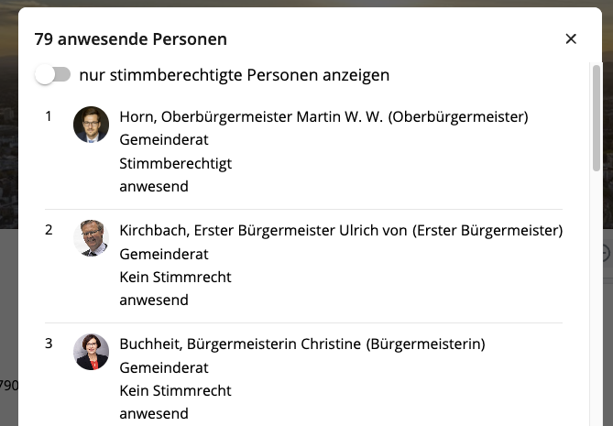
Mandatary / participant (eli-dl:had_participant_person)
Result in HVT
Folkerts105001
Bürgermeister Prof. Dr. Haag
Michael Haußmann
Oberbürgermeister Horn
Expected
Not expected
Already available in OParl API
A person participating in an activity.

Slide 49
Voting (ext:voting)
A Vote activity
Result in HVT
No annotation
Expected
Not expected
PDF flow should capture: einstimmig bei 41 Ja-Stimmen, 0 Nein-Stimmen und 0 Enthaltungen

Slide 50
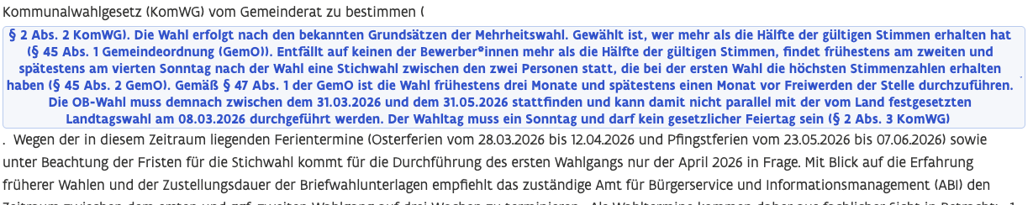
Legal framework (ext:legal_framework)
Result in HVT
Expected
Should be separate references:
§ 2 Abs. 2 KomWG
§ 45 Abs. 1 Gemeindeordnung (GemO)
§ 45 Abs. 2 GemO
§ 47 Abs. 1 der GemO
§ 2 Abs. 3 KomWG

Slide 51
Previous decisions (ext:previousDecisions)
Result in HVT
No annotation
Expected
Not expected

Slide 52
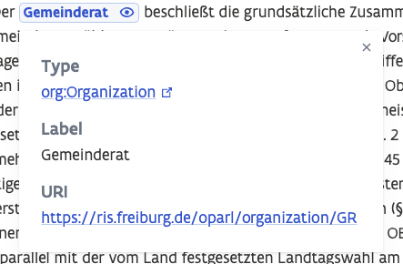
Administrative body
(eli:passed_by)
Result in HVT
Gemeinderat
Der Gemeinderat
Der Gemeinderat
Expected
Gemeinderat (https://ris.freiburg.de/oparl/organization/GR)

Slide 53
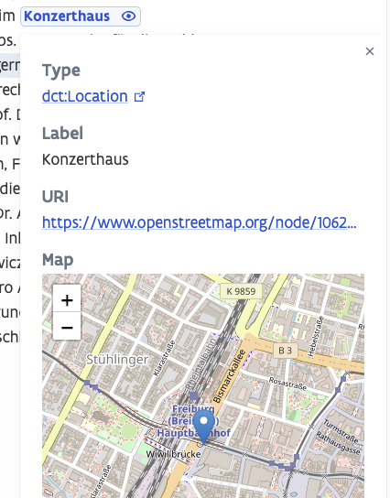
Context location (dct:spatial)
General location that is not the impact location (where the decision has impact on)
Result in HVT
Konzerthaus (https://www.openstreetmap.org/node/1062400002 )
Expected
Konzerthaus (https://www.openstreetmap.org/node/1062400002 )

Slide 54
Impact location (prov:atLocation)
Result in HVT
No annotation
Expected
Not expected

Slide 55
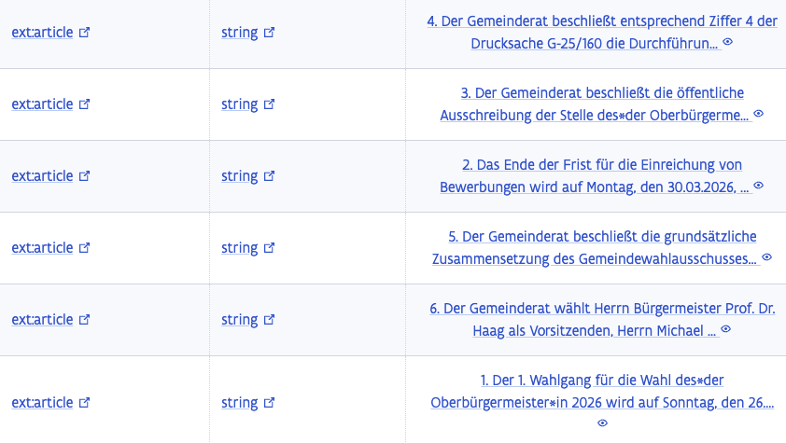
Article (ext:article)
Indicates the article number
Result in HVT
Expected
1.
2.
…
6.

Slide 56
Guideline compare human validation tool with PDF
LBRON-1520

Slide 57
Bamberg

Slide 58

AGENDA
Example decision of Bamberg
What gets annotated by AI
Step-by-step Human Validation Tool (HVT)

Slide 59
Beschlussvorlage - VO/2025/9541-OB

Slide 60
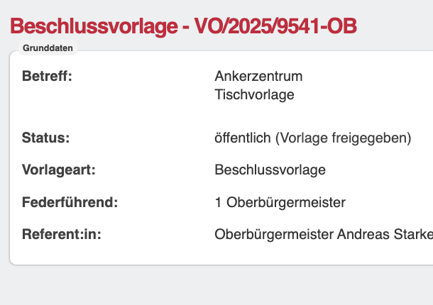
Context
https://ris.freiburg.de/submission?id=5681308100162
Beschlussvorlage - VO/2025/9541-OB
City council
Session: 21th October 2025
Published on 1th October 2025
The city council approves the negotiated agreement.

Slide 61
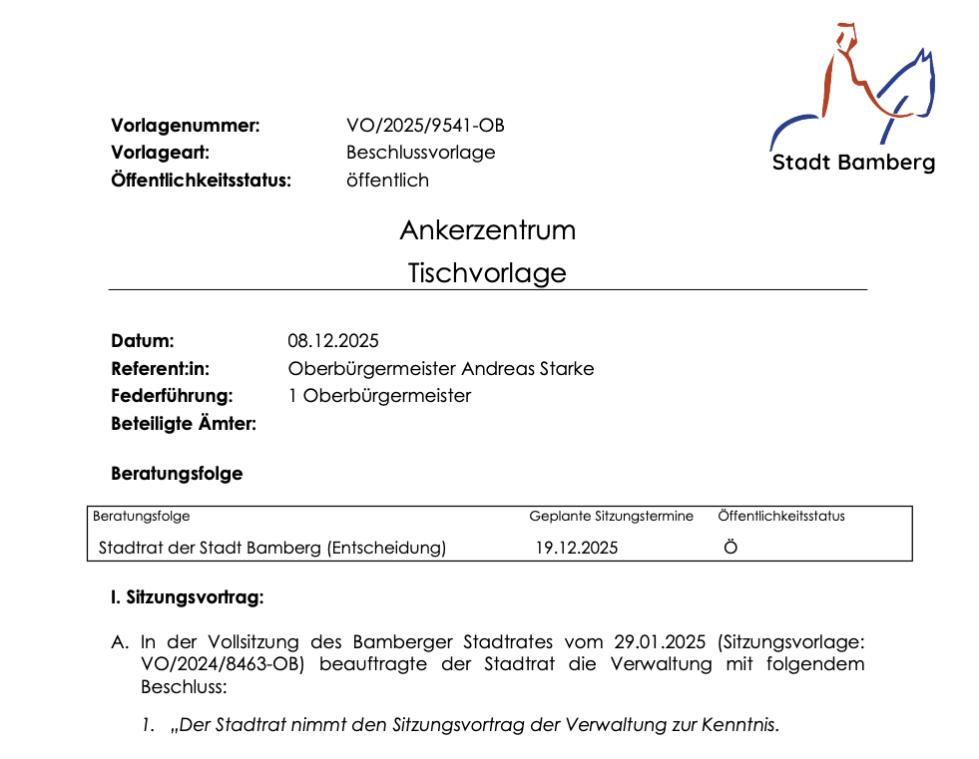
AI annotates ELI Expression Content = PDF text

Slide 62
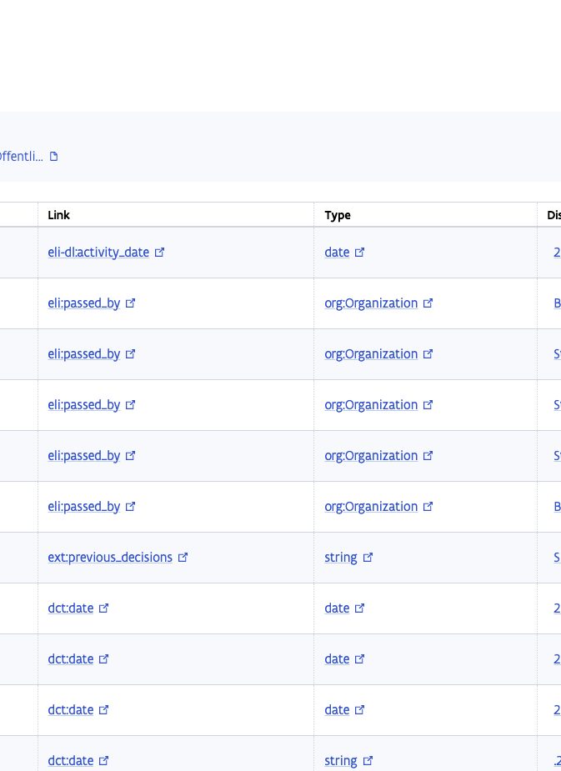
Human Validation Tool
https://human-validator.decide.lblod.info/validate/3b7ecdf2-8c9c-48df-970e-121c84afd98c

Slide 63

Title (eli:title)
Result in HVT
<no title:> VO/2025/9541-OB 1/5 Vorlagenummer: VO/2025/9541-OB Vorlageart: Beschlussvorlage Öffentli...
Expected
Ankerzentrum
Tischvorlage

Slide 64
Motivation (ext:motivering)
Result in HVT
No annotation
Expected
Not expected (maybe motivation maps on "Sitzungsvortrag"?)

Slide 65
Content (ext:decision)
Result in HVT
No annotation
Expected
I. Sitzungsvortrag:
In der Vollsitzung des Bamberger Stadtrates vom 29.01.2025 (Sitzungsvorlage: VO/2024/8463-OB) beauftragte der Stadtrat die Verwaltung mit folgendem Beschluss: ...
II. Beschlussvorschlag
Der Stadtrat nimmt den Vortrag der Verwaltung zur Kenntnis.
Der Stadtrat stimmt dem Verhandlungsergebnis zu.

Slide 66
Context date (dct:date)
General date that is not an impact date (date of activity that is allowed/declined by the decision)
Result in HVT
2025-01-28
2025-09-18
2025-02-11
.2025 10
Januar 2026...
Expected
Always date (yyyy-mm-dd) format
2025-01-28
2025-09-18
2025-02-11
...

Slide 67
Context period (dct:date)
General period (start and end) that is not an validity period (of activity that is allowed/declined)
Result in HVT
No annotations
Expected
Not expected

Slide 68

Entry date (eli:first_date_entry_in_force)
The first date any part of the legal resource came into force
Result in HVT
No annotation
Expected
2025-12-19 (date of decision in meeting)

Slide 69
Impact date (eli:date_applicability)
The date at which the legislation becomes applicable. This is distinct from the date of entry into force : a text may come in force today, and state it will become applicable in 3 months.
Result in HVT
No annotation found
Expected
Not expected

Slide 70
Expiry date (eli:date_no_longer_in_force)
The last date any part of the legislation is in force, if the date is known.
Result in HVT
No annotation found
Expected
Not expected

Slide 71
Legal basis date (eli:date_document)
Date of adoption or signature (of the form yyyy-mm-dd)
Result in HVT
No annotation
Expected
2025-12-19 (date of decision in meeting)

Slide 72
Publication date (eli:publication_date)
Date of publication of the official version of the legislation (yyyy-mm-dd)
Result in HVT
No annotation
Expected
Not expected
Not mentioned anywhere

Slide 73
Session date (eli-dl:activity_date)
Date of meeting
Result in HVT
2025-12-19
Expected
2025-12-19

Slide 74
Validity period (dct:extent)
The time frame of the Normatieve provision, when something is allowed. Same as impact date.
Result in HVT
No annotations
Expected
Not expected

Slide 75
Mandatary / participant (eli-dl:had_participant_person)
Result in HVT
No annotations
Expected
Not expected
A person participating in an activity.

Slide 76
Voting (ext:voting)
A Vote activity
Result in HVT
No annotation
Expected
Der Stadtrat stimmt dem Verhandlungsergebnis zu.

Slide 77
Legal framework (ext:legal_framework)
Result in HVT
No annotation
Expected
VO/2024/8463-OB

Slide 78
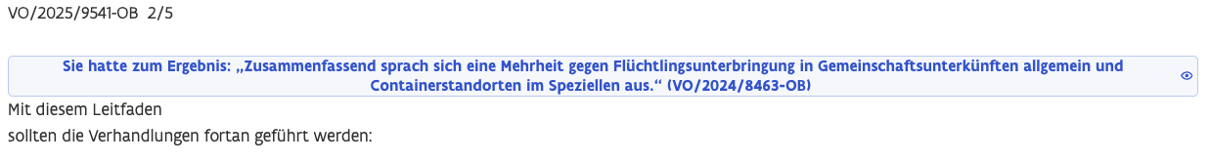
Previous decisions (ext:previousDecisions)
Result in HVT
Expected
VO/2024/8463-OB

Slide 79
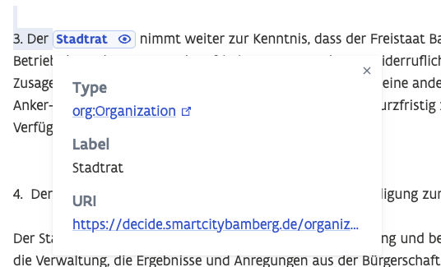
Administrative body
(eli:passed_by)
Result in HVT
Bamberger Stadtrates
Stadtrat
Bamberg
Expected
Stadtrat der Stadt Bamberg (https://decide.smartcitybamberg.de/organizations#d029ed62-8cad-4415-b016-7c07d4cbbc87)

Slide 80
Context location (dct:spatial)
General location that is not the impact location (where the decision has impact on)
Result in HVT
Bayern
Expected
Bayern (https://www.openstreetmap.org/relation/2145268#map=7/48.607/12.129)
Although not linked

Slide 81
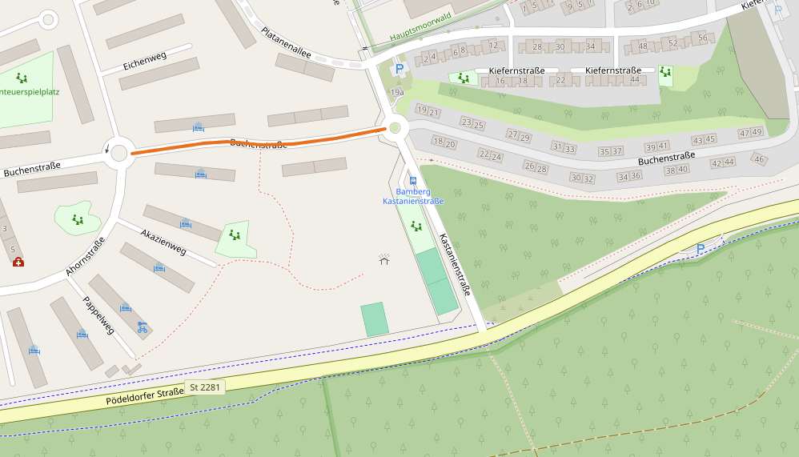
Impact location (prov:atLocation)
Result in HVT
Recycling-/Wertstoffhof Stadt Bamberg, Rheinstraße, Gaustadt, Bamberg, 96052, Deutschland (https://www.openstreetmap.org/node/1272074907)
Expected
Buchenstraße 13/17
Buchenstraße 14/16
eine angrenzende Grünfläche
Buchenstraße (https://www.openstreetmap.org/way/39935904)?

Slide 82
Article (ext:article)
Indicates the article number
Result in HVT
No annotation
Expected
Der Stadtrat nimmt den Vortrag der Verwaltung zur Kenntnis.
Der Stadtrat stimmt dem Verhandlungsergebnis zu.

Slide 83
BEDANKT!

