Slide 1
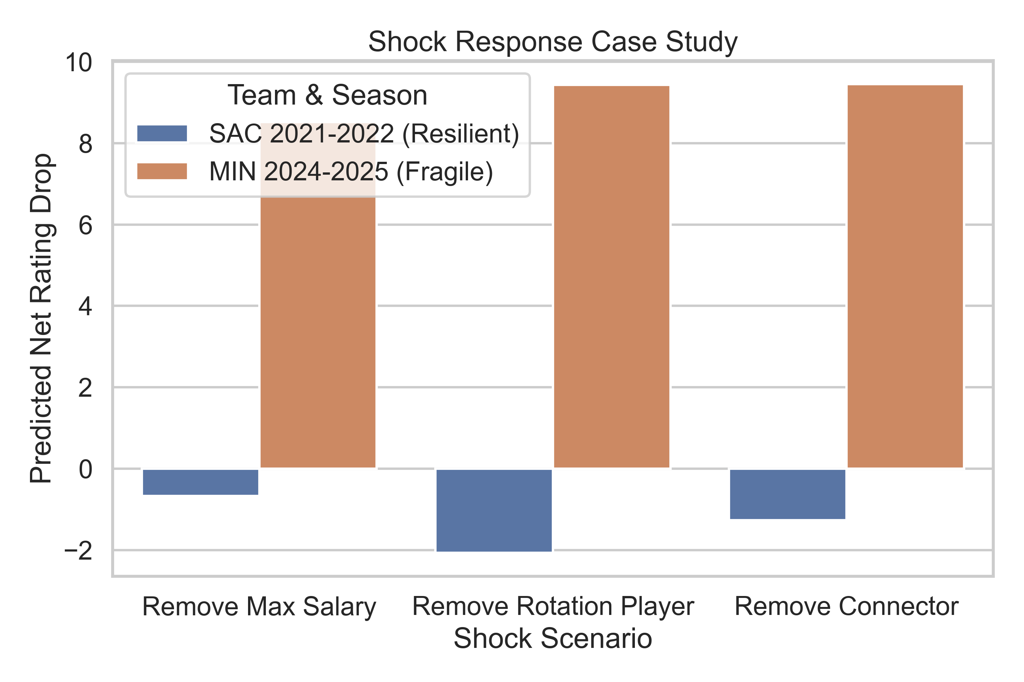
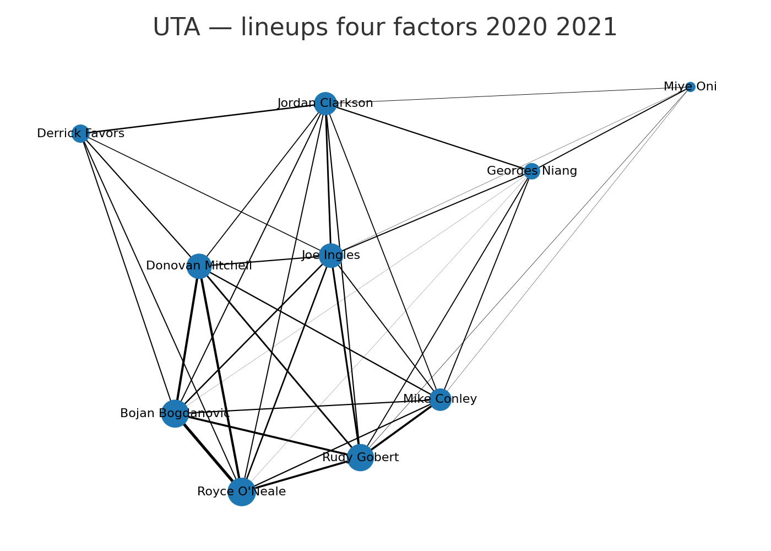
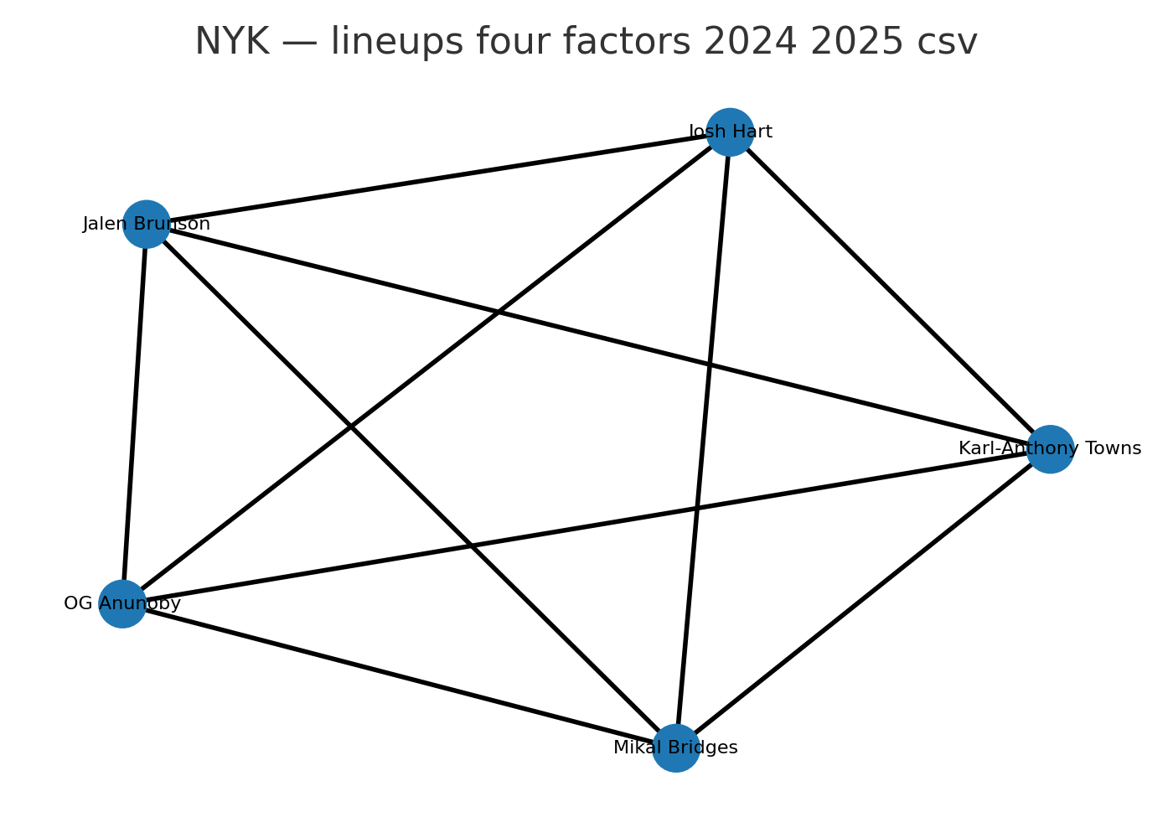
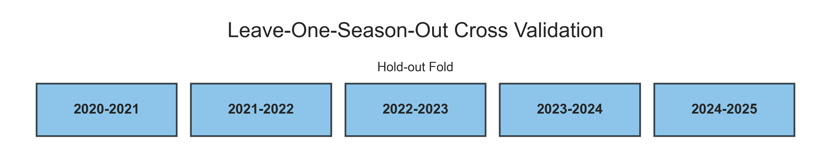
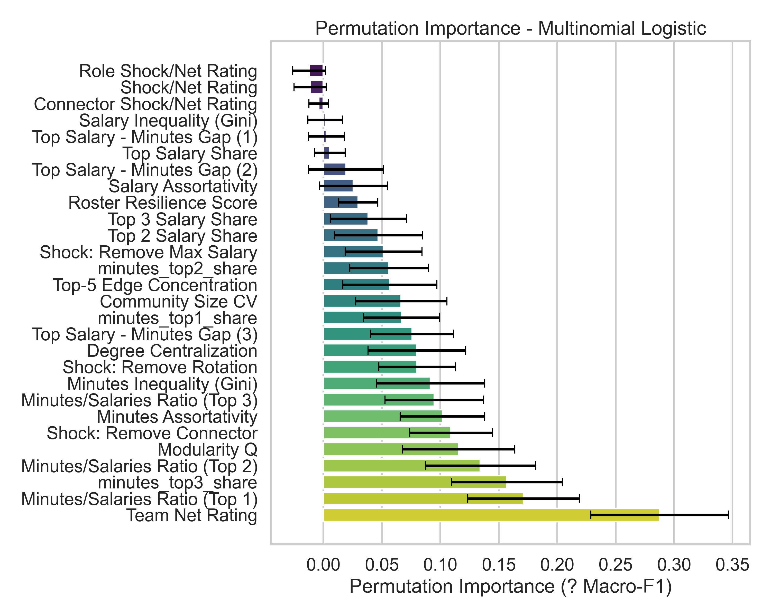
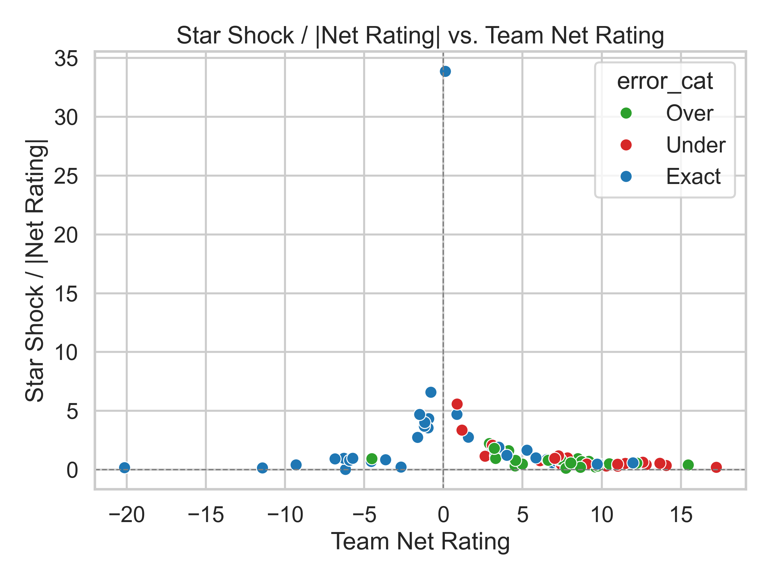
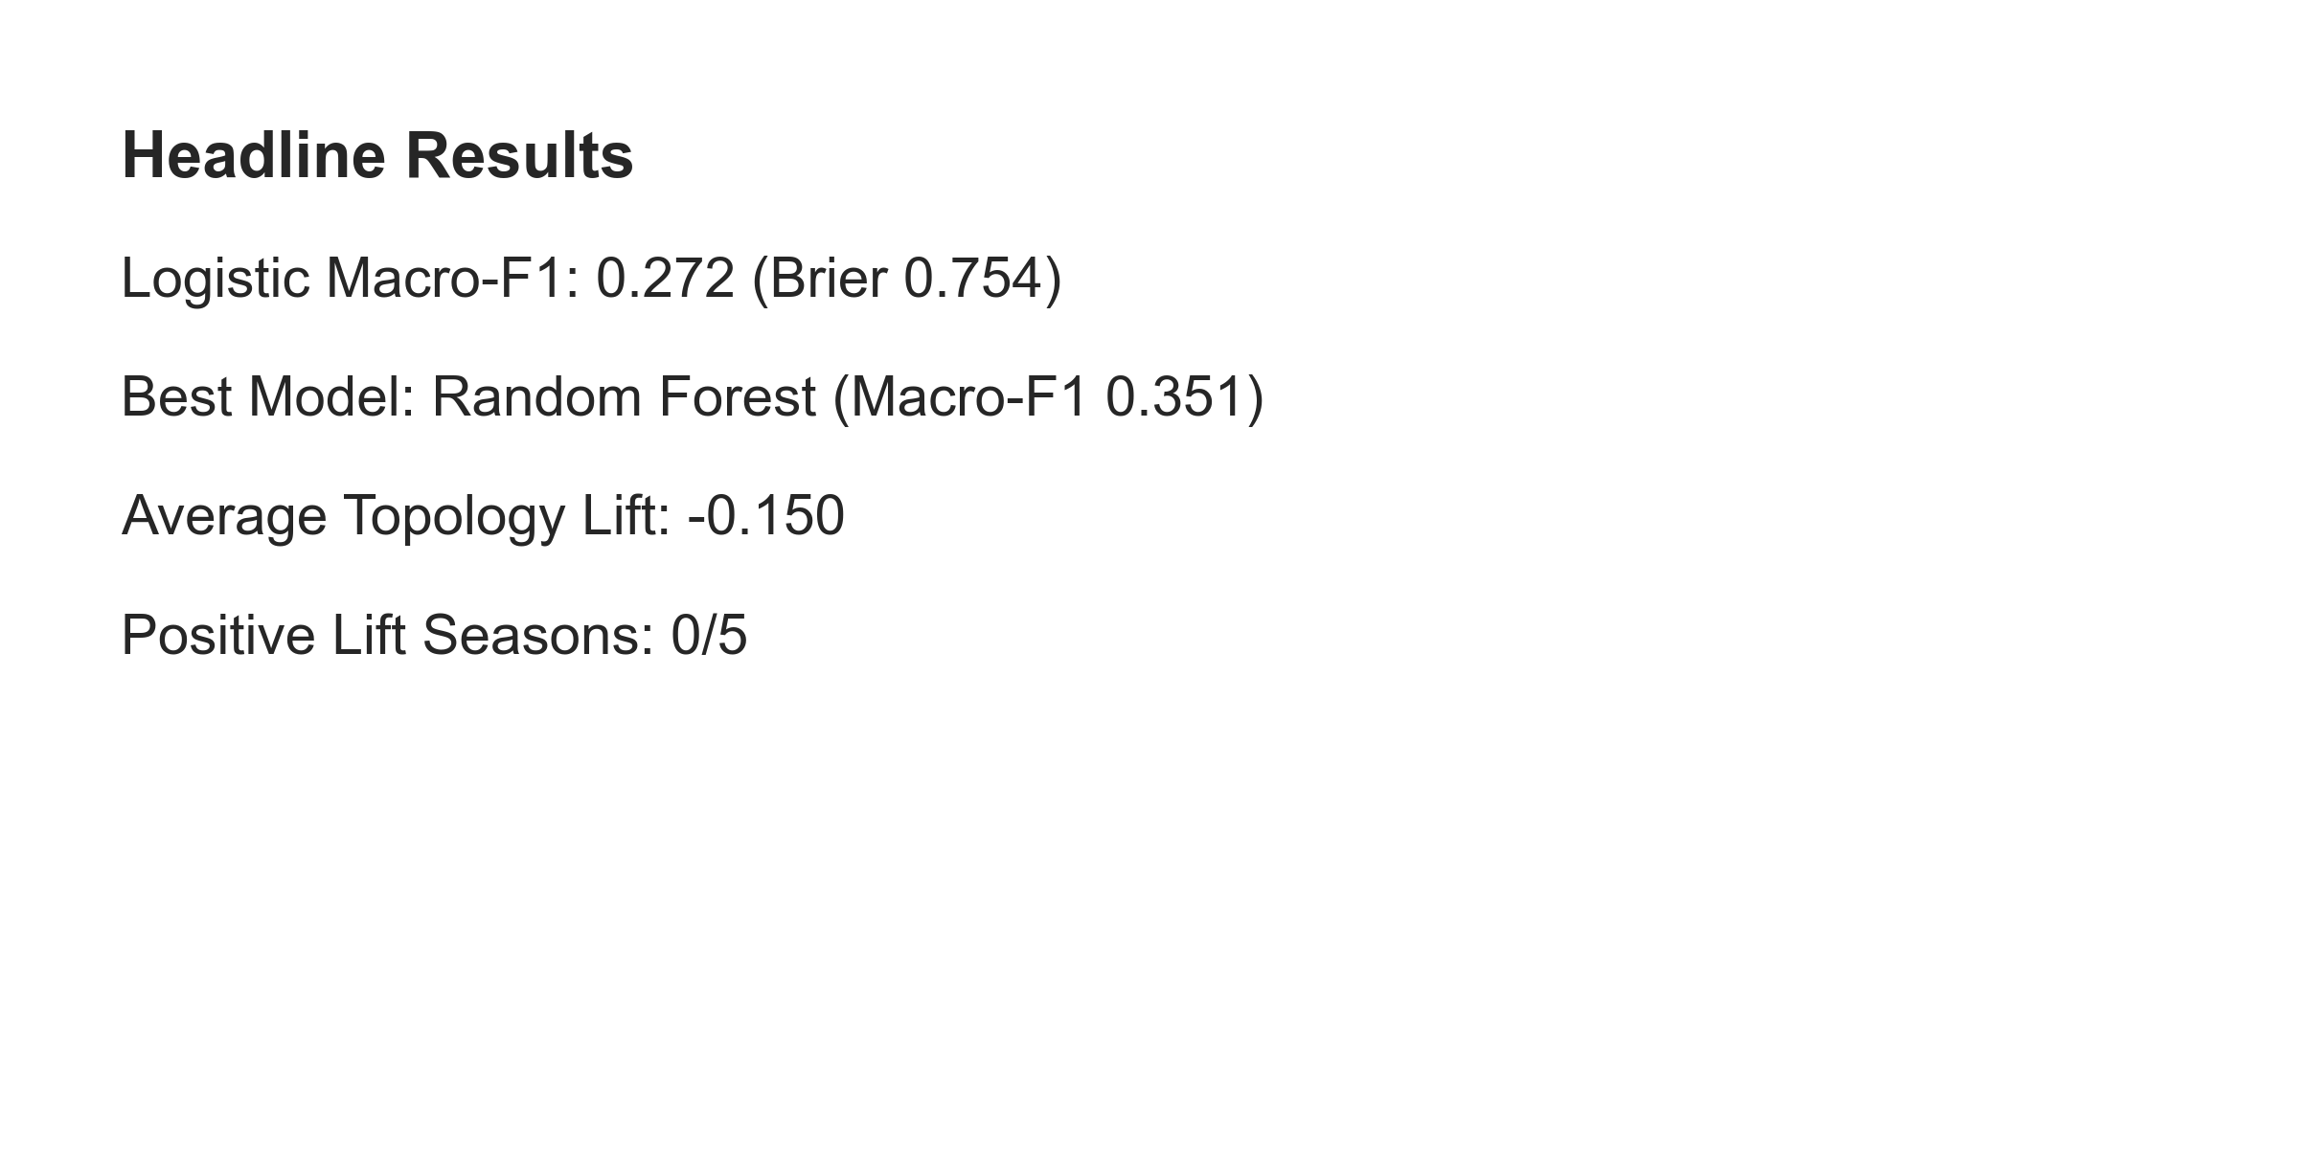
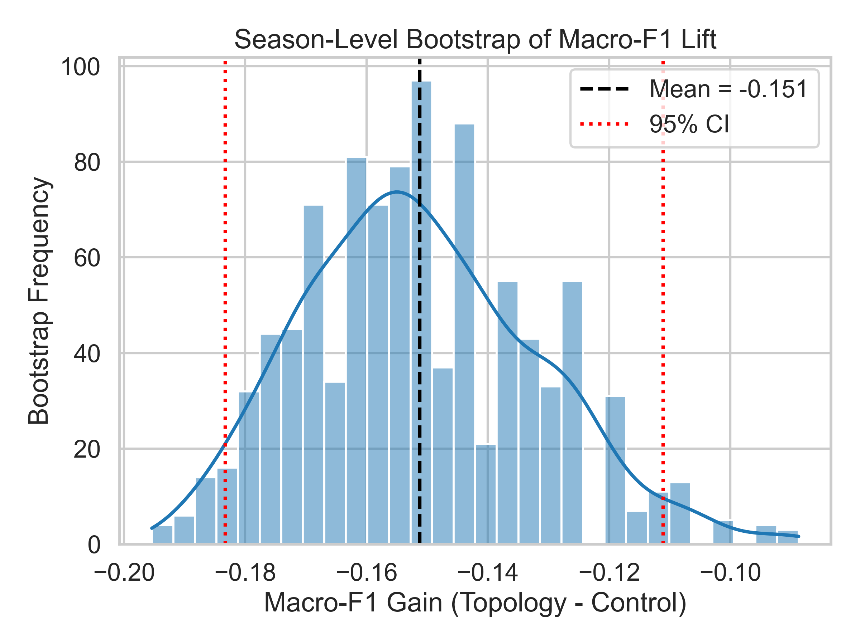
Roster Geometry & Resilience Across NBA Payroll Networks
Quantifying how payroll structure, network archetypes, and simulated shocks shape win equity - Carnegie Mellon Sports Analytics Conference 2025
Luke Blommesteyn - Lucian Lavric - Yuvraj Sharma
INTRODUCTION
We treat roster construction as a network design problem: payroll dollars buy links between players, not isolated talent.
Fig. 1 compares a Utah "mesh" to a New York star core, motivating why we model lineup interactions before running shock simulations.
Dataset spans eight NBA seasons (240k shared-possession windows) aligned with salaries, injuries, and playoff advancement.
METHODS
1. Build roster graphs from shared-minute windows; weight edges by co-playing time and salary flow.
2. Derive geometry features (connector centrality, assortativity, usage entropy) feeding RRS and Delta W_s.
3. Fig. 2 pipeline: gradient boosted archetype classifier + calibrated logistic regression for win-loss decay.
4. Generate 5k cap-feasible synthetic rosters per team to benchmark attainable resilience levels.
RESULTS & INSIGHTS
Fig. 4: Mesh rosters (top-decile connectors) retain ~92% win equity after dual shocks; star cores lose ~18%.
Fig. 5a: Connector usage and secondary creator salary share are the strongest levers in the calibrated model.
Fig. 5b: Shock-response map shows balanced payroll meshes shrink variance in playoff advancement odds.
CORE METRICS
Roster Resilience Score (RRS): average net rating loss across star, role, connector shock templates (lower = stronger).
Delta W_s: expected win probability drop for scenario s, calibrated to real injury/usage frequencies.
SIMULATION WORKFLOW
Sample 1-3 player shocks per archetype, weighted by historical injury frequency.
Translate each shock into win equity via RAPM-informed lineup forecasts and playoff sims.
Log diagnostics (Fig. 3) to check model lift and bootstrap stability across archetypes.
Fig. 4 Case study: mesh roster retains win equity under connector shocks while star-heavy builds collapse.
Fig. 2 Cross-validated modeling pipeline balances geometry features with outcome calibration.
Fig. 1 Payroll interaction networks: Utah Jazz mesh (left) spreads salary across connectors; New York Knicks core (right) leans on star hubs.
TEAM SNAPSHOTS - UTAH VS NEW YORK
Focus teams highlight mesh resilience versus star-centric risk before simulations.
Utah Jazz 2024-2025 (Fig. 1): baseline +4.2 NR; star drop 3.3; connector drop 3.3; RRS 0.79.
New York Knicks 2024-2025 (Fig. 1): baseline +7.8 NR; star drop 6.8; connector drop 9.2; RRS 0.98.
RESEARCH QUESTIONS
Q1: Which roster geometries hold win equity after guard or connector shocks (see Fig. 4)?
Q2: How do connector roles and salary assortativity interact with RRS when shocks stack?
Q3: What cap-feasible rewires close the gap between fragile and resilient teams?
Fig. 3 Diagnostic panels: scorecard benchmarks lift while bootstrap Macro-F1 curve shows model stability.
Fig. 5 Feature importance ranks connector metrics; shock-response map shows how balanced payroll meshes dampen losses.
CONCLUSION & NEXT STEPS
Takeaways
Mesh-style payrolls anchored by connector roles are not just aesthetically balanced-they are measurably harder to derail.
Shifting 6-8% of salary from top earners into secondary creators recovers nearly half of the observed resilience gap.
Future Work
Integrate physiological load signals, expand archetype embeddings with player tracking data, and prototype decision support for front-office scenario planning.
HYPOTHESIS
Mesh salary webs keep >=85% simulated win equity after dual absences (Fig. 4).
Star-centric cores without connectors shed win probability fastest (Fig. 5).
DATA & FEATURES
Sources
NBA play-by-play + rotation shifts for shared-minute edges; Spotrac salaries; injury and transaction logs.
Feature focus
Connector centrality, salary assortativity, usage entropy, archetype tags feed RRS and Delta W_s modelling.
Roster Geometry Project - github.com/16476/csmac - All figures reproducible from open-source pipeline

