Slide 1
GMLC 1.4.23 Adaptive control of inverters to restabilize distribution-network voltage after a cyberattack
Daniel Arnold dbarnold@lbl.gov
Shammya Saha shammya.saha@asu.edu
Nathan Tsang nathan_tsang@lbl.gov
Sean Peisert sppeisert@lbl.gov
August 15th, 2018

Slide 2
Overview
Simulation flow diagram
Cyberattack modeling
Results

Slide 3
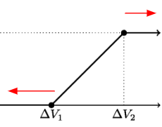



Simulation flow diagram
V_{k-1}
psi_{k-1}
ep_{k-1}
filtVolt_{k-1}
threshold
u_{k-d}
V_{k-d}
V_{k}
V_{k}
HPF
x²
LPF
evaluate
$$\int{x}$$
psi_{k}
ep_{k}
filtVolt_{k}
u_{k}
instability observer
adaptive controller
loads_{k}
V_{k-d}
V_{k-1}
Z
V0_{k}
$γ$_{k-1}
V_{k+1}
evaluate
p_{k}
evaluate
LPF
delay
$γ$_{k}
VBP_{k-d}
VBP_{k}
q_{k}
power flow
Inverter model
Volt-VAR; Volt-Watt

Slide 4
Cyberattack modeling
α
s_{k}
not-hacked inverters
cyberattack
power flow
V_{k}
X
s_{k}
business as usual
1-α
X
hacked inverters

Slide 5
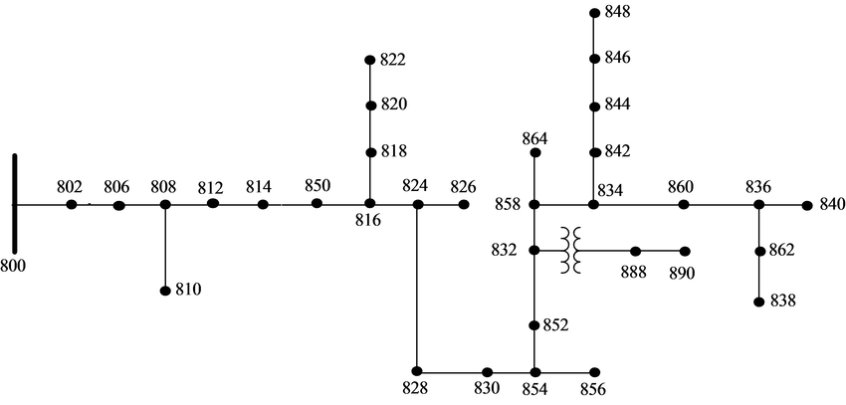
IEEE 34 bus feeder
Not compromised
Compromised*
*meaning 1-100% of inverters are compromised
1
2
3
5
4
9
10
13
12
11
6
8
7

Slide 6
Scenario 1: no hack
Nodes with compromised inverters:
Percent hacked: 0%
Time step of hack: n/a
Load scaling factor: 1.5
Generation scaling factor: 5
Slack bus voltage: 1.04
Gain: 100
Delay: 10 / 60 seconds
VBP (uncompromised – initial): 1.01, 1.03, 1.03, 1.05
VBP (compromised): 1.01, 1.015, 1.015, 1.02

Slide 7
Scenario 2: 10% hacked at each node
Nodes with compromised inverters: 822, 822m, 824, 826, 826m, 828, 828m, 830, 834, 836, 838, 838m, 840
Percent hacked: 10%
Time step of hack: 300
Load scaling factor: 1.5
Generation scaling factor: 5
Slack bus voltage: 1.04
Gain: 100
Delay: 10 / 60 seconds
VBP (uncompromised – initial): 1.01, 1.03, 1.03, 1.05
VBP (compromised): 1.01, 1.015, 1.015, 1.02

Slide 8
Scenario 3: 50% hacked at each node
Nodes with compromised inverters: 822, 822m, 824, 826, 826m, 828, 828m, 830, 834, 836, 838, 838m, 840
Percent hacked: 50%
Time step of hack: 300
Load scaling factor: 1.5
Generation scaling factor: 5
Slack bus voltage: 1.04
Gain: 100
Delay: 10 / 60 seconds
VBP (uncompromised – initial): 1.01, 1.03, 1.03, 1.05
VBP (compromised): 1.01, 1.015, 1.015, 1.02

Slide 9
Scenario 4: 50% hacked at each node
Nodes with compromised inverters: 822, 822m, 824, 826, 826m, 828, 828m, 830, 834, 836, 838, 838m, 840
Percent hacked: 50%
Time step of hack: 300
Load scaling factor: 1.5
Generation scaling factor: 6
Slack bus voltage: 1.02
Gain: 100
Delay: 10 / 60 seconds
VBP (uncompromised – initial): 1.01, 1.03, 1.03, 1.05
VBP (compromised): 1.01, 1.015, 1.015, 1.02

Slide 10
Scenario 5: 20% hacked along main lateral
Nodes with compromised inverters: 824, 828, 828m, 830, 834, 836, 840
Percent hacked: 20%
Time step of hack: 300
Load scaling factor: 1.5
Generation scaling factor: 5
Slack bus voltage: 1.04
Gain: 100
Delay: 10 / 60 seconds
VBP (uncompromised – initial): 1.01, 1.03, 1.03, 1.05
VBP (compromised): 1.01, 1.015, 1.015, 1.02

Slide 11
Scenario 6: 50% hacked along main lateral
Nodes with compromised inverters: 824, 828, 828m, 830, 834, 836, 840
Percent hacked: 50%
Time step of hack: 300
Load scaling factor: 1.5
Generation scaling factor: 5
Slack bus voltage: 1.04
Gain: 100
Delay: 10 / 60 seconds
VBP (uncompromised – initial): 1.01, 1.03, 1.03, 1.05
VBP (compromised): 1.01, 1.015, 1.015, 1.02

Slide 12
Scenario 7: 100% hacked at terminal
Nodes with compromised inverters: 836, 838, 838m, 840 Percent hacked: 100%
Time step of hack: 300
Load scaling factor: 1.5
Generation scaling factor: 5
Slack bus voltage: 1.04
Gain: 100
Delay: 10 / 60 seconds
VBP (uncompromised – initial): 1.01, 1.03, 1.03, 1.05
VBP (compromised): 1.01, 1.015, 1.015, 1.02

Slide 13
Scenario 8: 100% hacked (7 random nodes)
Nodes with compromised inverters: 822, 824, 826m, 830, 834, 836, 838m
Percent hacked: 100%
Time step of hack: 300
Load scaling factor: 1.5
Generation scaling factor: 5
Slack bus voltage: 1.04
Gain: 100
Delay: 10 / 60 seconds
VBP (uncompromised – initial): 1.01, 1.03, 1.03, 1.05
VBP (compromised): 1.01, 1.015, 1.015, 1.02

