Slide 1
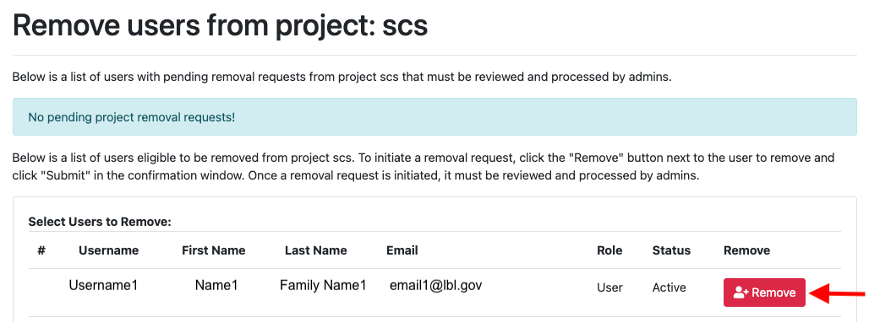
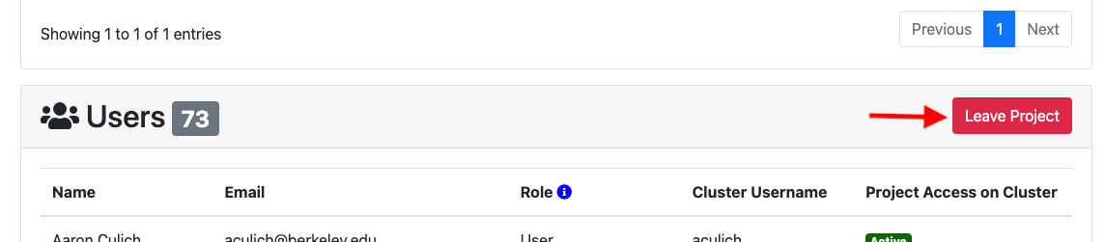
PI/manager request to remove a user from project.
User’s request to Leave Project

