Slide 1

Python script Overview How To
L. Bodenstein-Dresler¹, M v.d. Merve¹, F. Mentzel²
¹ Dept. Interface Design, Helmholtz-Zentrum Berlin für Materialien und Energie GmbH
² TU Dortmund

Slide 2
What to do
With this presentation I want to give a short overview about the written python program, how it works, what to prepare for the fitting, possible problems, and how to extract the data later
The folder Fitting_at_HZB can be found in the group folder under python
The slides sometimes have a lot of text on it so see it more like a manual/guide then a presentation.

Slide 3
Used scripts
_{Pre-set parameters/programms}
Please install python 3.8.
Either as a virtual machine
Or as a single program (I used PyCharm from Anaconda)
If using a VM (like the one on the PC Will provided me with @ EMIL:
Open a terminal in the folder where the VM is in
→ $ source env/bin/activate
(the $ means insert in the terminal)
Necessary packages/commands for the command line:
pip install wheel
pip install matplotlib
sudo apt-get install python3-tk
pip install numpy
pip install pandas
pip install pyyaml
pip install glob2
pip install lmfit

Slide 4
XPS analysis
Fitting

Slide 5
Used scripts
_{Analysis}
Copy the folder Fitting_at_HZB to a location of your choice on your device
It consists of the subfolder: plots_scripts, results
The files in the main folder are: Fitting_testing_MvD_LBD.py, Inputs_fit.yaml, param.yaml, Result_analysis.py, Inputs_ana.yaml, Analysis_data_exporting.py
Do not change the file names in the plots_scripts-folder! If you do, the script will not find the references and will not work anymore
2. Prepare the data-file
can be in a different folder
3. Prepare the param-file
can be moved to a different folder
4. Prepare the Inputs_fit-file
can be moved to a different folder
5. Start the Fitting

Slide 6
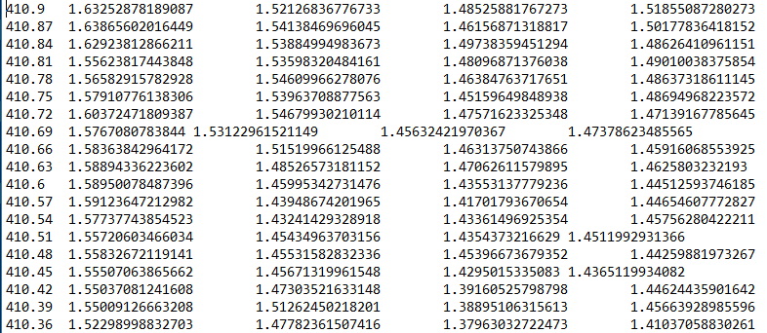
Used scripts
_{data-file}
This file consist of the data you want to fit. If you do not have everythoing in one file but as single files in a folder, see slide 10.
If a header (lines above the spectra) is used note the number of rows (see slide 10)
1st column: energy axis
Can be BE or KE
2nd column: spectra 1 (0)
2nd column: spectra 2 (1)
spectra nr later used in the param-file. As in all programing languages, it goes from [0,…,n-1]

Slide 7
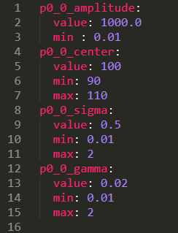
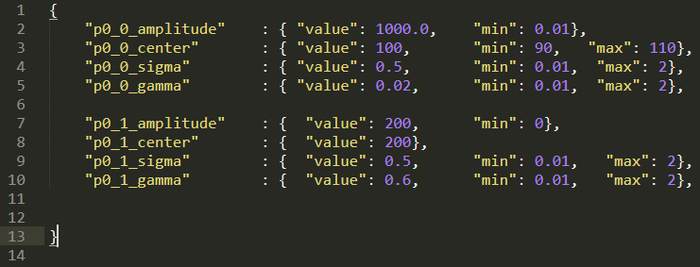
Used scripts
_{param-file}
In this file you prepare the fit parameters for the spectra.
It can be either be a .yaml file or a .json type. I´ll cover the .yaml here. (.json wasn´t tested a long time but work the same way)
This is important! The code will crash, if the amplitude/area will get 0 since we will divide by it later!
Do not forget the {} for this type of file

Slide 8
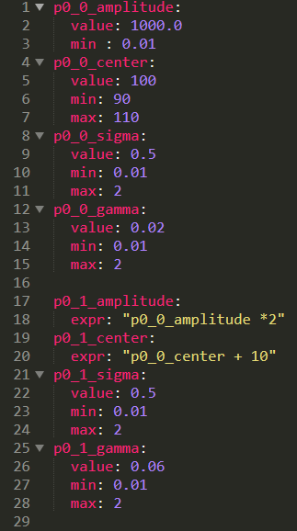
Used scripts
_{param-file}
Meaning of all naming: p0_0_XXX
The first 0 is the spectra nr to which these parameters belong. Starting with 0 counting to n-1
The 2nd 0 is the peak nr in the spectra. Normally the same peaks in all spectra are assigned to the same oxid state.
With the XXX you can change specific properties of the peak.
amplitude: is the area of the peak (not the absolute height!) in theory you could also change the height, but since physically the area stays the same not the height we choose this
center: the energy where the peak is located
sigma: width of the peak, originates for the Voigt model
gamma: broadening (?), also comes from the convolution
This file can be reused if you have similar samples with more or less the same starting params.

Slide 9
Used scripts
_{param-file}
Meaning of all naming: p0_0_XXX
With the XXX you can change specific properties of the peak.
amplitude: is the area of the peak (not the absolute height!) in theory you could also change the height, but since physically the area stays the same not the height we choose this
center: the energy where the peak is located
sigma: width of the peak, originates for the Voigt model
gamma: broadening (?), also comes from the convolution
There you can input the following parameters
value: the absolute value of the parameter. Only numbers are allowed!
expr: to link parameters. Works as a string (“xxx” where you can insert mathematical expressions
min, max: lower/upper bound of it. Only necessary if values are given
vary: a bool with either True or False (not shown here). With this you can also fix the parameter to a specific value (True is the default setting → means it can change during the fitting)
Note: you do not have to pre-set every number exactly in the beginning! You get the chance to do so later in the .py script. But: you´ll not be able to exchange /add parameters (value to expr or add min, max)! This has to be pre-set

Slide 10
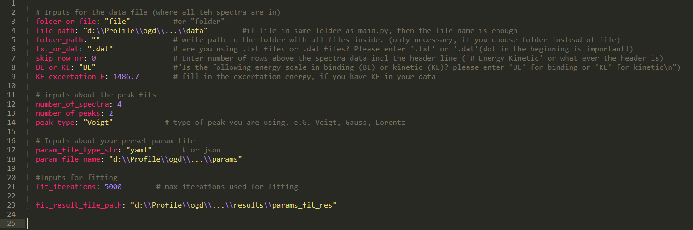
Used scripts
_{Intpus_fit-file}
The Inputs file looks like this. Fill out the fields with the red arrow
Explanation to what what means is written as a comment next to it

Slide 11
Used scripts
_{param-file}
Possible differences for you:
Line 3: if you do not have all spectra in one file but one folder → change it to “folder” and insert the path of the folder in line 5 (follow the instructions of the .py file command lines then)
Line 6: if your spectra file is not a .dat but a .txt file change it there (do not forget the dot)
Line 7: if you have something written above the actual spectra data: skip these rows here (see slide 5)
Line 8&9: if your spectra is fresh out of the analyzer and you didn’t put the BE energy axis (column) in the file, here you can set it to “KE” and preset the excertation energy (I know its written wrong but I´m to lazy at the moment to change it in the code)…

Slide 12
Used scripts
_{param-file}
Possible differences for you:
Line 12: insert the number of spectra you want to fit. Note: it’s the actual value and not counted from 0! So 4 spectra and not 5 in the example here.
Line 13: insert the number of peaks you want to use for fitting. This number is the same for all spectra.
So if you want to fit different numbers of peaks for each spectra, still put the max amount in the param-file and just set the amplitude: 0.001 with vary: False
Line 14: If you want to use a different type of peak, change it here. Now included: “voigt”, “lorentz”, “gauss”. Later: “doniach” (@ Marianne todo in Shirley_fkt_build.py line 95)
The path´s are self explanatory
Same for fit iterations

Slide 13

Used scripts
_{Fitting_testing_MvD_LBD-file}
You´ll start the Fitting_testing_MvD_LBD.py in the console.
Enter the path of your Inputs_fit-file
After this all peak parameters are loaded. Then you can choose if you want to check the preset parameters spectra by spectra or not. Insert “y” or “yes” (w/o the “”) to do so
Then choose the spectra you want to look at. Counting from 0!
After this all the params are reloaded.. And a plot of the preset params emerge

Slide 14
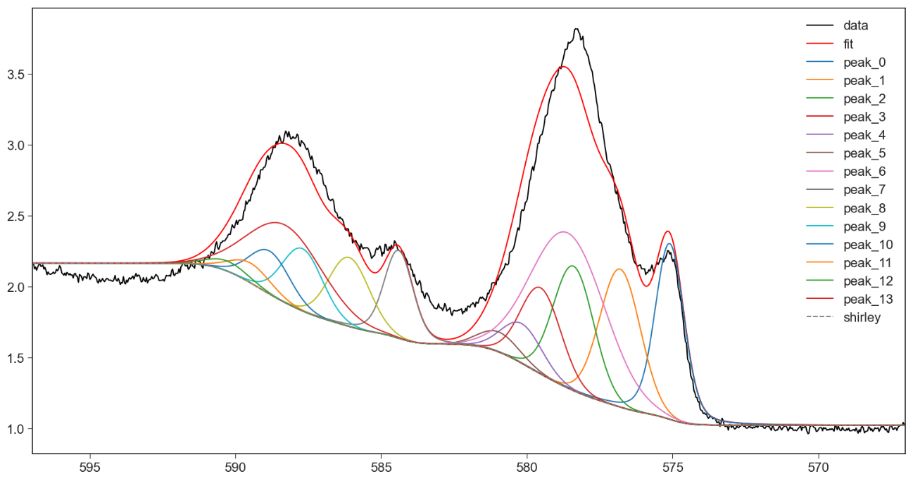

Used scripts
_{Fitting_testing_MvD_LBD-file}
A spectra will be shown with the pre-set params.
If you are not satisfied with it and want to change the parameters, do so, save the param-file and then enter “n”/”no”.
The new param values will be loaded and the same plot will be shown again

Slide 15
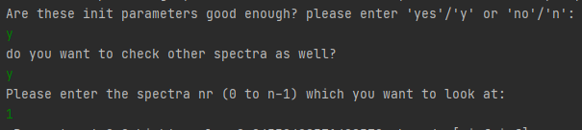
Used scripts
_{Fitting_testing_MvD_LBD-file}
A spectra will be shown with the pre-set params.
If you close it you´ll be asked if you want to check other spectra as well and everything repeats

Slide 16
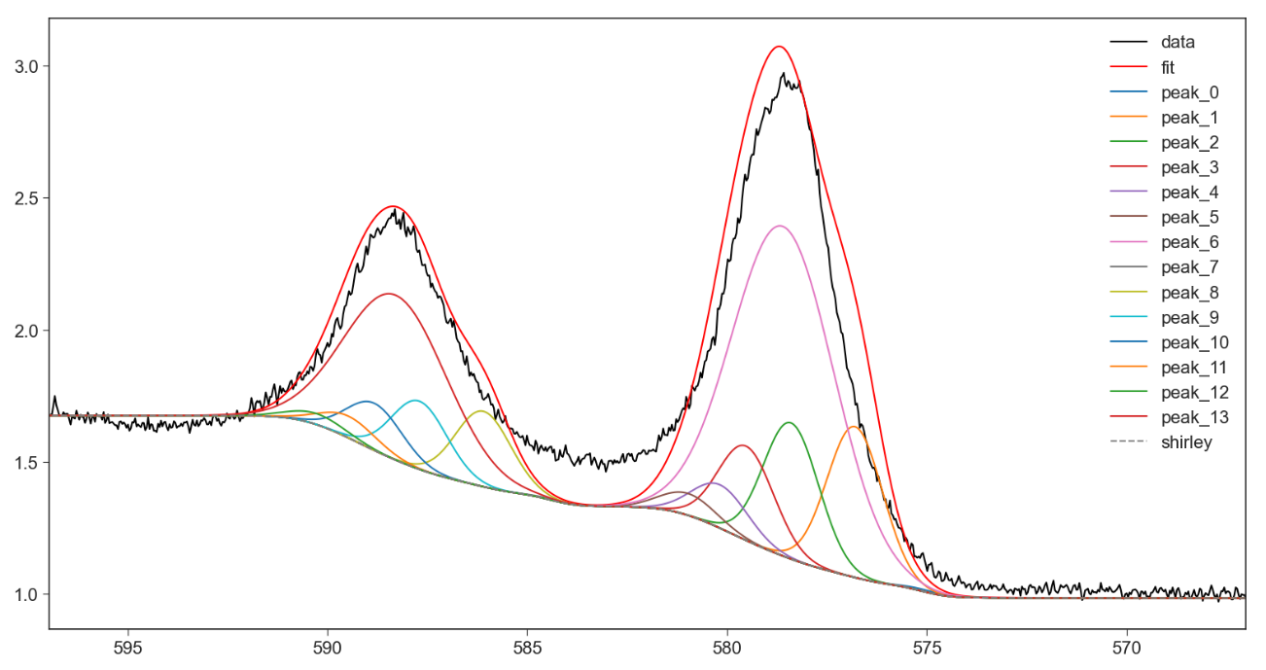
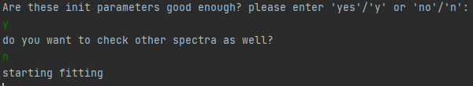
Used scripts
_{Fitting_testing_MvD_LBD-file}
A spectra will be shown with the pre-set params.
If you are finished and satisfied with all spectra first answer “y”/”yes” then “n”/“no” with this you´ll end the param checking loop and the fitting starts

Slide 17

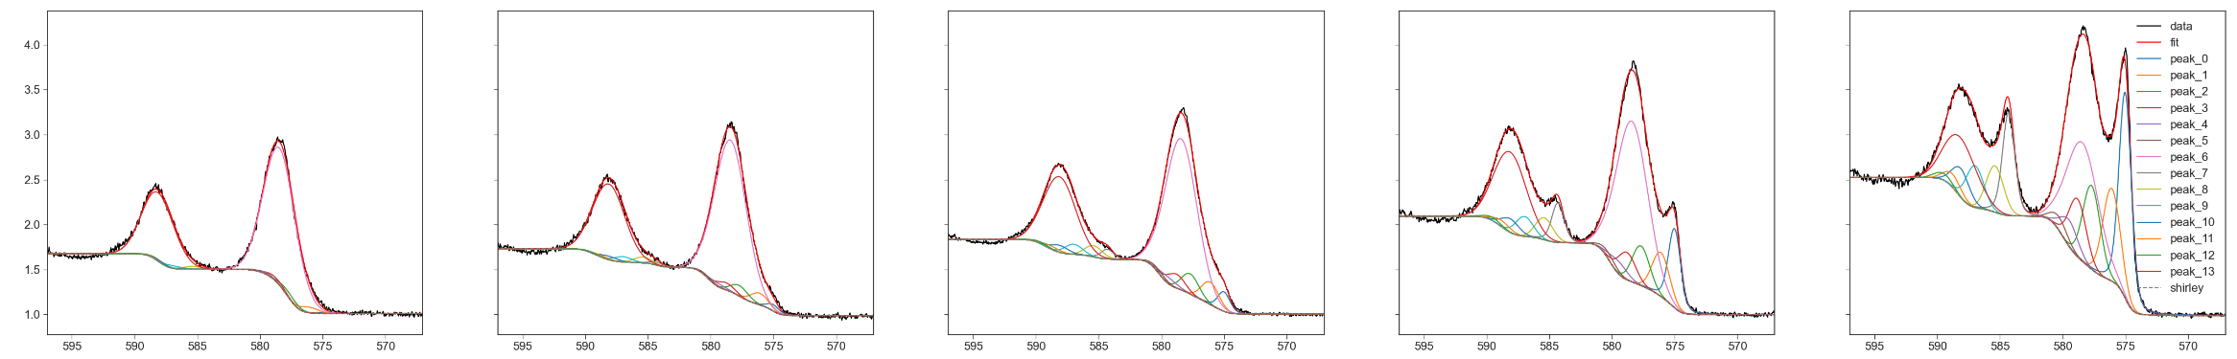
Used scripts
_{Fitting_testing_MvD_LBD-file}
After the fitting ended you can choose how many and how you want to look at the result spectra. Imagine the plots on a x-y grid. There you can choose how many you want to look at once (absolute numbers not programmers counted. In the example here we will get 5 spectra in 1 row).
You can also not look at all if you want to, but the most top left spectra will always be the 1st (0th)!

Slide 18
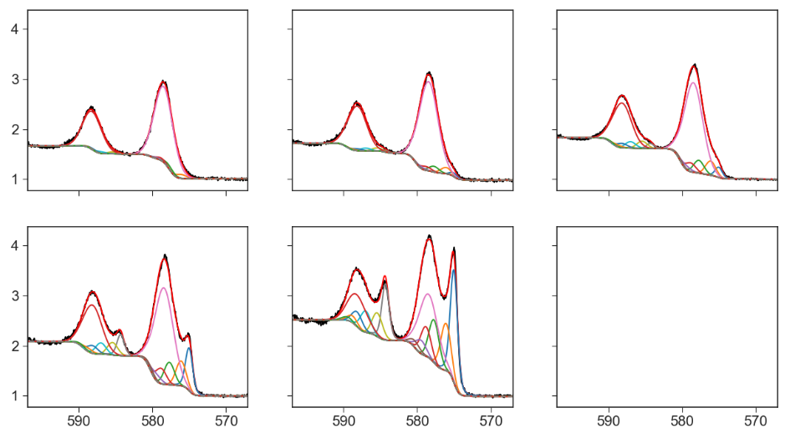
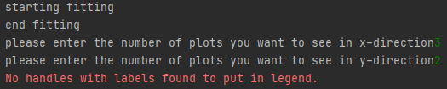
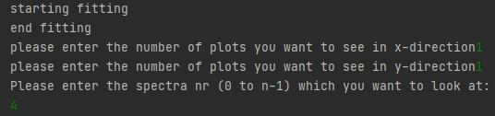
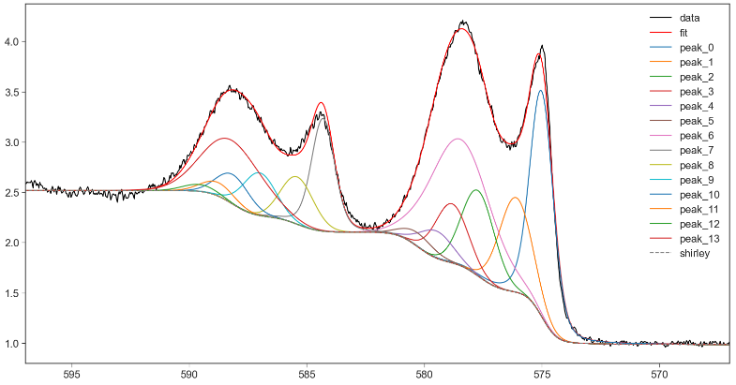
Used scripts
_{Fitting_testing_MvD_LBD-file}
You can also change the plotting style. If you want to look at it in a more matrix style: you can also enter it in the following way. If there are more canvases than spectra the remaining will be left empty
Note, with this option the legend will not be shown
Bc. the program wants to get it from the last canvas which is empty.
A 3rd possibility is to just enter x=1, y=1, then you can look at a specific spectra which you can choose then (n-1). But keep in mind, that this is the only spectra you´ll see.

Slide 19
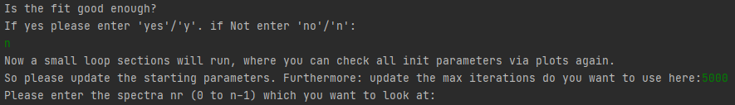
Used scripts
_{Fitting_testing_MvD_LBD-file}
There you can choose if the fits are good enough. If not enter “n”/”no”. Then you can choose to increase the fit iterations and change the parameters again (starting from slide 12 again)
If you are satisfied enough enter “y”/”yes” and the program will save all resulting params in the result_param-file

Slide 20
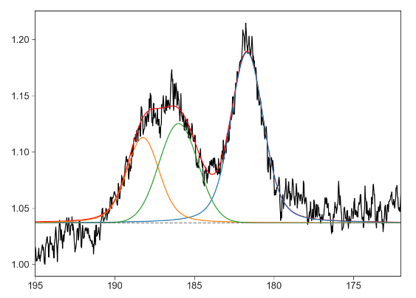
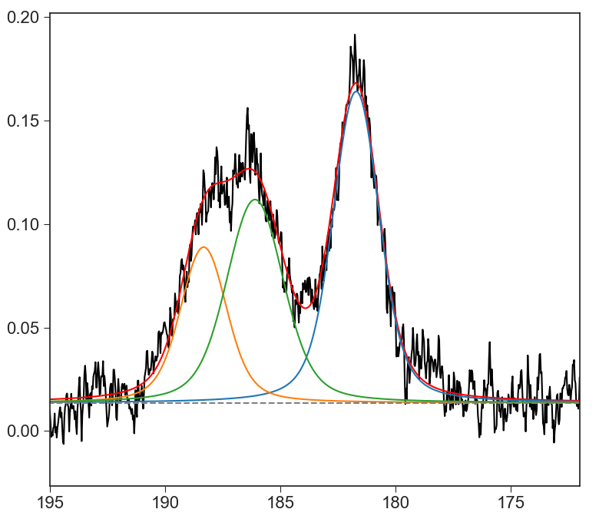
Used scripts
_{Fitting_testing_MvD_LBD-file}
Possible errors:
The Program works that way, that the right side is the lowest intensity (like it physically should be). The Shirley then is like a step function which adds intensity to match with the left. → If the left side is lower than the right side the fitting might not work well. Therefore for some special cases subtract a liner function before hand and then fit it again.
← lin. fkt sub
BE BE
Sometimes the fit doesn´t seem to fit/change at all. Then the pre-set parameters aren´t good enough and the program doesn´t see any changes while fitting so it aboards it

Slide 21
XPS analysis
End of fitting

Slide 22
Used scripts
_{Analysis & Export}
Start the analysis file Result_analysis.py, or Analysis_data_exporting.py
with
Result_analysis.py: For ratio, error calculations (in matrix style). A bit more complicated and pre-work to do. (Not shown here jet. Might be included later)
Analysis_data_exporting.py: For exporting the fitted data as spectra ready to import it
into Origin, as well as the peak areas of the oxid states for all spectra
For this you need to
1. Prepare the data-file (where all the spectra are in)
can be in a different folder
2. Prepare the result_param-file (from the fitting)
can be moved to a different folder
3. Prepare the Inputs_ana-file (can be included into the Inputs_fit-file)
can be moved to a different folder
4. Start the analysis

Slide 23
XPS analysis
Analysis

Slide 24
Used scripts
_{Result_analysis-file}
This script does the (complete) analysis for you. It
Imports the parameters from the result file
Can analyze the data
The areas of the oxidation states (up to 3)
Calculate the ratios to another element (with cross sections, IMFP, TF included)
The location of your (main) peaks
Much more (more detailed later)
Plot the ratios
Export all the things above in a “matrix” like style
For this you need to add some stuff to your Inputs file/create a new one called Inputs_ana
Might be included later

Slide 25
XPS analysis
Export

Slide 26
Used scripts
_{Analysis_data_exporting-file}
This script
Imports the parameters from the result file
Exports the areas of the peaks & oxid states for each spectra
Plots each spectra
Exports all peaks from the plot in a txt file with each spectra as a single column, which then can be imported into Origin for other visualisation if wanted. The columns are:
Energy
Spectra_i + Shirley BG
Shirley BG (alone if one wants to subtract it later)
Fit (sum of all peaks + Shirley)
For this you need to add some stuff to your Inputs file/create a new one called Inputs_ana

Slide 27
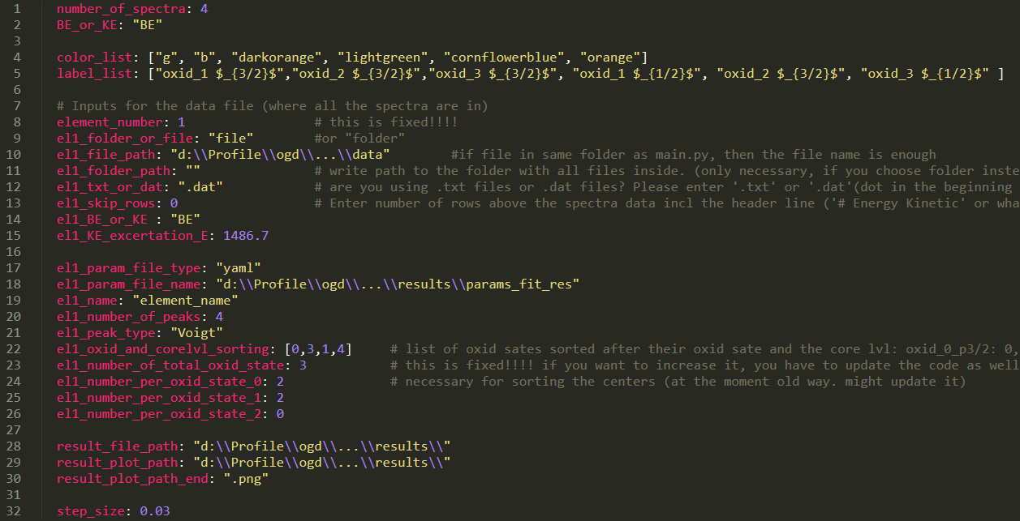
Used scripts
_{Analysis_data_exporting-file}
The Inputs file looks like this. Fill out the fields with the red arrow

Slide 28
Used scripts
_{Inputs_ana-file}
Possible differences for you:
Line 1: number of spectra you fitted
Line 5: update the label list. Replace the oxid_X with an element etc.
Line 9,10&12: path to the same data-file you used before (same as in Inputs_fit)
Line 18: the path to the result_param-file you got from fitting
Line 19: change the element name to e.g. O1s (this will occur later in the naming of the result files)
Line 20: as before change the number of peaks

Slide 29
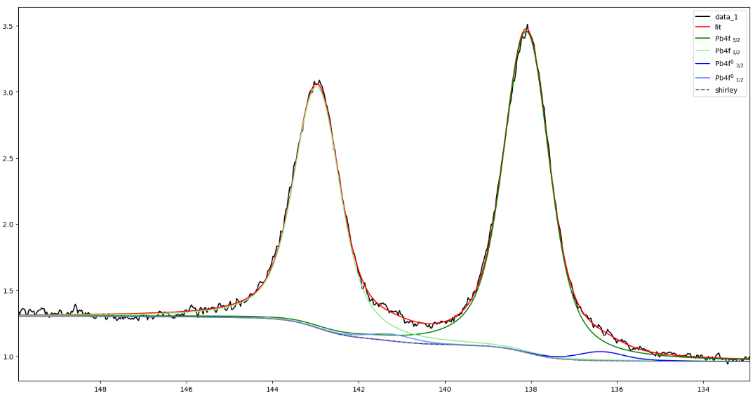
Used scripts
_{Inputs_ana-file}
Line 22: This list represents the pi_idx_XXX from your peaks. The 1st position is p0_0, the 2nd p0_1 etc.
([p0_0, p0_1, p0_2, …]). The value in this list points to the position of the color_list and label_list (line 4&5) with 1st position=0.
Example:
el1_oxid_..: [0, 3, 1, 4]
label_list: [ox_1₁, ox_2₁, ox_3₁, ox_1₂, ox_2₂, ox_3₂]
color_list: [“g”, “b”, “o”, “lg”, “lb”, “lo”]
Of cause you can change the orders and colors how you like it (as long as |list| <=6!)

Slide 30
Used scripts
_{Inputs_ana-file}
Line 24-26: The same way you add change the number of peaks to the corresponding oxid sates (can be more than 2)
Line 28&29: insert path
Line 32: change step size if necessary
The el1 means element number (set in line 8). For the ratio calculation el2 will be used. (see Result_analysis part)

Slide 31
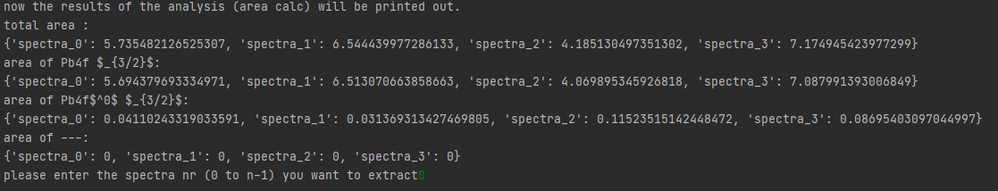

Used scripts
_{Result_analysis-file}
After this the results are printed out:
With the total areas of all oxid states (el1_oxid_[..]-list value: [0;2]) and for each oxid state singularly (el1_oxid_[..]-list value: [0, 1, 2]). If some peaks get the same number assigned, they get added as well
“spectra_i” here corresponds to the pi_idx_XXX
After this you can choose which spectra you
want to plot & extract which then has this kind of header and order

Slide 32
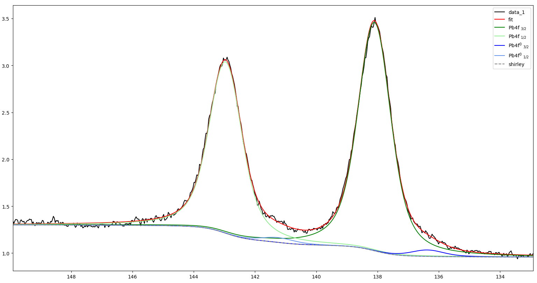
Used scripts
_{param-file}
After this you can choose which spectra you
want to plot & extract
Note the names & colour of the peaks

