Slide 1

A06 Game Treatment
Canadian Donut (Luke Bodwell and Gavin Taylor)

Slide 2
Game Title: Corona Cure
Log line: Avoid the sick for a corona vaccine.

Slide 3
Essential Features
Different maze-like levels to search for items
Green squares represent infected people
Pink squares represent helpful items such as health
Yellow squares represent the cure, of which you need 5 to successfully create the cure
If you get touched by infected people, then you lose health for each time they touch you
Impact sounds will be for taking damage, one chip-tune of some sort will be for gaining health, and a second will be for picking up vaccine pieces.

Slide 4
Artist Statement
The premise of this game is to put the player in the shoes of the health care works that are working day in and out to help find a cure for this virus. With enemies that resemble infected people always gravitating towards them, you get a sense of the struggle that is constantly being around sick people while trying to help them. In addition to keeping things semi-realistic, the process to developing a cure takes time with multiple discoveries, so thus the player needs to find numerous pieces to the cure to create the vaccine.

Slide 5
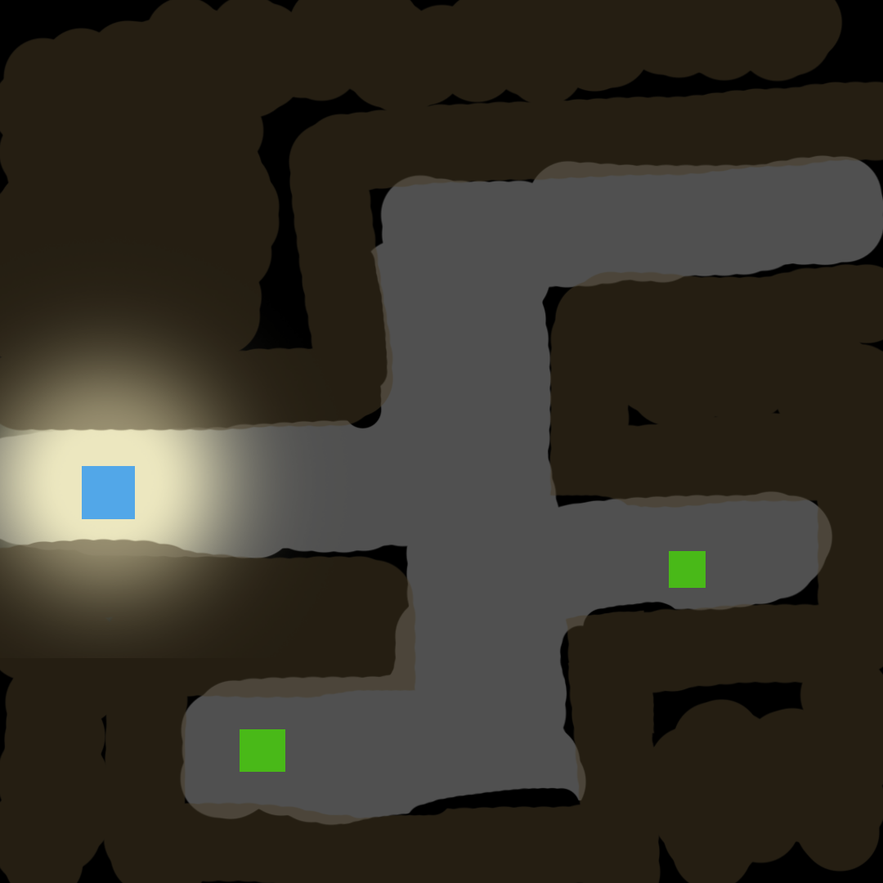
Screen Mockup 1
Main Player
Infected people

Slide 6
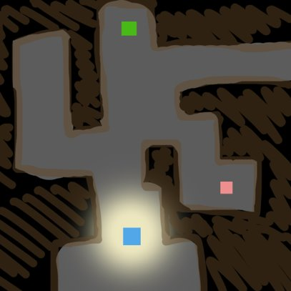
Screen Mockup 2
Health

Slide 7
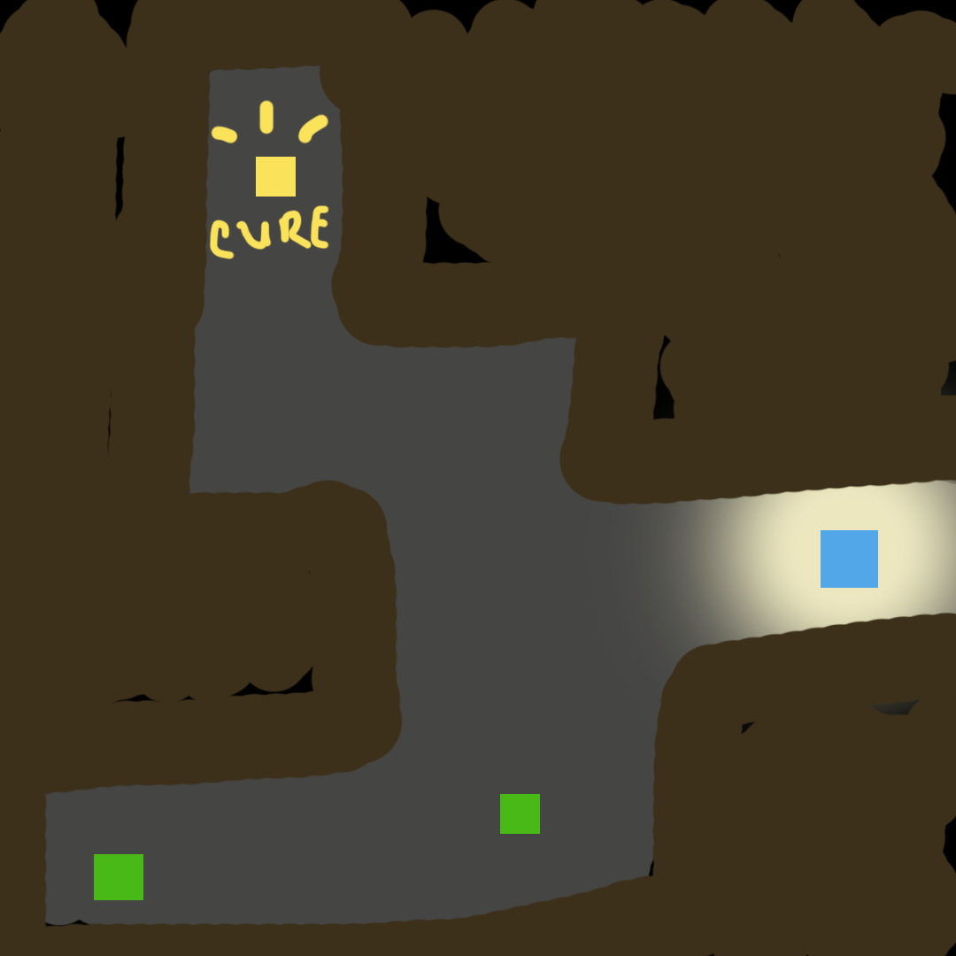
Screen Mockup 3
Piece of the vaccine

