Slide 1

A10 Game Treatment
Canadian Donut (Luke Bodwell and Gavin Taylor)

Slide 2
Game Title: Corona Cure
Log line: Avoid the sick for a corona vaccine.

Slide 3
Essential Features
Different maze-like levels to search for items
Red squares represent infected people
Purple squares represent health pickups
Green squares represent pieces of a vaccine
If you get touched by infected people, then you lose health for each time they touch you
The yellow area in the first level is the base where you bring all the vaccines to create the cure

Slide 4
Artist Statement
The premise of this game is to put the player in the shoes of the health care workers that are working day in and out to help find a cure for this virus. With enemies that resemble infected people always gravitating towards them, you get a sense of the struggle that is constantly being around sick people while trying to help them. In addition to keeping things semi-realistic, the process to developing a cure takes time with multiple discoveries, so thus the player needs to find numerous pieces of the vaccine to create the cure.

Slide 5
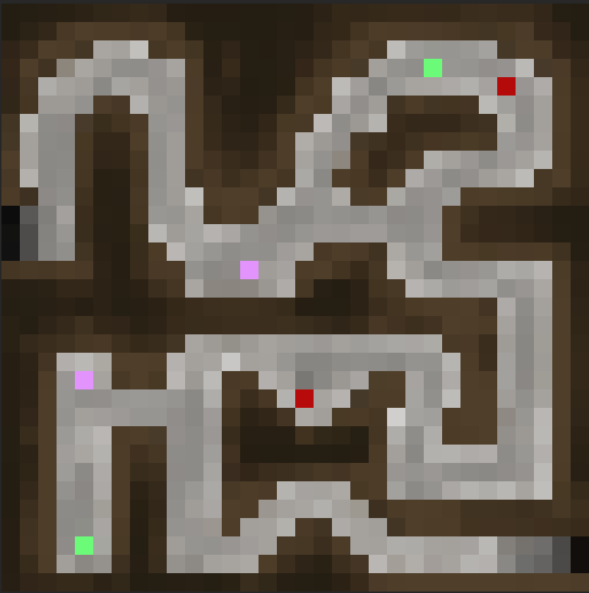
Screen Mockup 1
enemy
Health pickup
vaccine

Slide 6
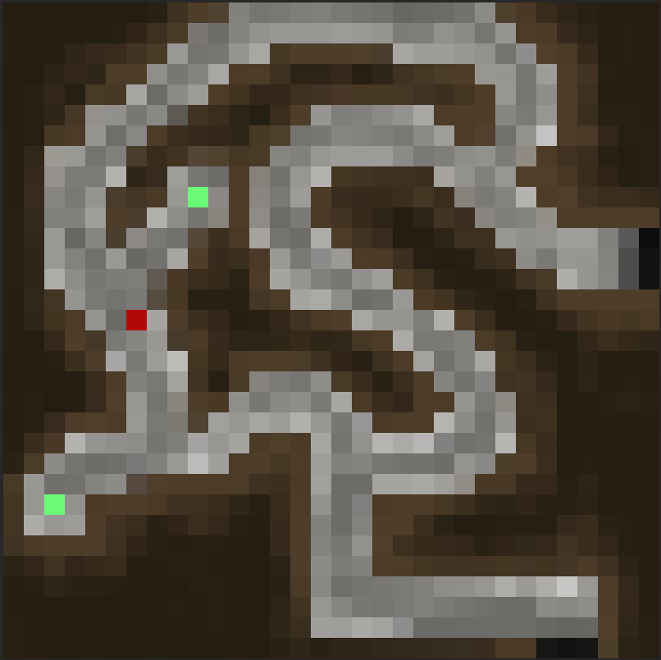
Screen Mockup 2

Slide 7
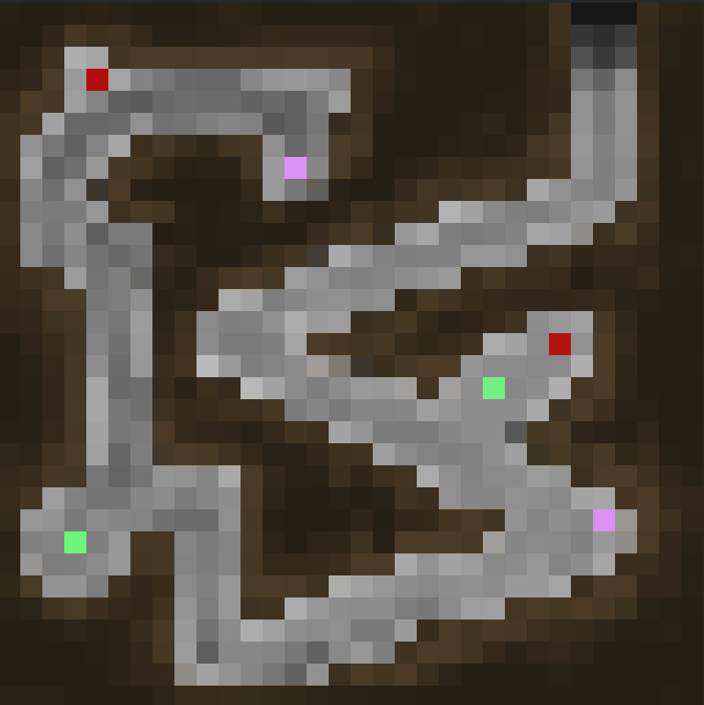
Screen Mockup 3

