Slide 1

A04 Toy Treatment
Canadian Donut (Luke Bodwell and Gavin Taylor)

Slide 2
Toy Title: Fireworks
Logline: In the night sky, colorful explosions go boom.

Slide 3
Essential Features
A 16x16 borderless, black grid with matching beads to represent the night sky.
Randomly selected beads are white with large borders to make them smaller and look like stars.
Clicking a bead removes its borders if it’s a star then changes it to a randomly selected color, keeping track of the position of the star.
The originally clicked bead is made black again and the 8 beads in the cardinal and ordinal directions are made the selected color, representing firework particles.
The 8 particles continue travelling outward in straight lines until they reach the edge of the grid or travels 8 beads, at which point they quickly disappear one at a time.
Stars are restored when fireworks pass through them.
A series of random explosion sounds plays when a firework is created, and a fizzling out sound plays when all the particles have disappeared.

Slide 4
Toy Description
An interactive field of fireworks triggered by clicking various beads in the grid.

Slide 5
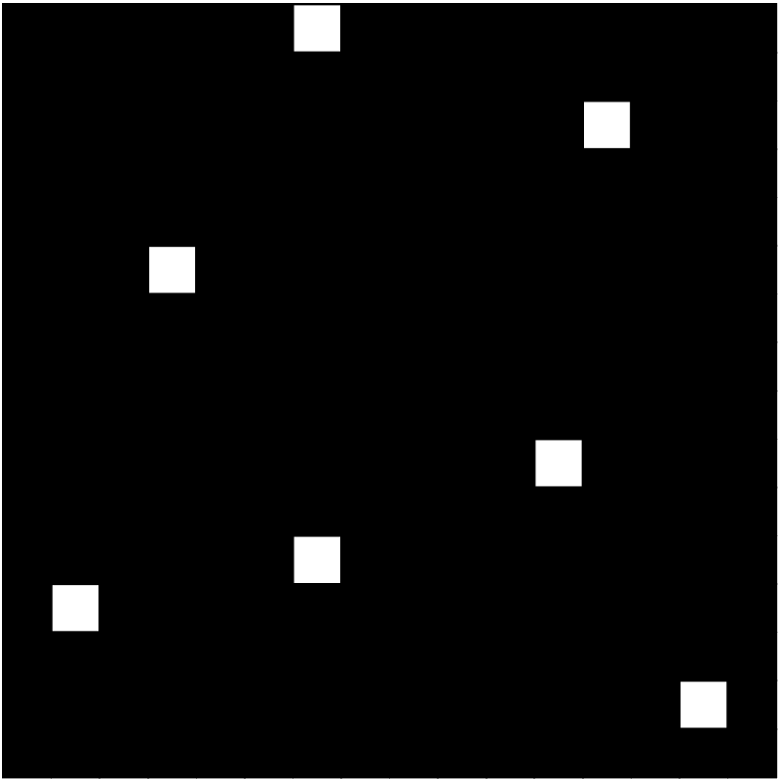
Screen Mockup 1

Slide 6
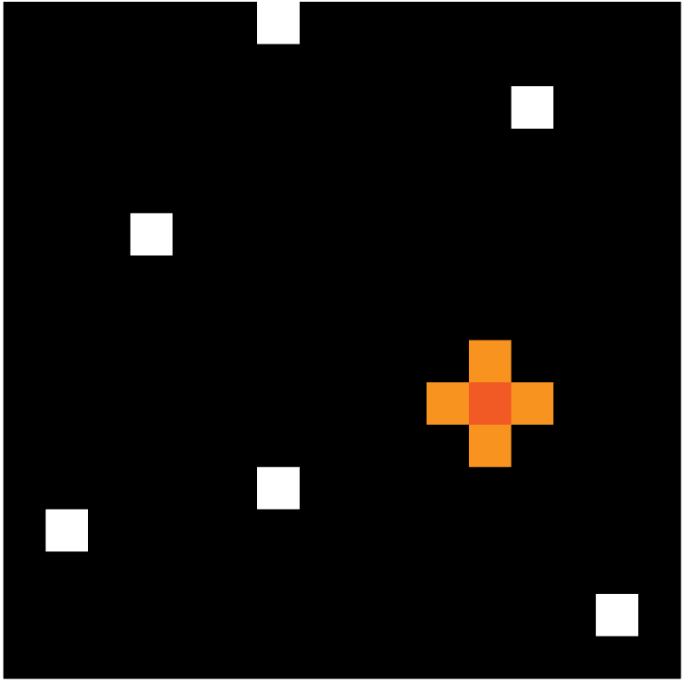
Screen Mockup 2

Slide 7
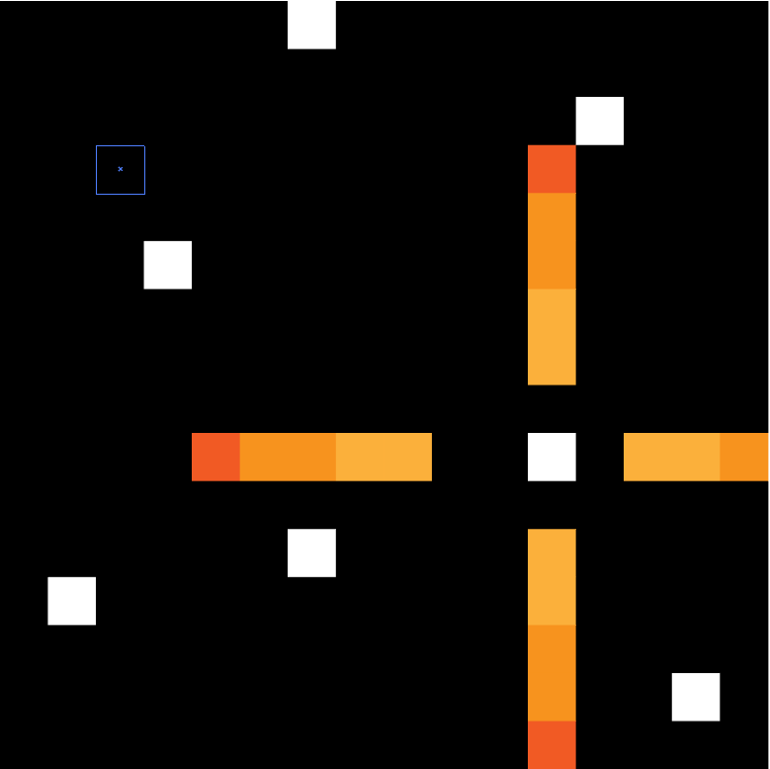
Screen Mockup 3

Slide 8
Demo Code
Some very rudimentary code can be found here: http://users.wpi.edu/~ljbodwell/IMGD-2900/A04/game.js

