Slide 1

A05 Toy Treatment
Canadian Donut (Luke Bodwell and Gavin Taylor)

Slide 2
Toy Title: Fireworks
Logline: In the night sky, colorful explosions go boom.

Slide 3
Essential Features
A 32x24 borderless, navy blue grid on a black background to represent the night sky.
Randomly selected beads are white with different sized borders to make them look like stars.
Stars are restored when fireworks pass through them.
Clicking a bead makes a colored bead travel up to the click point .
Particles explode outward leaving a trail of asterisk glyphs to simulate fireworks, then disappear with a fading effect.
The color of the bead is reflected in the glow of the grid and the title.
A whistle sound plays when fireworks are launched, a pop when they explode, and an explosion when they reach the edge of the grid or travel a predetermined distance.

Slide 4
Toy Description
An interactive field of fireworks triggered by clicking various beads in the grid.

Slide 5
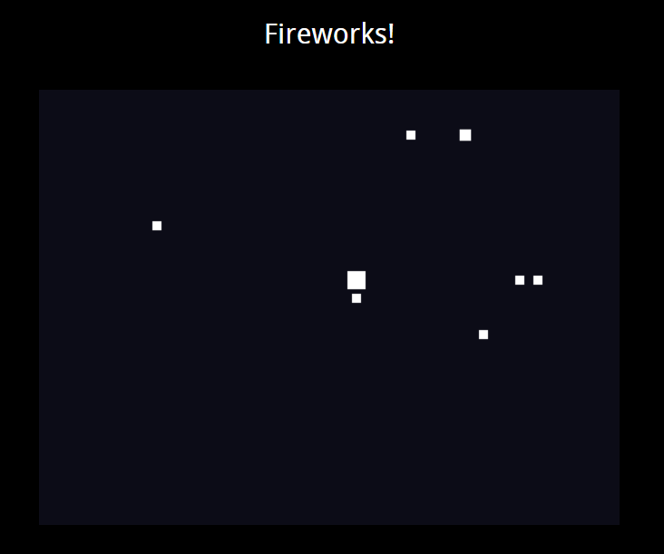
Screen Mockup 1

Slide 6
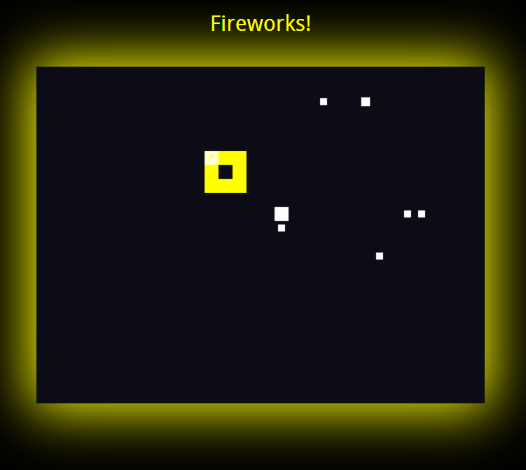
Screen Mockup 2

Slide 7
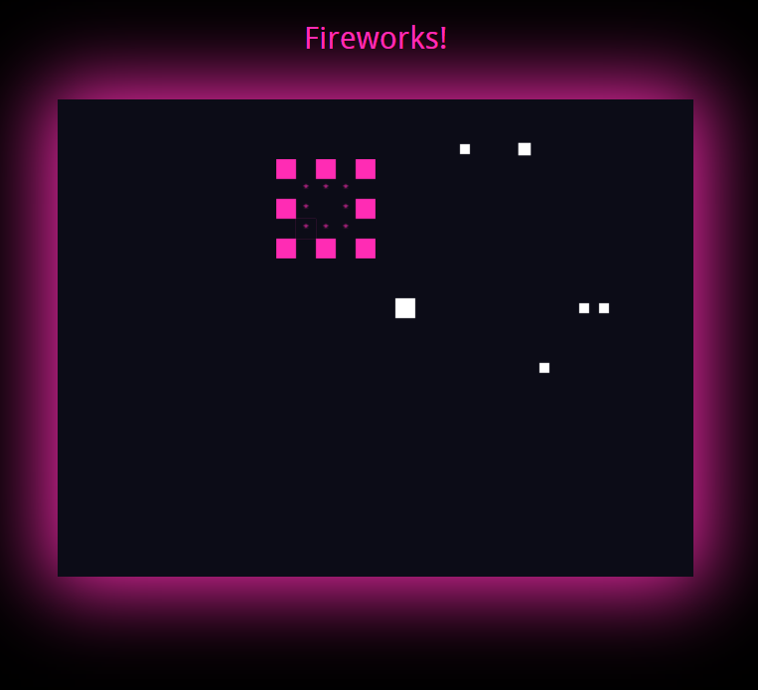
Screen Mockup 3

