Slide 1
Function Recursion
to understand recursion
you must understand recursion

Slide 2
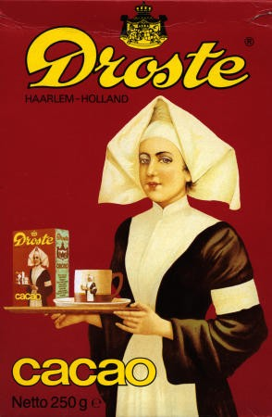
Outline
why using recursion
recursion example: printing digits
how recursion works
how to code recursion
recursion vs. iteration

Slide 3
Why Recursion
in top-down design one of the major techniques is to break the task into subtasks and code the tasks separately
it may turn out that one of the subtasks is a smaller version of the larger task
example: to search an array you split it into halves, searching each half is similar to searching the whole array
can be solved with recursion
recursive function definition – the definition contains calls to itself

Slide 4
Example: Printing Numbers
need to write a function that vertically prints digits of the number n on the screen
subtasks:
  output all digits but last ← resembles original task
  output the last digit
cases
  n < 10 is trivial
  n > 10 – we invoke the same function and then print the last digit
void write_vertical(int n) {
if (n < 10) {
cout << n << endl; // n is one digit
} else{ // n is two or more digits long
write_vertical(n/10);
cout << (n%10) << endl;
}
}

Slide 5
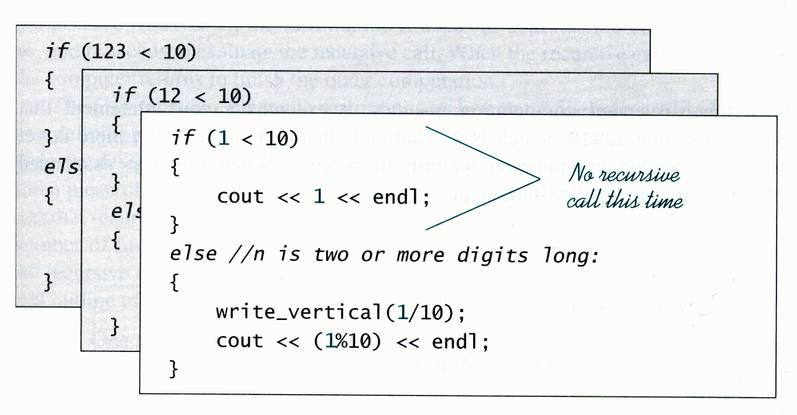
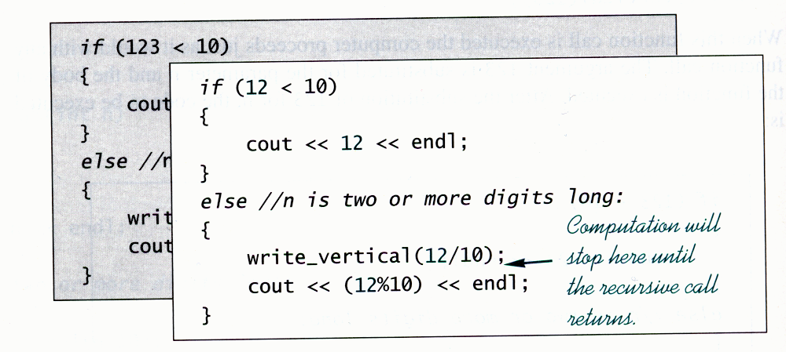
How Recursion Works
recursive function call is the same as ordinary function call
caller function is suspended until callee is done
even though the two functions have the same name their invocations are different (they operate on different parameters and use different memory space
  in particular each invocation has separate local variables and arguments
multiple recursive calls produce multiple invocations
stack – structure where computer stores info on function invocations
  allows insertions and deletions from one end only
  LIFO – last in first out

Slide 6
How to Code Recursion
base or stopping case – situation where a function does not make recursive call
each recursive program run needs to execute a stopping case
easiest way – some (positive) quantity is decreased with each recursive invocation
  stopping case – the quantity is zero
what quantity decreases in write_vertical?
what happens when there is a run with no stopping case?
infinite recursion – run time error where recursion lacks stopping case. What happens when a program with infinite recursion is run
stack overflow – program uses up all stack space and terminates abnormally
// infinite recursion
void wrong_write_vertical(int n) {
wrong_write_vertical(n/10);
cout << (n%10) << endl;
}

Slide 7
Recursion vs. Iteration
every task that can be coded recursively can be coded using iteration – using explicit looping constructs
recursion – usually simpler
iteration
  usually (but not always) more complex – have to explicitly track the number of subtasks and their instances
  usually faster – no procedure call
  no danger of stack overflow
    may have infinite iteratation

Slide 8
Questions on Recursion
what is recursion? recursive function definition?
what is function invocation? how is function invocation related to function definition? What is special about invocation of a recursive function?
what is program stack? stack (function) frame? what happens with stack if recursive function is invoked multiple times? What is the scope of automatic variables in a recursive function invocation?
what is stopping case? stack overflow? infinite recursion?
how is recursion related to iteration?

