Slide 1
Using Diagrams to Represent Program Structure
OMT and UML
Some pictures and material are from
“Design Patterns” by Gamma et al

Slide 2
Outline
why diagrams
diagram types
class diagram elements
  class
  aggregation
  inheritance
  instantiation
class diagram examples
object diagram
use case diagram
state diagram

Slide 3
Why Diagrams
diagrams is a way to capture the essential aspects of the program
  have an overview of the whole program
  see the important relationships between elements of program
  get the picture of the program before it is coded
standardized as part of
  object modeling technique (OMT) – Rumbaugh, Blaha, et al 1991
  universal modeling language (UML) – Rational Rose Inc. and other companies
used in program planning, development and documentation
language independent (not necessarily C++)

Slide 4
Diagram Types
structure diagram – emphasizes what constructs must be present in the modeled system
  class diagram – the system classes, attributes, their relationships
  object diagram – a view of the modeled system at a specific moment of execution
behavior diagram – emphasizes what actions must happen in the system
  use-case diagram – system functionality in terms of interaction with outside actors
  state diagram – program state transitions

Slide 5
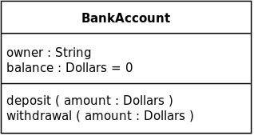
Classes
ClassName
instVar1: Type
instVar2: Type
operations – member functions/methods
instance variables – member variables/attributes
oper2(): returnType
oper1(parName: parType): rType
class Example{
  public:
  void showchar();
  string getstring();
  private:
  char c;
  string str;
  };
Example
c: char
str: string
showchar(): void
getstring(): string
class BankAccount{
  public:
  void deposit(dollars amount);
  void withdrawal(dollars amount);
  private:
  string owner;
  dollars balance;
  };

Slide 6



Aggregation
if class contains instances (objects) of other classes the class aggregates them
if class aggregates more than one instance of the same class it is shown diagramatically
multiplicity - shows how many instances of objects on each side

Slide 7
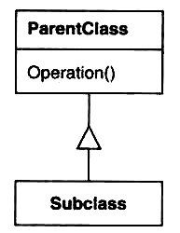
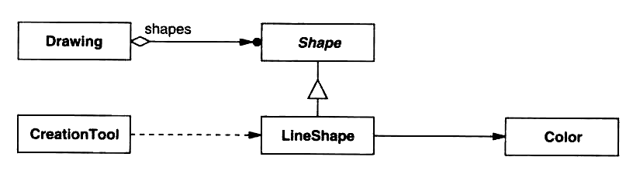
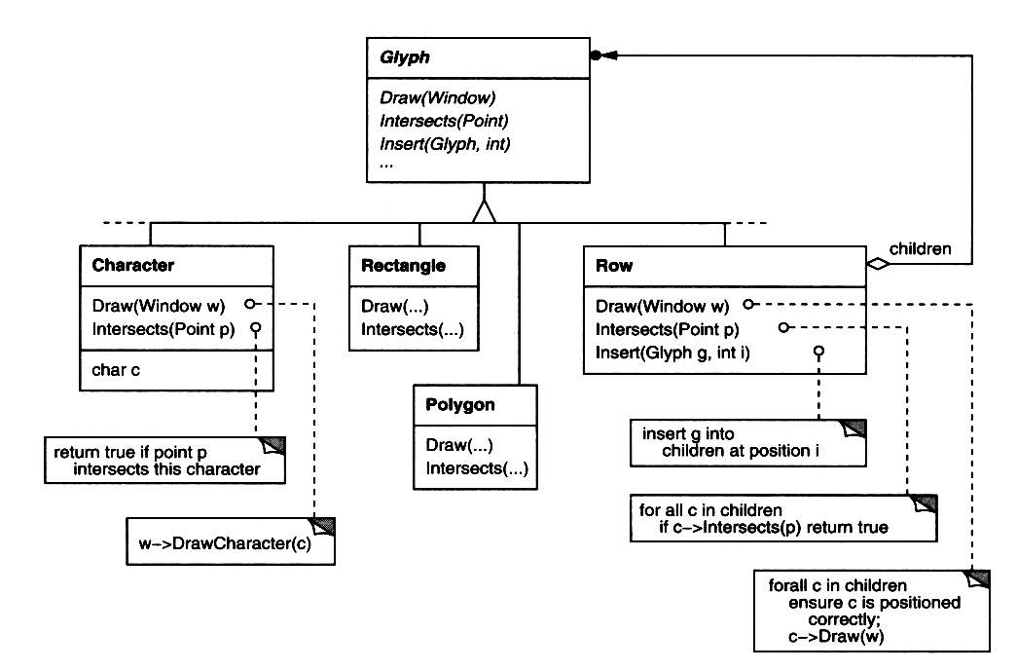
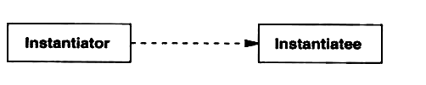
Inheritance, Reference and Instantiation
Class inheritance
class contains a reference to another
Additional comments
object creation (class instantiation) is done by a method of another class

Slide 8
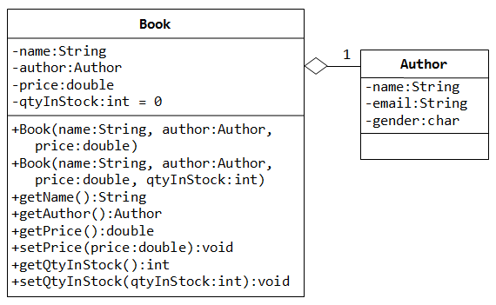
Visibility
- private member
+ public member

Slide 9
Example Class Diagram 1

Slide 10
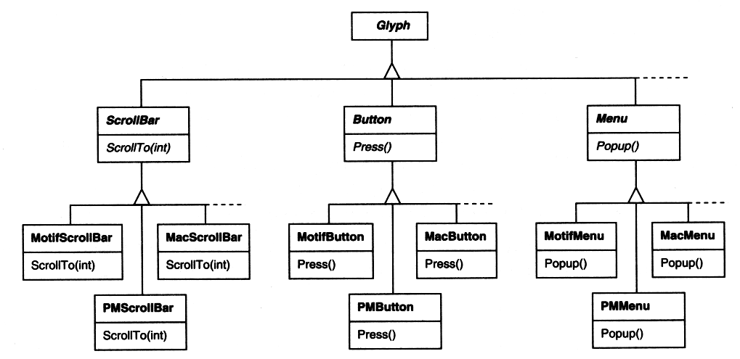
Example Class Diagram 2

Slide 11
Example Class Diagram 3
blah

Slide 12
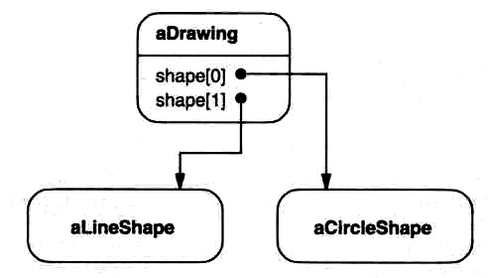
Object Diagram
shows objects and references as the program is executed
what would be a class and an object diagram for an object with dynamically allocated members?

Slide 13
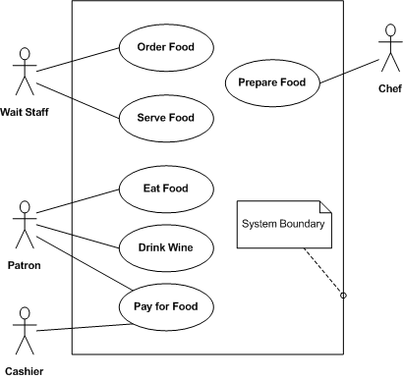
Use Case Diagrams
written description of the system’s behavior regarding tasks or requirements
captures interactions between actors (outside entities) and the system through use cases
use case
actor

Slide 14
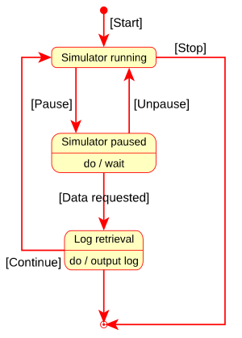
State Diagram
depicts an object transitions through states
  what is object state again?
notation
  filled circle – initial state
  hollow/filled circle – final state
  rounded rectangle – state
    top: name of state
    bottom: activities done in this state
  arrow – transition
    label in square brackets – name of the event causing transition
Notes:
need to add forks/joins

Slide 15
Questions on Diagrams
What is the purpose for the use of diagrams
What is the difference between structure and behavior diagrams?
What types of structure diagrams we have studied? Behavior diagrams?
How is class denoted on a structure diagram?
What is aggregator/agregatee? How is their relationship denoted?
What is multiplicity and how is it denoted?
What is visibility and how is it denoted?
How are objects denoted on a structure diagram?
What diagram uses use cases, actors? What is system boundary?
What does filled, hollow/filled circle, rectangle, arrows represent in a state diagram?

Slide 16
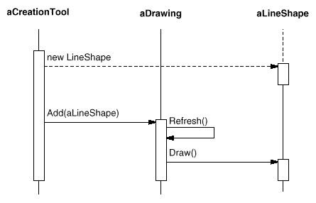
Interaction (Sequence) Diagram
shows order in which requests (methods) between objects are executed - scenario, typically within a single use case
  boxes – processes (function invocation) in each object
  lines – messages (interaction) between objects
  lifeline – vertical dashed line represents objects’ existence

Slide 17
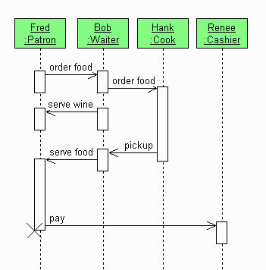
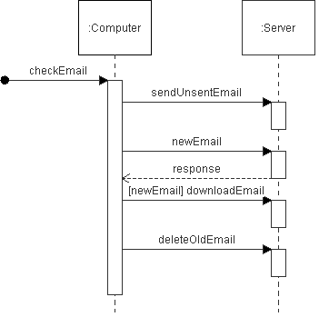
Interaction Diagram Examples

Slide 18
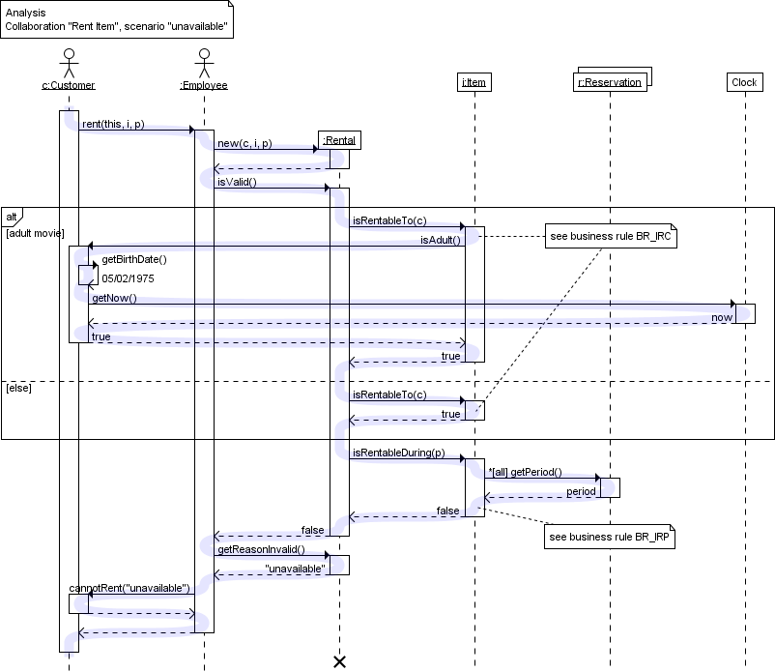
Interaction Diagram Examples 2

Slide 19
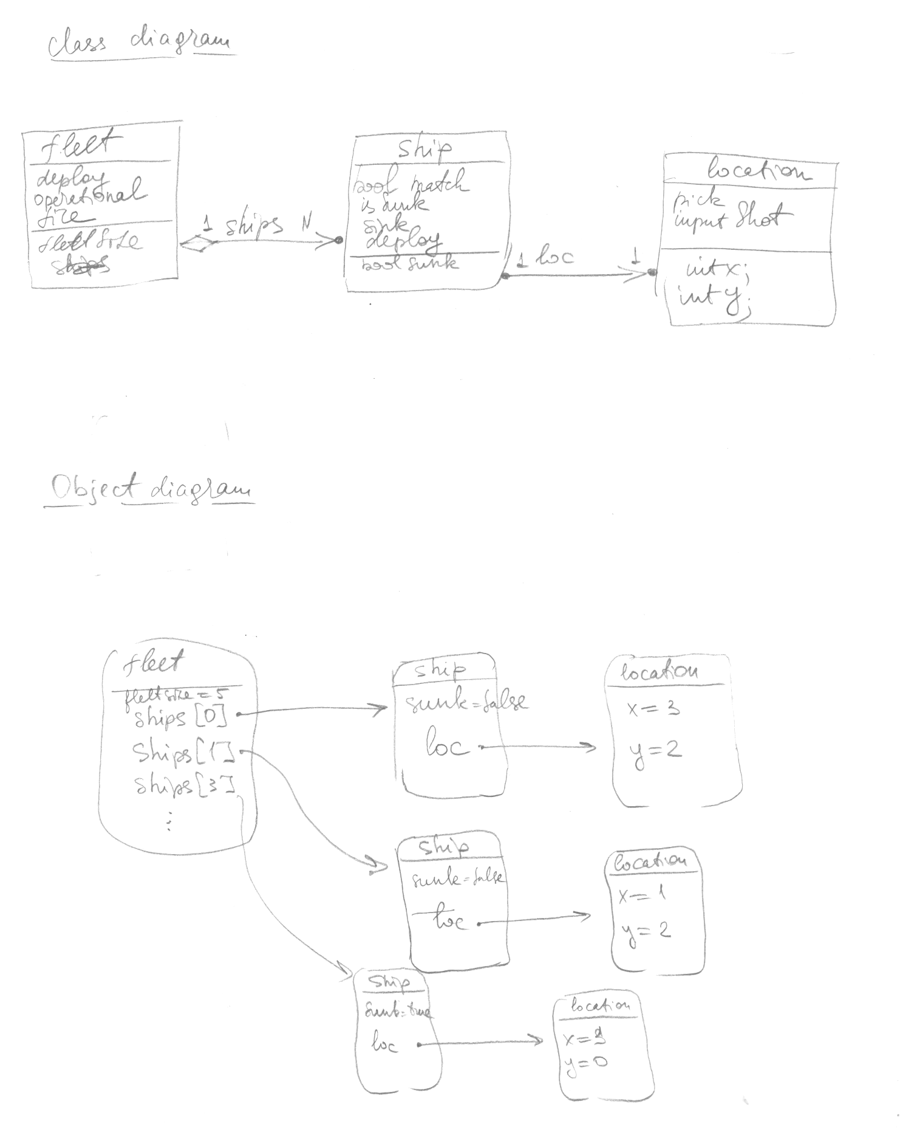
Battleship
Class and Object Diagrams

Slide 20
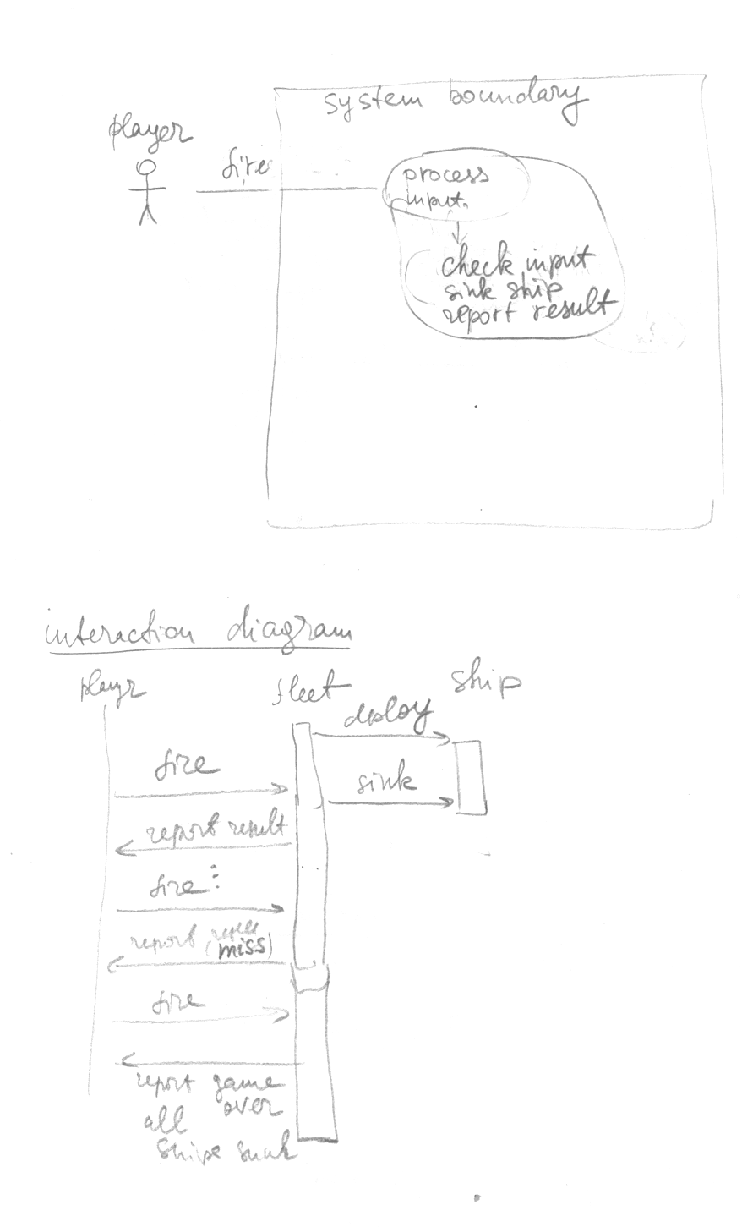
Battleship
Use Case and
Interaction
Diagrams

