Slide 1
CS 13011 CS 13012
CS IA: Procedural Programming
CS IB: Object-Oriented Programming

Slide 2
Hardware
hardware - physical devices that make up computer equipment
computer - PC/mainframes/workstations
computer contains 5 main components
CPU/processor - follows the instructions and performs calculations specified by the program
input device - any device that allows outside world to communicate information to the CPU
output device - any device that allows CPU to communicate information to the outside world
main memory/primary memory/RAM - a list of addressable memory locations that CPU can operate upon, not permanent
bit - the least possible amount of information: 0 or 1
byte - 8 bits
memory location - single (indivisible) portion of memory that holds data
address - number that identifies a memory location
secondary memory – memory that is used for keeping a permanent record of information – disk/data CD/flash drive

Slide 3
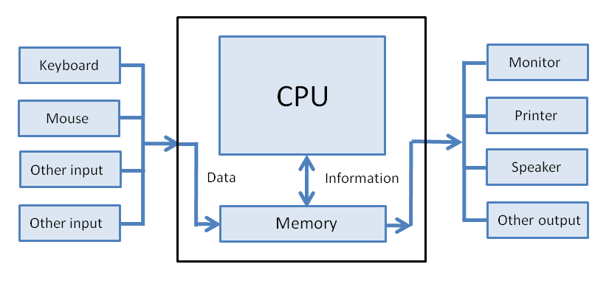
Hardware Diagram

Slide 4
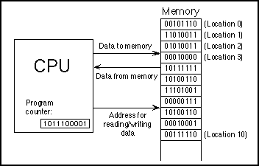
CPU Accessing RAM

Slide 5
Languages
ambiguous instructions – may have multiple meanings, open to interpretation
Call me a taxi, please!
I thought your name was Bob.
computers understand unambiguous binary instructions only
languages
natural - language used by humans
ambiguous
high-level - language (close to natural) that is understood by humans,
unambiguous
C++ is a high-level language
machine (low-level) - list of instructions in binary format that a computer understands
unambiguous
example: 0101 0001 1100 0010

Slide 6
Software
program (code) – a sequence of instructions for computer to follow
system – to be used by other programmers
operating system – allocates computer resources, launches other programs and ensures they work properly
application – to be used by end-users
software - collection of programs
data - input to the program
running/executing program - performing program instructions on given data
code
source (in high-level language)
object (in machine language)
executable code (in machine language) - can run on computer
library – a collection of previously developed object code: input/output, math, etc.
compiler – a system program that translates high-level language into low-level language
linker - program that takes object code and produces executable code

Slide 7
Producing Executable Code
source code (add1.cpp)
include files (add1.hpp, iostream)
done by linker
add include files
link object code with pre-compiled routines from standard libraries to produce executable code
check
object code (add1.o)
file
unit for legal
syntax and
compile it into
an object code
standard libraries
done by compiler
executable code

Slide 8
Programming Language Power vs. Understanding
programming language properties
power – ability to express variety of ideas, code tasks (ex: bigger toolkit); more powerful language makes it easier to program
understandability – ease of making sense of the code by proficient programmer

Slide 9
C++ Creation History
in 1967, BCPL was developed as a language for writing operating systems and compilers
In 1970, the creators of UNIX operating system needed a high-level language that provided enough power for their task. They developed B on the basis of BCPL
In 1972, an enhanced and improved version of the language called C was used to code most of UNIX
C is powerful yet,
lower understandability: is easy to write code that is difficult to understand
early 1980es, Bjarne Stroustrup developed an extension of C called C++
absorbed best features of C, combines power of low-level language with understandability of high-level language
major addition is objects: C++ is object-oriented

Slide 10
C++ Popularity
C/C++ are possibly the most popular programming languages in use today
most of operating systems (one of the largest and most complicated pieces of software) is written in C or C++
source code for Microsoft Windows 10 contains 50-60 million lines of mostly C/C++
source code for Linux kernel (v.4.19) 27.8 million lines of primarily C

Slide 11
C++ Program Layout
#include <iostream>
int main() {
statement 1;
// comment
statement 2;
...
}
include directive - tells compiler where to find certain items about the program
main part (main function) - contain instructions for computer, starts and ends with curly brackets: {}
indicates program start
statement – single unit of execution
each statement ends with semicolon ;
program consists of a sequence of statements
comment is a portion of line ignored by compiler - serves to make the code easier to understand by humans
line breaks and indentation is for humans - compiler ignores them. Make program easier to understand

Slide 12
First Program: helloWorld.cpp
include
directive
// displays a greeting
// Mikhail Nesterenko
// 8/25/2013
#include <iostream>
using std::cout; using std::endl;
int main() {
cout << "Hello, World!" << endl;
}
comments
function named main() indicates start of program
output
statement

Slide 13
Rules of Programming
syntax - the principles of constructing (structuring) the program
legal program construct complies with syntactic rules
illegal violates
ex: every statement ends with a semicolon
semantics – the meaning of programming constructs
ex: assignment statement gives a new value to a variable
style – non-syntactic rules of program writing aimed at making program easier to read and understand
ex: start the program with comments explaining its purpose

