Slide 1
iGATE - GE Infra
JSF – Session 2

Slide 2
Agenda
Custom Tags
Internationalization
Data tables
Ajax4jsf
MyFaces
Richfaces
Facelets

Slide 3
Custom Tags

Slide 4
Custom Tags
Can create our own custom tag to render a pre-defined content.
What’s a Custom tag?
  A custom tag is like a normal JSF tag, and uses “ui:composition” to insert content into the page.
  Steps to create Custom tag:
  Uses ui:composition” tag to create a predefined content.
  Declare the custom tag in a tag library descriptor.
  Register the tag library descriptor in the web.xml.

Slide 5
Custom Tag Example
Create a jsp file to implement the custom tag, which will use ui:composition tag to group elements.
  - Ex: CommandButton.jsp
<!DOCTYPE html PUBLIC "-//W3C//DTD XHTML 1.0 Transitional//EN" "http://www.w3.org/TR/xhtml1/DTD/xhtml1-transitional.dtd">
<html xmlns="http://www.w3.org/1999/xhtml"
xmlns:ui="http://java.sun.com/jsf/facelets"
xmlns:h="http://java.sun.com/jsf/html"
xmlns:c="http://java.sun.com/jstl/core"
xmlns:f="http://java.sun.com/jsf/core">
<ui:composition>
<h:commandButton type="submit" value="#{buttonSubmitLabel}" /> <h:commandButton type="reset" value="#{buttonResetLabel}" />
</ui:composition>
</html>

Slide 6
Custom Tag Example
  Define custom tag detail in a tag library descriptor file.
  namespace – Namespace of this tag library, create an unique name to avoid conflict.
  tag-name – Custom tag name.
  source – Implementation of the custom tag.
<?xml version="1.0"?>
<!DOCTYPE facelet-taglib PUBLIC
"-//Sun Microsystems, Inc.//DTD Facelet Taglib 1.0//EN"
"facelet-taglib_1_0.dtd">
<facelet-taglib>
<namespace>http://www.***.com/***/mytag</namespace>
<tag>
<tag-name>commandButton</tag-name>
<source>./components/CommandButton.jsp</source>
</tag>
</facelet-taglib>

Slide 7
Custom Tag Example
  Register the tag library in web.xml
<context-param>
<param-name>facelets.LIBRARIES</param-name>
<param-value>
/WEB-INF/facelets/tag/mytaglib.xml
</param-value>
</context-param>

Slide 8
Custom Tag Example
To use the custom tag, declare its namespace on top.
<!DOCTYPE html PUBLIC "-//W3C//DTD XHTML 1.0 Transitional//EN" "http://www.w3.org/TR/xhtml1/DTD/xhtml1-transitional.dtd">
<html xmlns="http://www.w3.org/1999/xhtml"
xmlns:ui="http://java.sun.com/jsf/facelets"
xmlns:f="http://java.sun.com/jsf/core"
xmlns:c="http://java.sun.com/jstl/core"
xmlns:h=“http://java.sun.com/jsf/html”
xmlns:mytag="http://www.***.com/***/mytag">
<f:view>
<body>
<h1>Custome Tags</h1>
<mytag:commandButton buttonSubmitLabel="Submit" buttonResetLabel="Reset" />
</body>
</f:view>
</html>

Slide 9

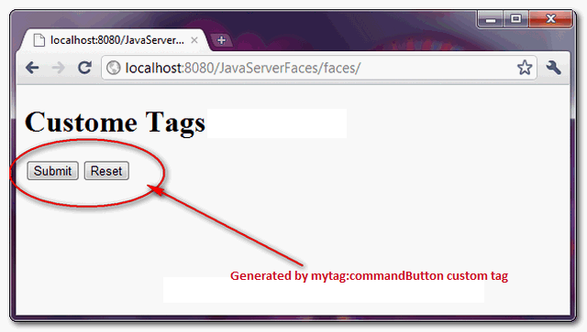
Custom Tag Example

Slide 10
Internationalization

Slide 11
Internationalization
Internationalization
  Preparing a web – application content compatible to a user/region’s preferred language and country.
Using JSF:
  Supports I18n.
  Locale specific messages should be given in a .properties file, called Resource Bundles
  Naming convention of those files will be like Filename_language_country.properties or Filename_language.properties

Slide 12
I18N
Steps to implement I18N in JSF:
  Create locale specific resource bundles (.properties files) with proper naming convention and place it in src folder.
  Register the resource bundles in the faces-config.xml
  Use in the view like <f:loadBundle>
  <application>
    <message-bundle>
    com.**.**.**.ApplicationResource
    </message-bundle>
    <locale-config>
    <default-locale>en_US</default-locale>
      <supported-locale> ja_JP </supported-locale>
    </locale-config>
  </application>

Slide 13
I18N
Create the Resource Bundle files
Ex: Create for en and ja
  File names: ApplicationResource_ja_JP.properties
        ApplicationResource_en_US.properties
        # Resource bundle for English
        username= Username
        password= Password
        # Resource bundle for Japanese
        username= \u610F\u5473
        password= \u89E3\u6790

Slide 14
I18N
To use in JSP: Login.jsp:
<%@page contentType="text/html" pageEncoding="UTF-8"%>
<%@taglib prefix="f" uri="http://java.sun.com/jsf/core"%>
<%@taglib prefix="h" uri="http://java.sun.com/jsf/html"%>
<!DOCTYPE HTML PUBLIC "-//W3C//DTD HTML 4.01 Transitional//EN" "http://www.w3.org/TR/html4/loose.dtd">
<html>
<head><meta http-equiv="Content-Type" content="text/html; charset=UTF-8"> <title>Login JSP</title>
</head>
<f:view>
<f:loadBundle basename="ApplicationResource" var="localeValue" />
<body>
<h:outputText value="#{localeValue.username}" /><h:inputText value=”#{login.username}” />
<h:outputText value="#{localeValue.password}"/> <h:inputText value=”#{login.password}” />
</body>
</f:view>
</html>

Slide 15
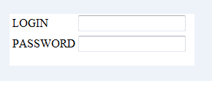
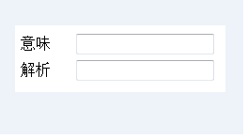
I18N

Slide 16
Data tables

Slide 17
Data tables
Issue
  Dealing with variable length data
  Non-looping
    Using custom tags
  Looping
    - JSTL
    - <% for(...) { ... %>
    HTML Code
    <% } %>
JSF provides h:datatable

Slide 18
Data tables
    <h:dataTable
    value "#{someBean someCollection}“ var="rowVar“ border="1">
    <h:column>
    <h:outputText value="#{rowVar.col1Data}"/>
    </h:column>
    <h:column>
    <h:outputText value= "#{rowVar.col2Data} />
    </h:column>
    ...
    </h:dataTable>

Slide 19
Data tables
Value: a collection of data
Var: bound to each collection entry in turn
Standard TABLE attributes
  border, bgcolor, width, cellpadding, cellspacing, ...
Style sheet designators
  rowClasses, headerClass, footerClass
h:Column
  usually encloses h:outputText elements
  Regular HTML can be enclosed in f:verbatim
  Table headers and footers specified with f:facet

Slide 20
Data tables
<h:dataTable value="#{myBean.dataList}" var="dataItem">
<h:column>
<f:facet name="header">
<h:outputText value="ID" />
</f:facet>
<h:outputText value="#{dataItem.id}" />
</h:column>
<h:column>
<f:facet name="header">
<h:outputText value="Name" />
</f:facet>
<h:outputText value="#{dataItem.name}" />
</h:column>
<h:column>
<f:facet name="header">
<h:outputText value="Value" />
</f:facet>
<h:outputText value="#{dataItem.value}" />
</h:column>
</h:dataTable>

Slide 21
Ajax4jsf

Slide 22
Ajax4jsf
AJAX aims at providing faster response to the client applications by reloading only the needed data.
Asynchronous Javascript and XML
Opensource from Jboss community
What is Ajax?
  JS can directly communicate with server end
  Request and response data between client and server are exchanged in XML format
  Advantage is speed up of performance
  Ajax4jsf:
  Adds Ajax support to JSF components
  Ajax4jsf components are extensions of JSF components

Slide 23
Ajax4jsf
  Normal request from client, intercepted by Faces servlet, goes through 6 phases of JSF life cycle.
  When the request is Ajax, the AjaxEngine fires the Javascript event, which is on client side.
  Its Ajax engine’s job to submit the original request to the Ajax4jsf, so request will be intercepted by Ajax4jsf filter.
  Data conversion to XML format will happen through various XML filters, after that request is forwarded to the Faces Servlet.
  Ajax Containers – represents a tree of components along with request values that are encoded and decoded during Ajax request and response.
  Its because of the Ajax engine in the client side, that the updation of few portion of the web page is possible.

Slide 24
Ajax4jsf
Library
  Region tag
    Portion of a page is sufficient for processing a request.
    Kind of Container tag, meaning that it can hold other type of component tags.
    Components defined inside this tag, only the values of that are processed in the server side when the ajax request is made.
  If not specified, whole jsp is considered as a region.
  Multiple region tags are possible in a page.
  <a4j:region id = "employeeRegion" actionListener = "#{manager.processEmpData}">
  <!-- Other Set of Components -->
  </a4:region>
  <a4j:region id = "stockRegion" actionListener "#{manager.processStockData}">
  <!-- Other Set of Components -->
  </a4:region>

Slide 25
Ajax4jsf
Library
  CommandButton tag
    To fire Action Events on server.
    Ajax request is generated which will be intercepted by Ajax Engine.
    “onComplete” – can have js function which will be executed when response comes back from server.
    “rerender”- takes comma seperated list of component identifier that will get re-generated once the control comes back from server to client.
    <a4j:commandButton id = "clickButton" value = "Click Me"
    action = "#{Listener.processClickRequest}"
    oncomplete = "jsFunction()“
    reRender = "CompId1, CompId2, CompId3"
    </a4j:commandButton>

Slide 26
Ajax4jsf
Library
  CommandLink tag
    Similar to CommandButton tag.
    Action Component.
    <a4:commandLink id = "myLink" value = "This is my Link"
    action = "Listener.processMyLink">
    </a4:commandLink>
  Media Output tag
    To render rich contents back to client like Image, Audio, Video
    “createContent” – method takes 2 arguments, java.io.OutputStream and java.lang.Object.
    <a4j:mediaOutput id = "telephone" element = "img" mimeTye = "image/png" createContent = "#{ImagePainter.drawImage}"> </a4j:mediaOutput>

Slide 27
Ajax4jsf
public class ImagePainter
{
private String fileName = "telephone.png";
public void drawImage (OutputStream output, Object object) throws IOException
{
File file = new File(fileName);
byte byteArray[] = new byte[1000];
FileInputStream inputStream = new FileInputStream(file);
while(true) {
try {
int bytesRead = inputStream.read(byteArray);
output.write(byteArray, 0, bytesRead);
}
finally {
if (inputStream != null){ inputStream.close();
}
}
}
}
}

Slide 28
Ajax4jsf
Library
  KeepAlive tag
    Managed Bean is in Request scope. So its valid in current request only.
    Illegal Argument Exception occurs when tried to access the bean out of the request.
    To prevent this, we can use keepalive.
    Maintains the state of the whole bean object among subsequent request.
    <a4j:keepAlive beanName = "#{manager.empBean}">
    </a4j:keepAlive>

Slide 29
Ajax4jsf
Library
  Repeat tag
    Implements basic iteration operation
    Used to display a set of objects in a collection.
    <a4j:repeat id = "repeater" value = "#{manager.empList}" var = "employee">
    <h:outputText id = "name" value = "#{employee.name}"/>
    <h:outputText id = "age" value = "#{employee.age}"/>
    </a4:repeat>
  Poll tag
    Used to Auto refresh the current page by sending periodic request to server at regular intervals by submitting the form.
    Ex: Live Stock value, live cricket scores etc.

Slide 30
Ajax4jsf
Library
    <a4j:poll id = "refreshId" reRender = "CompId1, CompId2" timeout = "50000" interval = "1000">
    </a4j:poll>
  Status tag
    To indicate client the current status of the request, like if the request has been served or still in processing.
    <a4j:status startText = "Request sent to the Server" stopText = "Request is completed">
    </a4j:status>
  Support tag
    Most commonly used tag.
    Appears as child tag of various components.
    <a4j:inputText id = "userInput">
    <a4j:support event = 'onblur' action = "#{bean.process}" binding = "bean.userInput" reRender = "CompId1, CompId2"/>
    </a4j:inputText>

Slide 31
Ajax4jsf
    In web.xml
    <filter>
    <display-name>Ajax4jsf Filter</display-name>
    <filter-name>ajax4jsf</filter-name>
    <filter-class>org.ajax4jsf.Filter</filter-class>
    </filter>
    <filter-mapping>
    <filter-name>ajax4jsf</filter-name>
    <servlet-name>Faces Servlet</servlet-name>
    <dispatcher>FORWARD</dispatcher>
    <dispatcher>REQUEST</dispatcher>
    <dispatcher>INCLUDE</dispatcher>
    </filter-mapping>

Slide 32
MyFaces

Slide 33
MyFaces
MyFaces is from Apache
Open source JSF implementation
Popular component libraries
  Tomahawk
  Tobago
  Trinidad
Configuring MyFaces to use Tomahawk
  Add jars to web-inf lib
  – Documented:
  • tomahawk.jar
  – Undocumented
  • commons-fileupload.jar
  • commons-validator.jar
  • oro-x.x.x.jar

Slide 34
MyFaces Tomahawk
Add Filter and filter mapping entries in web.xml
Poorly organized
Library:
  t:inputDate – to gather a java.util.Date
  <h:form>
  Date: <t:inputDate value="#{sample.date}" popupCalendar="true"/><BR>
  <h:commandButton action= "show.date"/>
  </h:form>
  t:panelTabbedPane – to use css to create tabbed panes
        - works along with t:panelTab

Slide 35
MyFaces Tomahawk
<h:form>
<t:panelTabbedPane bgcolor= #FFFFCC >
<t:panelTab label="Tab 1">
<f:verbatim><H1>Tab 1</H1></f:verbatim>
</t:panelTab>
<t:panelTab label="Tab 2">
<f:verbatim><H1>Tab 2</H1></f:verbatim>
</t:panelTab>
<t:panelTab label="Tab 3">
<f:verbatim><H1>Tab 3</H1></f:verbatim>
</t:panelTab>
<h:commandButton value="Common Button" action="..."/>
</t:panelTabbedPane>
</h:form>

Slide 36
MyFaces Tomahawk
  t:dataList – to iterate through a collection
  <t:dataList value="#{sample.states}" var="state"
  layout= unorderedList > layout="unorderedList">
  <t:popup displayAtDistanceX="10"
  displayAtDistanceY="10"
  styleClass ="popupStyle“>
  <h:outputText value="#{state[0]}"/>
  <f:facet name="popup">
  <h:outputText value="#{state[1]}"/>
  </f:facet>
  </t:popup>
  </t:dataList>

Slide 37
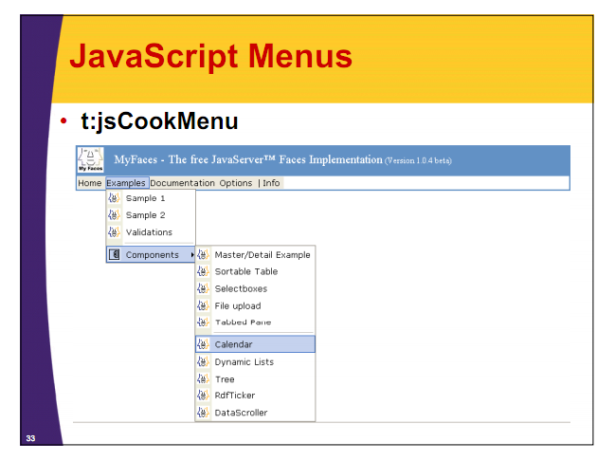
MyFaces Tomahawk

Slide 38
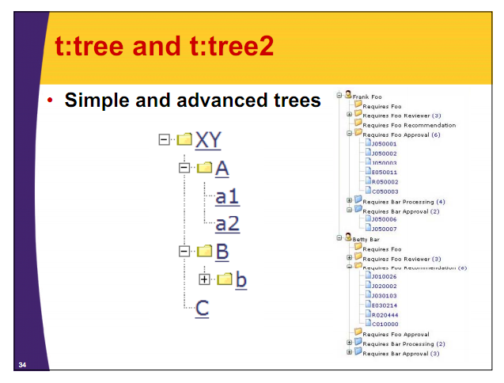
MyFaces Tomahawk

Slide 39
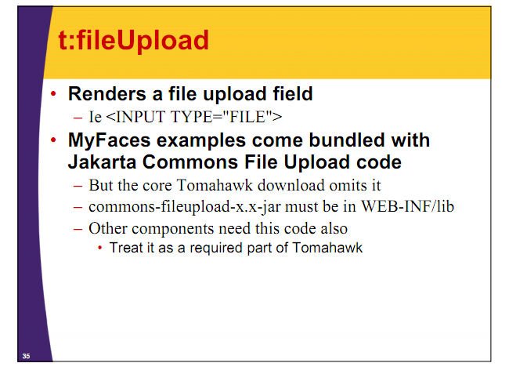
MyFaces Tomahawk

Slide 40
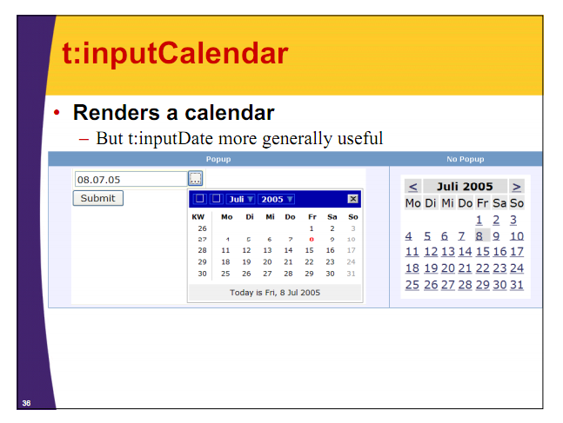
MyFaces Tomahawk

Slide 41
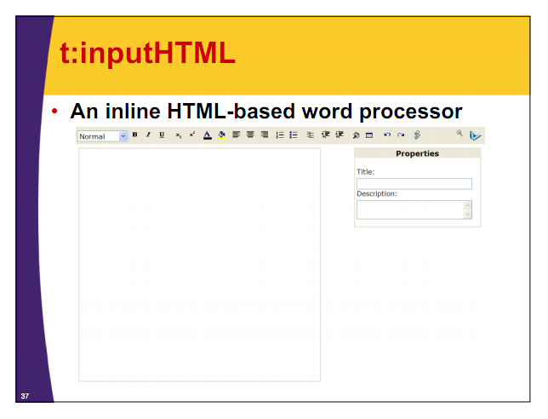
MyFaces Tomahawk

Slide 42
MyFaces Tomahawk
Validators:
Most used validators
– validateRegExpr
– validateEmail
– validateCreditCard
– validateEquals
validateRegExpr
  pattern: the regular expression pattern
  <TABLE BGCOLOR="WHITE">
  <h:form>
  …
  <TR><TD><B>ZIP Code:</B>
  <t:inputText value="#{order.zipCode}“ required="true" id="ZIP">
  <t:validateRegExpr pattern="\d{5}“ message="ZIP Code must be 5 digits"/>
  </t:inputText>
  <TD><h:message for="ZIP" styleClass="red"/></TD>
  </TD></TR>

Slide 43
MyFaces Tomahawk
validateEmail
  <TR><TD>
  <B>Email:</B>
  <t:inputText value="#{order.email}“required="true“ id="email">
  <t:validateEmail message="Invalid email address"/>
  </t:inputText>
  <TD><h:message for="email" styleClass="red"/></TD>
  </TD></TR>
  validateCreditCard
  <TR><TD>
  <B>Credit Card:</B>
  <t:inputSecret value="#{order.creditCard} required="true" id="card1">
  <t:validateCreditCard message="Invalid credit card number"/>
  </t:inputSecret>
  <TD><h:message for="card1" styleClass="red"/></TD>
  </TD></TR>

Slide 44
MyFaces Tomahawk
validateEquals
  For - Required: the id of the component that must match the id of the component that must match
  Message - Optional but useful
  <TR><TD>
  <B>Credit Card:</B>
  <t:inputSecret value="#{order.creditCard}“ required="true" id="card1">
  <t:validateCreditCard message="Invalid credit card number"/>
  </t:inputSecret>
  <TD><h:message for="card1" styleClass="red"/></TD></TD></TR>
  <TR><TD>
  <B>Confirm Credit Card:</B>
  <t:inputSecret required="true" id="card2">
  <t:validateEqual for="card1" message= "The two credit card entries do not match two credit card entries do not match /> "/>
  </t:inputSecret>
  <TD><h:message for="card2" styleClass="red"/></TD></TD></TR>

Slide 45
Richfaces

Slide 46
Richfaces
Richfaces is advanced UI component framework for easily integrating Ajax capabilities in to business applications using JSF.
Open source project from Jboss
Very well documented
Supports Skinnability – defining common interface styles
Jars required
  richfaces-api-**.jar
  richfaces-impl-**.jar
  richfaces-ui-**.jar
    Copy that "jars“ to WEB-INF/lib folder

Slide 47
Richfaces
Register richfaces with web.xml
...
<!-- Plugging the "Blue Sky" skin into the project -->
<context-param>
<param-name>org.richfaces.SKIN</param-name>
<param-value>blueSky</param-value>
</context-param>
<!-- Making the RichFaces skin spread to standard HTML controls -->
<context-param>
<param-name>org.richfaces.CONTROL_SKINNING</param-name>
<param-value>enable</param-value>
</context-param>
<!-- Defining and mapping the RichFaces filter -->
<filter>
<display-name>RichFaces Filter</display-name>
<filter-name>richfaces</filter-name>
<filter-class>org.ajax4jsf.Filter</filter-class>
</filter>
<filter-mapping>
<filter-name>richfaces</filter-name>
<servlet-name>Faces Servlet</servlet-name>
<dispatcher>REQUEST</dispatcher>
<dispatcher>FORWARD</dispatcher>
<dispatcher>INCLUDE</dispatcher>
</filter-mapping>
...

Slide 48
Richfaces
Example – Richfaces Greeter
Managed Bean:
package demo;
public class user {
private String name="";
public String getName() {
return name;
}
public void setName(String name) {
this.name = name;
}
}
Register bean with faces-config.xml
<managed-bean>
<description>UserName Bean</description>
<managed-bean-name>user</managed-bean-name>
<managed-bean-class>demo.user</managed-bean-class>
<managed-bean-scope>request</managed-bean-scope>
</managed-bean>

Slide 49
Richfaces
JSP – Greeter.jsp
<!doctype html public "-//w3c//dtd html 4.0 transitional//en">
<%@ taglib uri="http://java.sun.com/jsf/core" prefix="f" %>
<%@ taglib uri="http://java.sun.com/jsf/html" prefix="h" %>
<%@ taglib uri="http://richfaces.org/a4j" prefix="a4j"%>
<%@ taglib uri="http://richfaces.org/rich" prefix="rich"%>
<html>
<head><title>RichFaces Greeter</title></head>
<body>
<f:view>
<a4j:form>
<rich:panel header="RichFaces Greeter" style="width: 315px">
<h:outputText value="Your name: " />
<h:inputText value="#{user.name}" >
<f:validateLength minimum="1" maximum="30" />
</h:inputText>
<a4j:commandButton value="Get greeting" reRender="greeting" />
<h:panelGroup id="greeting" >
<h:outputText value="Hello, " rendered="#{not empty user.name}" />
<h:outputText value="#{user.name}" />
<h:outputText value="!" rendered="#{not empty user.name}" />
</h:panelGroup>
</rich:panel>
</a4j:form>
</f:view>
</body></html>

Slide 50

Richfaces
<rich:panel> tag - Container for information
Output:
Library:
  <rich:toolBar>
    Horizontal-oriented panel
    Can be used for top-level menu,
    Tools-like menu etc.
    <rich:toolBar id="bar" height="30" itemSeparator="#{tbBean.groupSeparator}">
    <rich:toolBarGroup itemSeparator="#{tbBean.groupItemSeparator}">
    <h:outputText value="Group1.1"></h:outputText>
    <h:outputText value="Group1.2"></h:outputText>
    <h:outputText value="Group1.3"></h:outputText>
    </rich:toolBarGroup>
    </rich:toolBar>

Slide 51
Richfaces
  <rich:dropDownMenu>
    Allows to organize hierarchical menu similar to the one that most of the desktop applications have.
    <rich:toolBar>
    <rich:dropDownMenu>
    <f:facet name="label">
    <h:panelGroup>
    <h:graphicImage value="/images/icons/copy.gif" styleClass="pic"/>
    <h:outputText value="File"/>
    </h:panelGroup>
    </f:facet>
    <rich:menuItem submitMode="ajax" value="New"
    action="#{ddmenu.doNew}" icon="/images/icons/create_doc.gif">
    </rich:menuItem>
    <rich:menuItem submitMode="ajax" value="Open"
    action="#{ddmenu.doOpen}" icon="/images/icons/open.gif" />
    <rich:menuItem submitMode="ajax" value="Close"
    action="#{ddmenu.doClose}" />
    <rich:menuSeparator id="menuSeparator11" />
    <rich:menuItem submitMode="ajax" value="Exit"
    action="#{ddmenu.doExit}" />
    </rich:dropDownMenu>
    ….
    </rich:toolBar>

Slide 52
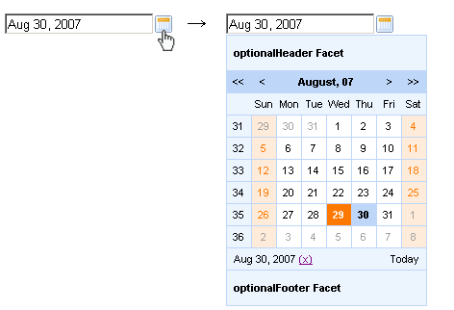
Richfaces
  <rich:calendar>
    To create inputs for date and time.
    <rich:calendar value="#{calendarBean.selectedDate}" id="calendarID"
    locale="#{calendarBean.locale}"
    popup="#{calendarBean.popup}"
    datePattern="#{calendarBean.pattern}"
    showApplyButton="#{calendarBean.showApply}" style="width:200px"/>

Slide 53
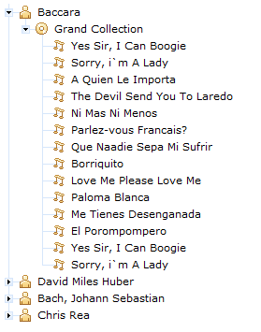
Richfaces
  <rich:tree>
    Tree is a component that renders a tree control on the page.

Slide 54
Richfaces
  <rich:tree>
    <rich:tree switchType="client" style="width:300px" value="#{library.data}" var="item" nodeFace="#{item.type}">
    <rich:treeNode type="artist" iconLeaf="/images/tree/singer.gif" icon="/images/tree/singer.gif">
    <h:outputText value="#{item.name}" />
    </rich:treeNode>
    <rich:treeNode type="album" iconLeaf="/images/tree/disc.gif" icon="/images/tree/disc.gif">
    <h:outputText value="#{item.title}" />
    </rich:treeNode>
    <rich:treeNode type="song" iconLeaf="/images/tree/song.gif" icon="/images/tree/song.gif">
    <h:outputText value="#{item.title}" />
    </rich:treeNode>
    </rich:tree>

Slide 55
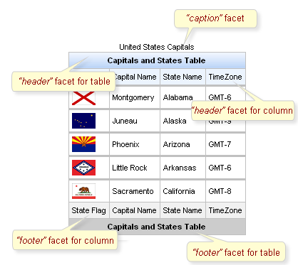
Richfaces
  <rich:dataTable>
    For rendering tables.

Slide 56
Richfaces
  <rich:dataTable>
    ...
    <rich:dataTable value="#{capitalsBean.capitals}" var="cap" rows="5">
    <f:facet name="caption">
    <h:outputText value="United States Capitals" />
    </f:facet>
    <f:facet name="header">
    <h:outputText value="Capitals and States Table" />
    </f:facet>
    <rich:column>
    <f:facet name="header">State Flag</f:facet>
    <h:graphicImage value="#{cap.stateFlag}"/>
    <f:facet name="footer">State Flag</f:facet>
    </rich:column>
    <rich:column>
    <f:facet name="header">State Name</f:facet>
    <h:outputText value="#{cap.state}"/>
    <f:facet name="footer">State Name</f:facet>
    </rich:column>
    ….
    <f:facet name="footer">
    <h:outputText value="Capitals and States Table" />
    </f:facet>
    </rich:dataTable>
    ...

Slide 57
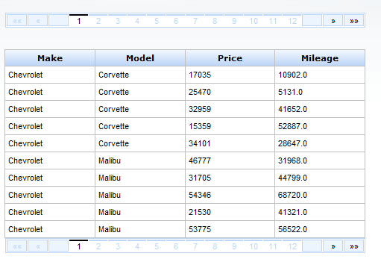
Richfaces
  <rich:dataScroller>
    To provide the functionality of table pagination using AJAX requests.. ...
    …<rich:datascroller align="left" for="carList" maxPages="20"
    page="#{dataScrollerBean.scrollerPage}" reRender="sc2" id="sc1" />
    ...

Slide 58
Facelets

Slide 59
Facelets
Creating a view from instructions in one or more markup files.
Templating - weaving together reusable bits of interface code to produce markup.
Templates can be parameterized and default values can be specified.
Templates may be invoked through Facelets taglibs.
more flexible than gluing JSP pages together with include tags.
helps in developing a more maintainable code base and aids in rapid development.
Composite views
  Approach to user interface development that encourages subdivision and reuse of view elements such as navigation, headers, footers, menu etc..
Jsf-facelets.jar

Slide 60
Facelets
Web.xml
<context-param>
<param-name>javax.faces.DEFAULT_SUFFIX</param-name>
<param-value>.jsp</param-value>
</context-param>
<context-param>
<param-name>facelets.REFRESH_PERIOD</param-name>
<param-value>2</param-value>
</context-param>
<context-param>
<param-name>facelets.SKIP_COMMENTS</param-name>
<param-value>true</param-value>
</context-param>
Faces-config.xml
<application>
<view-handler>com.sun.facelets.FaceletViewHandler</view-handler>
<locale-config>
<default-locale>en</default-locale><supported-locale>zh</supported-locale></locale-config>
<message-bundle>*/*/*.Messages</message-bundle>
</application>

Slide 61
Facelets
Example:
Layout.jsp
<!DOCTYPE html PUBLIC "-//W3C//DTD XHTML 1.0 Transitional//EN" "http://www.w3.org/TR/xhtml1/DTD/xhtml1-transitional.dtd">
<html xmlns="http://www.w3.org/1999/xhtml"
xmlns:ui="http://java.sun.com/jsf/facelets"
xmlns:f="http://java.sun.com/jsf/core"
xmlns:h="http://java.sun.com/jsf/html"
xmlns:c="http://java.sun.com/jstl/core">
<ui:composition><f:view ><head>… </head><body>
<table align="center" cellspacing="0" cellpadding="0" border="0" width="100%" class="bodyTable">
<tr><td width="100%" valign="top" align="center" height="85px">
<ui:insert name="header"><ui:include src="/pages/common/Header.jsp" /></ui:insert>
</td></tr>
<tr><td width="100%" valign="top" align="center" style="padding-top:10px;">
<ui:insert name="bodyContent"></ui:insert>
</td></tr>
<tr><td width="100%" valign="bottom" align="center">
<ui:insert name="footer"><ui:include src="/pages/common/Footer.jsp" /></ui:insert>
</td></tr>…
</table></body></f:view>
</ui:composition></html>

Slide 62
Facelets
Example:
Home.jsp
<html
xmlns:html="http://www.w3.org/1999/xhtml"
xmlns:ui="http://java.sun.com/jsf/facelets"
xmlns:h="http://java.sun.com/jsf/html"
xmlns:f="http://java.sun.com/jsf/core"
xmlns:rich="http://richfaces.org/rich"
xmlns:a4j="http://richfaces.org/a4j">
<ui:composition template="/pages/templates/Layout.jsp">
<ui:define name="scripts"><script language="JavaScript">….</script></ui:define>
<ui:define name="bodyContent">
<h:form id="homeForm“ >
…………..
…………..
</h:form>
</ui:define>
</ui:composition>
</html>

Slide 63
Facelets
UIComposition: will trim anything outside of it. This becomes your visual editor. Facelets use contents inside the ui:composition tag alone.
It uses “template” attribute to refer the template to be used.
UIDefine: when facelets build the page, those block of contents will be placed appropriately in the template.
UIDecorate: will not trim everything outside of it. Useful in scenarios in which we want list of items to be decorated or framed.
UIInsert: The insert tag is used within your templates to declare spots of replaceable data.
UIInclude: The include tag can point at any Facelet which might use the composition tag, component tag

Slide 64
Facelets
JSTL support:
  Facelets includes limited support to JSTL tags.
    <c:if>
    <c:forEach>
    <c:set>…

Slide 65
Thank You

