Slide 1
Telosys Maven dependencies
Telosys CLI
Telosys Eclipse
telosys-tools-parent ( modules list with version ) ( used only for Maven build )
mvn clean mvn install
telosys-tools-all (telosys-tools-all-x.x.x. jar ) Fat JAR
telosys-tools-generator GeneratorVersion.java
telosys-tools-generator-engine-velocity17
velocity 1.7
( Abstract model / interfaces )
telosys-tools-generic-model GenericModelVersion.java
telosys-tools-api
TelosysApiVersion.java
telosys-tools-commons
( DSL model ) telosys-tools-dsl-parser DslModelVersion.java
json-simple 1.1.1
( DB model ) telosys-tools-repository DbModelVersion.java
telosys-tools-database

Slide 2
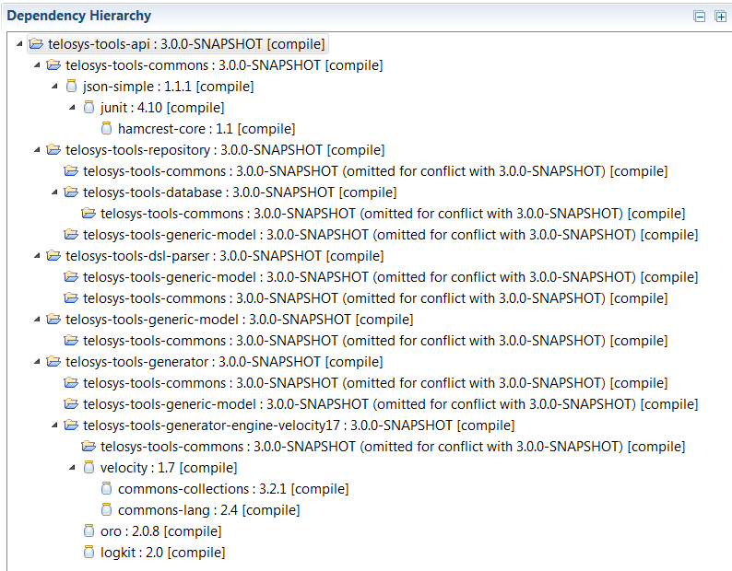
OLD

Slide 3
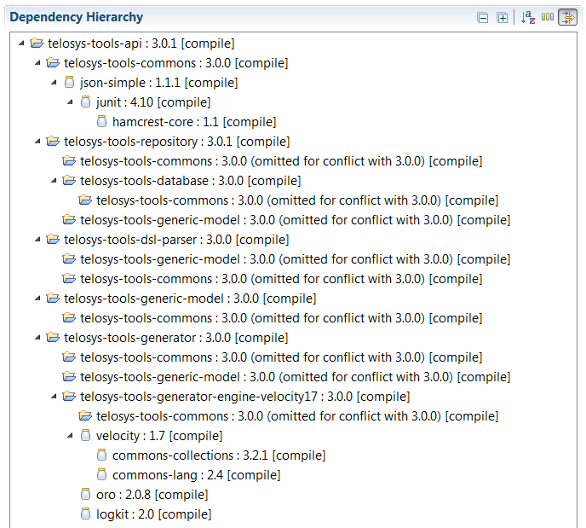
NEW

