Slide 1
Greetings Volunteer!
This is a customizable PowerPoint that can be used for a presentation of your service. This template can be adjusted for a presentation to a variety of audiences, including community groups, colleagues, school groups or media. Please customize each slide with any pictures you would like to share, and feel free to edit or delete any information or slides you do not want. Be sure to check the notes section below each slide for tips, links and guidance.
There are endless ways to present your volunteer work with Feed the Future. This presentation follows chronologically with your service. However, feel free to be creative in how you organize presentation flow.
Thank you for your sharing your volunteer experience!
**Delete this slide before presenting**

Slide 2
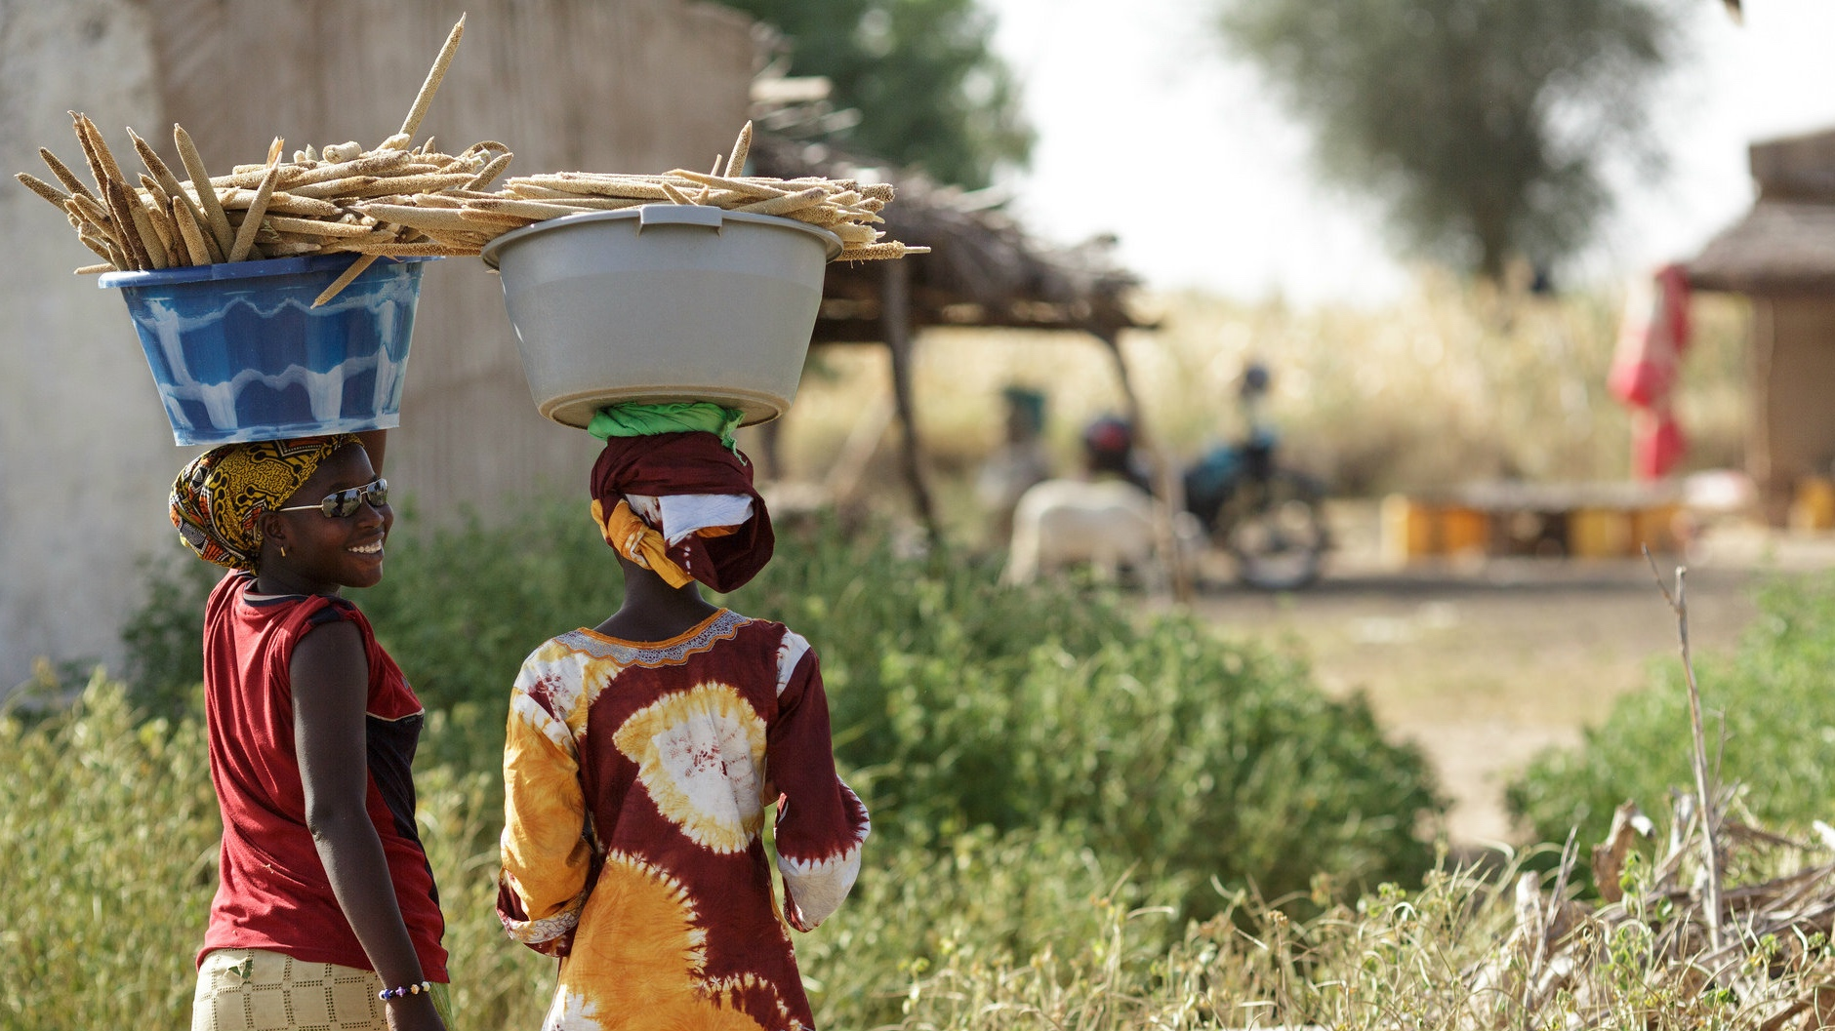

MY FEED THE FUTURE JOURNEY
VOLUNTEERING IN [INSERT COUNTRY]

Slide 3

WHAT IS FEED THE FUTURE?
Feed the Future is the U.S. Government's global hunger and food security initiative.
Feed the Future is helping countries transform their own agricultural sectors to address the root causes of hunger and poverty and forge long-term solutions to chronic food insecurity and undernutrition.

Slide 4











WHO IS INVOLVED?
Notes:
Who is involved:
United States Agency for International Development (USAID)
Millennium Challenge Corporation (MCC)
United States Department of Agriculture
Overseas Private Investment Corporation (OPIC)
United States Department of State
United States Geological Survey
United States Department of Commerce
Executive Office of the President (EOP)
Peace Corps
United States Department of the Treasury
America's Development Foundation (ADF)

Slide 5
HOW DO THEY WORK TOGETHER?
Feed the Future is working with:
Private Sector Companies
Partner Governments
Local Nonprofit Organizations and Groups
Universities & Researchers
U.S. Farmers, Ranchers, and NGOs

Slide 6

VOLUNTEERING WITH [YOUR PROGRAM NAME]
Volunteers can support food security and sustainability by serving as a Feed the Future volunteer through [USAID's Farmer-to-Farmer program, the Peace Corps, etc.]
The Farmer-to-Farmer (F2F) program promotes sustainable economic growth, food security and agricultural development worldwide.
**OR**
The Peace Corps is one of the eleven U.S. agencies that is working to increase food security and nutrition through the Feed the Future initiative.
**Remove and replace logos and text, as needed**

Slide 7
WHY IS FOOD SECURITY IMPORTANT?
I
II
III
Agriculture effectively reduces poverty and increases economic growth
Food security improves women’s and youth empowerment, entrepreneurship and nutrition
Food security increases community stability and underpins U.S. national security

Slide 8
ABOUT ME
Update with personal Feed the Future Photo
Insert a few bullets on your background:
Brief bio (Hometown, College, Work Experience)
Why you became interested in F2F/Peace Corps/other program
Location / Time/Country details about your F2F/Peace Corps/other trip
Notes:
Provide some information about yourself, why you decided to volunteer and the country you worked in. This could include facts like population and landmass (compare with a state in the USA, i.e., Mali is about the same size as Texas), average per capita income in US dollars, and other facts you think make your country unique. Be sure to use statistics only from reliable sources.
Feel free to add photos of your experience. Whenever possible, use references the audience knows already.

Slide 9
MY VOLUNTEER WORK
Update with image of country on a map
Insert a few bullets on the work you did with F2F/Peace Corps/other:
Brief summary of the country need
Details on your F2F/Peace Corps/other trip objective and goals
Results of your work (e.g., farmers engaged, crop yields, economic impact)
Brief summary of the work you did on your F2F/Peace Corps/other trip
Update with photo of the people you worked with
Notes:
Talk about working with the community, projects you started, completed, or continued.
Talk about your coworkers, counterparts, or students, and your working relationship.
What are you most proud of? What was the most challenging? What surprised you?
Tip*: Instead of talking all about work in technical terms, share the goal of your work and the outcomes.

Slide 10
WHAT I ACCOMPLISHED
Update with personal Feed the Future Photo
Insert a few bullets on what you accomplished with F2F/Peace Corps/other:
Results of your work (e.g., farmers engaged, crop yields, economic impact)
Follow-ups with those you helped
Plans to re-engage with F2F/Peace Corps/other
Notes:
Describe your site and show pictures of your experience. Was it remote, warm, vast, etc.? What crops/technology did you work on? What local organizations did you work with?
Did you take a video or pictures of your work site? Take them on a tour!

Slide 11
HOW TO GET INVOLVED
Update with personal Feed the Future Photo
JOIN
There are a wide range of jobs and opportunities available for individuals interested in getting involved with Feed the Future through the F2F Program and/or Peace Corps.
Visit Peace Corps https://www.peacecorps.gov/volunteer/ OR Famer to Farmer http://farmer-to-farmer.org/volunteers
ACT
Follow Feed the Future on Twitter (@FeedtheFuture) and/or Facebook (facebook.com/feedthefuture)
MY EMAIL: [INSERT EMAIL]

