Slide 1
MediSearch.ai
AI-generated comparison and summary of latest medical research trends for Continuous Medical Education users
AI CAPSTONE PROJECT
GROUP #2
Brent Rovner
Lauren Taylor
Steve D’Adamo
Williams Ozowe
Yemi Soyombo
Notes:
Insert product name

Slide 2



MISSION STATEMENT
PRODUCT VISION
MediSearch.ai
“Our mission is to enhance medical education and research with innovative technology, making lifelong learning in healthcare both enjoyable and impactful; and ultimately providing better healthcare for every person.”
Leverage Advanced AI: Harness cutting-edge AI technology to create dynamic, accurate summaries and comparisons of the latest medical research, thereby enhancing how users access and engage with medical information.
Personalized Lifelong Learning: Offers customized learning experiences with alerts and recommendations tailored to individual medical fields, fostering engaging and continuous professional development.
Research Comparison Tools: Features innovative tools for comparing current and historical research findings, highlighting differences and advancements to keep healthcare professionals informed and ahead in their practice.

Slide 3

PRODUCT SUMMARY
MediSearch.ai
MediSearch.ai is a product that enables continuous medical education users to quickly search information on a preferred topic through a plethora of scientific data and research papers, using an advanced AI search algorithm to:
1
Provide links to helpful references and sources
Compare and contrast current and past research findings
2
3
Provide a concise and up-to-date comparative summary of findings from the search result

Slide 4


PROBLEM STATEMENT
AI USE CASE
MediSearch.ai
An example could be that a new research paper has emerged two years after a medical trial that debunked the previous results. The summary would not only show the new information from the study but also show a comparison to the previous summary on what has changed. This can be used by medical practitioners for continuous education or for general research purposes.
Can we create a product with the capability to access scientific data repositories that allows continuing education users or researchers in the medical field to:
Research topics and provide appropriate reference articles for continued medical education
Provide a concise summary of the researched topic from the provided articles
Compare how the data sources have changed over time.
AI can be used to aggregate data from different medical repositories, find the more subtle updates to this data over time and provide a comparison of what has changed over time, unlike current research databases that can only provide current summaries.

Slide 5



HEALTHCARE INDUSTRY (1/2) - OVERVIEW
Definition: Businesses that provide medical services, manufacture medical equipment, or drugs, provided medical insurance, or otherwise facilitate the provision of healthcare to patients (Investopedia, 2021).
Global healthcare market is expected to reach $665B by 2028 according to Verified Market Research.
US Healthcare Sectors include:
Health Insurance
Healthcare Marketing
Pharmaceuticals
Healthcare Tech
Health Administration
75% of experts state that “A highly skilled and educated healthcare workforce results in improved patients, decrease in malpractice, and gain in financial performance”...

Slide 6


RISK
REWARD
HEALTHCARE INDUSTRY (2/2) - CONTINUING ED EXPLORED
Tri Council for nursing published a study stating that “Without a more educated nursing workforce, the nation’s health will further be at risk”
Increasing education for nursing in lower socioeconomic communities can reduce mortality rates as these communities are at greater risk for lack of education physicians.
9.5% of all deaths were due to error publicized from a 2016 study. Many of these deaths were proven to be due to lack of resource material.
Results of a study for nurses using the Kirkpatrick model showed promising results in improving clinical abilities by increasing CE requirements
Increased pain for post cancer patients when nurses were not provided with adequate continuing education materials.
Hospitals that published more often have lower risk mortality rates, increased ratings, and patient recommendations.

Slide 7




PAIN POINTS
TIME CONSTRAINT
LACK OF PERSONNEL
FINANCIAL COST
Journal of Medicine averaged the amount of time that would need to be spent by a physician practicing and applying continuing education with the current guidelines at 27 hours a day
Health systems are working to combat the decline in physicians and other highly educated practitioners by creating their own proprietary systems for learning and training.
Many scholarly articles today are posted behind paywalls adding to the exorbitant out of pocket cost of CE for providers.

Slide 8
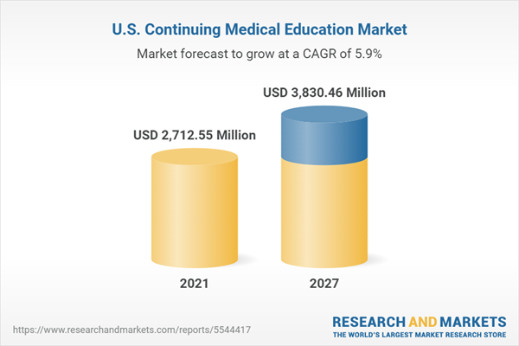


SURGEON
NURSE PRACTITIONER
PEDIATRICIAN
PSYCHIATRIST
TARGET USERS
CME expectation of 15 *CEUs per 24 month
Avg. expenditure on CE: $45,000
100 contact hours of advanced *CEUs every 5 years
Avg. expenditure on CE: $14,880
100 CME hours required per every 5 years
Avg. expenditure on CE: $30,000
30 specialty and/or subspecialty CME per year over 3 years
Avg. expenditure on CE: $1,000
*CEU - Continuing Education Units

Slide 9
MARKET SIZE
$60.5B Continuing Education Market with YoY growth expectation of ~7.5%
TAM
SAM
SOM
Healthcare Industry
Healthcare Marketing
Pharmaceuticals
Healthcare Tech
Health Administration
Health Administration/Education
Private Practice
Individual Users I.E. Physician
Universities
All Practicing Hospitals
Health Administration/Education
Universities
Learning Hospitals

Slide 10
PRODUCT GOAL - SIMPLE UX & EASE OF USE
BASE PRODUCT
COMPREHENSIVE SEARCH CAPABILITIES
Enable users to search across a wide array of scientific data and research papers, leveraging advanced search algorithms to ensure relevant and precise results. This will drastically reduce the time spent by users in finding the information they need
DYNAMIC SUMMARY GENERATION
Utilize AI to provide concise, up-to-date summaries of research findings. This feature will help users quickly grasp the essence of a study without needing to read the full text, saving time and making information more accessible.
AI
PRODUCT
HISTORICAL COMPARISON TOOLS
Introduce functionality to compare and contrast current research findings with past studies. This is particularly useful when new research debunks or supports previous results, offering users a clear view of how scientific understanding has evolved over time.
User may be able to drag and drop different papers of a subject together, and the tool automatically summarizes the key differences.
The tool will also create a timeline of the differences, so you can see a visual landscape.
CUSTOMIZABLE ALERTS & RECOMMENDATIONS
Allow users to set up personalized alerts and receive recommendations based on their research interests or fields of study. This feature will make it easier for users to stay informed about relevant new data and research papers, enhancing their knowledge and expertise over time.
Notes:
NOTES: [FEW BULLETS ON HOW THE PRODUCT WILL
ACHIEVE ITS GOAL AND RELIEVE THE PAIN
POINTS FOR THE TARGET USER IDENTIFIED IN
PREVIOUS SLIDE]

Slide 11
ADDITIONAL PRODUCT IMPACT
ACCELERATE SCIENTIFIC RESEARCH AND INNOVATION
By offering a platform where users can easily access, compare, and understand the latest research alongside historical data, the product will significantly reduce the time and effort required for reviews and data analysis. This acceleration in the research process can lead to faster breakthroughs and innovations, benefiting various scientific fields and industries.
ENHANCE QUALITY OF PROFESSIONAL PRACTICE
For practitioners in fields like medicine, engineering, and environmental science, having up-to-date knowledge is crucial for making informed decisions. The repository's ability to highlight new findings and compare them with existing data ensures that professionals can apply the latest evidence-based practices to their work, improving the quality of their services and outcomes.
SUPPORT LIFELONG LEARNING & PROFESSIONAL DEVELOPMENT
The continuous evolution of scientific knowledge necessitates ongoing education for professionals across disciplines. By providing easy access to the latest research and facilitating understanding through summaries and comparisons, the product encourages lifelong learning. It enables practitioners to stay at the forefront of their fields, fostering professional growth and enhancing the overall competency of the industry.
Notes:
NOTES: [FEW BULLETS OUTLINING EXTRA MERITS OF USING OUR PRODUCT
[RELATE IT TO ADDITIONAL INDUSTRY METRICS NOT ALREADY MENTIONED IN THE
PAIN POINTS]

Slide 12
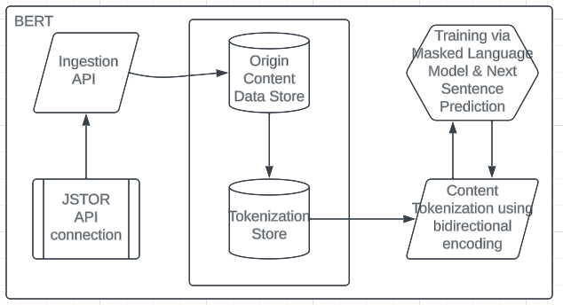
AI SOLUTION
This system uses Bidirectional Representation of Transformers (BERT), layered with additional tasks
to develop powerful search capabilities and dynamic text summary, as well as other features to contextualize a user’s search

Slide 13
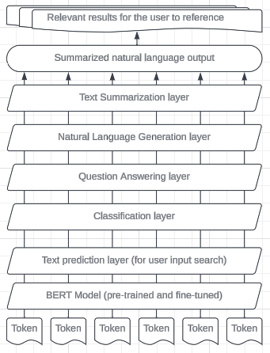
AI SOLUTION
(BERT + Layers)
The BERT model enables storage and tokenization of all research content, but it requires additional layers in order to perform the various tasks required to achieve MediSearch.ai’s goal

Slide 14
AI SOLUTION
MODEL MERITS
MODEL DEMERITS
Versatility for dynamic understanding of user input and multiple layers to perform various related tasks at once.
Semantic understanding for natural language tasks.
Bidirectional context to better understand user search inputs
Transfer Learning to perform individual tasks with relatively small data usage
The use of multiple layers increases the complexity of the model, and leaves more room for error.
Model’s complexity leads to higher cost of development, storage, maintenance, and re-training.
Low interpretability, where QA on BERT responses may be difficult to confirm.
Domain adaptation requires further fine-tuning for a domain-specific use case.
Inference latency may cause slowness in response to user inputs

Slide 15
AI MODEL DEVELOPMENT STEPS
1
2
3
4
5
Acquire corpus (body of text), such as a digital archive of research papers
Tokenize the corpus data into sentences and words.
Pre-train the model using MLM and NSP techniques.
Fine-Tune the model using SQaD, SWAG, and GLUE evaluation methods.
Layer the model with additional tasks to perform the desired outcomes.

Slide 16



GO-TO MARKET STRATEGY
ACQUISITION
ENGAGEMENT
RETENTION
Provide free trial to new users by starting with free trials in an academic setting in order for product to be featured in a research article
Pick a beta group of learning hospitals and offer group rates heavily discounted
Allow App store access to reach different demographics for ease of use
Google Ads targeting continuing education & research
Provide online learning portal and free training for new users
Create accounts on online platforms that allow customer feedback and engagement such as a forum, discord, etc.
Allow users to sign up for automated updates on new content
Provide meetups in person/online to foster interaction with published authors
Provide customer service free of cost for 30 days post adoption
Provide a promise of 30 new articles to come each month
Partner with key institutions that will allow company to showcase renowned as well as up and coming researchers publications
Continuously improve the model and incorporate feedback from the users

Slide 17


SUCCESS METRICS (1/2) - BUSINESS METRICS
Onboard 100,000 new CME users in the first year
5% bounce rate per user
Net Promoter Score (NPS) of 8 out of 10
ACQUISITION
SATISFACTION
5,000 monthly active users (MAU) by end of the first year
5% growth in MAU from the second year
90% click through rate (CTR) per user
Minimum of 6 linked references per research topic
Less than 2 minutes to display summary
30 lines per research topic summary
ENGAGEMENT
SPEED & QUALITY
Target 70% retention of all first year active users
100% conversion rate per active user
RETENTION

Slide 18


SUCCESS METRICS (2/2) - MODEL METRICS
The model’s ability to accurately classify research topics and serve them to users based on variable and dynamic search inputs is crucial for ensuring relevant search results. MediSearch.ai will rely on F1 score to balance between Precision and Accuracy, allowing for more nuanced evaluation of this multi-class model.
Returning results that are only partially related would be a better outcome to the user than failing to return results that are pertinent to their search query.
F1 SCORE
MediSearch.ai should reliably serve up the most relevant results for users, and not become biased towards “popular” results among users.
Predictive parity will be used as the primary metric to measure bias in the model. This will help ensure accurate positive classification of search results.
BIAS
MITIGATION

Slide 19


COMPETITOR ANALYSIS - LANDSCAPE OVERVIEW
US Continuing Education Financial Market
Reported 2022: $60.52B
Projection 2028: $93.25B
MEDBRIDGE provides some of the top instructors from around the world to create high quality education for clinicians without the cost associated for offline courses. They offer 1k+ accredited courses over a multitude of disciplines.
Wolters Kluwer CME/CE connection is the forefront for access to continuing education courses based on the highest quality and peer reviewed content brought to you by LWW (LippinCott Williams & Wilkins) and other leading providers.
Highly competitive market involving larger institutions with cont. ed providers
AI has increased projected market value forecast as it will improve access to learning which in turn will improve learning outcomes

Slide 20
SWOT ANALYSIS OF COMPETING PRODUCTS
MEDBRIDGE
Wolters Kluwer
MediSearch.ai
STRENGTHS
50+ new courses added monthly based on new research and client requests
Approved and accredited info tailored to profession that goes towards CE
Utilizes latest AI technology to create dynamic, accurate summaries and comparisons of latest medical research
WEAKNESS
Vast and board nature of the data can feel all consuming and overwhelming for users
Focuses only on accreditation material which can reduce newly available research articles
AI solution requires constant updates and vast amounts of data from several medical repositories for training
Tailor and create learning paths for healthcare specializations
Continue to capitalize on branching out into healthcare specialties
Offers both monthly or yearly SaaS subscription and a one-time software license package delivery model
OPPORTUNITIES
With only yearly subscription pricing available, it does not provide a safe way for the user to try the product
Pricing is not readily available which can turn off potential customers prior to trying
Other generic summary generating products built on AI platforms available on the internet for free
THREATS

Slide 21
END
THANKS FOR YOUR INSIGHTFUL AND IMPACTFUL TEACHING THROUGHOUT THE COURSE

