Slide 1
Figure prototyping with ggplot2
Lyuba V. Bozhilova
MBU PostDoc Workshop, 5 May 2022

Slide 2
Housekeeping notes
You need a laptop with R and RStudio installed.
Workshop materials: https://tinyurl.com/pfc-datavis
Please ask questions & give feedback anytime!
Irrelevant, but some of us run on Thursdays…

Slide 3
Outline
Part 1: What is the Grammar of Graphics?
Part II: Creating complex, versatile plots
Part III: Refining figures
There are exercises throughout, go at your own pace.
Already using ggplot2? Try #TidyTuesday.

Slide 4
Outline
Part 1: What is the Grammar of Graphics?
Part II: Creating complex, versatile plots
Part III: Refining figures
There are exercises throughout, go at your own pace.
Already using ggplot2? Try #TidyTuesday.
Slides, now
Code, later

Slide 5
The Grammar of Graphics
Big Idea: Plots are made by adding separate, (semi)-independent elements together.
Some elements are essential, they make the plot work:
data
aesthetic mappings
geometric objects
Some elements are there to make things pretty:
scales
annotation
themes
Part II
Part III

Slide 6
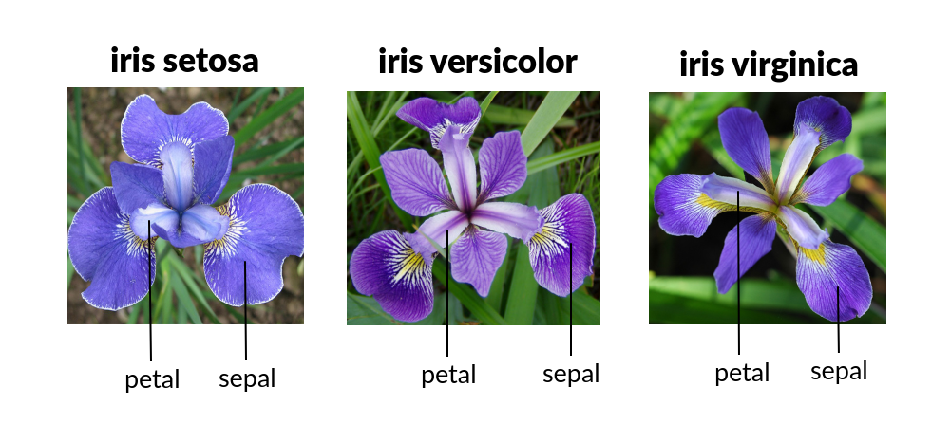
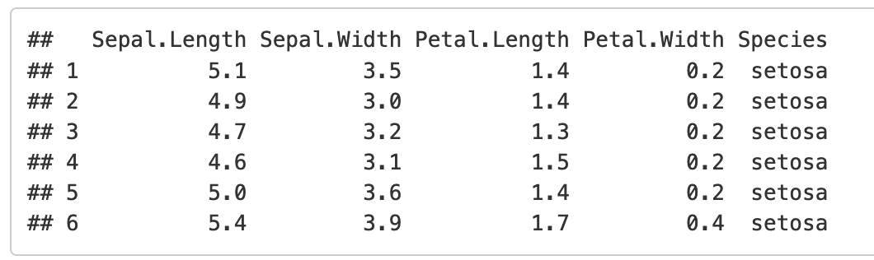
Fisher’s iris data
Famous toy dataset
Five variables, 150 observations
Data frame format
columns are variables
rows are observations

Slide 7
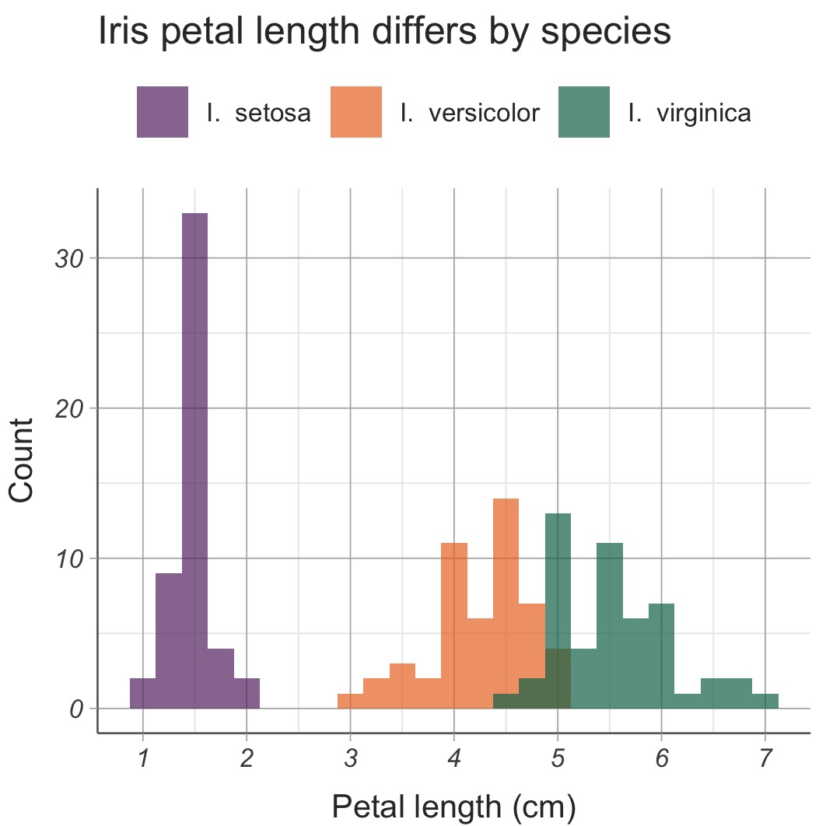

Slide 8
Data: iris data
Aesthetic mappings
colour: species
x-axis: petal length
Geometric object
histogram

Slide 9
Core ggplot2 elements
Data
Multiple observations of one or more variables
Variables can be of many types: numeric, categorical, time, etc.
Aesthetic mappings
How do the variables map onto plot elements?
Think axes, colours, shapes, line type…
Geometric objects
What kind of statistical plot do we see?
E.g. histogram, scatter plot, box plot

Slide 10
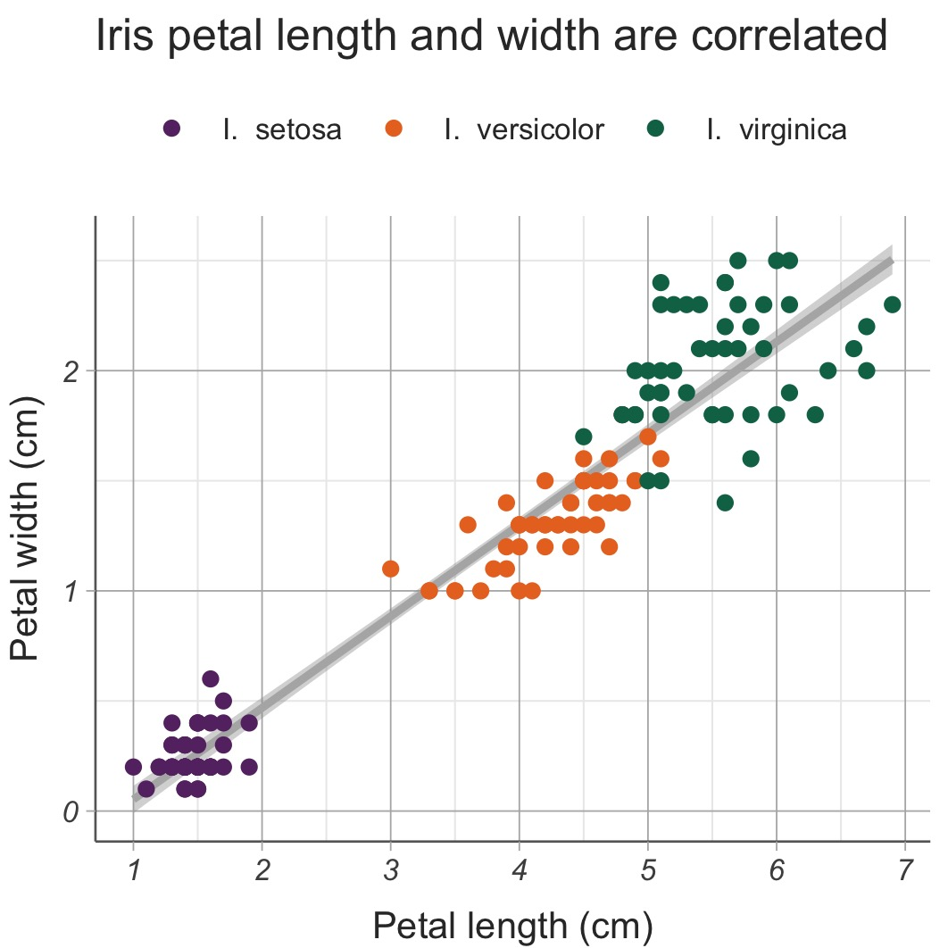

Slide 11
Data: iris data
Aesthetic mappings
colour: species
x-axis: petal length
y-axis: petal width
Geometric objects
scatter plot
regression line

Slide 12
The rest of the workshop
Part II: functional plots
How ggplot2 code works
More aesthetic mappings
Geometric objects: how to add them together effectively, and how to use stats and positioning
Facets
Part III: pretty figures
Scales to make aesthetics pretty
Themes to make everything else pretty
Annotations can be helpful
Make subfigures
Save figures with good resolution and font size

Slide 13
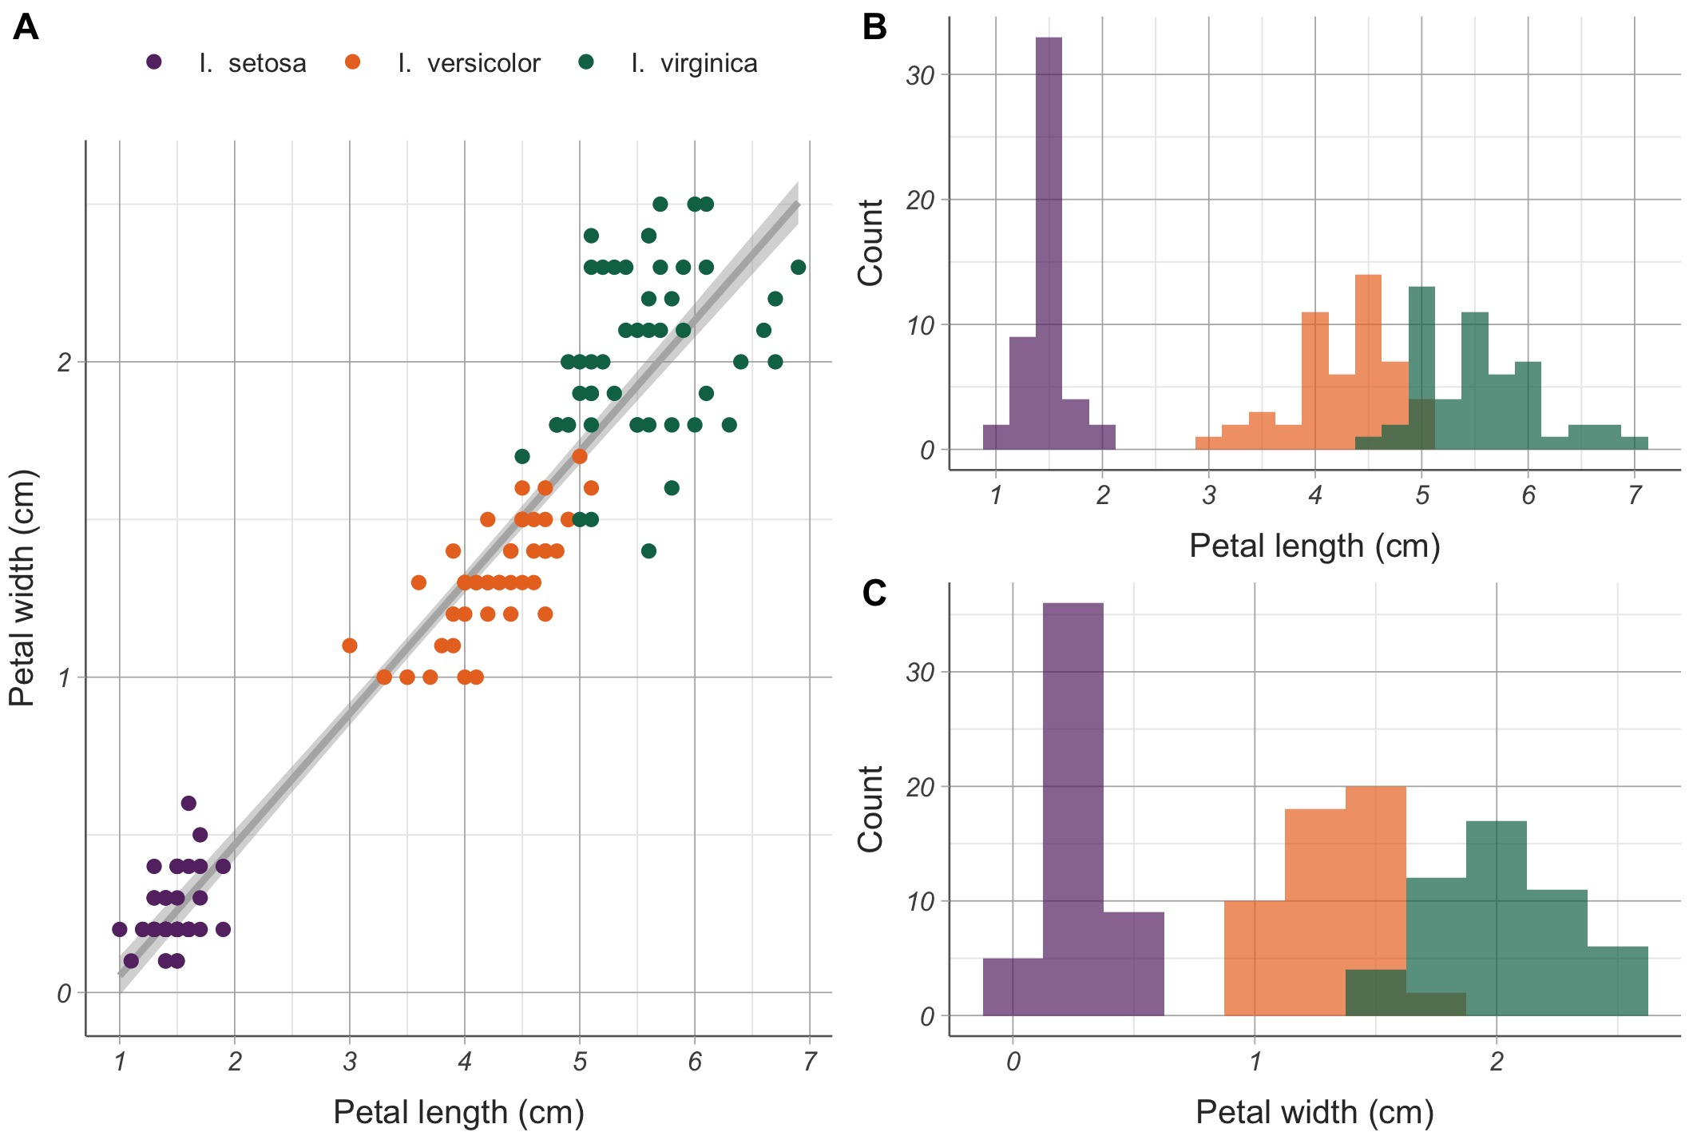
End goal

Slide 14
#TidyTuesday
Tidy Tuesday is an online community project, in which practice their tidyverse / ggplot2 skills.
GitHub repo
New dataset every week
this week: solar and wind power plants in the US
two weeks ago: UK cryptic crosswords
People share their code and figures, so you can learn a lot!

