Slide 1

Updated Introduction
to
Creative Commons
Released under Creative Commons Attribution 3.0 Hong Kong Licence
Released under Creative Commons Attribution 3.0 Hong Kong Licence

Slide 2
Creative Commons
Simplify Sharing
Reduce the FEAR in
using Copyrighted Materials
Simulate Creativity

Slide 3
History of Creative Commons
2001 Kick-Off
2002 Six Licences
(Six Contracts)

Slide 4


Choices
©
All Rights Reserved
Creative Commons
Public Domain
Notes:
Before Creative Commons, creators can either keep all their copyrights, or, put their creations in the public domain, where they have no control of their rights. Creative Commons provides an array of choices, for creators to choose what they want to control and what to give away.

Slide 5




licence elements:
Attribution 署名
Non-Commercial 非商業性
No Derivative Works 禁止衍生
Share Alike 相同方式共享
Notes:
The first symbol means Attribution or “BY.” All of the licenses include this condition.
The second symbol means NonCommercial or “NC,” which means the work is only available to be used for noncommercial purposes. Three of the CC licenses include this restriction.
The third symbol means ShareAlike or “SA,” which means that adaptations based on this work must be licensed under the same license. Two of the CC licenses include this condition.
The forth symbol means NoDerivatives or “ND,” which means reusers cannot share adaptations of the work. Two of the CC licenses include this restriction.

Slide 6


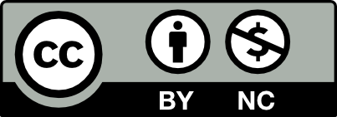

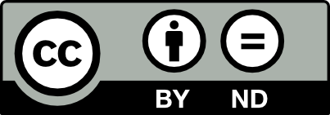
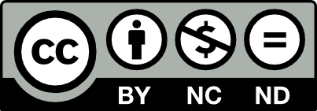
the licences
6 variations
Attribution
(by)
Attribution Share Alike
(by-sa)
Attribution Non-commercial
(by-nc)
Attribution Non-commercial Share Alike
(by-nc-sa)
Attribution No Derivatives
(by-nd)
Attribution Non-commercial No Derivatives (by-nc-nd)
Notes:
The four license elements—BY, SA, NC, and ND—combine to make up six different license options.
All of the licenses include the BY condition. In other words, all of the licenses require that the creator be attributed in connection with their work. Beyond that commonality, the licenses vary whether (1) commercial use of the work is permitted; and (2) whether the work can be adapted, and if so, on what terms.
The six licenses, from least to most restrictive in terms of the freedoms granted reusers are listed above.

Slide 7
授權條款
6 個不同條款
署名
(by)
署名 相同方式共享
(by-sa)
署名 非商業性
(by-nc)
署名 非商業性 相同方式共享
(by-nc-sa)
署名 禁止衍生
(by-nd)
署名 非商業性 禁止衍生
(by-nc-nd)
Notes:
The Attribution license or “CC BY” allows people to use the work for any purpose (even commercially and even in modified form) as long as they give attribution to the creator.
CC BY SA image
The Attribution-ShareAlike license or “BY-SA” allows people to use the work for any purpose (even commercially and even in modified form), as long as they give attribution to the creator and make any adaptations they share with others available under the same or a compatible license. This is CC’s version of a copyleft license, and is the license required for content uploaded to Wikipedia, for example.
CC BY NC image
The Attribution-NonCommercial license or “BY-NC” allows people to use the work for noncommercial purposes only, and only as long as they give attribution to the creator.
CC BY NC SA image
The Attribution-NonCommercial-ShareAlike license or “BY-NC-SA” allows people to use the work for noncommercial purposes only, and only as long as they give attribution to the creator and make any adaptations they share with others available under the same or a compatible license.
CC BY ND image
The Attribution-NoDerivatives license or “BY-ND” allows people to use the unadapted work for any purpose (even commercially), as long as they give attribution to the creator.
CC BY NC ND image
The Attribution-NonCommercial-NoDerivatives license or “BY-NC-ND” is the most restrictive license offered by CC. It allows people to use the unadapted work for noncommercial purposes only, and only as long as they give attribution to the licensor.

Slide 8
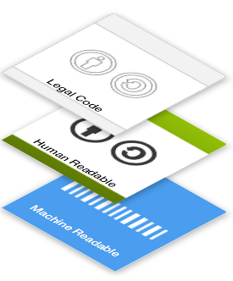
three layers design
Layers 2016, https://creativecommons.org/share-your-work/licensing-considerations/layers/ , CC-BY 4.0
Notes:
The licenses were designed to be a free, voluntary solution for creators who want to grant the public up-front permissions to use their works. Although they are legally enforceable tools, they were designed in a way that was intended to make them accessible to non-lawyers.
The licenses are built using a three layer design.

Slide 9
three layers of a licence
Lawyer-Readable: Legal Code
Human-Readable: Commons Deeds
Machine-Readable: Digital Code, Metadata

Slide 10
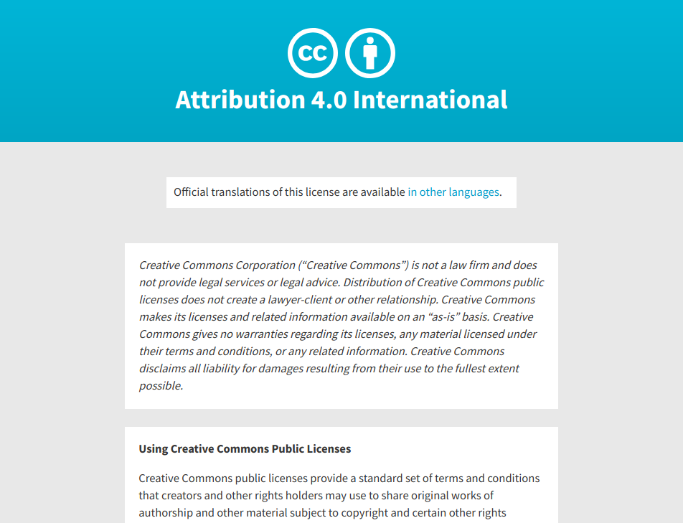
Legal Code 授權條款全文
Notes:
The legal code is the base layer. This contains the “lawyer-readable” terms and conditions that are legally enforceable in court. Take a minute and scan through the legal code of CC BY to see how it is structured. Can you find where the attribution requirements are listed?

Slide 11
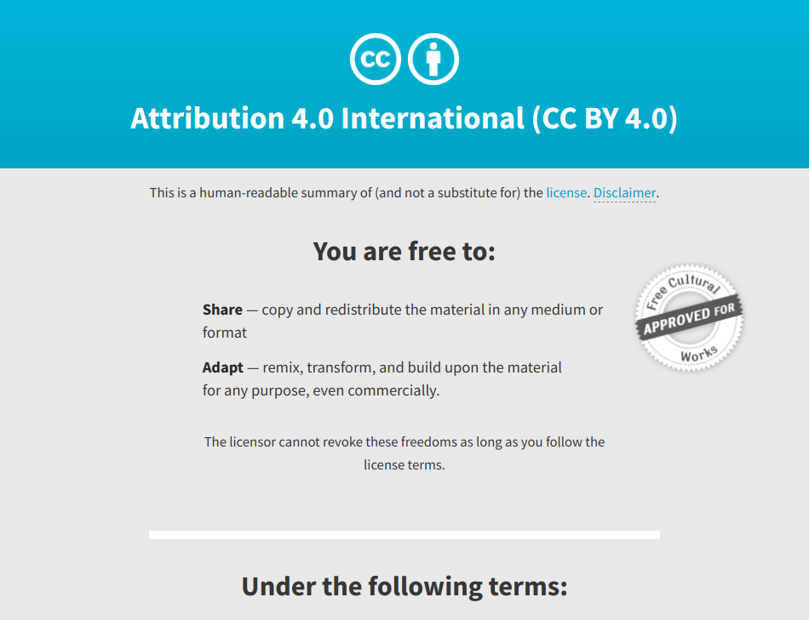
Commons Deeds 法律條款的摘要
Notes:
The commons deeds are the most well-known layer of the licenses. These are the web pages that lay out the key license terms in so-called “human-readable” terms. The deeds are not legally enforceable but instead summarize the legal code. Take some time to explore the deeds for CC BY and CC BY-NC-ND and identify how they differ. Can you find the links to the legal code from each deed?

Slide 12
Digital Code 數碼源碼
<a rel="license" href="http://creativecommons.org/licenses/by/4.0/"><img alt="Creative Commons License" style="border-width:0" src="https://i.creativecommons.org/l/by/4.0/88x31.png" /></a><br />This work is licensed under a <a rel="license" href="http://creativecommons.org/licenses/by/4.0/">Creative Commons Attribution 4.0 International License</a>.
Notes:
The final layer of the license design recognizes that software plays a critical role in the creation, copying, discovery, and distribution of works. In order to make it easy for websites and web services to know when a work is available under a Creative Commons license, we provide a “machine readable” version of the license—a summary of the key freedoms granted and obligations imposed written into a format that applications, search engines, and other kinds of technology can understand. We developed a standardized way to describe licenses that software can understand called CC Rights Expression Language (CC REL) to accomplish this. When this metadata is attached to CC licensed works, someone searching for a CC licensed work using a search engine (e.g., Google advanced search) can more easily discover CC licensed works.

Slide 13
Creative Commons
against
Fair Use
or
Fair Dealings?
Notes:
By design, CC licenses do not reduce, limit, or restrict any rights under exceptions and limitations to copyright, such as fair use or fair dealing. If your use of CC-licensed material would otherwise be allowed because of an applicable exception or limitation, you do not need to rely on the CC license or comply with its terms and conditions. This is a fundamental principle of CC licensing.

Slide 14
Creative Commons
with
Public Domain?
Notes:
CC licenses should not be applied to works in the worldwide public domain. All CC licenses are clear that they do not have the effect of placing restrictions on material that would otherwise be unrestricted, and you cannot remove a work from the public domain by applying a CC license to it. If you want to dedicate your own work to the public domain before the expiration of applicable copyright or similar rights, use CC's legally robust public domain dedication. If a work is already in the worldwide public domain, you should mark it with CC's Public Domain Mark.

Slide 15
Credits
This set of slides is based on Rebecca McKinnon (2008). Creative Commons: Copyright in the digital age for Greater China and Hong Kong, from http://www.slideshare.net/rmackinnon/cc-hku-129484 , CC-BY 2.5 Unported.
Most of the text in the notes section is taken from the course material of "Creative Commons Certificate for Educators and Librarians", https://certificates.creativecommons.org/cccertedu/ , CC-BY 4.0.

