Slide 1
CREATIVE COMMONS
Lift the Fear of Sharing
Background: a snowy ball of cat by ryanne lai, https://www.flickr.com/photos/laihiu/2552250/ ,
CC-BY-NC 2.0
Notes:
Creative Commons(CC) is a defacto standard to share copyrighted content legally internationally. In the last few hundred years, creativity works are increasingly controlled under the copyright system which grows more complex everyday. You can get into trouble if you use content not according to this system. CC licences lift the fear to share and use copyrighted content.
(Text released under CC-BY 4.0)

Slide 2
MICKEY MOUSE
OF COPYRIGHT?
Sonny Bono Copyright Term Extension Act
Background: a snowy ball of cat by ryanne lai, https://www.flickr.com/photos/laihiu/2552250/ ,
CC-BY-NC 2.0
Notes:
The term of copyright was lengthened again when the Sonny Bono Copyright Term Extension Act (CTEA) was enacted in 1998. It extended the term of copyright for every work in the United States—even those already published—for an additional 20 years, so the copyright term equaled the life of the creator plus 70 years. The CTEA was commonly referred to as the Mickey Mouse Protection Act because the extension came just before the original Mickey Mouse cartoon, Steamboat Willie, would have fallen into the public domain.
(Text taken from the Creative Commons Certificate for Educators and Librarians, https://certificates.creativecommons.org/cccertedu/chapter/1-1-the-story-of-creative-commons/ , CC-BY 4.0)

Slide 3
Eldred v. Ashcroft
CHALLENGE COPYRIGHT!
Background: a snowy ball of cat by ryanne lai, https://www.flickr.com/photos/laihiu/2552250/ ,
CC-BY-NC 2.0
Notes:
Lessig represented a web publisher, Eric Eldred, who had made a career of making works available as they passed into the public domain. Together, they challenged the constitutionality of the Act. The case, known as Eldred v. Ashcroft, went all the way to the U.S. Supreme Court. Eldred lost.
(Text taken from the Creative Commons Certificate for Educators and Librarians, https://certificates.creativecommons.org/cccertedu/chapter/1-1-the-story-of-creative-commons/ , CC-BY 4.0)

Slide 4
CREATIVE COMMONS BORN!
Licences for Sharing
Background: a snowy ball of cat by ryanne lai, https://www.flickr.com/photos/laihiu/2552250/ ,
CC-BY-NC 2.0
Notes:
Inspired by the value of Eldred’s goal to make more creative works freely available on the internet, and responding to a growing community of bloggers who were creating, remixing and sharing content, Lessig and others came up with an idea. They created a nonprofit organization called Creative Commons and, in 2002, they published the Creative Commons licenses—a set of free, public licenses.
(Text taken from the Creative Commons Certificate for Educators and Librarians, https://certificates.creativecommons.org/cccertedu/chapter/1-1-the-story-of-creative-commons/ , CC-BY 4.0)

Slide 5
CREATIVE COMMONS LICENCES
Choices for Sharing
Background: a snowy ball of cat by ryanne lai, https://www.flickr.com/photos/laihiu/2552250/ ,
CC-BY-NC 2.0
Notes:
Creative Commons licenses are a set of free, public licenses that would allow creators to keep their copyrights while sharing their works on more flexible terms than the default “all rights reserved.” Copyright is automatic, whether you want it or not. And while some people want to reserve all of their rights, many want to share their work with the public more freely. The idea behind CC licensing was to create an easy way for creators who wanted to share their works in ways that were consistent with copyright law.
(Text taken from the Creative Commons Certificate for Educators and Librarians, https://certificates.creativecommons.org/cccertedu/chapter/1-1-the-story-of-creative-commons/ , CC-BY 4.0)

Slide 6
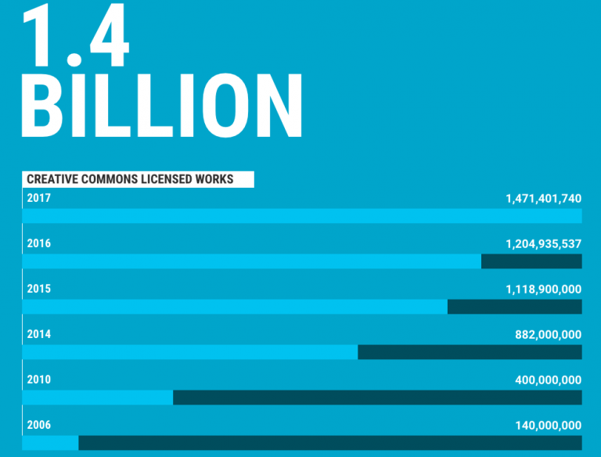
CREATIVE COMMONS LICENCES
Choices for Sharing
Background: a snowy ball of cat by ryanne lai, https://www.flickr.com/photos/laihiu/2552250/ ,
CC-BY-NC 2.0
Creative Commons Certificate for Educators and Librarians, https://certificates.creativecommons.org/cccertedu/chapter/1-1-the-story-of-creative-commons/ , CC-BY 4.0
Notes:
Today Creative Commons licenses are used by more than 1.4 billion works online across 9 million websites. The grand experiment that started more than 15 years ago has been a success, including in ways unimagined by CC’s founders.
(Text taken from the Creative Commons Certificate for Educators and Librarians, https://certificates.creativecommons.org/cccertedu/chapter/1-1-the-story-of-creative-commons/ , CC-BY 4.0)

Slide 7
CREATIVE COMMONS GLOBAL
The Movement &
The Organisation
Background: a snowy ball of cat by ryanne lai, https://www.flickr.com/photos/laihiu/2552250/ ,
CC-BY-NC 2.0
Notes:
Over the years, a global coalition of people has formed around Creative Commons and open licensing. This includes activists working on copyright reform around the globe, policymakers advancing policies mandating open access to research and data, and creators who share a core set of values. Most of the people and institutions who are part of the CC movement are not formally connected to Creative Commons.
Creative Commons is also a small nonprofit organization stewards the Creative Commons legal tools and helps power the open movement. CC is a distributed organization, with CC staff and contractors working from various locations around the world.
This CC Global Network is just one player in the larger open movement, which includes Wikipedians, Mozillians, open access advocates, and many more.
(Text taken from the Creative Commons Certificate for Educators and Librarians, https://certificates.creativecommons.org/cccertedu/chapter/1-2-creative-commons-today/ , CC-BY 4.0)

