Slide 1
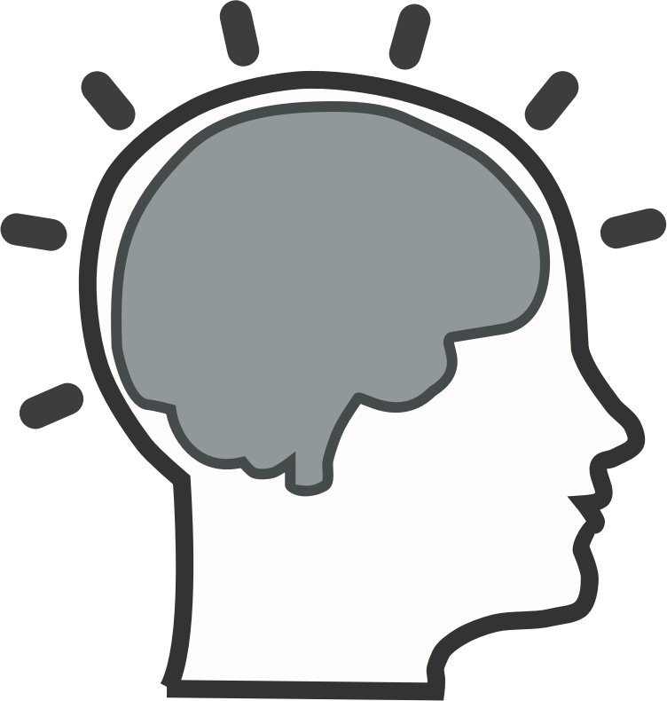
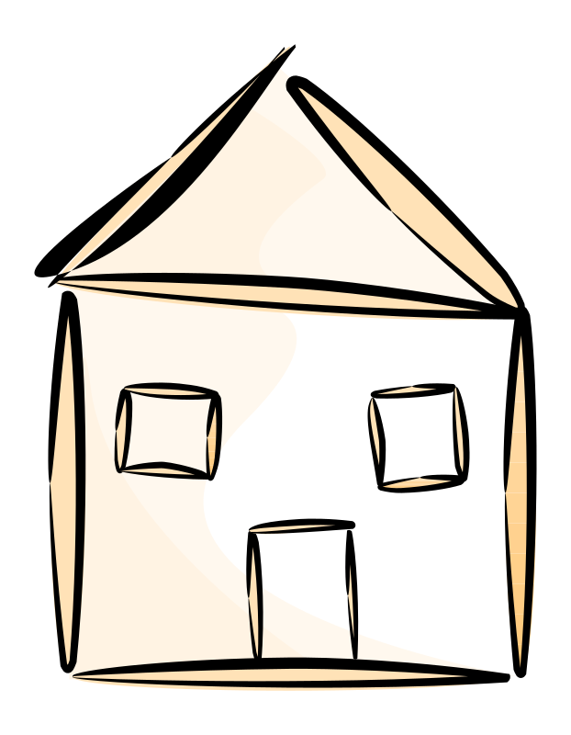
INTELLECTUAL PROPERTY
A Strange Concept
Clip Art from Open Clip Art
https://openclipart.org/detail/193152/brain-activity-metacognition
https://openclipart.org/detail/2026/stylized-house
Notes:
Intellectual Property is a strange concept. Ideas are neither physical, nor rival. Unlike physical properties, when a house was sold, the previous owner would not have the house any more. But when ideas are shared, the original inventor will not lose it. Watch this video https://www.youtube.com/watch?v=IeTybKL1pM4
(Text released under CC-BY 4.0)

Slide 2
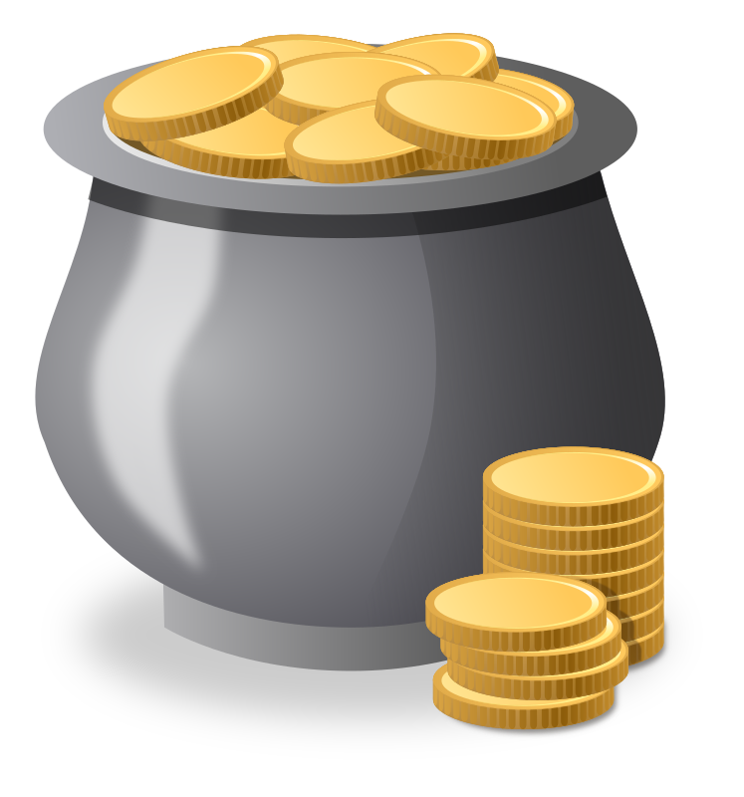
COPYRIGHT
A Strange
Incentive
Clip Art from Open Clip Art
https://openclipart.org/detail/193152/brain-activity-metacognition
https://openclipart.org/detail/171507/money-pot
Notes:
One type of Intellectual Property is Copyright. It is design to simulate more creativity by putting limits on creative works. In the "Copyright Clause" of the US Constitution, 1787 - "To promote the Progress of Science and useful Arts, by securing for limited Times to Authors and Inventors the exclusive Right to their respective Writings and Discoveries."
There are two primary rationales for copyright law, though rationales do vary among legal traditions.
Utilitarian: Under this rationale, copyright is designed to provide an incentive to creators. The aim is to encourage the creation of new works.
Author’s rights: Under this rationale, copyright is primarily intended to ensure attribution for authors and preserve the integrity of creative works. The aim is to recognize and protect the deep connection authors have with their creative works.
(Text remixed from the Creative Commons Certificate for Educators and Librarians, https://certificates.creativecommons.org/cccertedu/chapter/1-1-the-story-of-creative-commons/ , CC-BY 4.0)

Slide 3
COPYRIGHT
When and How?
Clip Art from Open Clip Art
https://openclipart.org/detail/193152/brain-activity-metacognition
https://openclipart.org/detail/2026/stylized-house
Notes:
Copyright applies to works of original authorship, which means works that are unique and not a copy of someone else’s work, and most of the time requires fixation in a tangible medium (written down, recorded, saved to your computer, etc.).
Works that are copyrightable can be:
- Literary and artistic works
- Translations, adaptations, arrangements of music and alterations of literary and artistic works
- Collections of literary and artistic works
Copyright does not protect facts or ideas themselves, only the expression of those facts or ideas. That may sound simple, but unfortunately it is not. The difference between an idea and the expression of that idea can be tricky, but it’s also extremely important to understand. While copyright law gives creators control over the expression of an idea, it does not allow the copyright holder to own or exclusively control the idea itself.
As a general rule, copyright is automatic the moment a work is fixed in a tangible medium. This is when an intellectual idea becomes a property of the creator. For example, you have a copyright as soon as you type the first stanza of your poem or record a song in most countries. Copyright protection can last a long time, even after the death of the creator.
(Text remixed from the Creative Commons Certificate for Educators and Librarians, https://certificates.creativecommons.org/cccertedu/chapter/1-1-the-story-of-creative-commons/ , CC-BY 4.0)

Slide 4
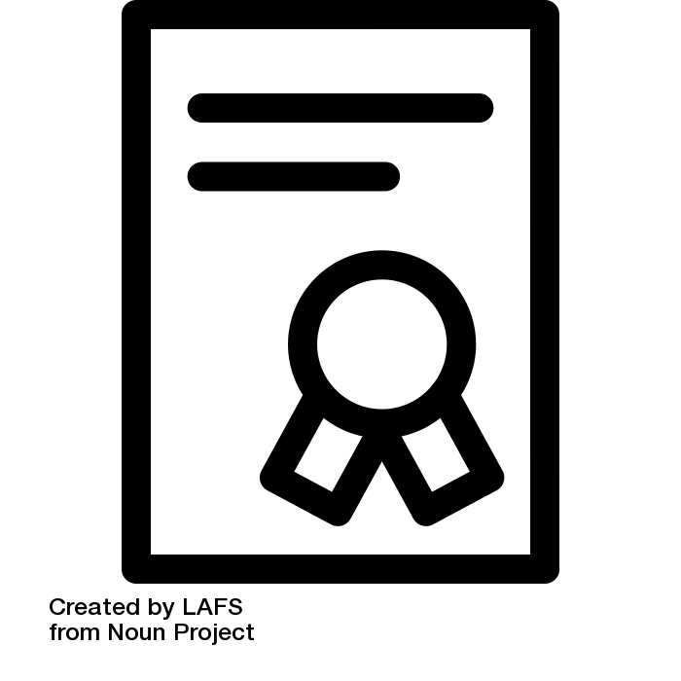
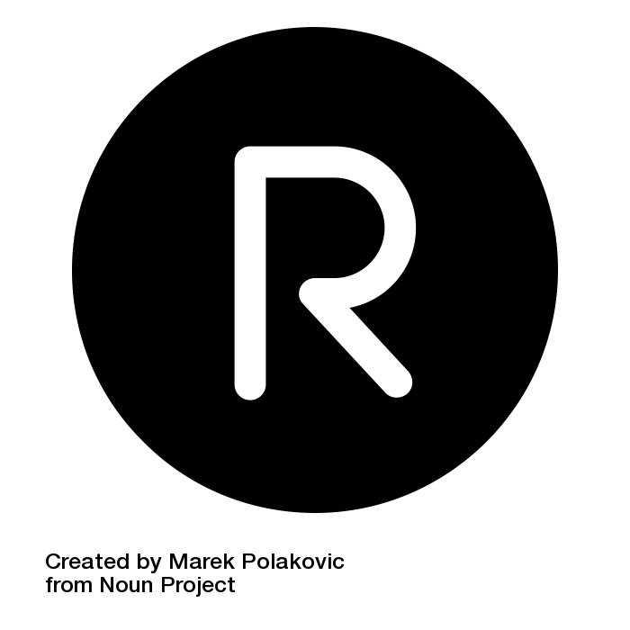
COPYRIGHT'S
BROTHERS
Patent and TM
Clip Art from Noun Project CC-BY 3.0 US
Patent by LAFS, https://thenounproject.com/term/patent/582626/
registered by Marek Polakovic, https://thenounproject.com/term/trademark/113954/
Notes:
Intellectual property is the term used for rights – established by law – that empower creators to restrict others from using their creative works. Copyright is one type of intellectual property, but there are many others. To help understand copyright, it is important to have a basic understanding of at least two other types of intellectual property rights and the laws that protect those rights.
Trademark law generally protects the public from being confused about the source of a good, service, or establishment. The holder of a trademark is generally allowed to prevent uses of its trademark by others if the public will be confused. Examples of trademarks are the golden arches used by McDonald’s, or the brand name Coca-Cola. Trademark law helps producers of goods and services protect their reputation, and it protects the public by giving them a simple way to differentiate between similar products and services.
Patent law gives inventors a time-limited monopoly to their inventions — things like mouse traps or new mobile phone technology. Patents typically give inventors the exclusive right to make, have made, use, have used, offer for sale, sell, have sold, or import patentable inventions.
(Text is taken from the Creative Commons Certificate for Educators and Librarians, https://certificates.creativecommons.org/cccertedu/chapter/1-1-the-story-of-creative-commons/ , CC-BY 4.0)

Slide 5
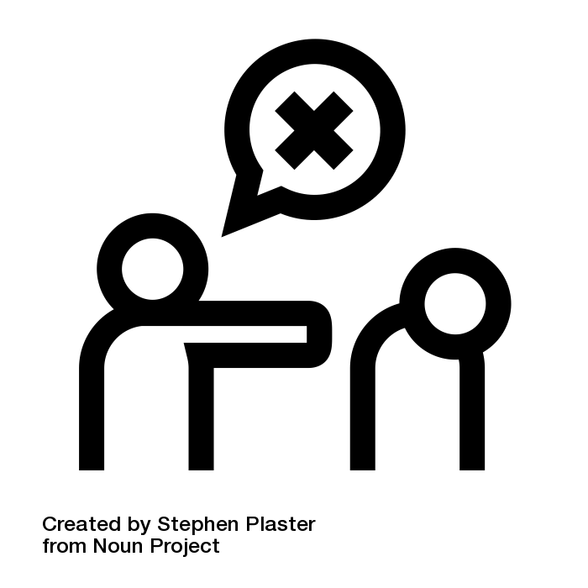
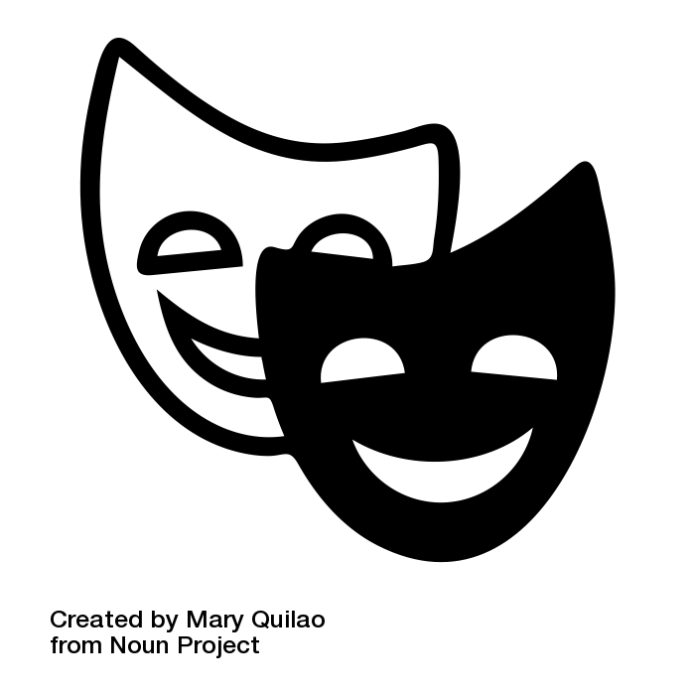
FAIR USE
FAIR DEALING
Exceptions of
Copyright
Clip Art from Noun Project CC-BY 3.0 US
criticism by Stephen Plaster, https://thenounproject.com/term/criticism/475444/
Comedy by Mary Quilao from the Noun Project, https://thenounproject.com/term/comedy/527705/
Notes:
Intellectual Property is non-material and non-rival. If the control of IP is too tight, no ideas can be shared and civilisations die. So copyright is not absolute. There are some uses of copyrighted works that do not require permission. These uses are limitations on the exclusive rights normally granted to copyright holders and are known as “exceptions and limitations” to copyright.
Fair use, fair dealing and other exceptions and limitations to copyright are an extremely important part of copyright design. Some countries afford exceptions and limitations to copyright, such as fair dealing, and other countries do not offer exceptions or limitations at all.[1] If your use of another’s copyrighted work is “fair” or falls within another exception or limitation to copyright, then you are not infringing the creator’s copyright.
When legislators created copyright protections, they realized that allowing copyright to restrict all uses of creative works could be highly problematic. For example, how could scholars or critics write about plays, books, movies, or other art without quoting from them? (It would be extremely difficult.) And would copyright holders be inclined to provide licenses or other permission to people whose reviews might be negative? (Probably not.)
For this and a range of other reasons, certain uses are explicitly carved out from copyright – including, in most parts of the world, uses for purposes of criticism, parody, access for the visually impaired, and more.
(Text remixed from the Creative Commons Certificate for Educators and Librarians, https://certificates.creativecommons.org/cccertedu/chapter/1-1-the-story-of-creative-commons/ , CC-BY 4.0)

Slide 6


PUBLIC DOMAIN
Beyond
Copyright
Notes:
Despite the expansive reach of copyright, there is still a rich (and growing) public domain full of works which are free from copyright. Works enter the public domain in one of four ways:
1.The copyright expires.
2.The copyright holder failed to comply with formalities to acquire or maintain their copyright.
3. The work was never entitled to copyright protection.
4. The creator dedicates the work to the public domain before copyright has expired.
(Text is taken from the Creative Commons Certificate for Educators and Librarians, https://certificates.creativecommons.org/cccertedu/chapter/1-1-the-story-of-creative-commons/ , CC-BY 4.0)

