Slide 1
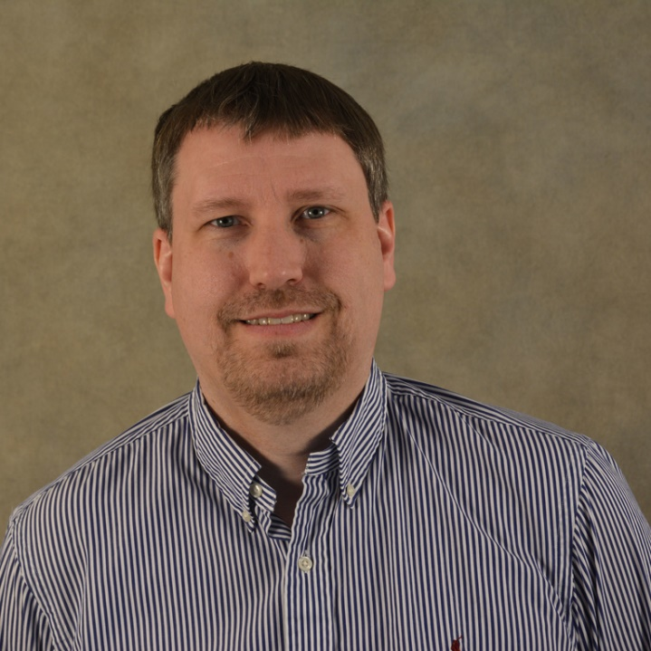
Alveolar macrophages act as an early viral sponge resulting in long-lived functional enhancement
Department of Pathobiological Sciences
Steven Varga, Ph.D.
Associate Dean for Academic Affairs and Graduate Student Development & Professor of Microbiology and Immunology University of Iowa School of Medicine
March 17, 2022
12:00 PM
Louisiana State University • Center for Lung Biology and Disease
Contact Ky Hoang (kyhoang@lsu.edu) for more information

