Slide 1
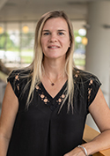
Epigenetics in Vascular Disease
Katherine Gallagher, M.D., F.A.C.S.
Professor, Department of Surgery,
University of Michigan School of Medicine
March 03, 2022
12:00 PM
Louisiana State University • Center for Lung Biology and Disease
Contact Duane Jeansonne (wfontenot1@lsu.edu) for more information

