Slide 1


LBRN - HPC systems : CCT, LSU

Slide 2
HPC systems @ CCT & LSU
LSU HPC
Philip
SuperMike-II
SuperMIC
LONI HPC
Eric
Qeenbee2
CCT HPC
Delta

Slide 3
LSU HPC
Philip
3 Compute Nodes | Two 2.93 GHz Quad Core Nehalem Xeon 64-bit Processors 96GB 1066MHz Ram 146GB HD 10/100/1000 Ethernet network interface Red Hat Enterprise Linux 5
32 Compute Nodes | Two 2.93 GHz Quad Core Nehalem Xeon 64-bit Processors 24GB 1333MHz Ram 146GB HD 10/100/1000 Ethernet network interface Red Hat Enterprise Linux 5
1 Login Node | Two 2.93 GHz Quad Core Nehalem Xeon 64-bit Processors 48GB 1066MHz Ram 146GB HD 10/100/1000 Ethernet network interface Red Hat Enterprise Linux 5
Cluster Storage | 190TB DDN storage running Lustre

Slide 4
LSU HPC
SuperMike-II
2 Interactive Nodes | Two 2.6 GHz 8-Core Sandy Bridge Xeon 64-bit Processors 64GB 1666MHz Ram 500GB HD 40 Gigabit/sec Infiniband network interface 1 Gigabit Ethernet network interface Red Hat Enterprise Linux 6
382 Compute Nodes | Two 2.6 GHz 8-Core Sandy Bridge Xeon 64-bit Processors 32GB 1666MHz Ram 500GB HD 40 Gigabit/sec Infiniband network interface 1 Gigabit Ethernet network interface Red Hat Enterprise Linux 6
50 Compute Nodes | Two 2.6 GHz 8-Core Sandy Bridge Xeon 64-bit Processors Two NVIDIA M2090 GPUs 64GB 1666MHz Ram 500GB HD 40 Gigabit/sec Infiniband network interface 1 Gigabit Ethernet network interface Red Hat Enterprise Linux 6
8 Compute Nodes | Two 2.6 GHz 8-Core Sandy Bridge Xeon 64-bit Processors 256GB 1666MHz Ram 500GB HD 40 Gigabit/sec Infiniband network interface 1 Gigabit Ethernet network interface Red Hat Enterprise Linux 6
Cluster Storage | 400 TB DDN Lustre High-Performance disk 2 TB NFS-mounted /home disk storage

Slide 5
LSU HPC
SuperMIC
1 Login Node | Two 2.8GHz 10-Core Ivy Bridge-EP E5-2680 Xeon 64-bit Processors One Intel Xeon Phi 7120P Coprocessors 128GB DDR3 1866MHz Ram 1TB HD 56 Gigabit/sec Infiniband network interface 10 Gigabit Ethernet network interface Red Hat Enterprise Linux 6
360 Compute Nodes | Two 2.8GHz 10-Core Ivy Bridge-EP E5-2680 Xeon 64-bit Processors Two Intel Xeon Phi 7120P Coprocessors 64GB DDR3 1866MHz Ram 500GB HD 56 Gigabit/sec Infiniband network interface 1 Gigabit Ethernet network interface Red Hat Enterprise Linux 6
20 Hybrid Compute Nodes | Two 2.8GHz 10-Core Ivy Bridge-EP E5-2680 Xeon 64-bit Processors One Intel Xeon Phi 7120P Coprocessors One NVIDIA Tesla K20X 6GB GPU with GPUDirect Support 64GB DDR3 1866MHz Ram 500GB HD 56 Gigabit/sec Infiniband network interface 1 Gigabit Ethernet network interface Red Hat Enterprise Linux 6
Cluster Storage | 840TB Lustre High-Performance disk 5TB NFS-mounted /home disk storage

Slide 6
LONI HPC
Queenbee2
480 Compute Nodes | Two 10-core 2.8 GHz E5-2680v2 Xeon processors. 64 GB memory 500 GB HDD 2 NVIDIA Tesla K20x GPU's
16 Compute Nodes | Two 10-core 2.8 GHz E5-2680v2 Xeon processors. 64 GB memory 500 GB HDD 2 Intel Xeon Phi 7120P's
4 Visualization Nodes | Two 10-core 2.8 GHz E5-2680v2 Xeon processors. Two NVIDIA Tesla K40 GPU's 128 GB memory 500 GB HDD
4 Big Memory Nodes | Four 12-core 2.6 GHz E7-4860v2 Xeon processors. 1.5 TB memory Two 1 TB HDD's
1 Login Node | Two 10-core 2.8 GHz E5-2680v2 Xeon processors 128 GB Ram Two 1 TB HDD's 1 NVIDIA K20X GPU
Cluster Storage | 2.8 PB Lustre file system

Slide 7
LONI HPC
Eric
128 Compute Nodes | Two 2.33 GHz Quad Core Xeon 64-bit Processors 8 GB Ram 10 Gb/sec Infiniband network interface 10/100/1000 Ethernet network interface Red Hat Enterprise Linux 4
1 Interactive Nodes | Two 3.00 GHz Quad Core Xeon 64-bit Processors 8 GB Ram 10/100/1000 Ethernet network interface Red Hat Enterprise Linux 4
Cluster Storage | 2.3 TB of local storage 12 TB Lustre filesystem

Slide 8
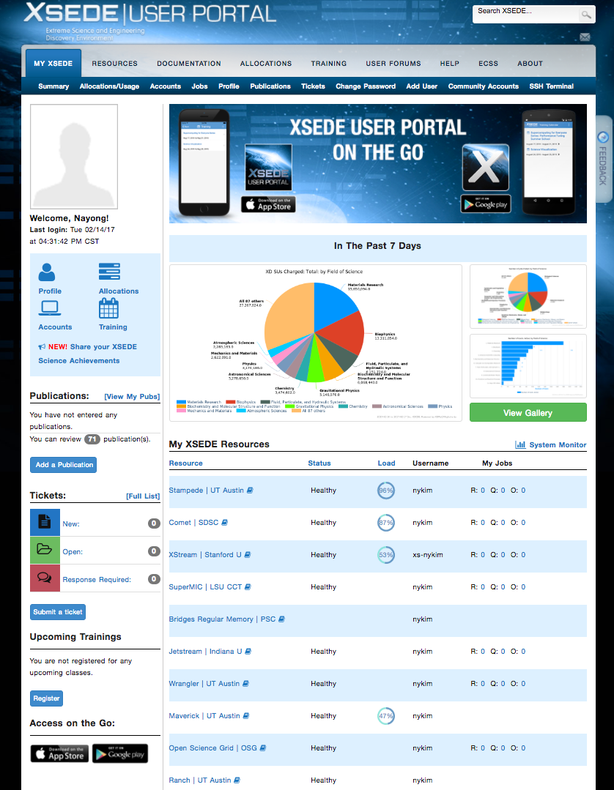
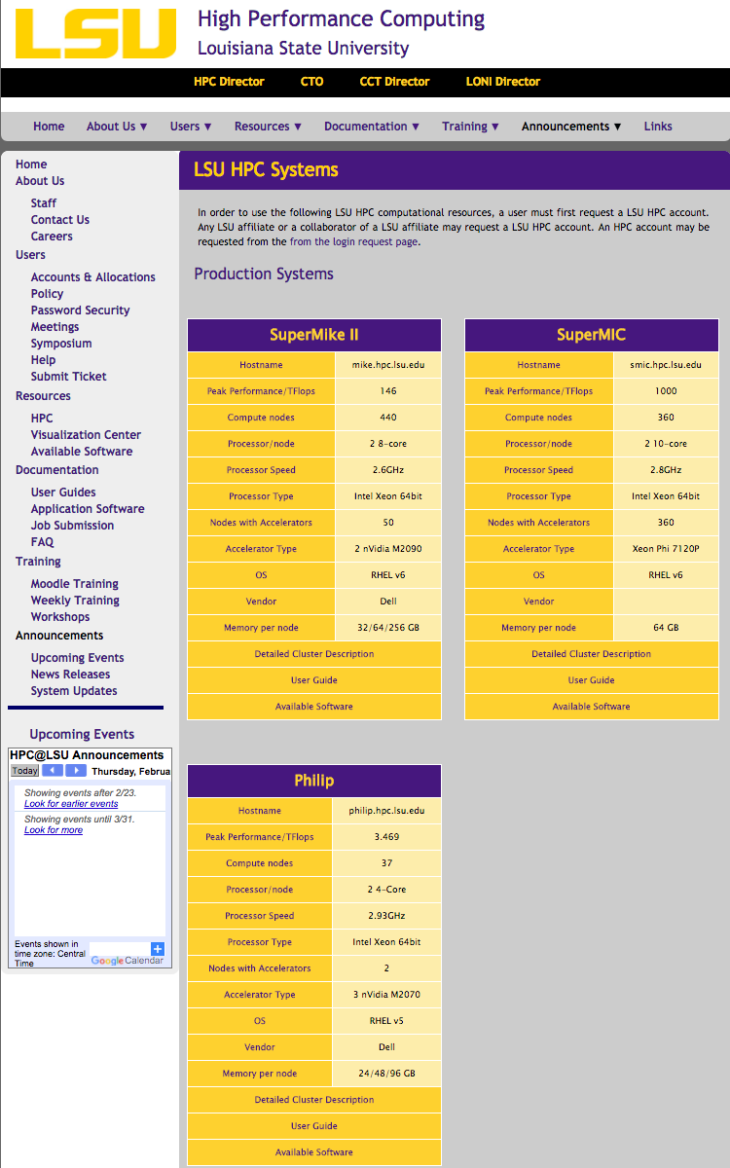
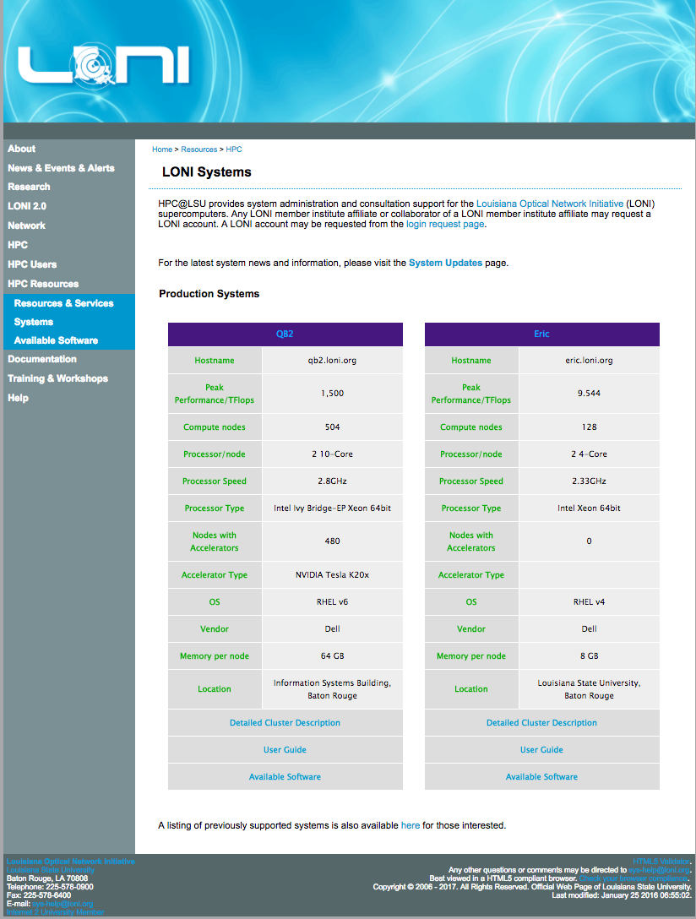

Getting Account
LSU affiliated account
XSEDE Portal
Extreme Science and Engineering Discovery Environment
LSU HPC
Philip
SuperMike-II
SuperMIC
LONI
LONI HPC
Eric
Qeenbee2
Delta webpage
CCT HPC
Delta

Slide 9
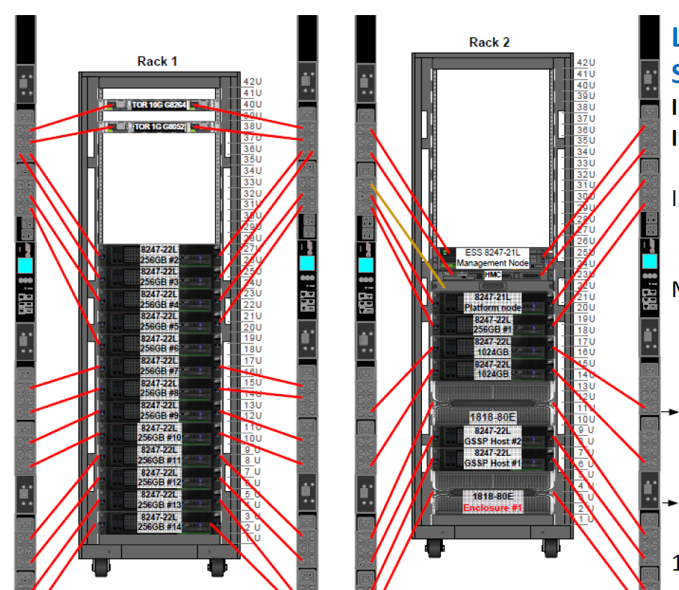
CCT
Delta
The Delta cluster consists of 17 nodes in total: 1 head node and 16 compute nodes. The PCM head node and compute nodes are all Power8 822Ls.
There are two classes of compute nodes in this cluster:
2 Fat Nodes, consisting of 1TB memory and many disks
14 Thin Nodes, consisting of 256GB memory and fewer disks

Slide 10

CCT
Delta (account & allocation)
In order to get access to Delta resources, user must create a Delta account.
Account is able to request through https://delta.cct.lsu.edu/
To apply, the principal investigator (PI) must be a researcher or educator at Louisiana based institution.
All allocation request are reviewed by the Delta Resource Allocation Committee(DRAC).
A user may apply for one of following allocation types.
Startup : The fastest way to get started on Delta, Startup allocations require minimum documentation, are reviewed all year long, and are valid for one year.
Research : Research allocation requests are reviewed quarterly and require more formal documentation. Research allocations will be granted for one year and may be renewed or extended.
Storage : Upto 10GB space per PUIs only for data store purpose. It will be granted 6 months period initially, and able to extend based on request and the decision of DRAC.
Job can be submitted through SAC, http://delta-lsf.cct.lsu.edu:8080/
All user account holders are asked to acknowledge their use of Delta resources in any resulting research publications or reports by including the following statement:
“Portions of this research were conducted with high performance computational resources provided by the Center for Computation & Technology (https://delta.cct.lsu.edu/).”

Slide 11
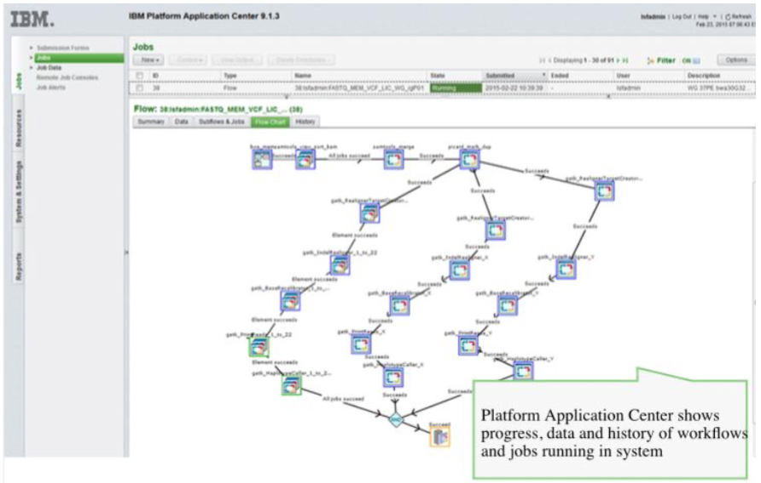
CCT
Delta (SAC)
Spectrum Application Center
GUI Interface to create graph based workflow
Provides a web portal interface to SPM(Spectrum Process Manager) workflows
Educates PIs and their students through visual monitoring of workflows

Slide 12
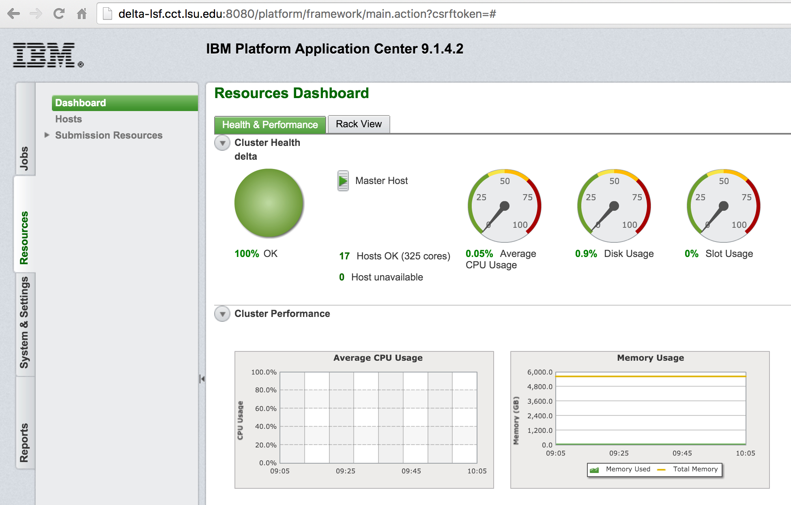
CCT
Delta (SAC)
Customized workflow is able to provide to users
Uploading data can be a trigger to submit jobs
Web-based real-time dashboard for monitoring global workloads and resources, including resource usage reporting.

