Slide 1

Laboratory Biosafety
LOUISIANA STATE UNIVERSITY
OFFICE OF
ENVIRONMENTAL HEALTH & SAFETY
Notes:
Hi, My name is Abbie Fish and I am the Biosafety Officer at LSU. Today I am going to be discussing with you the basics of biosafety in the lab.

Slide 2
BIOSAFETY VS. BIOSECURITY
Biosafety: reducing or eliminating exposure of individuals and the environment to potentially-hazardous biological agents
Biosecurity: protection of microbial agents from loss, theft, diversion, or intentional misuse
Notes:
Before we get started, I want to define two terms for you.

Slide 3

BIOSAFETY
Biosafety is achieved by implementing various degrees of laboratory controls and containment; through laboratory design and access restrictions, personnel expertise and training, use of specialized containment equipment, and safe methods of managing infectious materials in a laboratory setting.
Notes:
Biosafety is achieved by implementing various degrees of control and containment in the lab and that starts with lab design and restricting access to that space to individuals who work in that lab. Personnel experience and training is also a major part of biosafety—we want to make sure everyone in the lab knows what they are doing. Specialized equipment and safe methods of managing infectious agents are also a big part of biosafety.

Slide 4

BIOSECURITY
Biosecurity is achieved by limiting access to facilities, research materials, and information.
Notes:
Biosecurity is related to biosafety and is achieved by limiting access to research facilities, materials and information related to that material.

Slide 5
Biosafety and Biosecurity share common components
Both are based on:
Risk Assessment
Personnel Expertise & Responsibility
Control & Accountability for Research Materials
Access Control
Material Transfer Documentation
Training
Emergency Planning
Program Management
Notes:
Material transfer documentation- are you supposed to have the agents you have? And do you have all the correct permissions to be working with those agents.

Slide 6
Centers for Disease Control (CDC) & the national institutes of Health (NIH) guidelines
Laboratorians recognize the hazards of processing infectious agents.
Regulations outline precautions, special practices, and decontamination procedures.
Guidelines have been developed to protect workers in microbiological and medical labs through engineering controls, management policies, and work practices.
Notes:
CDC and NIH have established a set of guidelines that help individuals in a lab recognize the hazards of the biologic agent they are working with.
These regulations outline the precautions, special practices and decontamination procedures that are required for a specific agent.
They are in place to protect workers in microbiological and medical labs though the use of engineering controls (which we will talk about in a minute), standard operating procedures and work practices.

Slide 7
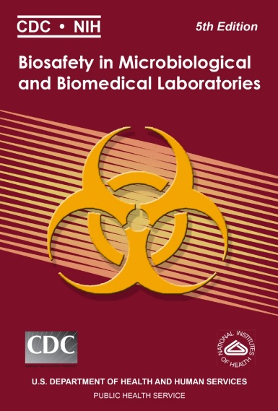
CDC & Nih guidelines
COMPLETE information and recommendations can be found in Biosafety in Microbiological and Biomedical Laboratories 5th Edition and the NIH Guidelines for Research Involving Recombinant or Synthetic Nucleic Acid Molecules
http://www.cdc.gov/biosafety/publications/bmbl5/
http://oba.od.nih.gov/rdna/nih_guidelines_oba.html
Notes:
Complete info and recommendations can be found in…. And also at the links below.

Slide 8
CDC & Nih guidelines: Primary barriers & universal precautions
Primary Barriers: physical barriers or personal protective equipment between lab worker and pathogen
Biological safety cabinets, special breathing apparatuses, etc.
Universal Precautions: set of guidelines that is aimed at preventing the transmission of blood-borne pathogens from exposure to blood and other potentially infectious materials.
originally developed to protect health professionals
Also apply in a clinical setting
May also be important for field epidemiology practices during an outbreak investigation (i.e., collecting lab specimens)
Notes:
One of the major ways that we protect ourselves in lab is through the use of primary barriers and universal precautions.
Primary barriers are physical barriers or personal protective equipment that are physically put between a person and the hazardous agent. Examples of primary barriers include: Biosafety cabinets, specialized breathing apparatuses such as masks and personal air purify respirators, safety glasses, lab coats or safety caps on centrifuge buckets.
Universal precautions are a set of guidelines that are aimed at preventing transmission of blood borne pathogens from blood and other potentially infectious materials to another person. These guidelines were developed by the CDC in the 80s in response to the outbreak of HIV. Although these were originally guidelines aimed at protecting health care workers, these precautions are also applicable in the lab because they provide guidance on how to handle lab specimens, or during an outbreak such as with CoVID19.

Slide 9
Universal precautions
Include: hand hygiene, gloves, gowns, masks, eye protection, face shields, and use of safe sharps practices
Require that all equipment or contaminated items are handled to prevent transmission of infectious agents
Special circumstances may require additional precautions
Additional protective clothing or special site decontamination
Ex: CoVID19 Pandemic
Notes:
Universal precautions include… washing your hands thoroughly, using gloves, lab coats, disposable gowns, face masks, face shields, safety glasses or goggles, and properly handling sharps such as needles and scalpels.
These guidelines require that all potentially infectious material and contaminated equipment be handled in a manner in with to prevent transmission of infectious agents.
There are special circumstances in which additional precautions may need to be taken. Which could include additional protective clothing. Such as with CoVID 19 and wearing a mask while out in public.

Slide 10
Lab Practices & Techniques
Strict adherence
Standard microbiological practices and techniques
Workers must be
Aware of potential hazards
Trained
Proficient in safe practices & techniques
Appropriate training
Notes:
When working in any laboratory, personnel should have strict adherence to standard microbiological practices and techniques.
All individuals need to be aware of the potential hazards when working in the laboratory, should be properly trained, and be proficient in safe practices and techniques.
The responsible scientist provides appropriate training. This could include the laboratory supervisor, lead scientist or other laboratory personnel proficient in laboratory procedures such as a graduate student or postdoc.

Slide 11
Biosafety Manual
Developed specifically for each laboratory
Identifies hazards
Specifies practices & procedures to minimize or eliminate these hazards
Required reading
Laboratory personnel
Responsible for work conducted in laboratory
Trained & knowledgeable in techniques, safety procedures, and associated hazards
Notes:
A lab biosafety manual should be developed that is specific for each individual lab. It needs to include lab specific hazards and special practices and procedures to minimize or eliminate those hazards.
All personnel in lab are required to read the biosafety manual and are responsible for the work that is being conducted in the lab. You need to be trained and knowledgeable in the specific techniques, safety procedures and hazards associated with the work.
The Biosafety in Microbiological and medical labs is the basis for developing a good biosafety manual, but it should not be used in its place.
11

Slide 12
Safety Equipment
Specialized equipment for a lab that provides protection to the worker from hazardous agents
Contains infectious splashes, splatters, aerosols
EX: biosafety cabinets (BSC), enclosed containers and safety caps on centrifuge buckets.
Engineering controls- protect workers by removing hazardous conditions or placing a physical barrier between the worker and the hazard
Protect lab personnel
Protect environment
Prevent contamination of materials
Notes:
In addition to a biosafety manual, each lab will have safety equipment that is specific to the biosafety level and hazards in the lab. This equipment is used to contain splashes, splatters and aerosols that are generated during manipulation.
Safety equipment is one form of an engineering control. Engineering controls are used to protect lab workers from biological hazards by placing a physical barrier between that person and the hazard. These controls not only protect individuals, but also protect the community and the environment form the hazards. They can also protect the material from becoming contaminated.
Safety equipment for all biosafety levels include biological safety cabinets, enclosed containers and safety caps on centrifuge buckets.

Slide 13
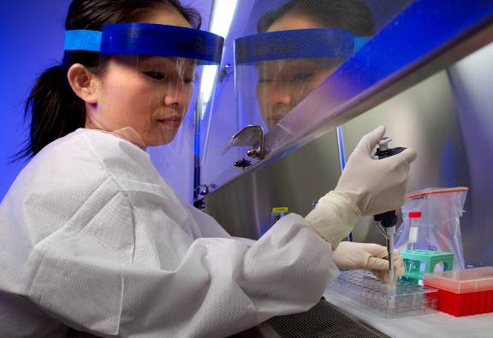
Safety Equipment
Personal protection equipment (PPE)
Gloves
Coats, gowns, sleeve covers
Boots, shoe covers
Respirators
Face shields, goggles, safety glasses
Used with BSCs or as primary barrier
Notes:
Personal protective equipment is another form of safety equipment. Proper PPE (personal protection equipment) includes a combination of disposable gloves, a lab coat or disposable gown, sleeve covers, closed toed shoes or shoe covers, respirators, face shields, safety goggles, or safety glasses. Required PPE will vary depending on the level of work, amount of hazardous material being used, and type of biological agents used in the laboratory.
PPE is generally used in conjunction with biosafety cabinets, but the requirements are different for each biosafety level.
13

Slide 14
Secondary Barriers
Facility design and construction
Laboratory worker protection
Protect persons outside lab
Protects community/environment
Recommended barriers
Depends on transmission of agents
Ex: Handwashing sinks, eye wash stations, safety showers, specialized decontamination facilities, specialized ventilation systems.
Notes:
The second major part of biosafety is what we call secondary barriers. Secondary barriers describe the requirements for design and construction of a laboratory facility. A good design contributes to the protection of the lab workers, individuals outside the lab and it also protects the environment and community from the hazards in the lab.
The recommended secondary barriers will depend upon the risk of transmission of the agents in the lab. Higher levels of containment are required for more hazardous biological agents.
Examples of some recommended barriers include: sinks for handwashing, eye wash stations, safety showers, specialized decontamination facilities, such as autoclaves, and specialized ventilation systems

Slide 15
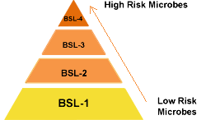
CDC & Nih guidelines
Labs are divided into 4 biosafety levels; protective practices increase with each level.
Notes:
Labs are divided into 4 biosafety levels each of which consists of a combination of specialized lab practices and techniques, safety equipment and lab facilities. The protective practices increase with each level a build upon the practices established for the safety level below it. .
BSL1 labs work with the least dangerous agents and require the fewest precautions while BSL4 labs work with the most dangerous biological agents and have the strictest methods and precautions.

Slide 16

Biosafety Levels
Assignment of Biosafety Levels (BSL)
Lab practices and techniques
Safety equipment
Laboratory facilities
Determined by risk assessment
Established by responsible staff
Notes:
Assignment of a biosafety level to a lab dictates the proper laboratory practices and techniques, safety equipment to be used, the design of the laboratory facility.
This designation is determined by a risk assessment and depends upon several factors including the biological materials being used in the laboratory and the route of transmission of that agent
The appropriate level is ultimately determined by the appropriate staff which includes the biological safety officer and the Institutional Biosafety Review Committee (IBC)

Slide 17
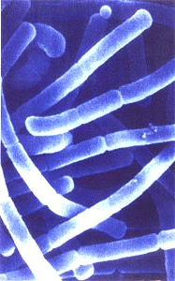
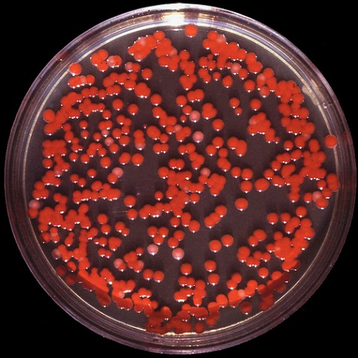
BSL-1
Type of laboratory
Research, student training, and teaching labs
Well-defined and characterized agents
No harm to healthy humans
Examples
Bacillus subtilis
Naegleria gruberi
Exempt organisms under NIH guidelines
Notes:
BSL-1 laboratories are designed for student educational training and teaching labs. This designation is also used for work involving the use of well-defined and characterized agents not known to cause disease in normal healthy adults.
Examples of these agents: Bacillus subtilis (gram positive bacteria), Naegleria gruberi (amoeba) and Other organisms that are exempt under NIH Guidelines.
Note on pictures: top picture is Bacillus subtilis, bottom picture of Naegleria gruberi

Slide 18
BSL-1
Basic level of containment
Use of gloves and lab coats
Relies on
Standard microbiological practices
No special primary or secondary barriers
Handwashing sinks are required
Notes:
BSL-1 laboratories have basic levels of containment that rely on standard microbiological practices with no special primary or secondary barriers recommended apart from handwashing sinks.

Slide 19
BSL-2
Type of laboratory
Research, clinical, diagnostic, and teaching labs
Work with indigenous, moderate-risk agents associated with human disease
Relies on standard microbiological techniques
Employ techniques to reduce the probability of splashes and aerosols
Biological safety cabinet
Notes:
BSL-2 laboratories are designed for clinical, diagnostic, teaching, and other laboratories working with a broad spectrum of indigenous moderate-risk agents present in the community and associated with human disease of varying severity.
Work can be conducted on an open bench with good standard microbiological techniques, providing that the probability for splashes and aerosols is low.
The use of a biosafety cabinet is required for work with potentially infectious material such as human or primate cells lines to reduce the risk of exposure to the lab worker.

Slide 20
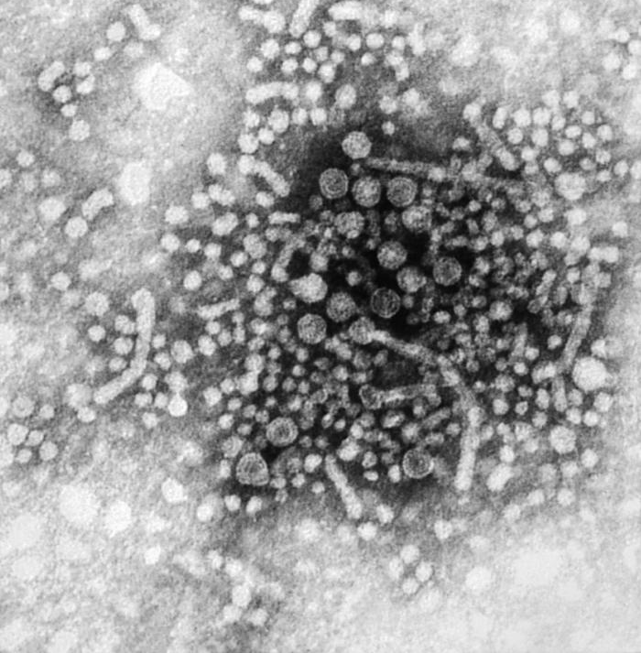
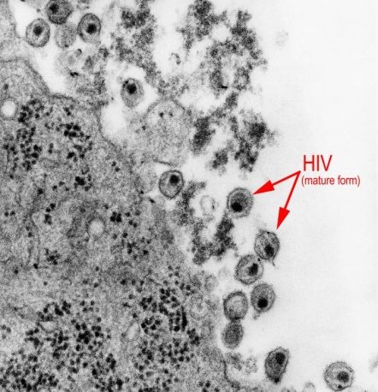
BSL-2
Examples
Hepatitis B virus
HIV
Mycobacterium leprae
Salmonella typhimurium
Primate or human-derived blood, body fluid, tissue or cell lines where the presence of an infectious agent is unknown
Notes:
Examples of agents that are used at BSL2 include Hepatitis B virus, HIV, Mycobacterium leprae, and Salmonella typhimurium.
Additionally, Primate and human derived blood, body fluid, tissues or cell lines where the presence of an infectious agent is unknown is also considered BSL2.

Slide 21
BSL-2
Primary hazards
Percutaneous or mucous membrane exposure
Ingestion
Contaminated needles or other sharps
Possible Inhalation
Primary and secondary barriers
Personal protective equipment
Lab coat, close toed shoes, gloves, safety glasses
Biological safety cabinet
Reduce probability of splashes and aerosols when working with potentially infectious material
Notes:
The primary hazards to individuals that work in a BSL2 is related to accidental percutaneous or mucous membrane exposure or ingestion of infectious materials.
Extreme caution needs to be taken when working with sharps.
Even though organisms that are routinely manipulated as BSL2 are not generally known to be transmissible by aerosols, extreme caution needs to be taken during procedures that generate aerosols or splashes.
Personal protective equipment including gloves, a lab coat, close toed shoes and safety glasses are required. BSC are required for when working with potentially infectious materials to reduce the probability of contacting splashes and aerosols.

Slide 22
BSL-3
Type of laboratory
Clinical, teaching, research, or production facilities
Indigenous or exotic agents
High potential for respiratory transmission
May cause serious and potentially lethal infection
Notes:
BSL-3 laboratories are designed for clinical, teaching, research, or production facilities that work with indigenous or exotic agents with potential for respiratory transmission,
These agents may cause serious illness or potentially lethal human infection.

Slide 23
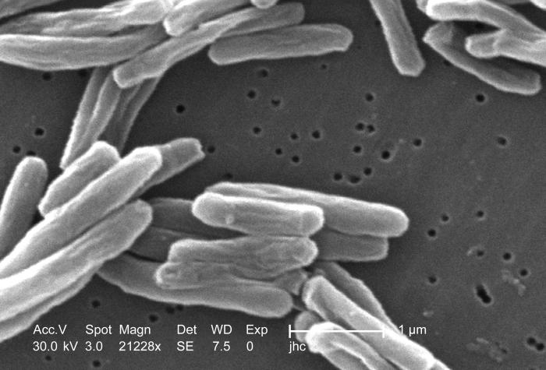
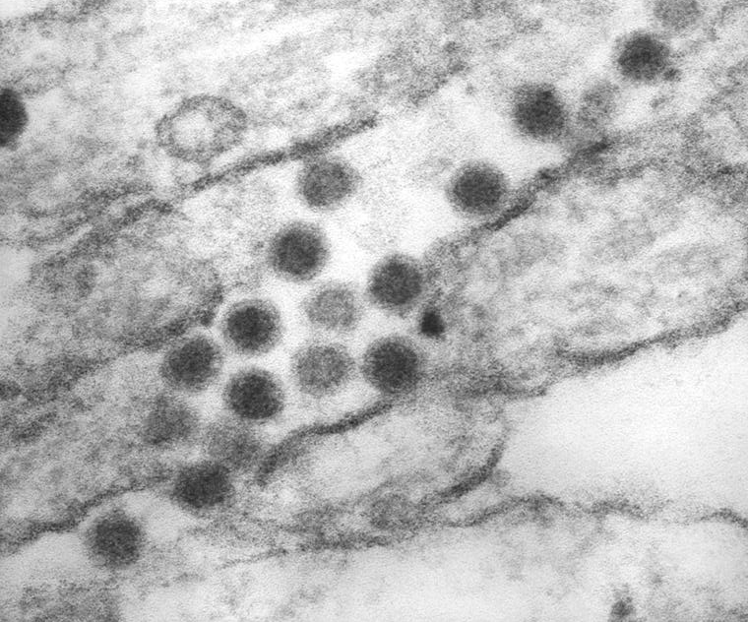
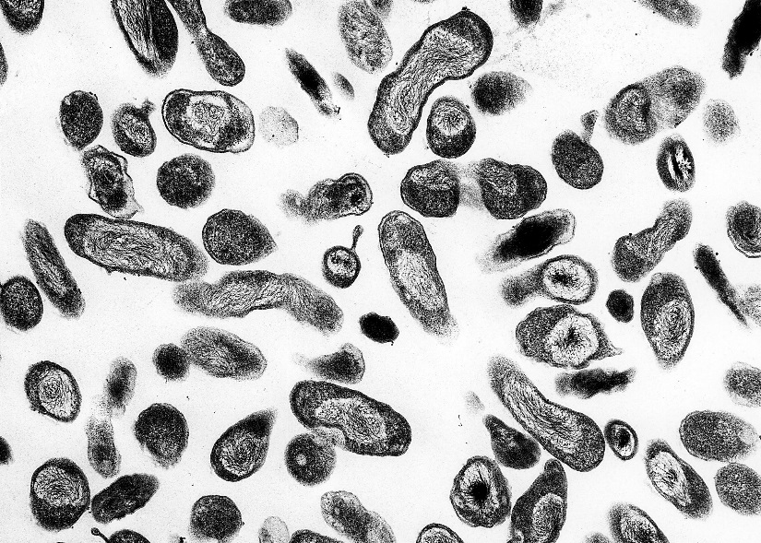
BSL-3
Examples
Mycobacterium tuberculosis
St. Louis encephalitis
Coxiella burnetii
Notes:
Examples of agents that are used in the BSL-3 laboratories are: M. tuberculosis, St. Louis encephalitis, and Coxiella burnetti
Note on pictures: top picture is M. tuberculosis, bottom right is St. Louis encephalitis, bottom left is Coxiella burnetti

Slide 24
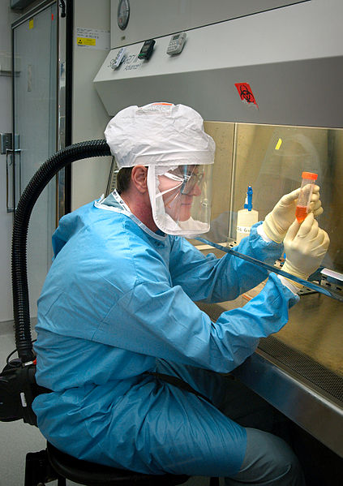
BSL-3
Primary hazards
Exposure to infectious aerosols
Autoinoculation
Ingestion
Primary and secondary barriers
Biosafety cabinets
Personal protective equipment
Includes personal respiratory protection
Controlled access to the lab
Specialized ventilation and waste disposal systems
Notes:
Primary hazards that laboratory personnel should be aware of in BSL-3 laboratories are: exposure to infectious aerosols, autoinoculation, and ingestion. Laboratory personnel should use primary and secondary barriers to protect personnel in adjacent areas, the community, and the environment when working in BSL-3 lab
The primary hazards that lab personnel should be aware of in a BSL3 is exposure to infectious aerosols, autoinoculation and ingestion of the biological agent.
At BSL3, more emphasis is put on primary and secondary barriers to protect individuals in contagious areas and to protect the community and environment from potentially infectious aerosols. Biosafety cabinets are required for all manipulations of an agent. Additional personal protective equipment, including disposable outerwear, shoe covers, double gloves and either a personal air purifying respiratory or N95 masks is required for entry. Lab access is tightly controlled and all individuals who have access have completed classroom and hands-on training. There is also HEPA filtered directional airflow in BSL3 to prevent recirculation of contaminated air.
There is a BSL3 on LSU’s campus

Slide 25
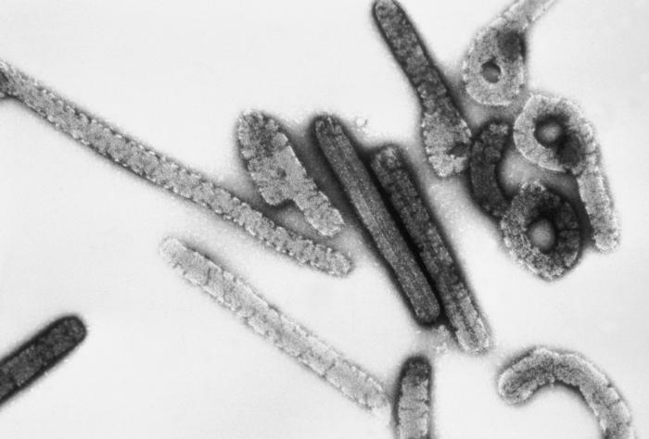
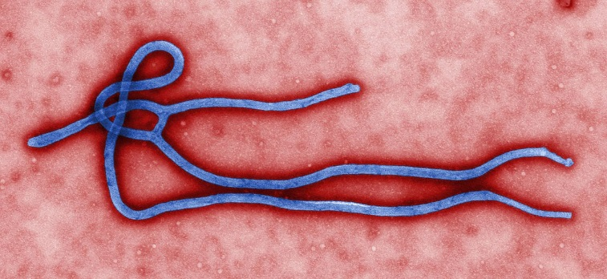
Bsl-4
Required for work with dangerous and exotic agents that pose a high individual risk of aerosol-transmitted laboratory infections and life-threatening disease that is frequently fatal, for which there are no vaccines or treatments, or a related agent with unknown risk of transmission
Examples
Ebola virus
Marburg virus
Notes:
BSL4 labs are required for work with dangers and exotic agents that pose a high individual risk of life threatening disease which may be transmitted via aerosols and for which there is no preventative vaccine or therapeutic intervention or for a related agent with an unknown risk of transmission.

Slide 26
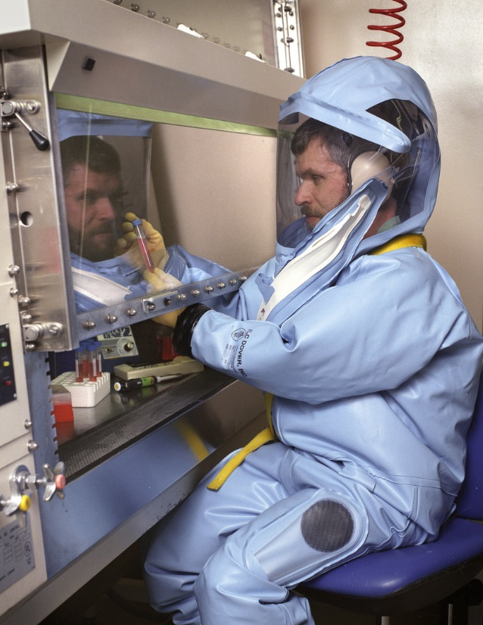
Bsl-4
Primary hazards
Exposure to infectious aerosols
Mucous membrane or broken skin exposure to infectious droplets
Autoinoculation
Primary and secondary barriers
Full body air supplied positive pressure personal suit
Facility is generally in a separate building or completely isolated zone with controlled access
Specialized ventilation and waste disposal system
Notes:
The primary hazards of working in a BSL4 are respiratory exposure to infectious aerosols, mucous membrane or broken skin exposure to infectious droplets and autoinoculation.
All manipulations with BSL4 agents pose a high risk of exposure to the lab personnel, community and environment, therefore primary and secondary barriers are extremely important
complete isolation from aerosolized BSL4 agents is achieved by wearing a full body air supplied positive pressure suit which his pictured here.
A BSL4 is an access controlled lab that generally located in a completely separate building or it is in an isolated area of a building. Only personnel who have received many hours of classroom and hands on training are allowed to work within the BSL4. The BSL4 also has a highly complex, specialized ventilation system in place as well as a specialized method of disposing waste.
There is no BSL4 on LSU’s campus.

Slide 27
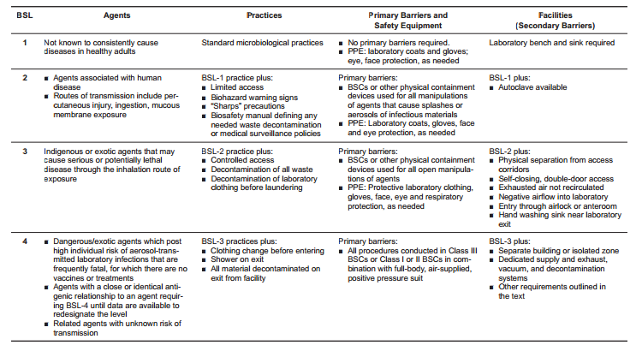
BMBL Summary of recommended biosafety levels for infectious agents
Notes:
Pictured here is a summary of the levels we have just discussed and the minimum requirements for each biosafety level. Details about each level can be found within the biosafety in microbiological and biomedical lab manual.

Slide 28
Additional Containment categories
ABSL-1, ABSL-2, ABSL-3, ABSL-4
Animal hosts
BL1-P, BL2-P, BL3-P, BL4-P
Plant hosts and rDNA in plants
BL1-N, BL2-N, BL3-N, BL4-N
rDNA in animals
ACL-1, ACL-2, ACL-3, ACL-4
Arthropods
Notes:
In addition to biosafety lab designations there are other containment categories utilized for work with animals, plants, recombinant DNA in animals and arthropods. Each of these containment categories also has a designation of 1 through 4. With 1 being the least hazardous and 4 being the most.

Slide 29
University Inspections
Checklist of items that correspond to federal regulations and guidelines
Assess for the presence of:
Biosafety Manual and SOPs
Proper Training of Lab Staff
Appropriate Posting/Labeling
Safety Materials (i.e., 1st Aid Kit, eye wash, etc.)
Proper PPE
Laboratory Design and Setup
Proper Waste Disposal
Notes:
As the biosafety officer at LSU, part of my job is to inspect all labs on an annual basis for compliance with federal regulations and guidelines.
During inspections, I am going to assess each lab for the presence of…..

Slide 30
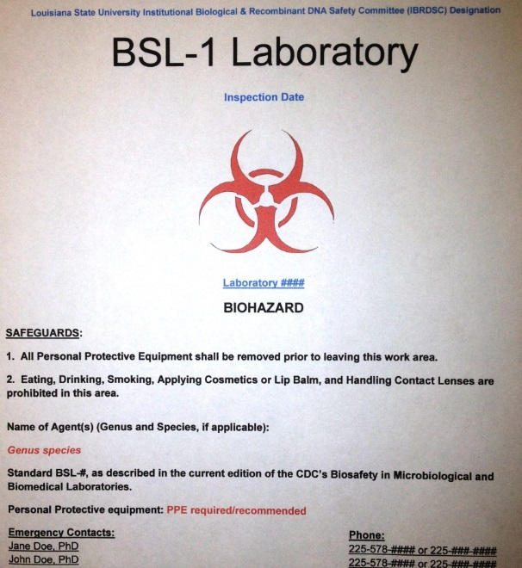
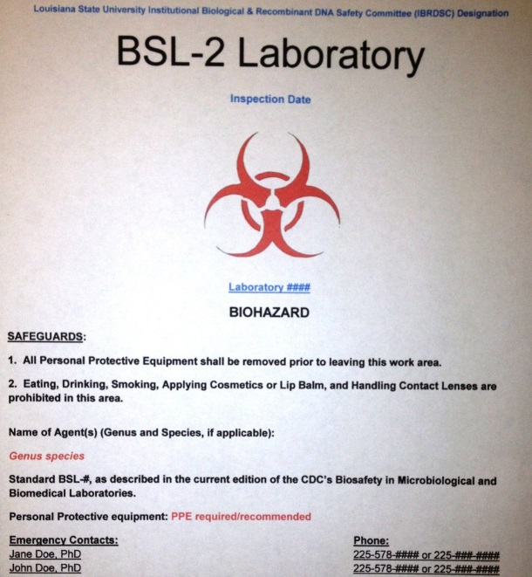
Door postings
Example of biosafety sign posted outside of research labs listing:
Lab’s biosafety level
Agents being studied
Contact information for responsible persons including emergency contact numbers
Notes:
Door postings are utilized outside each lab to communicate the hazards associated with each lab.
A couple of examples of door postings are pictured here. These signs need to communicate the biosafety level, the agents being used in the lab and the contact information for the responsible scientist and emergency contact

Slide 31
SUMMARY
Research should be evaluated from a biosafety as well as a biosecurity standpoint.
Biosafety guidelines have been developed to protect workers in microbiological and medical labs through a combination of safeguards including engineering controls, management policies, and work practices.
Differences between biosafety levels dictate necessary precautions required for each level.
When in doubt, refer back to the Biosafety in Microbiological and Biomedical Laboratories book.

