Slide 1

LABORATORY SAFETY AT
LSU
Environmental Health and Safety (EHS)
578-5640

Slide 2
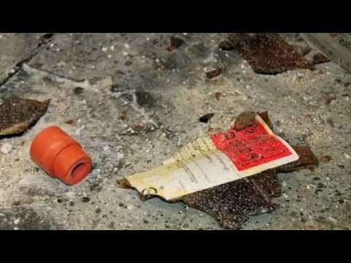
Chemical Safety Board on University Lab Safety

Slide 3
ON-LINE TRAINING
http://www.lsu.edu/ehs
Click on “Online Safety Training”
Click on “Access the Lab Safety Training”
Take BASIC LAB SAFETY Courses

Slide 4


EMERGENCY PROCEDURES

Slide 5

CHEMICAL SPILLS
NOTIFY SUPERVISOR AND DETERMINE LEVEL OF SEVERITY (CLEAN UP IF APPROPRIATE)
CALL EHS AND CAMPUS POLICE (911)
PROTECT YOURSELF AND OTHERS FROM EXPOSURE
CONTROL IGNITION SOURCES IF FLAMMABLES ARE INVOLVED
BEGIN EVACUATION IF NECESSARY
FOLLOW DIRECTIONS FROM EHS AND CAMPUS POLICE

Slide 6
SPILL RESPONSE
Lab Personnel
EHS at 578-5640
Facility Services
City Fire and HAZMAT

Slide 7
SPILL SEVERITY LEVELS
Level 1 - can be handled by lab workers
Level 2 - can be handled by EHS
Level 3 - can be handled by EHS and local Haz Mat
Level 4 - must be handled under control of State Police
Note: Unstable containers may be handled by BR City Police Bomb Team

Slide 8

INJURIES
DETERMINE EXTENT OF INJURY
PROVIDE FIRST AID AND CPR AS NEEDED-
Avoid contact with ALL Body Fluids
CALL 911 (LSU POLICE- 578-3231)IF EMS IS NEEDED, GIVING INFORMATION AS TO WHETHER CHEMICALS ARE INVOLVED OR NOT
ASSIST EMERGENCY PERSONNEL
SECURE SCENE FOR ACCIDENT INVESTIGATION

Slide 9

FIRES AND FIRE ALARMS
REMAIN CALM AND DO NOT ENTER A DANGEROUS AREA
PULL THE FIRE ALARM AND BEGIN EVACUATING THE BUILDING
CALL CAMPUS POLICE 578-3231 (911)
FOLLOW DIRECTIONS OF FLOOR MONITORS
STAY OUT UNTIL POLICE GIVE OK

Slide 10

RADIATION EMERGENCIES
SPILLS
  NOTIFY RADIATION SAFETY 578- 2008 (8-2008)
  KEEP ALL POTENTIALLY CONTAMINATED PERSONS IN THE GENERAL VICINITY OF THE LAB TO PREVENT THE SPREAD OF CONTAMINATION
  SECURE THE LAB

Slide 11

RADIATION EMERGENCIES, CONT’D
FIRES AND OTHER LAB UPSETS
  NOTIFY APPROPRIATE EMERGENCY PERSONNEL
  NOTIFY THE RADIATION SAFETY OFFICE
INJURY
  HANDLE THE SITUATION IN SAME MANNER AS NON RADIATION INJURY
  NOTIFY THE RADIATION SAFETY OFFICER
NOTE: RADIOACTIVE MATERIALS IN LSU LABS ARE SUCH THAT TAKING CARE OF THE EMERGENCY WILL POSE LITTLE OR NO EXPOSURE POTENTIAL TO PEOPLE INVOLVED

Slide 12
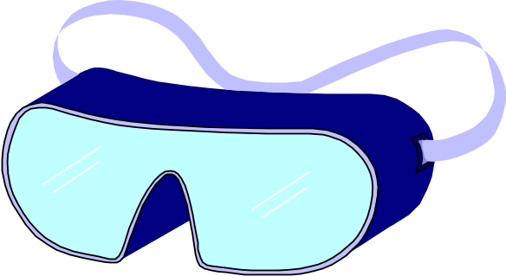
PPE
Personal Protective Equipment
  Eye Protection
    Glasses - worn at all times when in the lab
    Goggles - used for splash hazard to eyes
    Face Shield - used when a splash hazard to eyes and face
  Hand Protection
    Gloves - should be used if a hazard to the hands exists. Glove selection is based upon the specific hazard.

Slide 13
PPE
  Protective Clothing
    Lab Coats and/or Aprons - should be worn at all times. Must be used when a splash hazard exists from harmful materials ( corrosives, phenol, etc..). Flame resistant clothing should be used when a flash fire hazard exists.
  Footwear
    NOT Allowed:Open -toed shoes and sandals should not be worn in the lab

Slide 14
EMERGENCY PHONE NUMBERS for LSU Baton Rouge Campus
Campus Police 911
        (578-3231)
EHS 578-5640
Radiation Safety 578-2008
Facility Services 578-2327

Slide 15
Labels
All containers must be labeled
Name of material on label match the MSDS
Specific hazard items (Physical and Health hazards) stated

Slide 16
Chemical Safety
Know hazards of Chemicals in your work area
Know what to do in day-to-day operations and emergencies
Wear proper PPE when required or when exposure potential exists
Know emergency procedures for every chemical you use
Know locations of safety showers, fire extinguishers, spill response material, and Exits
If you notices signs of overexposure, leave area and summon help
Wash hands frequently, and before eating or taking a break

Slide 17
Laboratory operations in the COVID world.
Always maintain 6 feet separation .
  If not possible, wear lab coats, gloves and face mask.
  Clean/Sanitize hands often and always when leaving lab.
  Work staggered times/days.
  Do not report to lab is showing symptoms of COVID.
  Do not report to lab if test positive for COVID.
  Follow guidance of the university.

Slide 18

Dr. Jason LeJeune, CSP 225-578-5194

