Slide 1

“Library Book Tracker Android App”
Project Supervisor
Sabiha Sultana
Associate Professor
Dept. of CSE, Dhaka City College
Manjurul Sabrin
NU Reg: 14502000459
Session: 2014-15
Minhajul Islam Shawon
NU Reg: 14502000432
Session: 2014-15

Slide 2
Outlines
Objective
Existing Systems
Drawbacks of Existing Systems
Proposed System
Features of Proposed System
Requirements
Flow Chart
Data Flow Diagram
E-R Diagram
Use Case Diagram

Slide 3
Objective
Providing a Server based Android App for Library.
Improving the Library Management System Features.
Reducing the Access Time.

Slide 4
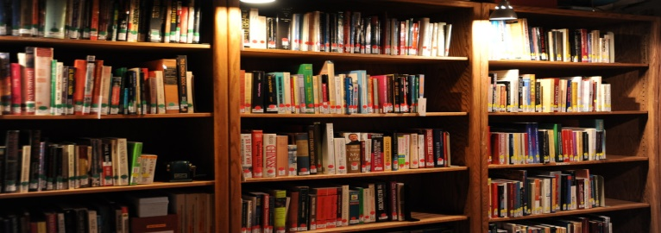
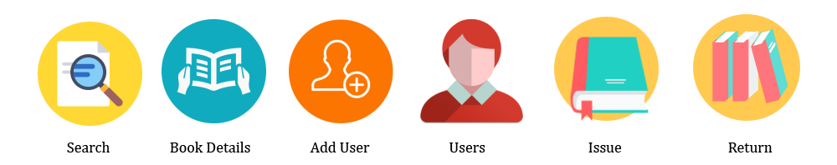
Existing Systems
Traditional Library System.
Web Based Library Management System.

Slide 5
Drawbacks of Existing Systems
User Interface isn’t responsive.
User can’t find specific book location easily.
Time consuming for users.
Issue and Return book process is not better.
User can’t check books availability.

Slide 6

Proposed System
-Server Based Android App-
Library Book Tracker

Slide 7
Features of Proposed System
Book preview.
Book Avail-ability Check.
Graphical Book loctation.
Sending Book request.
Borrowed book,
Returned book &
Penalty status.
Checking notice in Notice Board option.
Yearly book generated reports.
“Android App Features”

Slide 8
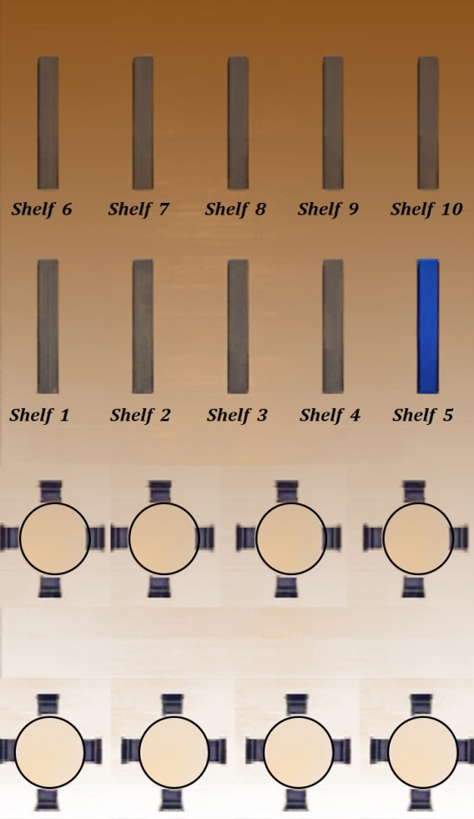
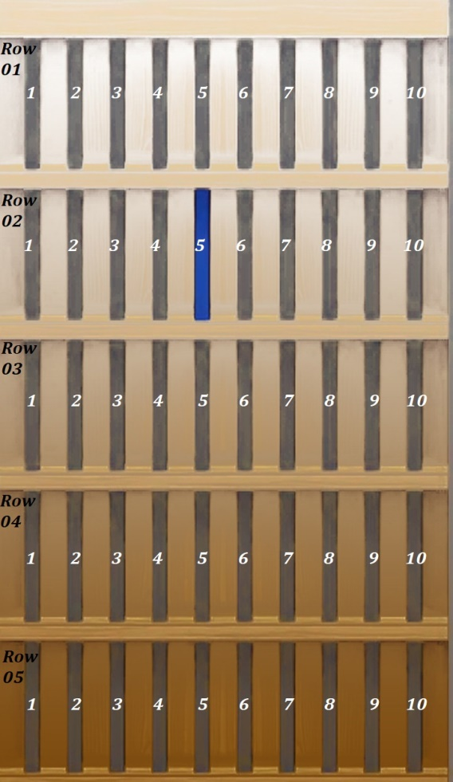
Graphical Location of a Book

Slide 9
Methodology
Creating Library server and database.
Designing the Android App with XML.
Developing the App with Android Studio Software.
Making a Location Map of the Library.
Connecting the App with Server.
Storing Information .
Maintaining Server and App.

Slide 10
Requirements
Software Requirements for Our Project-
Android Studio IDE (Integrated Development Environment).
Android SDK (Software Development Kit).
Android Emulator.
JDK(Java Development Kit).
JAVA Progamming Language.
XML for Software Design.
MySQL for Database.

Slide 11
User Requirements-
Android Smartphone (Minimum Android Version: Kit Kat 4.4.2 or Higher).
User Profile/Account.
Internet or Wifi Connection.

Slide 12
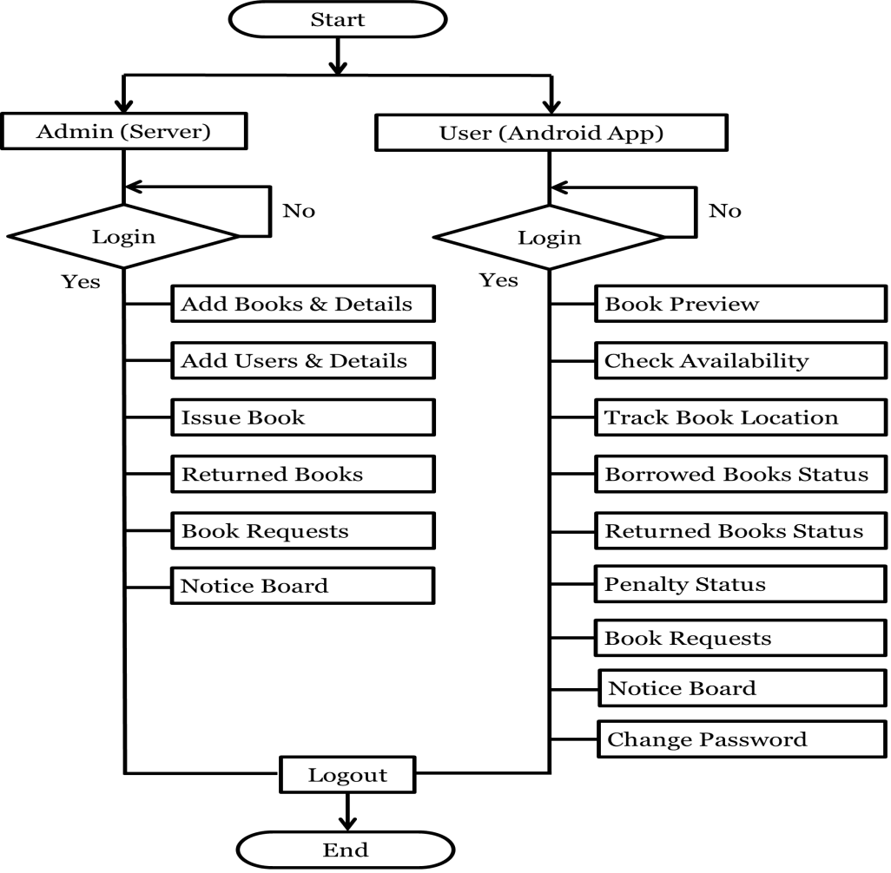
Flow Chart

Slide 13
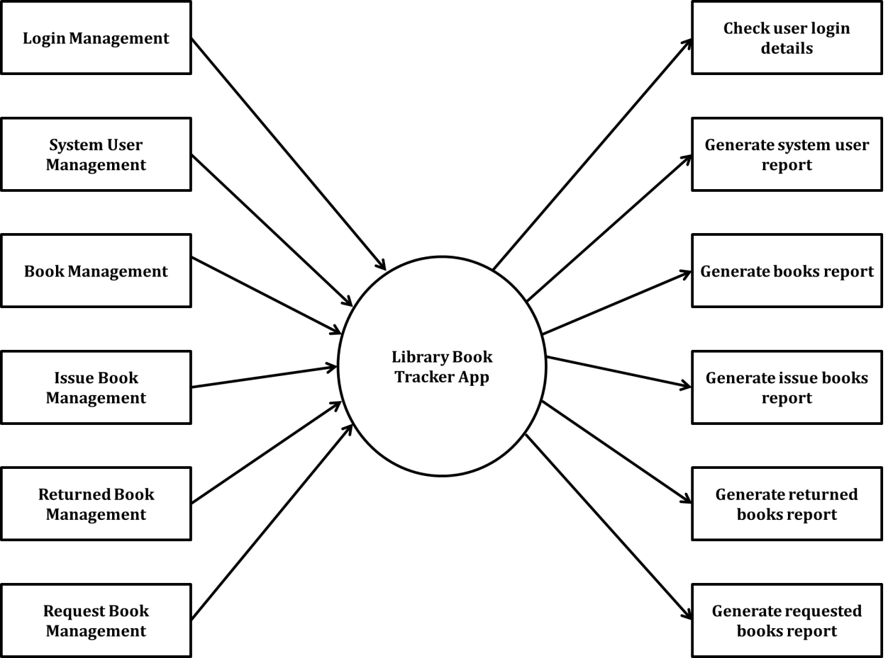
Data Flow Diagram

Slide 14
Server Databases
Book database.
User database.
Issue book database.
Return Book database.
Requested books database.

Slide 15
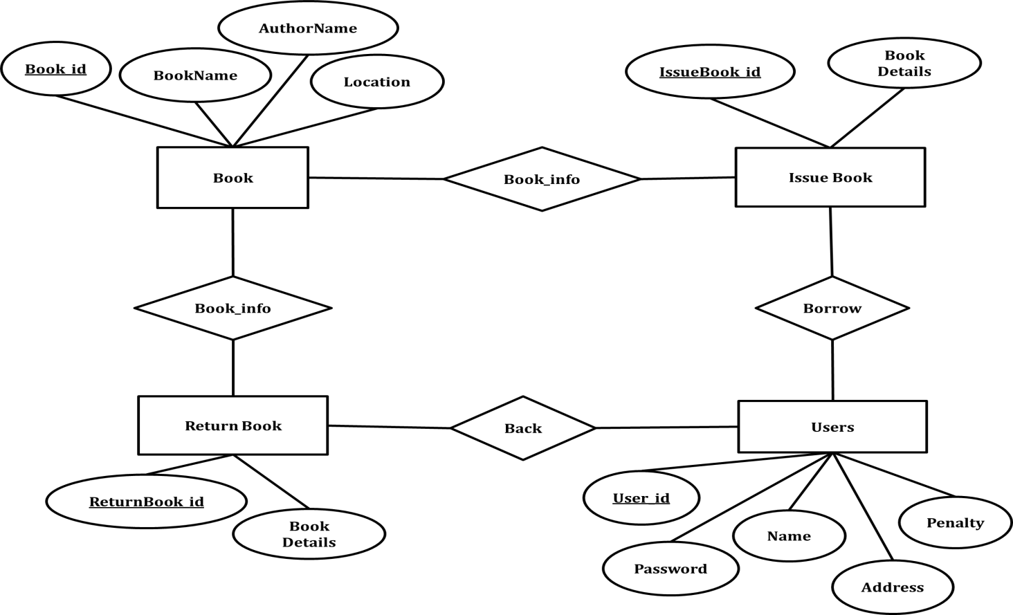
E-R Diagram

Slide 16
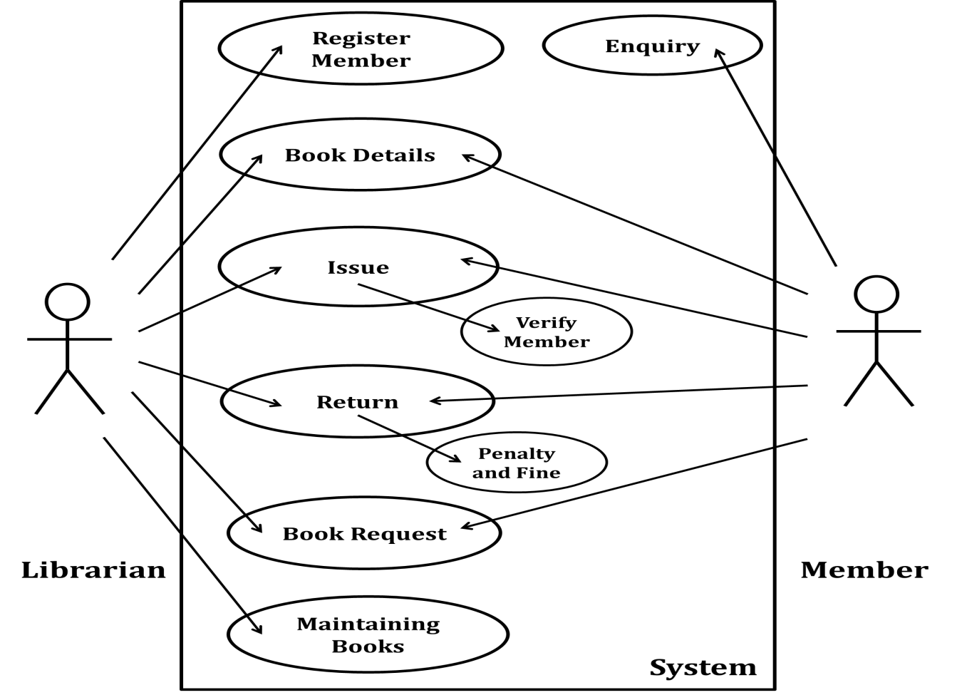
Use-Case Diagram

Slide 17

Thank You

