Slide 1

“Library Book Tracker Android App”
Project Supervisor
Sabiha Sultana
Associate Professor
Dept. of CSE, Dhaka City College
Manjurul Sabrin
NU Reg: 14502000459
Session: 2014-15
Presented By
Minhajul Islam Shawon
NU Reg: 14502000432
Session: 2014-15

Slide 2
Outlines
Objective
Existing Systems
Drawbacks of Existing Systems
Proposed System
Features of Proposed System
Requirements
Methodology
Flow Chart
Server Database Tables
E-R Diagram
Use Case Diagram
Conclusion

Slide 3
Objective
Providing a Server based Android App for the library members.
Improving the Library Management System Features.
Reducing the Access Time of the System.

Slide 4
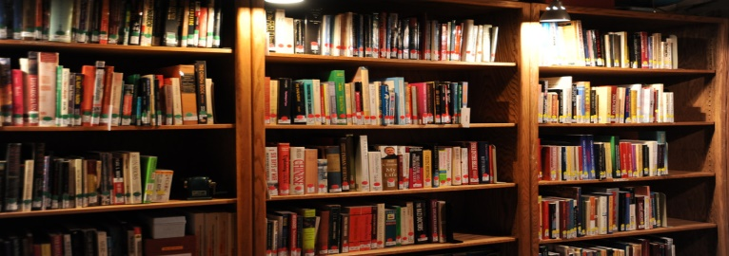
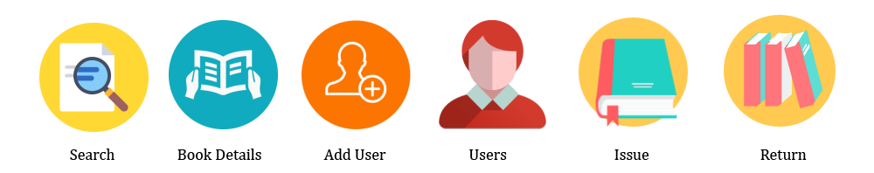
Existing Systems
Traditional Library System.
Web Based Library Management System.

Slide 5
Drawbacks of Existing Systems
User Interface isn’t responsive.
User can’t find specific book location easily.
Time consuming for users.
Issue and Return book process is not better.
User can’t check books availability.

Slide 6

Proposed System
-Server Based Android App-
Library Book Tracker

Slide 7
Features of Proposed System
Book preview.
Book Avail-ability Check.
Graphical Book Location.
Book Reservation.
Borrowed book,
Return book
(notification) &
Penalty status.
Checking notice in Notice Board option.
Yearly book generated reports.
“Android App Features”

Slide 8
Requirements
Software Requirements:
Operating System- Windows 7, 8, 10 or Linux Ubuntu 16.04.
Android Studio IDE (Integrated Development Environment).
Android SDK (Software Development Kit).
Android Emulator or Android Virtual Device (AVD).
JDK (JAVA Development Kit).
Hardware Requirements:
Memory of 4 GB RAM or more
Monitor resolution of 1024 x 768 or higher
Intel Pentium 4th generation processor or higher.
200GB (or more) available hard disk space.

Slide 9
Programming Language and other Requirements:
JAVA Programming Language.
XML for Software Design.
phpMyAdmin for server.
MySQL for Database.
User Requirements:
Android Smartphone (Minimum Android Version: Kit Kat 4.4.2 or Higher).
User Profile/Account.
Internet or Wifi Connection.

Slide 10
Methodology
Designing the Android App with XML.
Making a Location Map of the Library.
Developing the App with Android Studio Software.
Creating Library Server Account and Database.
Connecting the App with Server.
Storing Information .
Maintaining Server and App.

Slide 11
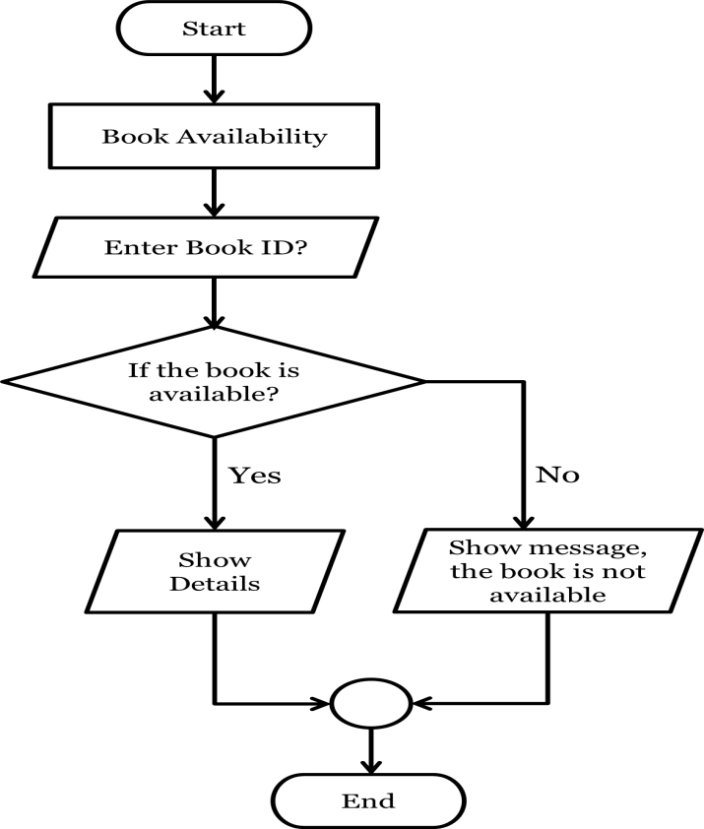
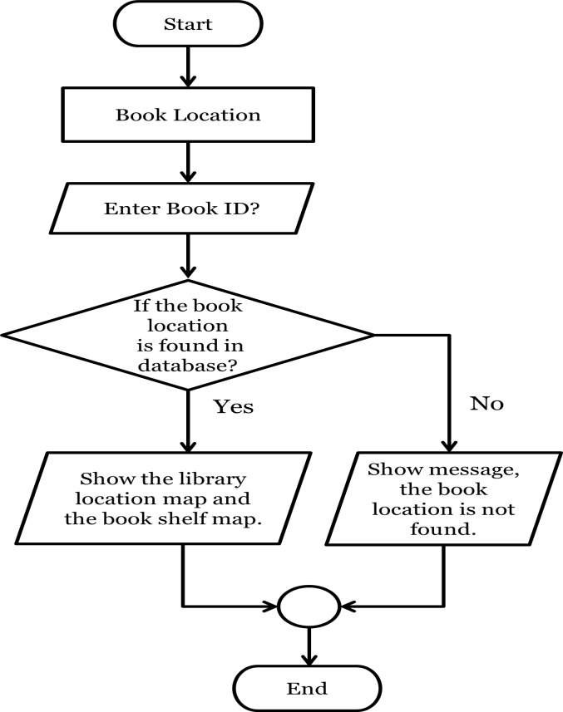
Flow Chart
Fig: Book Availability Flow Chart
Fig: Book Location Finding Flow Chart

Slide 12
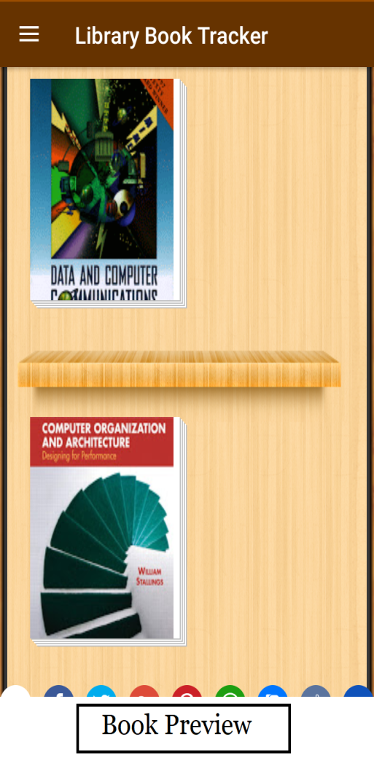
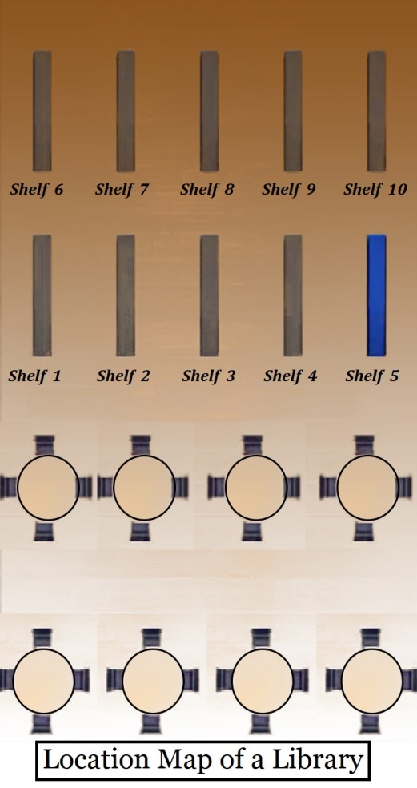
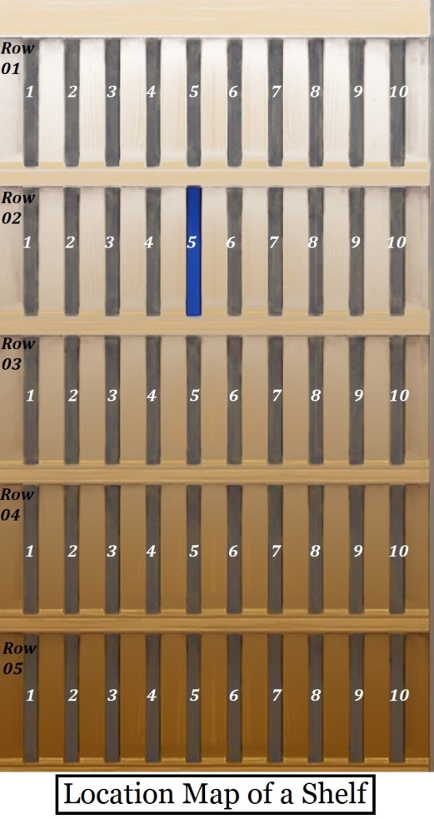

Slide 13
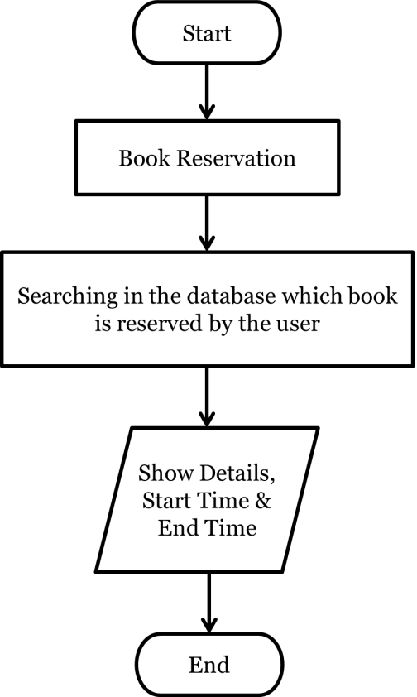
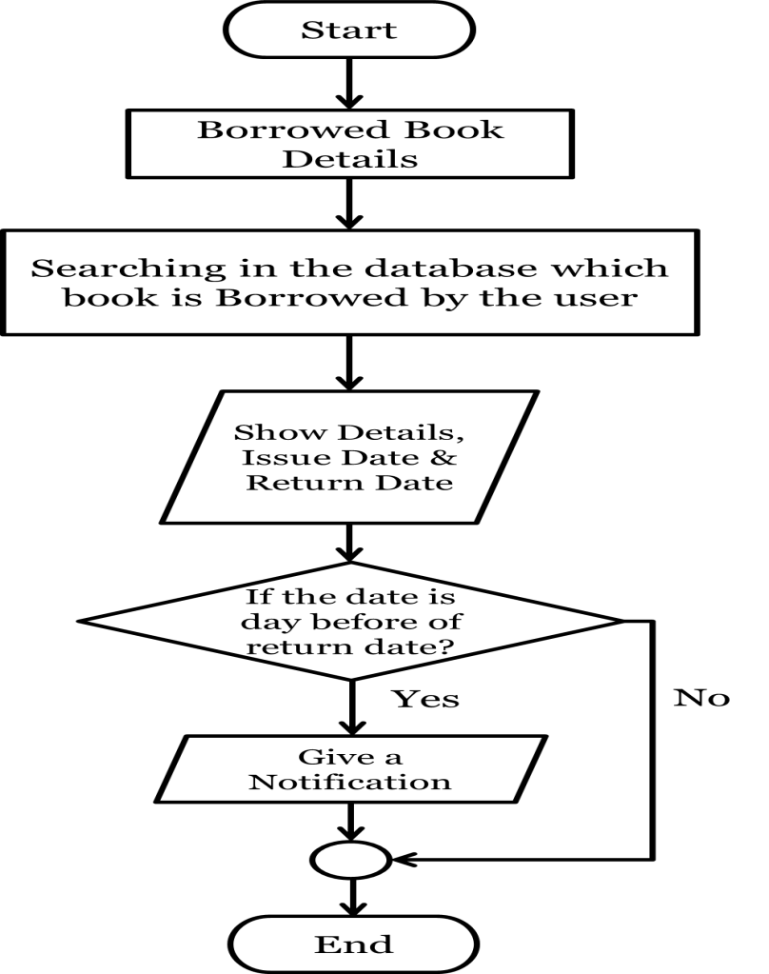
Fig : Book Reservation Flow Chart
Fig : Borrowed Book Details Flow Chart

Slide 14

Server Database Tables
Book Details Table.
User Details Table.
Reserved Book Table.
Notice Board Table.
Issued Book Table.
Statistics Table.

Slide 15
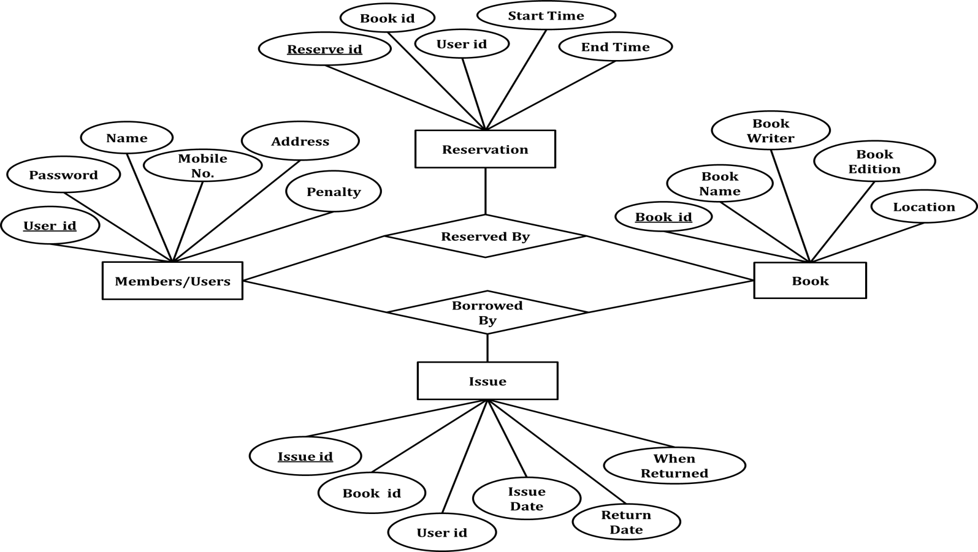
E-R Diagram

Slide 16
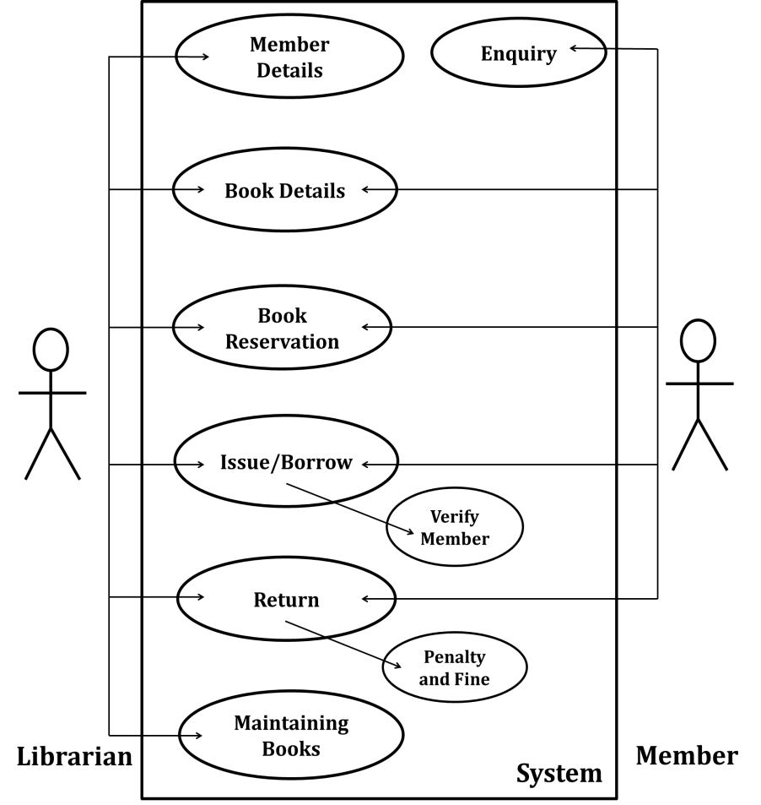
Use-Case Diagram

Slide 17
Conclusion
So, at the conclusion we can say that “Hopefully the project for “Library Book Tracker Android App” will help the library members to get most of the library facilities easily.”

Slide 18

Thank You

