Slide 1
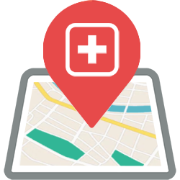
A.L.E.R.T.
ACTIVE LOOKOUT EMERGENCY RESPONSE TOOL
YOUR MOBILE LIFELINE

Slide 2
WHAT IS A.L.E.R.T. ?
Active Lookout Emergency Response Tool is a mobile application that serves as a communication tool between the central command and emergency rescue teams.
It aims to improve disaster management by alerting the nearest rescue team in the area of the reported emergency for immediate resolution.

Slide 3
WHY A.L.E.R.T. ?
It is common to have a hard time deploying rescue teams when simultaneous emergencies occur.
A.L.E.R.T. will help the central command center to inform the nearest rescue team/s available of the emergency that they need to address.

Slide 4



HOW A.L.E.R.T. WORKS
Use GPS-based maps to pinpoint the location of the emergency
Send alerts to the nearest rescue teams in the area
Responders receive the alerts for immediate response / resolution of the emergency

Slide 5





MARKETING
Conduct disaster safety seminars to barangays and schools for more awareness on what to do during the occurrence of a disaster
Build and maintain a site that shows current news on the different disasters that the country faces, as well as information regarding safety in the Philippines

Slide 6
A.L.E.R.T.
ACTIVE LOOKOUT EMERGENCY RESPONSE TOOL
YOUR MOBILE LIFELINE

