Slide 1


Chick-fil-A Menu Nutrition Analysis
Wook Lee
Junseok Park

Slide 2

Objective
Perform a detailed nutritional analysis of the menu items to see which menu options are healthier based on various nutritional metrics
Create interactive visualizations that allow users to explore the nutritional information in various ways
Use KMeans clustering algorithms to group menu items based on nutritional content and discover interesting patterns and help identify healthier alternatives

Slide 3
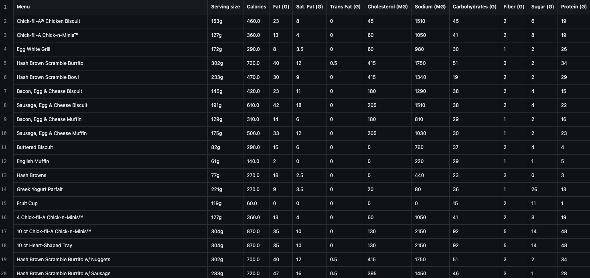
Chick-fil-A Dataset Overview

Slide 4
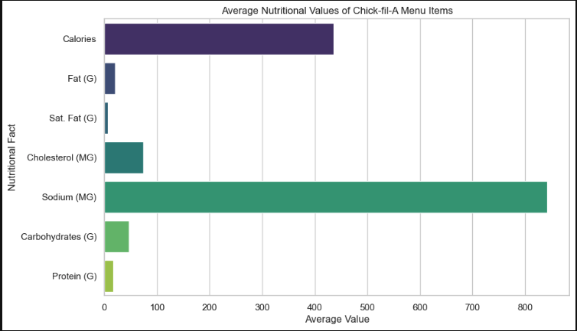
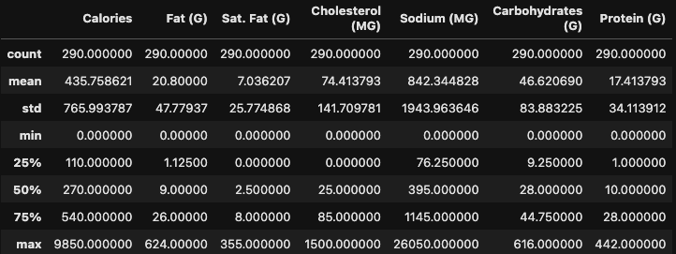
Average nutritional values
Calculated descriptive statistics for major nutritional facts among the Chick-fil-A menus
Sodium stands out as the nutrient with the highest average values which is typical for fast food menus

Slide 5
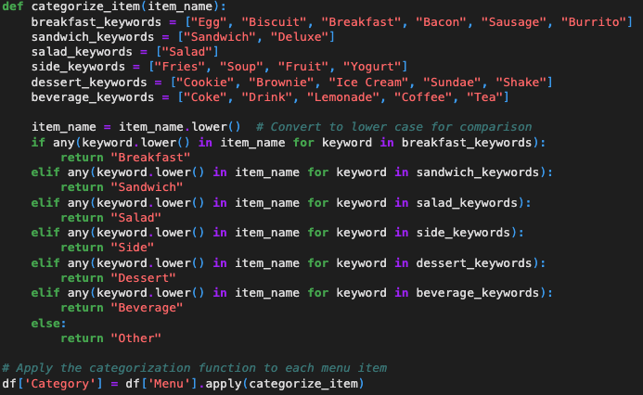
Category-specific Analysis
To see how nutritional profiles vary across different types of menu items
The current dataset doesn’t explicitly include item categories
Categorize menu items based on their names
For example)
Breakfast items keywords: “egg”, “biscuit”, “breakfast”, “sausage”, “burrito”

Slide 6
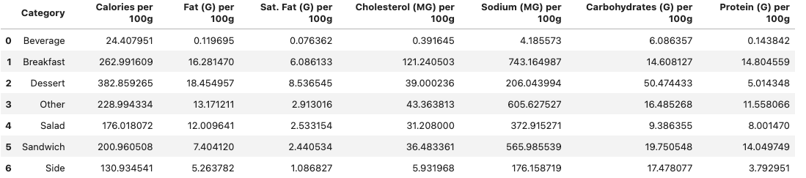
Adjust the nutritional values to a common basis
Serving size for each item was different
Normalize nutritional values to a per 100g basis
Enables direct comparison of nutritional density of menu items across different categories

Slide 7
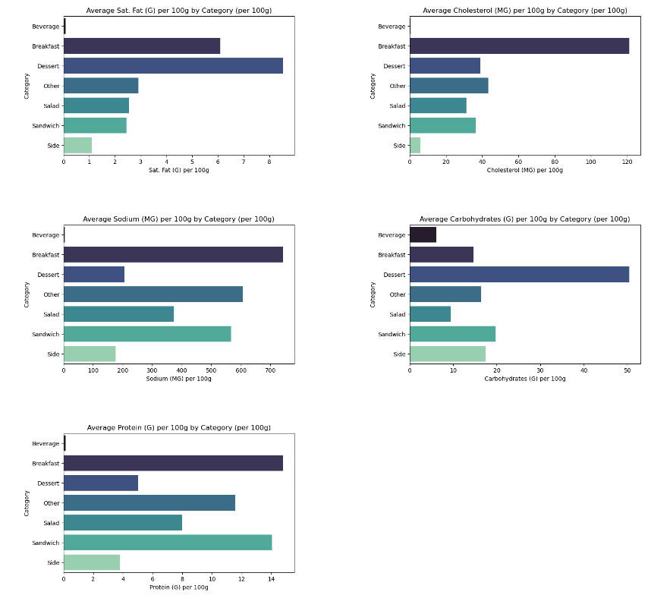
Beverages: lowest in almost all nutritional values per 100g.
Breakfast: highest in cholesterol and high in calories, fat, and saturated fat, typical of breakfast items that include eggs and bacon
Sandwiches: Moderate in calories and protein but lower in fat and cholesterol per 100g compared to breakfast items
Desserts: high in carbs and sat. Fat reflecting their sugary and rich nature
Salads: lower in calories compared to other solid food categories

Slide 8
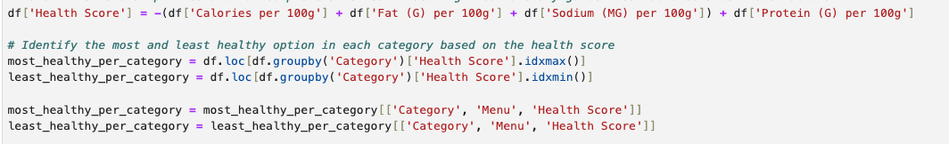
Healthy & Unhealthy options within each category
But what is “healthy”?
Generally, a “healthier” option could be one with lower calories, fat, sodium, and higher in protein
Healthy score we came up with
Score = - (Calories + Fat + Sodium ) + (Protein)

Slide 9
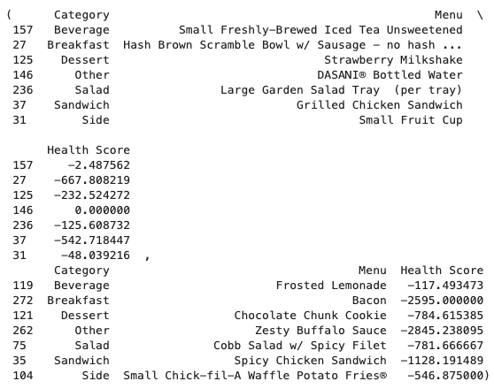
Healthy & Unhealthy options within each category
Beverage: Small Freshly-Brewed Iced Tea Unsweetened
Breakfast: Hash Brown Scramble Bowl w/ Sausage – no hash browns
Dessert: Strawberry Milkshake
Salad: Large Garden Salad Tray (per tray)
Sandwich: Grilled Chicken Sandwich
Side: Small Fruit Cup

Slide 10

Applying KMeans Clustering & PCA for Visualization
The ’KMeans’ algorithm from scikit-learn is applied to the standardized nutritional facts to group menu items into 5 clusters based on their nutritional similarity.
A new column called ‘Cluster’ is added to the DataFrame
Principal Component Analysis (PCA) is applied to facilitate a 2D scatter plot of the clusters

Slide 11
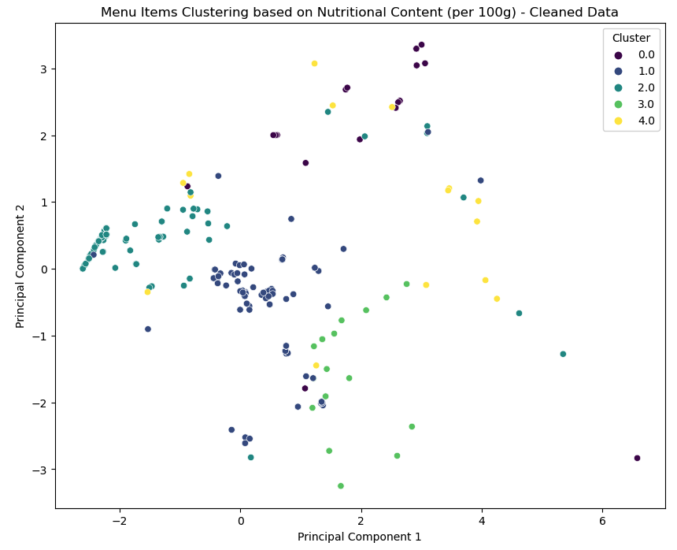
The scatter plot shows the distribution of menu items across the clusters
Give an idea of how many items fall into each cluster

Slide 12
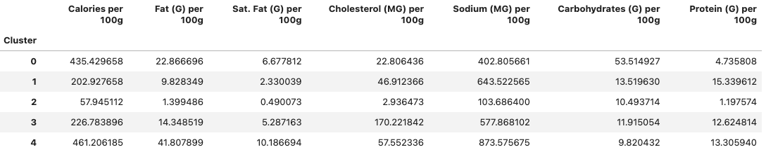
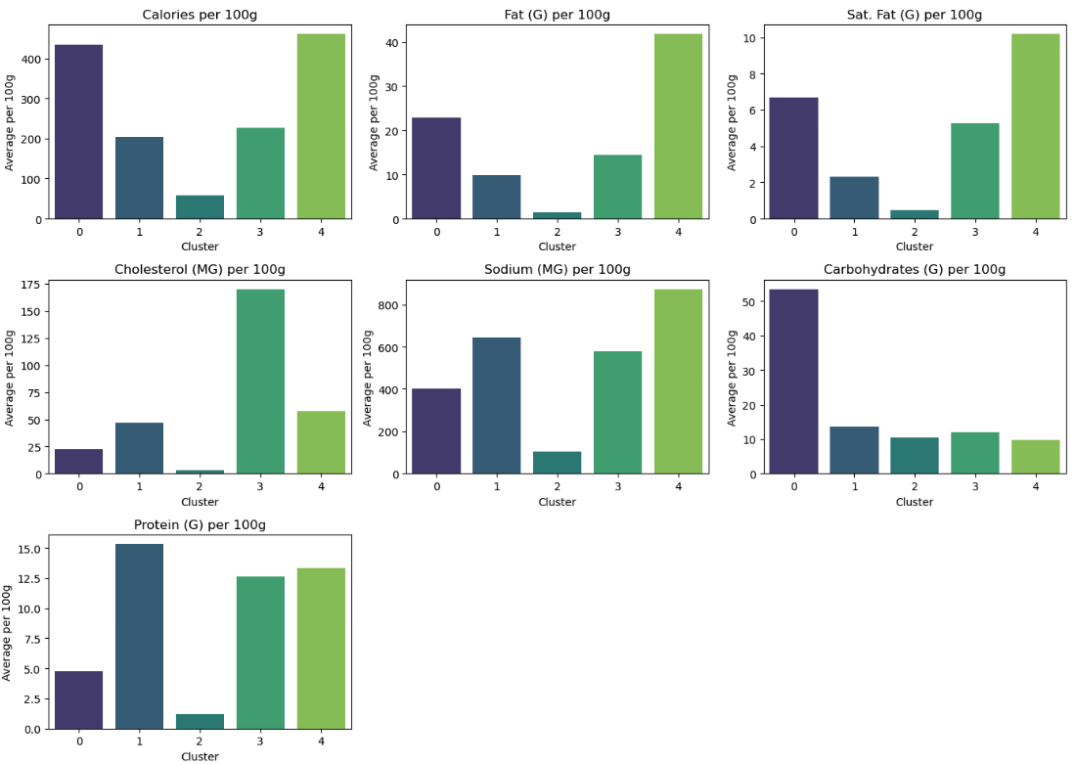
Calories & Fat: Cluster 4
Sat. Fat: Cluster 4, possibly fried or creamy items
Cholesterol: Cluster 3, indicating presence of animal-based proteins
Carbs: Cluster 0
Protein: Cluster 3 & 4

Slide 13
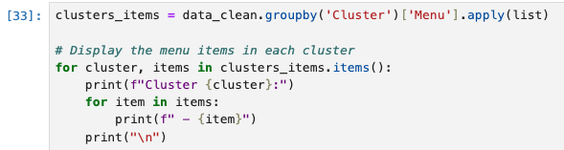
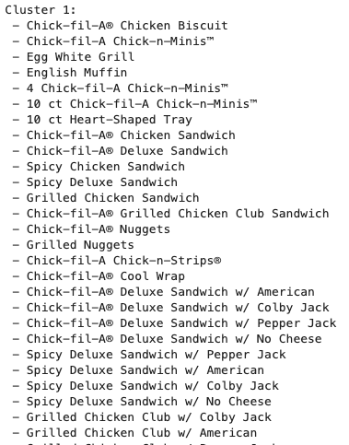
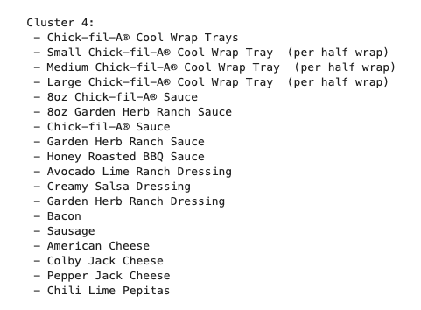
What items are in Cluster 4?

Slide 14




Tools used & code repository
Our source code is available at https://github.com/lbu0413/ds_class_project
Tools used

Slide 15

Wook Lee Junseok Park

