Slide 1
Wave Energy Converter Control Strategies
Point Absorber Buoy Model
Group 15
Wave Energy Project

Slide 2
Problem Overview
Wave energy is a renewable energy source
Point absorbers convert wave motion into electricity
Goal: maximise power extraction

Slide 3
Physical System
Heave motion (vertical oscillation)
Forces: excitation, buoyancy, radiation damping
Power Take-Off (PTO) acts as controllable damping

Slide 4
Comparable Mathematical Modelling
Modelled as a forced damped oscillator
Includes added mass and hydrostatic stiffness
Cummins equation introduces memory effects

Slide 5
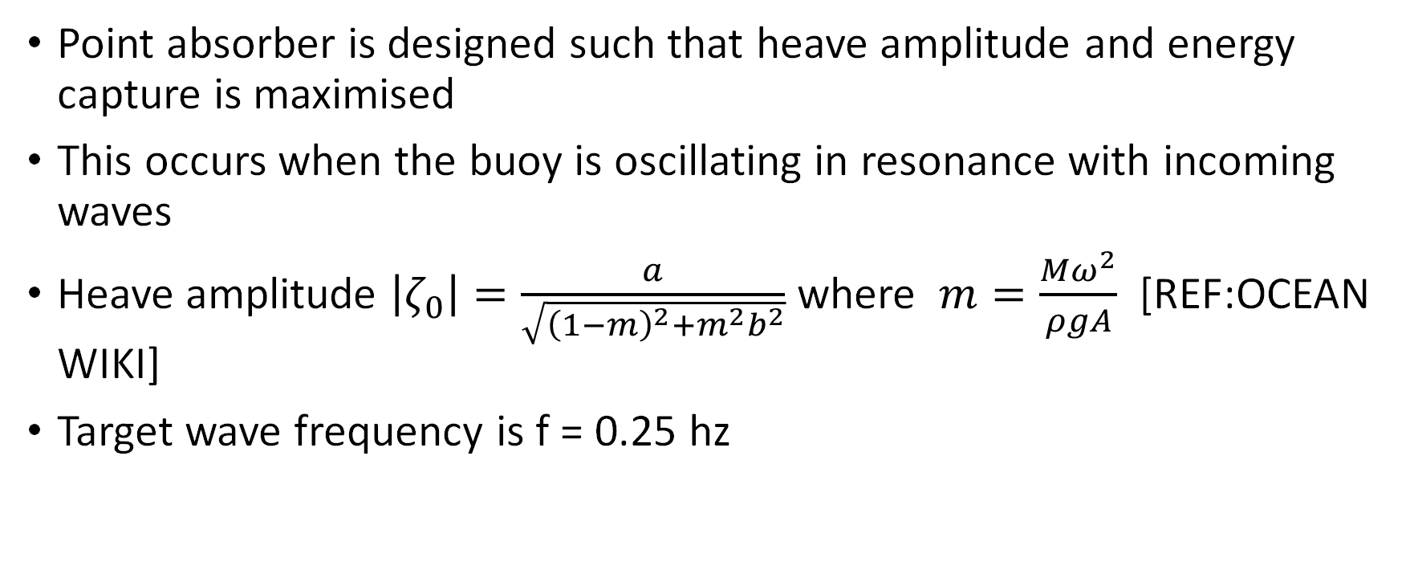
Finding resonant mass of buoy
Point absorber is designed such that heave amplitude and energy capture is maximised
This occurs when the buoy is oscillating in resonance with incoming waves
Heave amplitude $\left|ζ_{0}\right|=\frac{a}{\sqrt{{\left(1−m\right)}^{2}+m^{2}b^{2}}}$ where $m=\frac{Mω^{2}}{ρgA}$ [REF:OCEAN WIKI]
Target wave frequency is f = 0.25 hz

Slide 6
Hydrodynamic Model
Capytaine BEM solver used
Computes added mass and damping
Provides excitation forces

Slide 7
Modelling Sea States
Real waves are irregular
JONSWAP spectrum used
Multiple frequencies with random phases

Slide 8
Control Strategies
Fixed controls
Passive Damping
Predictive Damping
Latch Control
RL Control

Slide 9
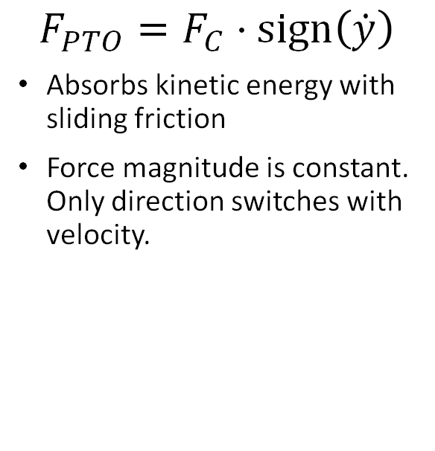
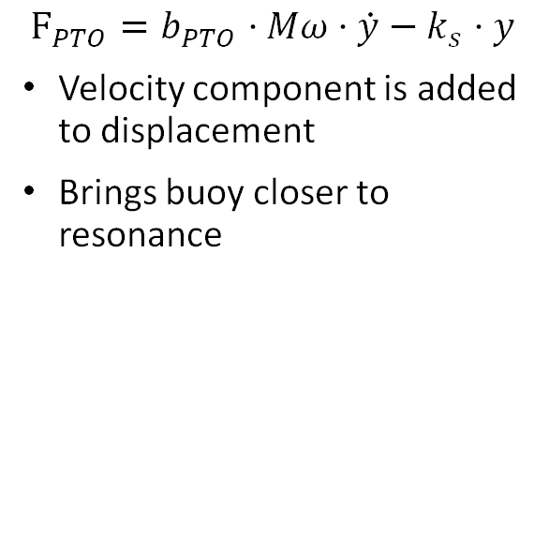

Fixed Controls
Coulomb
Displacement
Velocity
$$F_{PTO}=F_{C}⋅\text{sign}\left(\dot{y}\right)$$
Absorbs kinetic energy with sliding friction
Force magnitude is constant. Only direction switches with velocity.
$$F_{PTO}=b_{PTO}·Mω·\dot{y}$$
PTO force is proportional to the displacement of the buoy
$$F_{PTO}=b_{PTO}·Mω·\dot{y}−k_{s}·y$$
Velocity component is added to displacement
Brings buoy closer to resonance
Notes:
Frequency of __ used to compare the power output of a cylinder buoy with 3 fixed control techniques.

Slide 10
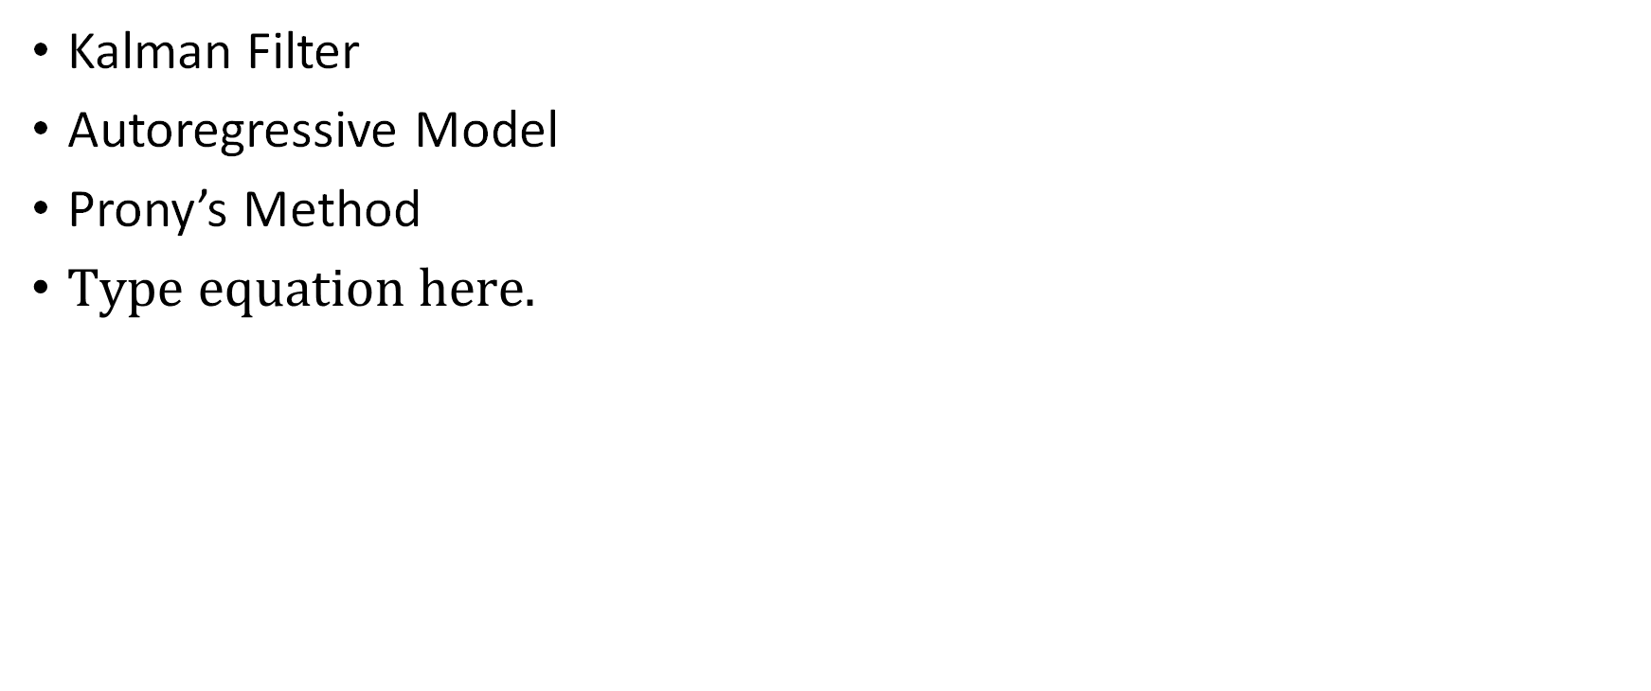
Prerequisite for Control
Kalman Filter
Autoregressive Model
Prony’s Method

Slide 11
Passive Damping
What it is?
Analytical tuning
Grid search tuning
Results

Slide 12
Latching Control
What it is?
Aim to keep excitation force and buoy in phase.
Results.
Comparison via Optimal Command Theory
How Optimal Command Theory can be used with neural networks to be used as a real-time control

Slide 13
Model Predictive Control
MPC is a control strategy which involves predicting behaviour over a time horizon and then optimising the control to maximise the power output.
Kalman Filter Implementation
Results

Slide 14
The latch state is determined from a Hamiltonian, H.
H can be thought of as an instantaneous score, measuring both the power currently being captured, and how current trajectory is affecting future energy capture.

Slide 15
Discussion
Control improves performance
Requires sensing and timing
Sensitive to wave conditions

Slide 16
Conclusion
Model successfully developed
Realistic sea conditions simulated
Latching improves energy capture
Control strategy is critical

Slide 17
Future Work
Extend to multi-degree motion
Nonlinear modelling
Further Adaptive control strategies

