Slide 1
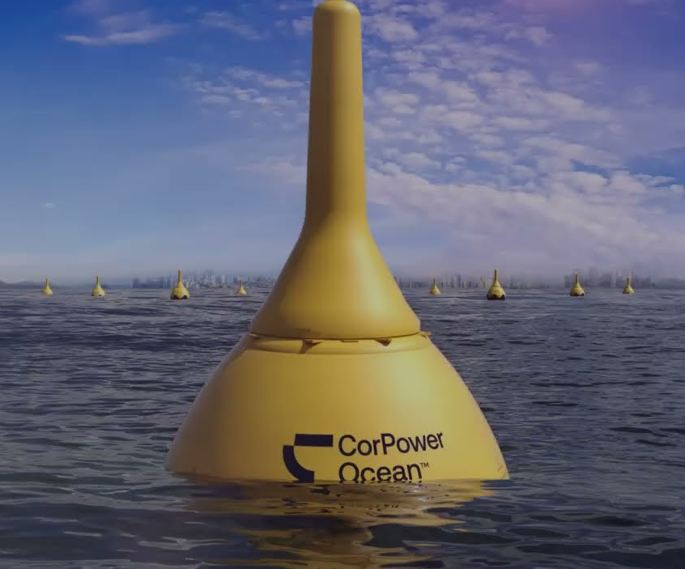
Point Absorber Control Strategies
Group 15
Wave Energy Project

Slide 2
Problem Overview
Wave energy is a renewable energy source
01
Point absorbers convert wave motion into electricity
02
Goal: maximise power extraction
03

Slide 3
Point Absorber Physical System
Heave motion (vertical oscillation)
Forces: excitation, buoyancy, radiation damping
Power Take-Off (PTO) acts as controllable damping

Slide 4
Comparable Mathematical Modelling
Modelled as a forced damped oscillator
Includes added mass and hydrostatic stiffness
Cummins equation introduces memory effects

Slide 5
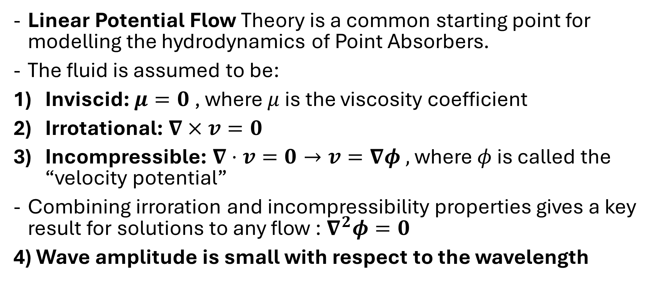
Hydrodynamic Model – Linear Potential Flow Assumptions
Linear Potential Flow Theory is a common starting point for modelling the hydrodynamics of Point Absorbers.
The fluid is assumed to be:
Inviscid: $μ=0$ , where $μ$ is the viscosity coefficient
Irrotational: $∇×v=0$
Incompressible: $∇⋅v=0→v=∇φ ,$ where $φ$ is called the “velocity potential”
Combining irroration and incompressibility properties gives a key result for solutions to any flow :$∇^{2}φ=0$
4) Wave amplitude is small with respect to the wavelength

Slide 6
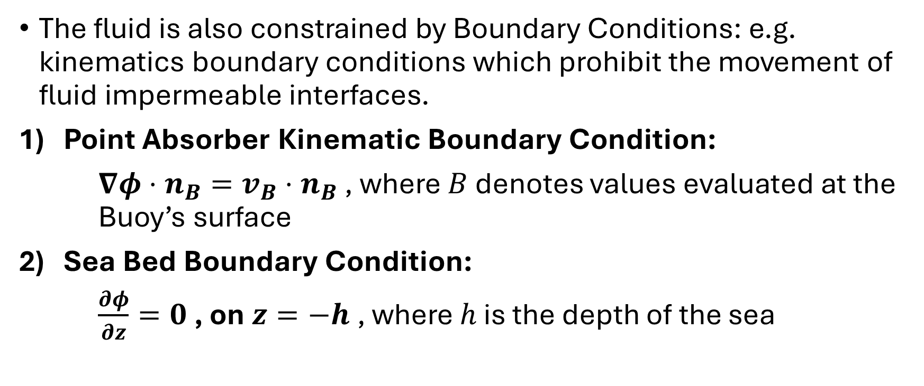
Hydrodynamic Model – Linear Potential Flow Boundary Conditions
The fluid is also constrained by Boundary Conditions: e.g. kinematics boundary conditions which prohibit the movement of fluid impermeable interfaces.
Point Absorber Kinematic Boundary Condition:
$∇φ⋅n_{B}=v_{B}⋅n_{B}$ , where $B$ denotes values evaluated at the Buoy’s surface
2) Sea Bed Boundary Condition:
$\frac{∂φ}{∂z}=0$ , on $z=−h$ , where $h$ is the depth of the sea

Slide 7
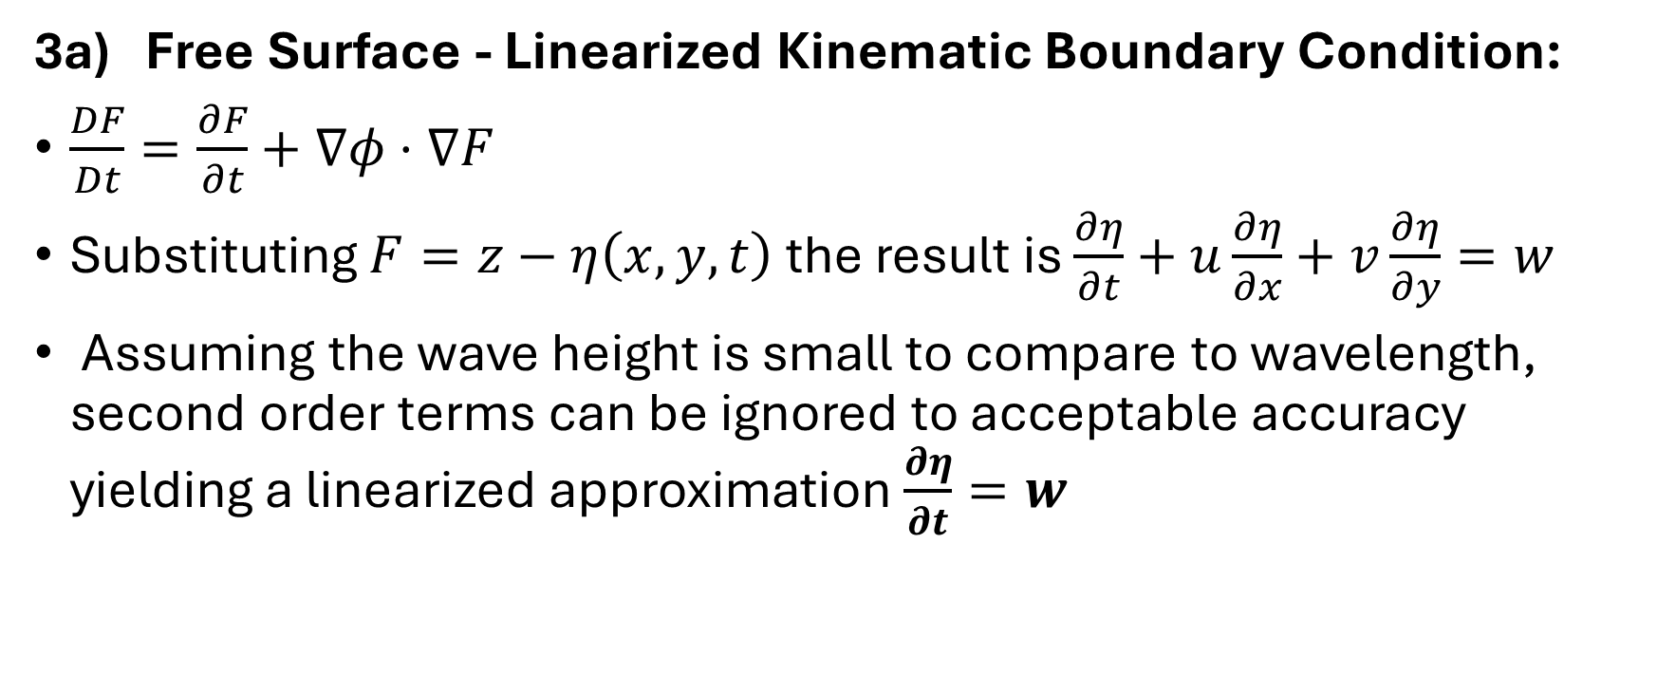
Hydrodynamic Model – Linear Potential Flow Boundary Conditions
3a) Free Surface - Linearized Kinematic Boundary Condition:
$\frac{DF}{Dt}=\frac{∂F}{∂t}+∇φ⋅∇F$
Substituting $F=z−η\left(x,y, t\right)$ the result is $\frac{∂η}{∂t}+u\frac{∂η}{∂x}+v\frac{∂η}{∂y}=w$
Assuming the wave height is small to compare to wavelength, second order terms can be ignored to acceptable accuracy yielding a linearized approximation $\frac{∂η}{∂t}=w$

Slide 8
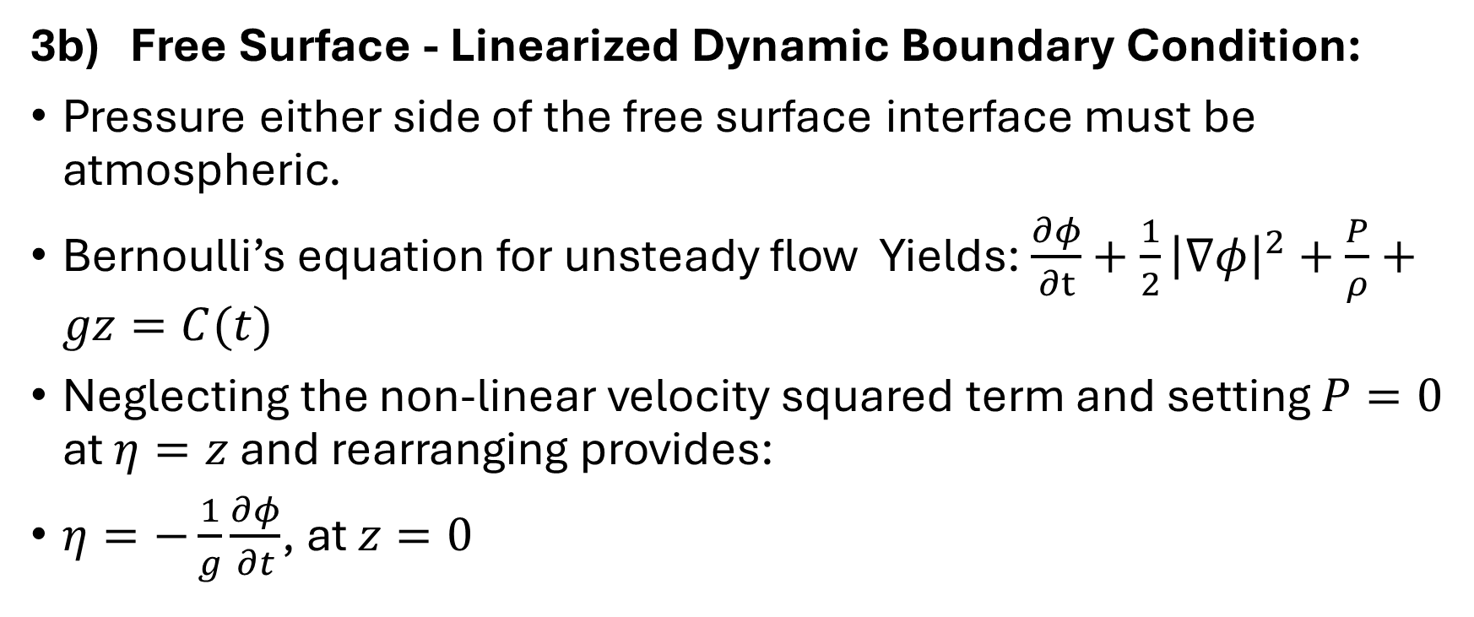
Hydrodynamic Model – Linear Potential Flow Boundary Conditions
3b) Free Surface - Linearized Dynamic Boundary Condition:
Pressure either side of the free surface interface must be atmospheric.
Bernoulli’s equation for unsteady flow Yields: $\frac{∂φ}{∂t}+\frac{1}{2}{\left|∇φ\right|}^{2}+\frac{P}{ρ}+gz=C(t)$
Neglecting the non-linear velocity squared term and setting $P=0$ at $η=z$ and rearranging provides:
$η=−\frac{1}{g}\frac{∂φ}{∂t}$, at $z=0$

Slide 9

Hydrodynamic Model – Linear Potential Flow Boundary Conditions
Combining the Free Surface Conditions:
$η=−\frac{1}{g}\frac{∂φ}{∂t}$, at $z=0$ and $\frac{∂η}{∂t}=w$
Gives: $\frac{∂^{2}φ}{∂t^{2}}+g\frac{∂φ}{∂z}=0$ on $z=0$

Slide 10
Hydrodynamic Model – 2 Types of Problem
Radiation Problem: The normal velocity on the body surface corresponds to the motion of the body along one of its degrees of freedom. The resolution of the Laplace problem allows to derive the added mass and the radiation damping associated with this degree of freedom.
Diffraction Problem: The velocity on the floating body is given by the velocity of Airy’s wave field. Once the problem has been solved, the linear Froude-Krylov force is computed by the integration of the pressure

Slide 11
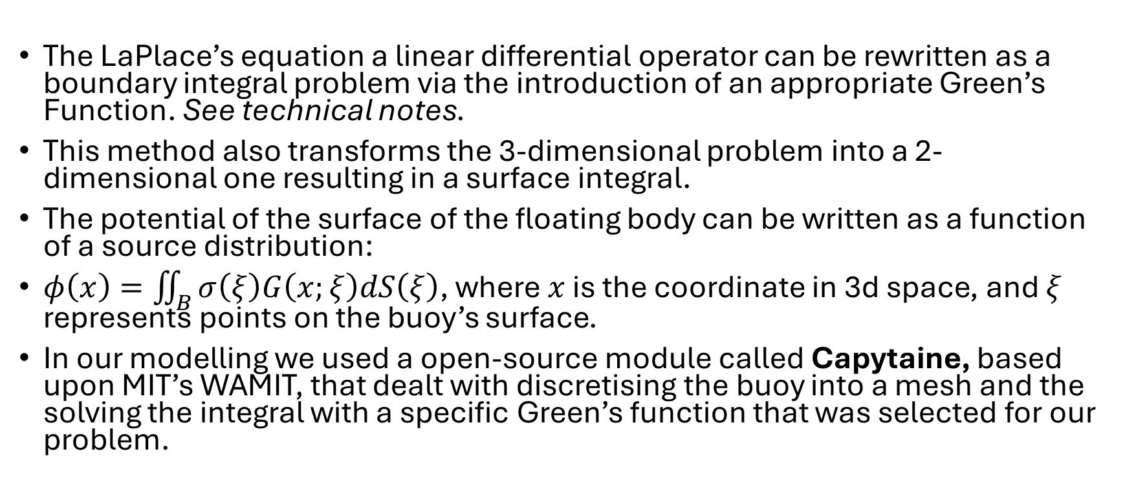
Hydrodynamic Model – Boundary Element Method to Solve Linear Potential Flow Problem’s
The LaPlace’s equation a linear differential operator can be rewritten as a boundary integral problem via the introduction of an appropriate Green’s Function. See technical notes.
This method also transforms the 3-dimensional problem into a 2-dimensional one resulting in a surface integral.
The potential of the surface of the floating body can be written as a function of a source distribution:
$φ\left(x\right)=\iint_{B}{σ\left(ξ\right)G\left(x;ξ\right)dS\left(ξ\right)}$, where $x$ is the coordinate in 3d space, and $ξ$ represents points on the buoy’s surface.
In our modelling we used a open-source module called Capytaine, based upon MIT’s WAMIT, that dealt with discretising the buoy into a mesh and the solving the integral with a specific Green’s function that was selected for our problem.

Slide 12
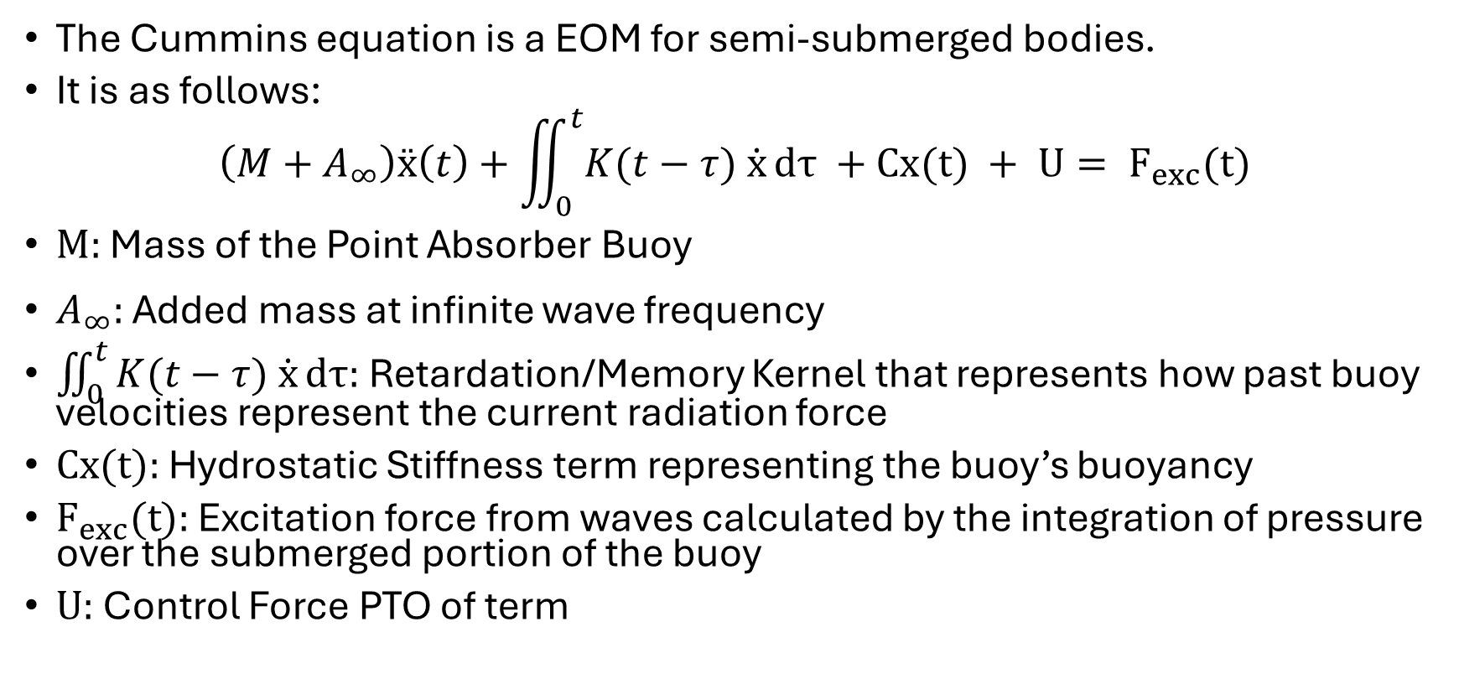
Equation of Motion for the Buoy:
The Cummins equation is a EOM for semi-submerged bodies.
It is as follows:
$$\left(M+A_{∞}\right)ẍ\left(t\right)+\iint_{0}^{t}{K(t−τ) \dot{x}}dτ +Cx(t) + U= F_{exc}(t)$$
$M:$ Mass of the Point Absorber Buoy
$A_{∞}:$ Added mass at infinite wave frequency
$\iint_{0}^{t}{K(t−τ) \dot{x}}dτ:$ Retardation/Memory Kernel that represents how past buoy velocities represent the current radiation force
$Cx(t):$ Hydrostatic Stiffness term representing the buoy’s buoyancy
$F_{exc}(t):$ Excitation force from waves calculated by the integration of pressure over the submerged portion of the buoy
$U:$ Control Force PTO of term

Slide 13
Modelling Sea States
Real waves are irregular
JONSWAP spectrum used
Multiple frequencies with random phases

Slide 14
Control Strategies - Analysed
Passive Damping
(Model Predictive Damping)
Latch Control
Pontryagin that can be used for RL Control

Slide 15
Prerequisite for Control
Kalman Filter
Autoregressive Model
Prony’s Method

Slide 16
Passive Damping
What it is?
Analytical tuning
Grid search tuning
Results

Slide 17
Latching Control
What it is?
Aim to keep excitation force and buoy in phase.
Results.
Comparison via Optimal Command Theory
How Optimal Command Theory can be used with neural networks to be used as a real-time control.

Slide 18
Model Predictive Control
What it is?
Results

Slide 19
Optimal Command using Pontryagin’s Maxima Principle

Slide 20
Discussion
Control improves performance
Requires sensing and timing
Sensitive to wave conditions

Slide 21
Conclusion
Model successfully developed
Realistic sea conditions simulated
Latching improves energy capture
Control strategy is critical

Slide 22
Future Work
Extend to multi-degree motion
Nonlinear modelling
Further Adaptive control strategies

