Slide 1
Introduction to Spatial Data Science and Machine Learning Urban Design B-Pro 2022/2023 Liam Thomas Bolton PhD Architectural Space and Computation student

Slide 2
Overview
The aim of the workshops is to provide an introduction to spatial data science and machine learning with Python:
Python programming for spatial data science
Spatial data, formatting
Data visualisation and mapping
Machine learning

Slide 3
Schedule
01. Spatial Data - November 11th 2022
02. Visualisation - November 18th 2022
03. Modelling - November 25th 2022
04. Advanced - December 2nd 2022

Slide 4
Material
The workshop material – including presentation slides, data and notebooks – has been uploaded to Github:
https://github.com/lbuk/UD_Intro_SDSML2022

Slide 5
What is Spatial Data Science? Definition Spatial data science is subset of data science that focuses on the analysis and visualisation of spatial data. It can also draw on techniques from machine learning.

Slide 6
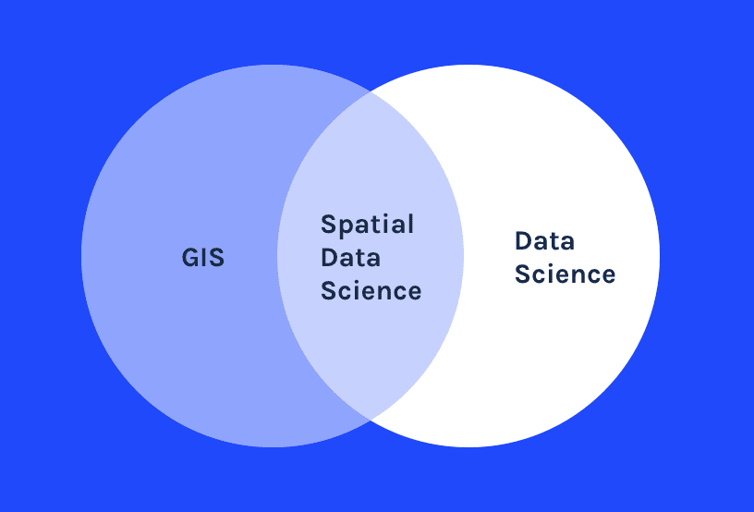
https://carto.com/what-is-spatial-data-science/

Slide 7
What is Machine Learning? Machine learning algorithms learn and make predictions from data.

Slide 8
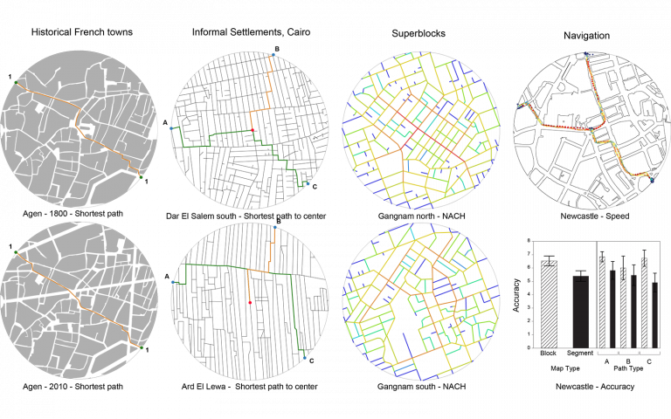
Spatial data science and machine learning have many applications in the spatial disciplines of urban design and architecture
Network Analysis
https://www.ucl.ac.uk/bartlett/architecture/events/2020/nov/space-syntax-laboratory-research-seminar-alice-vialard

Slide 9
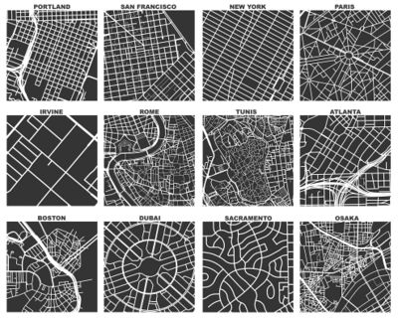
Mapping Urban Form
https://wiki.openstreetmap.org/wiki/OSMnx

Slide 10
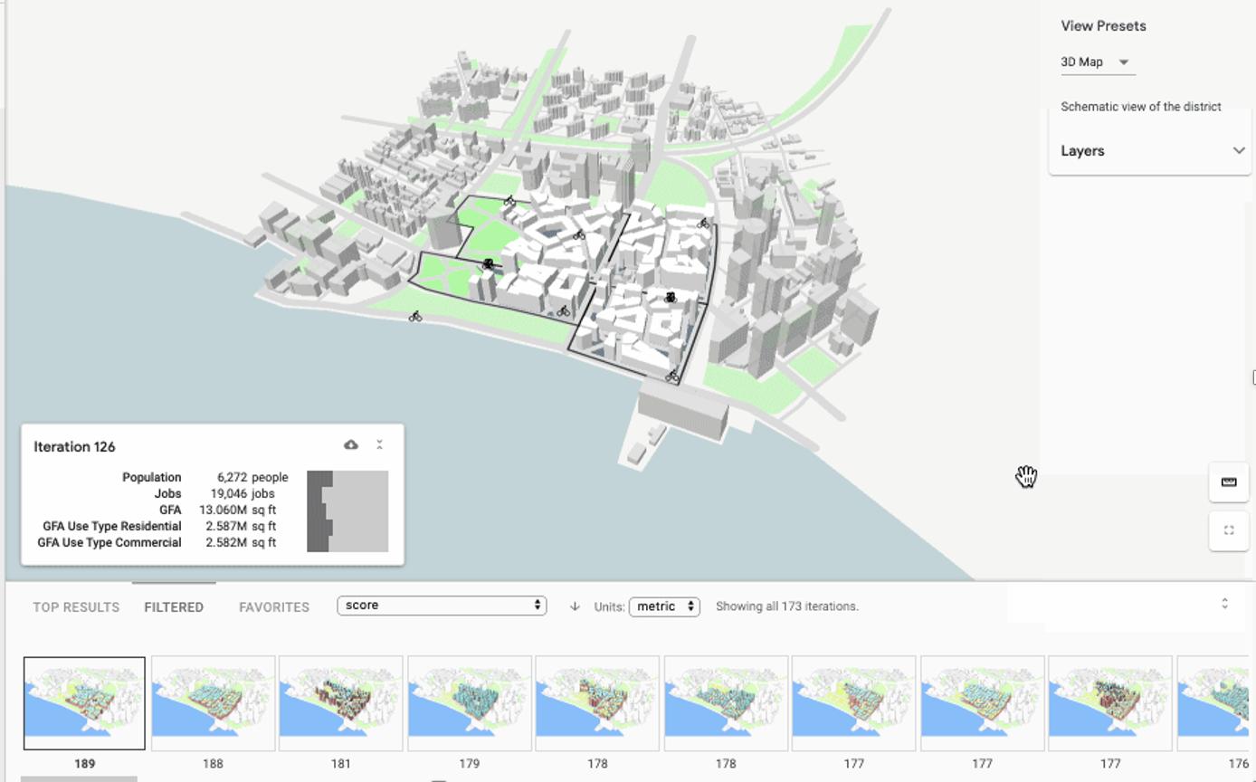
Machine Learning
https://www.archpaper.com/2020/01/sidewalk-labs-using-machine-learning-neighborhood-design-smoother/

Slide 11

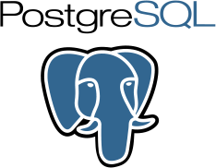



Computation and Spatial Data Science Computational skills are essential to many aspects of spatial data science and machine learning as well as urban design.

Slide 12

Programming with Python This workshop focuses on Python, a multi-purpose programming language often utilised in data science, spatial analysis and machine learning. Python packages for performing spatial data science include, but are not limited to: - Geopandas - Matplotlib - LiDAR - GDAL - Folium - OSMnx
https://www.python.org/

Slide 13
01. Spatial Data 01_spatial_data - data - notebook - slides

Slide 14
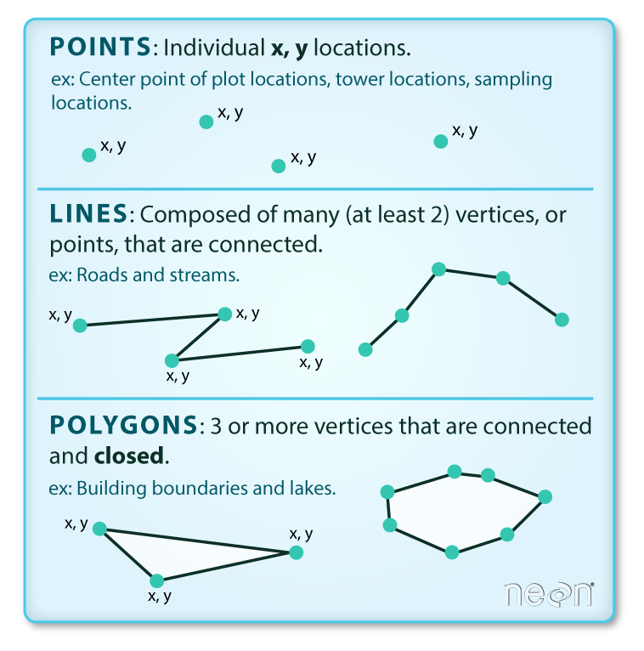
Vector Data
Points, lines and polygons.
https://www.earthdatascience.org/courses/use-data-open-source-python/intro-vector-data-python/spatial-data-vector-shapefiles/

Slide 15
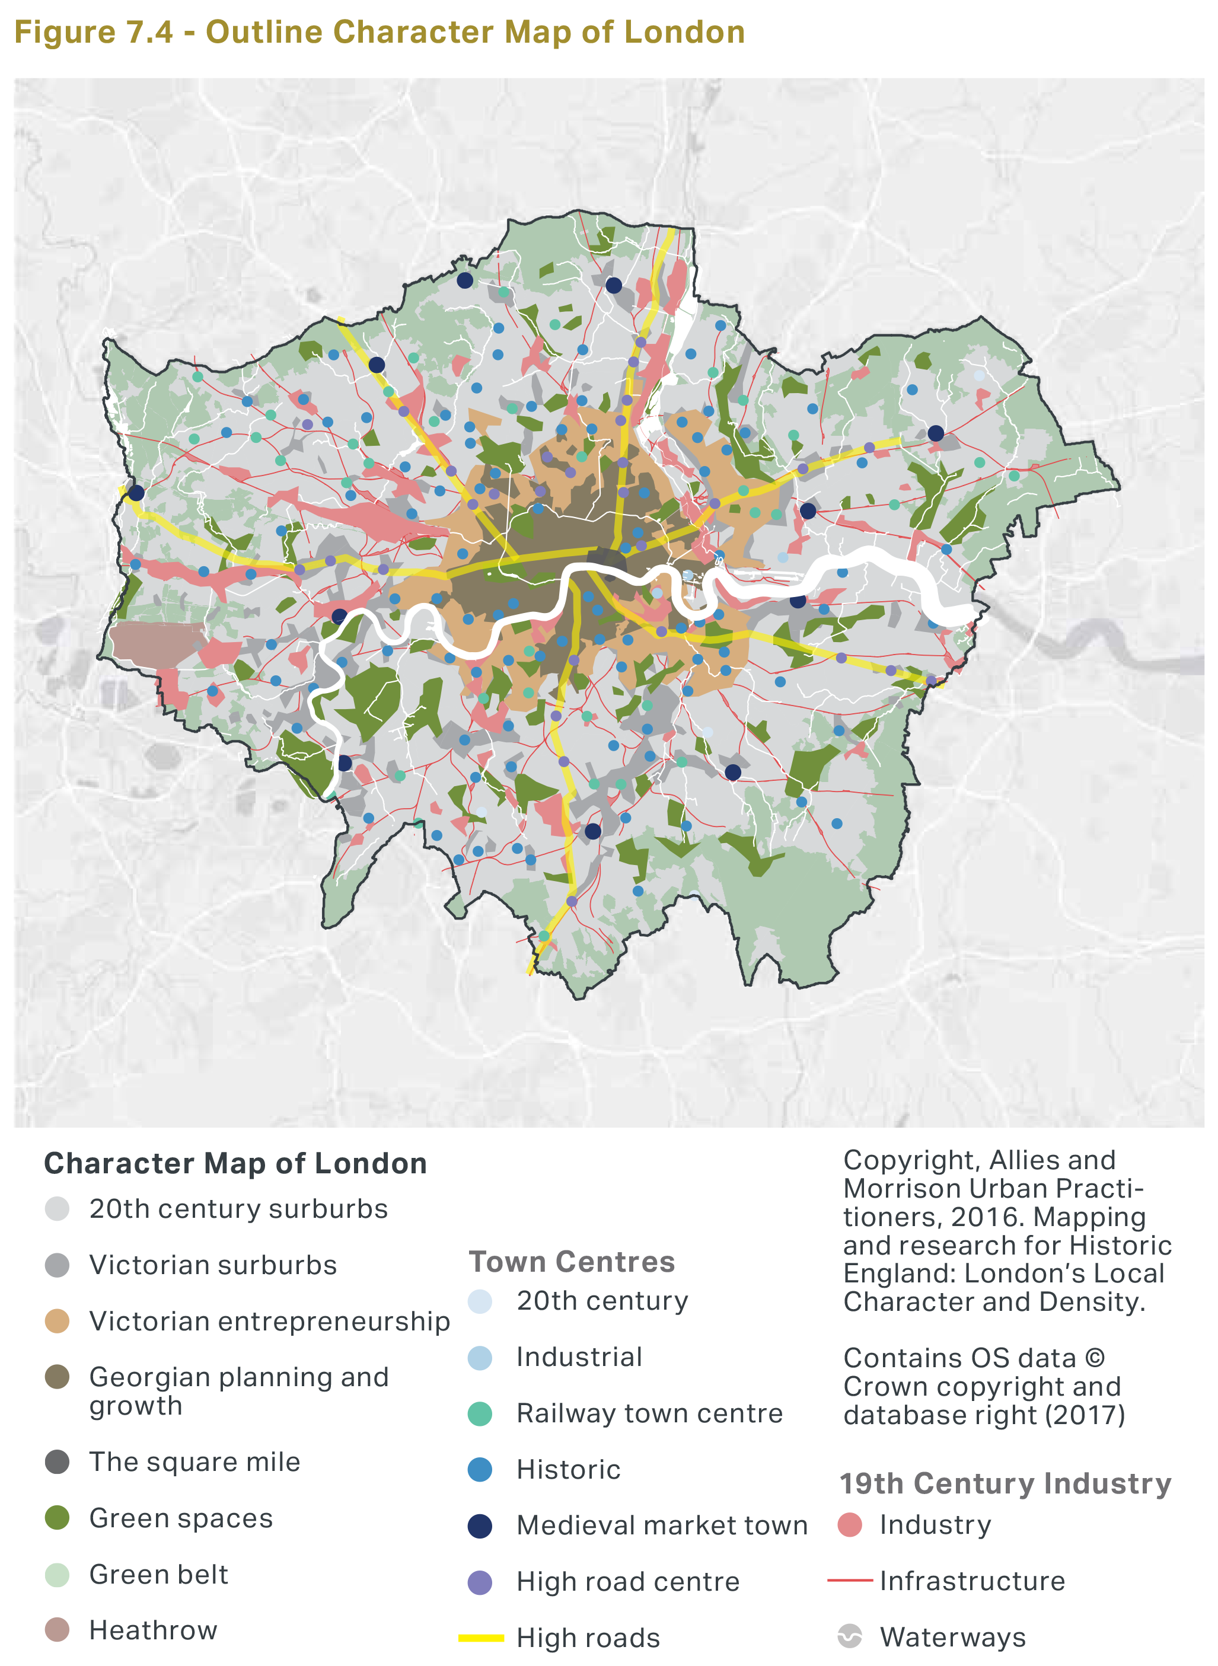
Vector Data
https://www.london.gov.uk/sites/default/files/intend_to_publish_-_clean.pdf

Slide 16
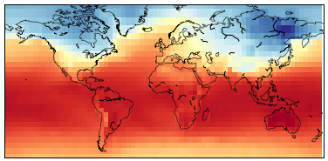
Raster Data
Continuous surfaces.
Surfaces represented as grids with cells.
https://developer.ibm.com/learningpaths/data-analysis-using-python/working-with-geospatial-raster-data-in-python/

Slide 17
Spatial Data Formats
A list of some of the most utilised spatial data formats:
Shapefile (.shp and .shx .prj .dbf .cpg .qpj)
GeoJSON (.geojson)
GeoPackage (.gpkg)
Geography Markup Language (.gml)
GeoTIFF (.tif)
File Geodatabase (.gdb)
Vector data
Raster data
Vector data / raster data

Slide 18

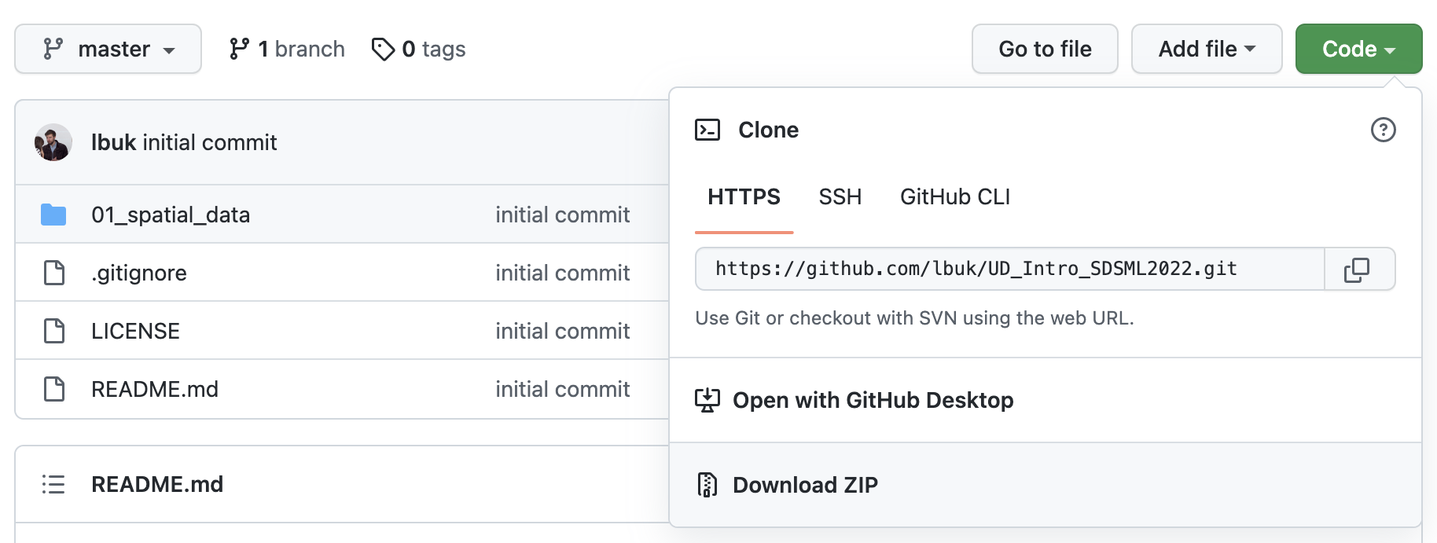
Jupyter Notebook and Python
1. If Jupyter is not already installed, download Anaconda (https://www.anaconda.com/)
and launch Python and Jupyter Notebook from Anaconda.
2. Download the ZIP file from Github: https://github.com/lbuk/UD_Intro_SDSML2022
3. Launch Jupyter Notebook from Anaconda or Jupyter and open the workshop folder and 01_spatial_data and notebook/01_notebook.ipynb

Slide 19
Resources ISDSML 2022 workshop materials: https://github.com/lbuk/UD_Intro_SDSML2022 Python site: http://www.python.org/ Jupyter site: https://jupyter.org/ OSMnx Github repo: https://github.com/gboeing/osmnx Geoprocessing with Python book: https://livebook.manning.com/book/geoprocessing-with-python Geographic Data Science with Python book: https://geographicdata.science/book/intro.html Introduction to Python for Geographic Data Analysis book: https://pythongis.org/

