Slide 1
Project-4-Titanic
File created on: 8/25/2023 4:12:53 AM

Slide 2
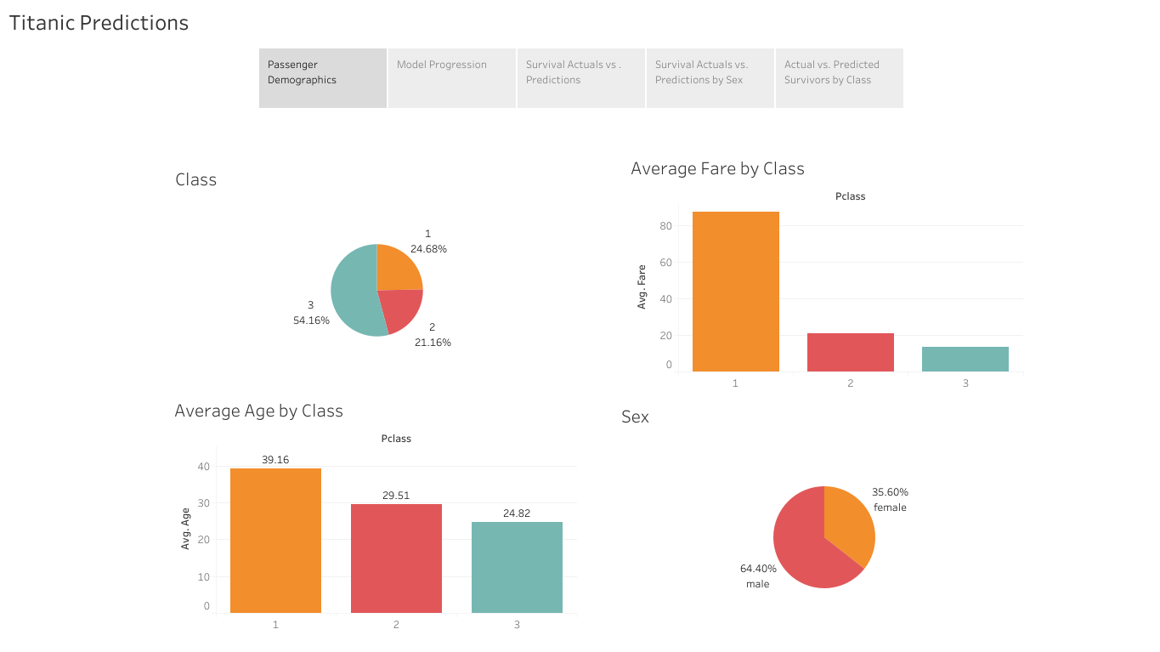

Slide 3
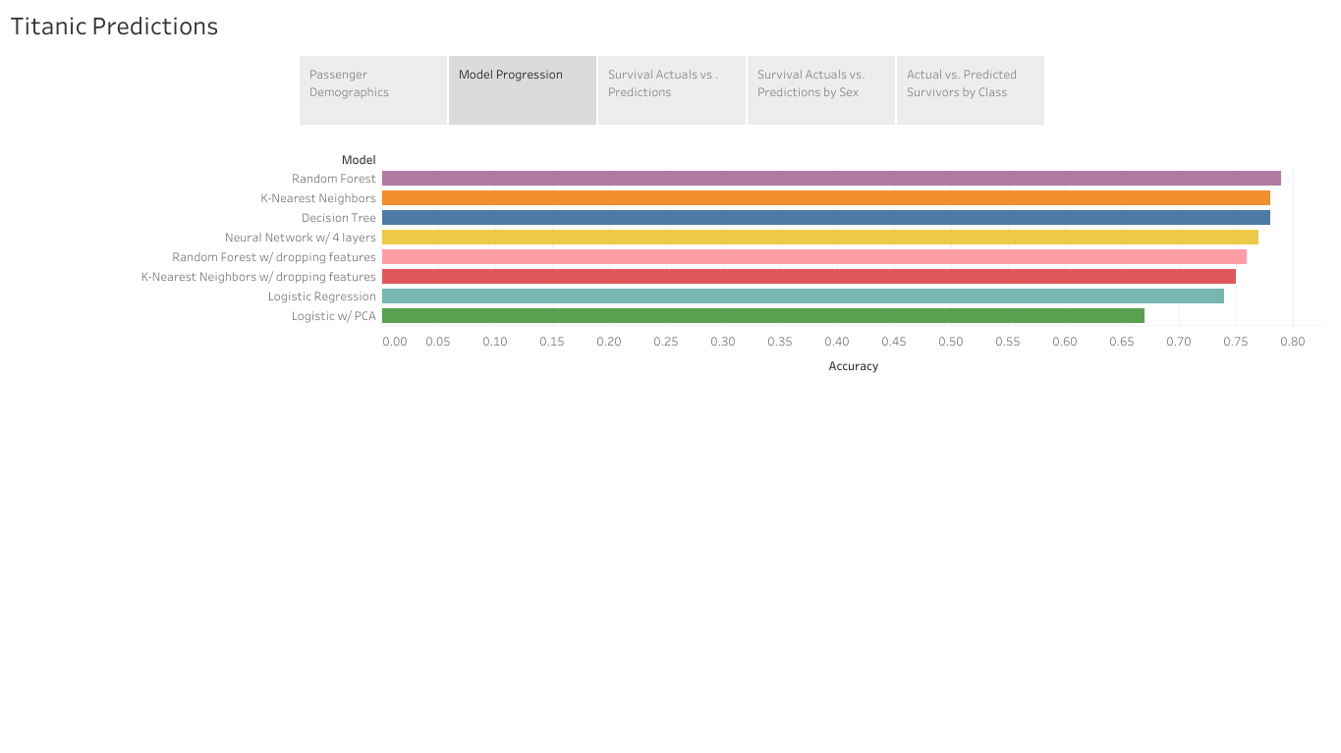

Slide 4
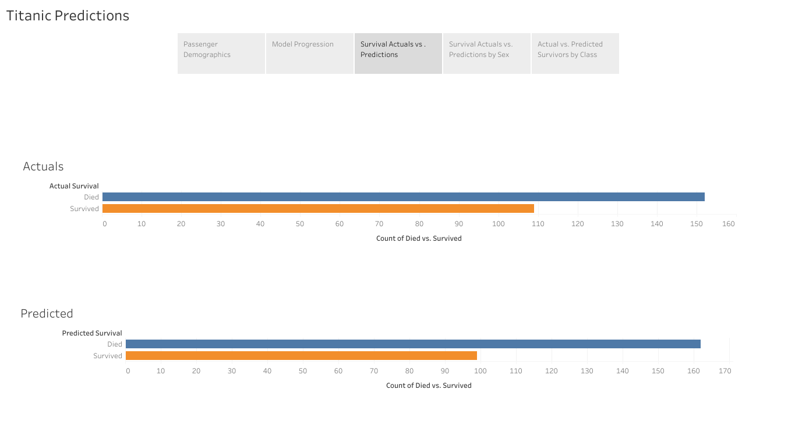

Slide 5
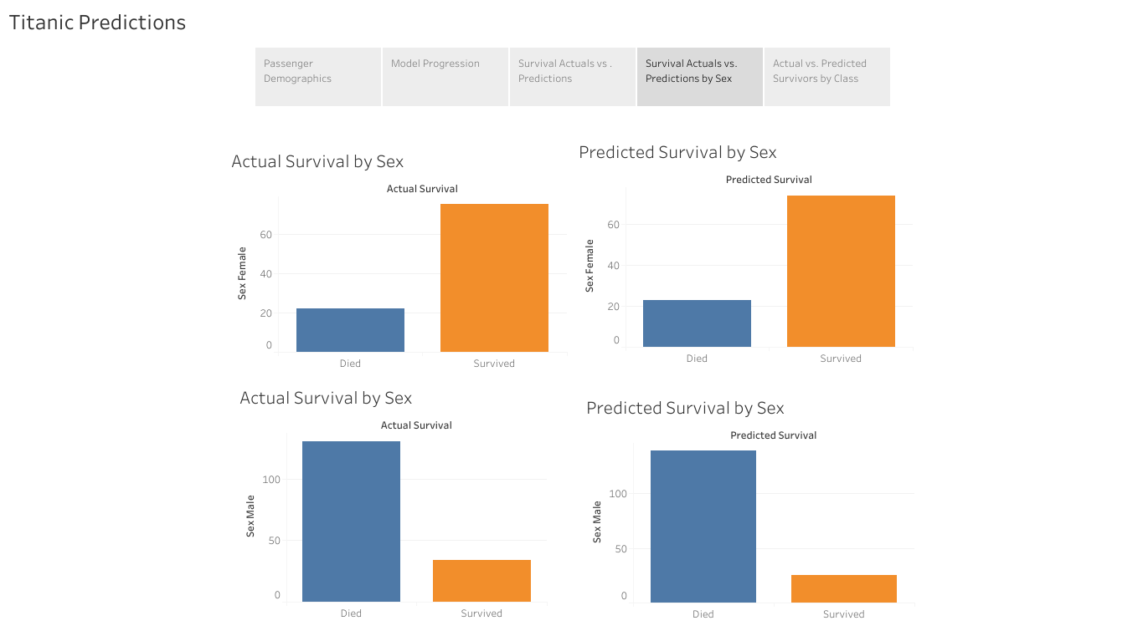

Slide 6
