Slide 1
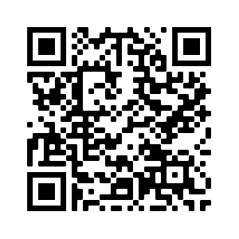
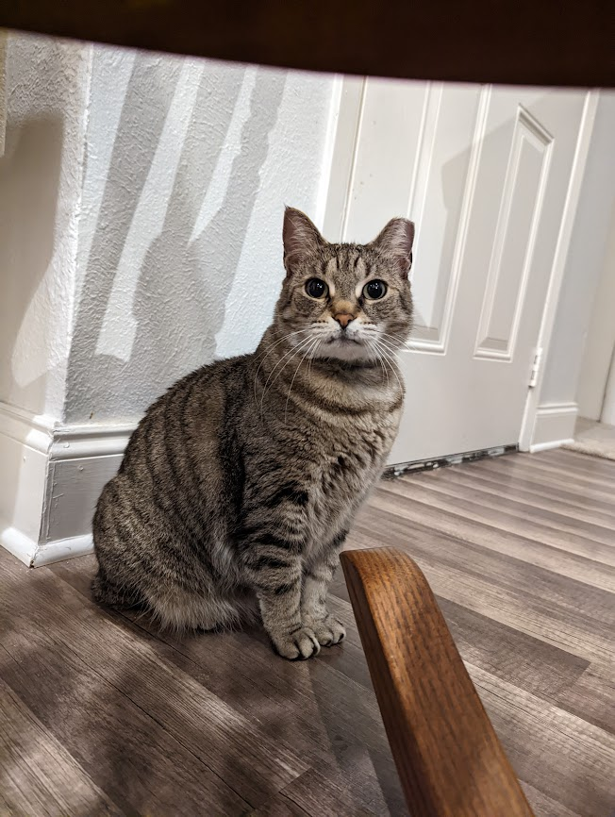
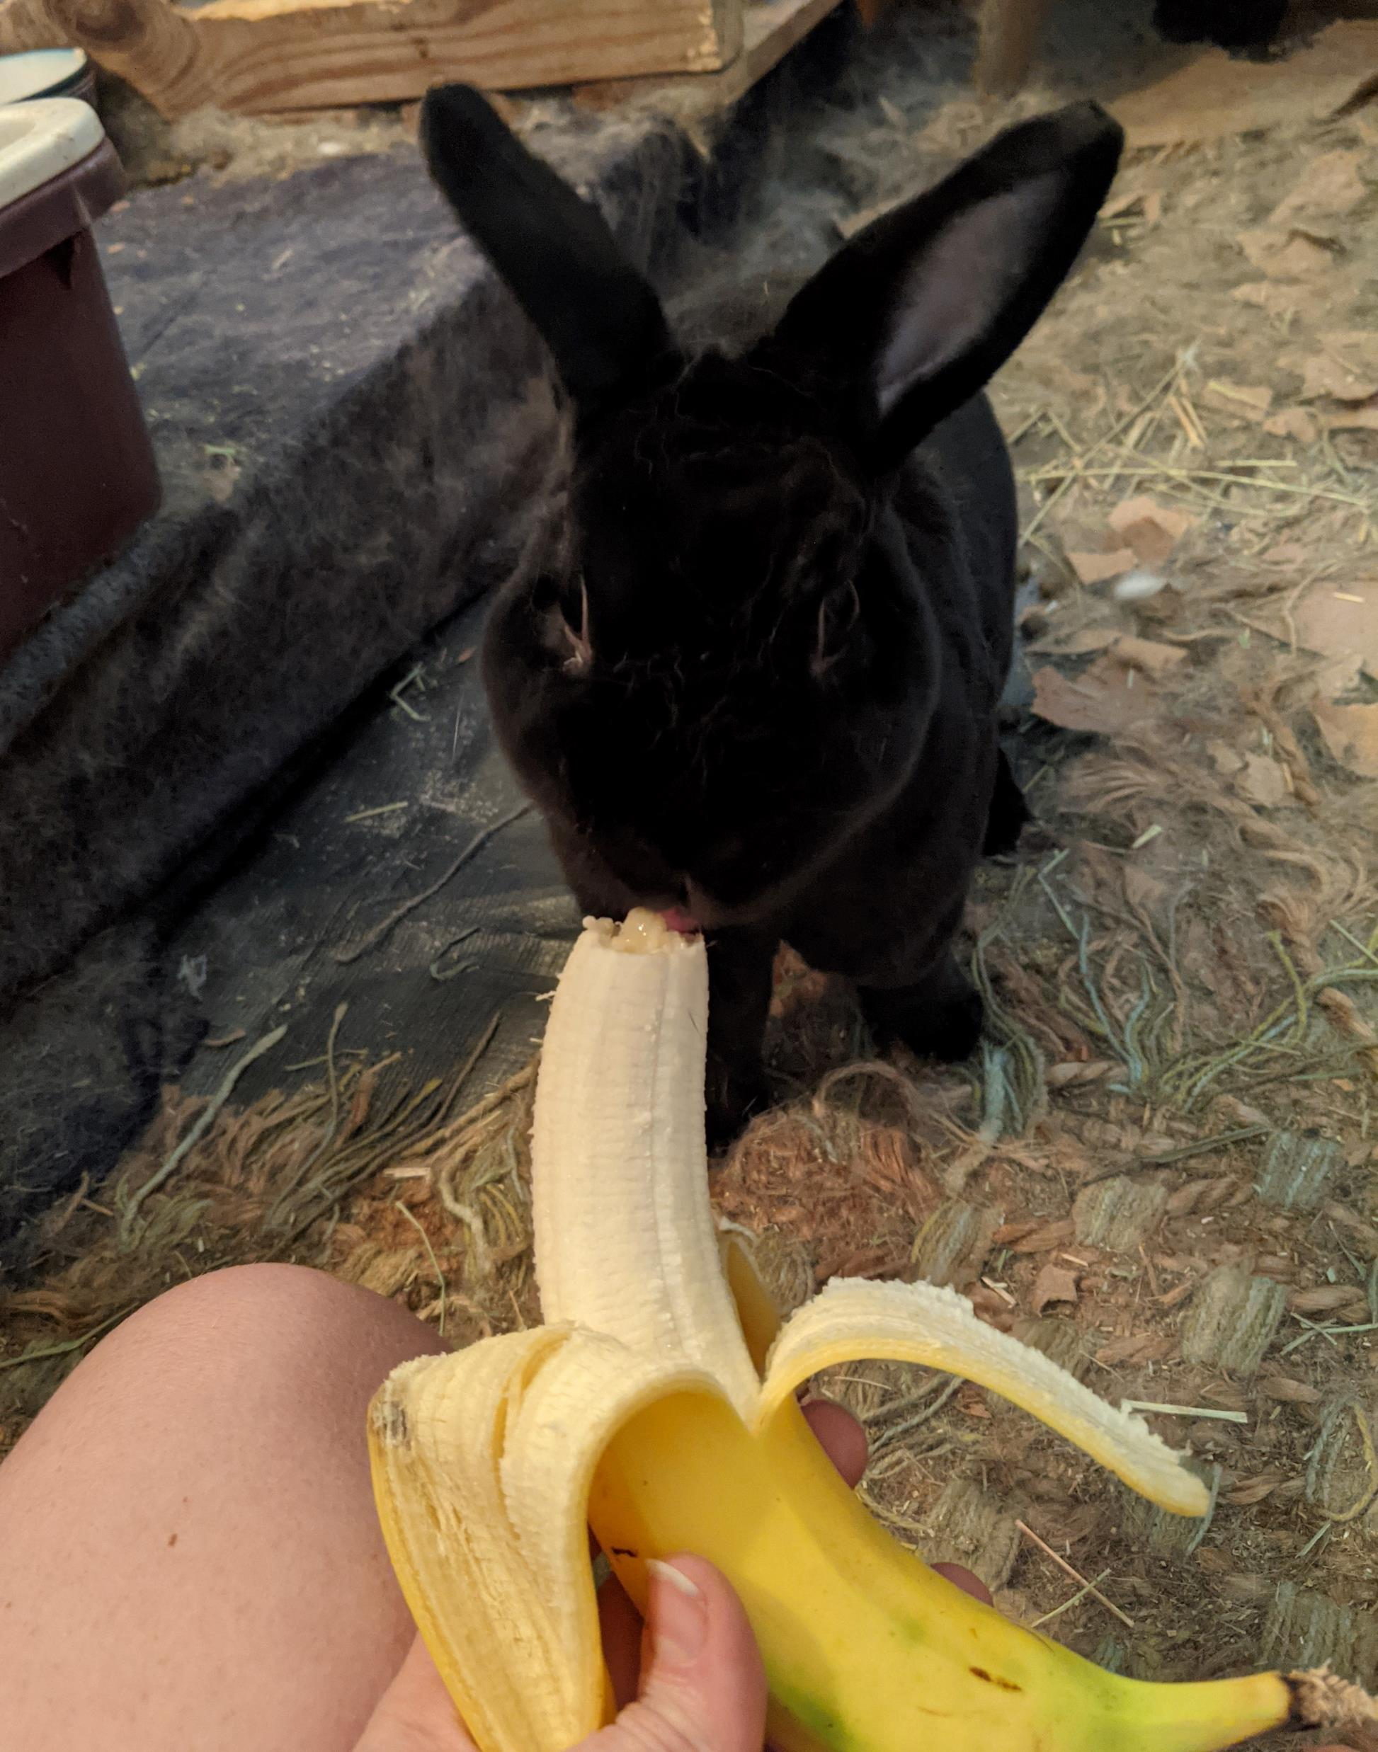
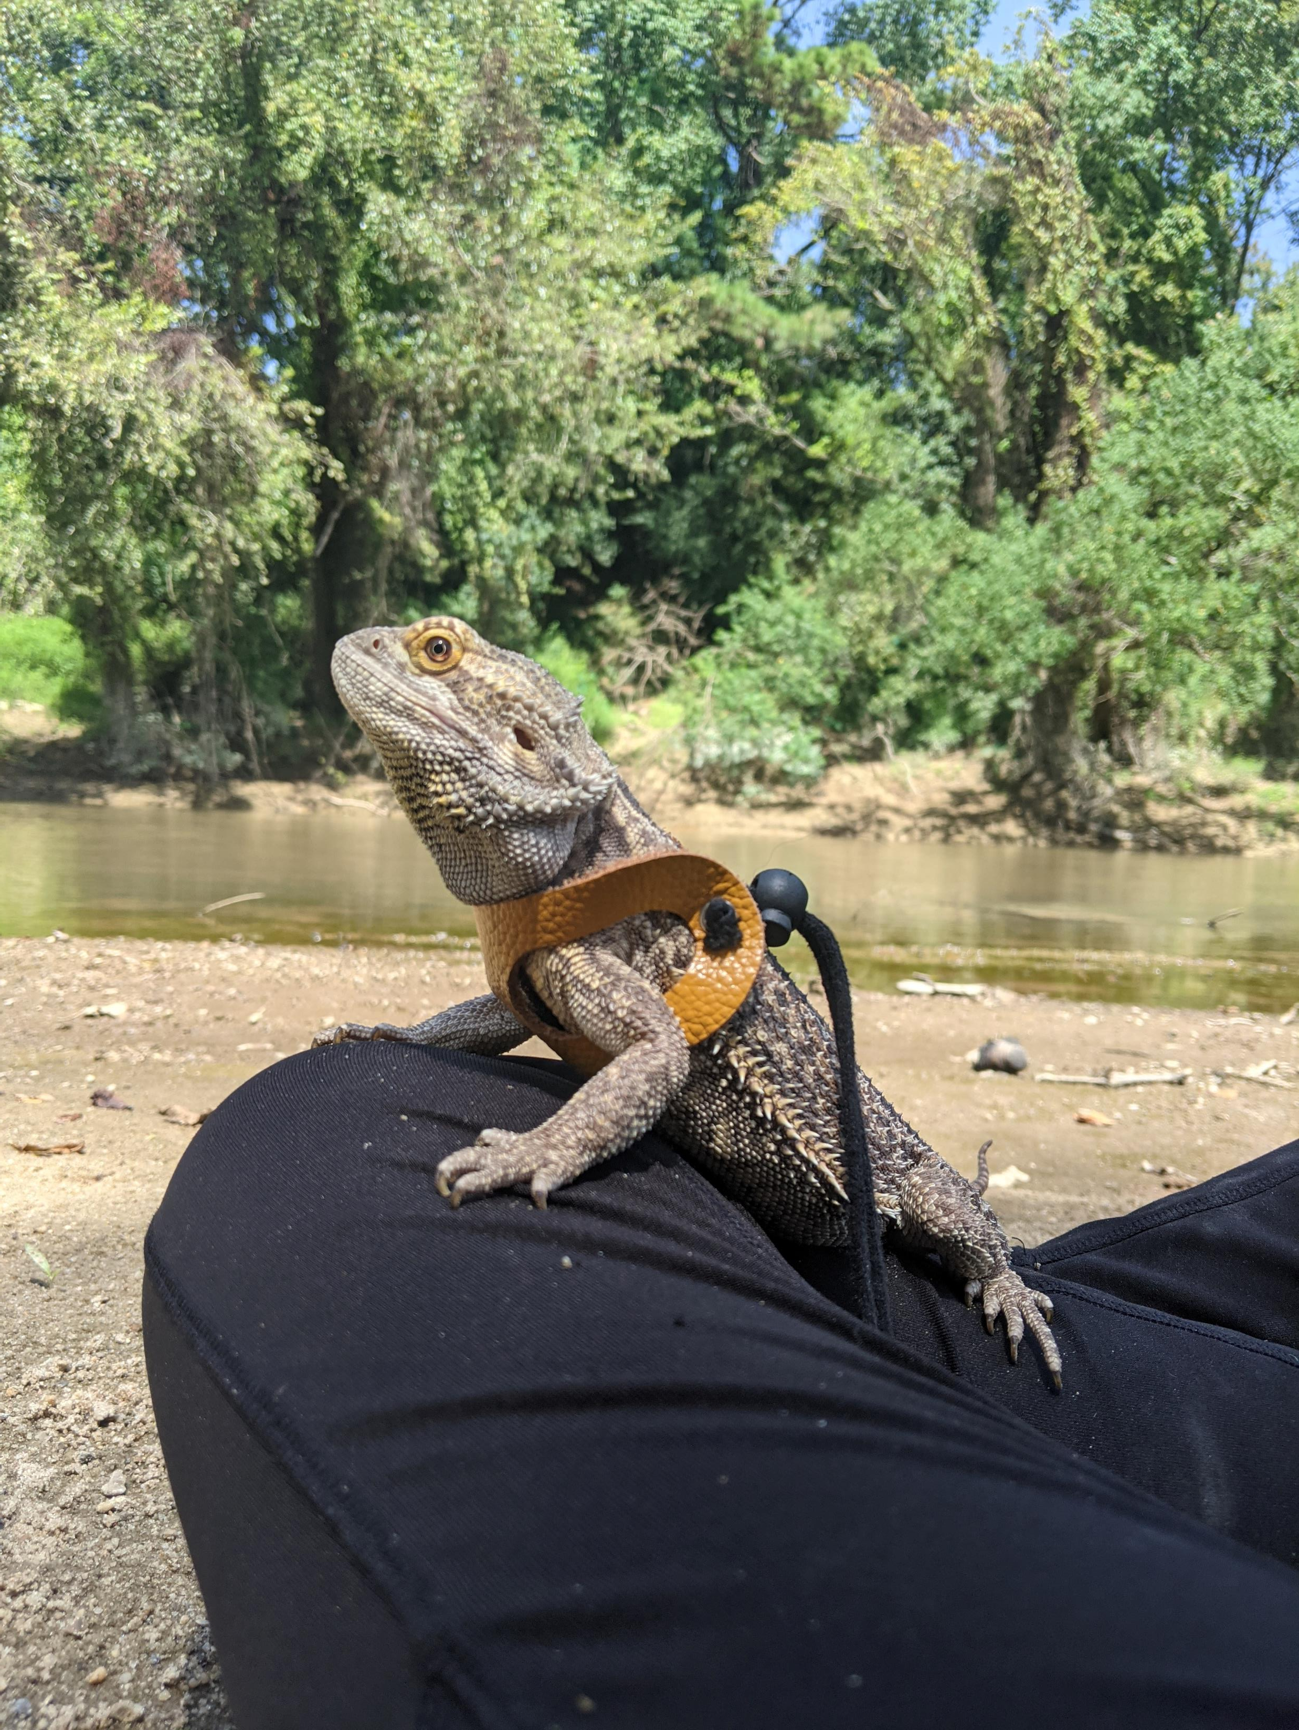
Lab 11: Chi Square Test
Add to playlist:
L Burleigh
11/10/22
Evie Severus Cal

Slide 2
Lab Objectives
Run a Chi Square

Slide 3
Helpful Code
Task | Code
Get a table reporting the number of times the columns ‘Here’ and ‘There’ appear in the same row of the dataset ‘Everywhere’ | table(Everywhere$Here, Everywhere$There)
Check the type of a ‘VariableOfInterest’ | class(VariableOfInterest)

