Slide 1

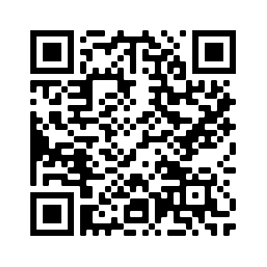
R Lab Week 2: Standard Scores and p-values
L Burleigh
9/2/2022
Check out our playlist
and add to it:
shorturl.at/CHRT2

Slide 2
Lab Objectives
Insert data without a pre-defined data base
Read in R stored dataset
Core arithmetic
Logical Indexing
Normal distributions

Slide 3
Clarifying Note
Data can be called from a data frame using a comma or dollar sign
dataframe[r, c]
- OR -
dataframe$c[r]

Slide 4
Helpful Code
Task | Code
Is equal to | ==
Is not | !
Or | |
And | &
Give values in variable x for instances where variable y is z | df$x[df$y == z]
P-value of standardized score x | pnorm(x, lower.tail = FALSE)
Standardized score that falls at y percentile | qnorm(y, lower.tail = FALSE)

