Slide 1
R Lab Week 7: Entering the tidyverse
L Burleigh
10/7/2022
Add to our playlist:

Slide 2
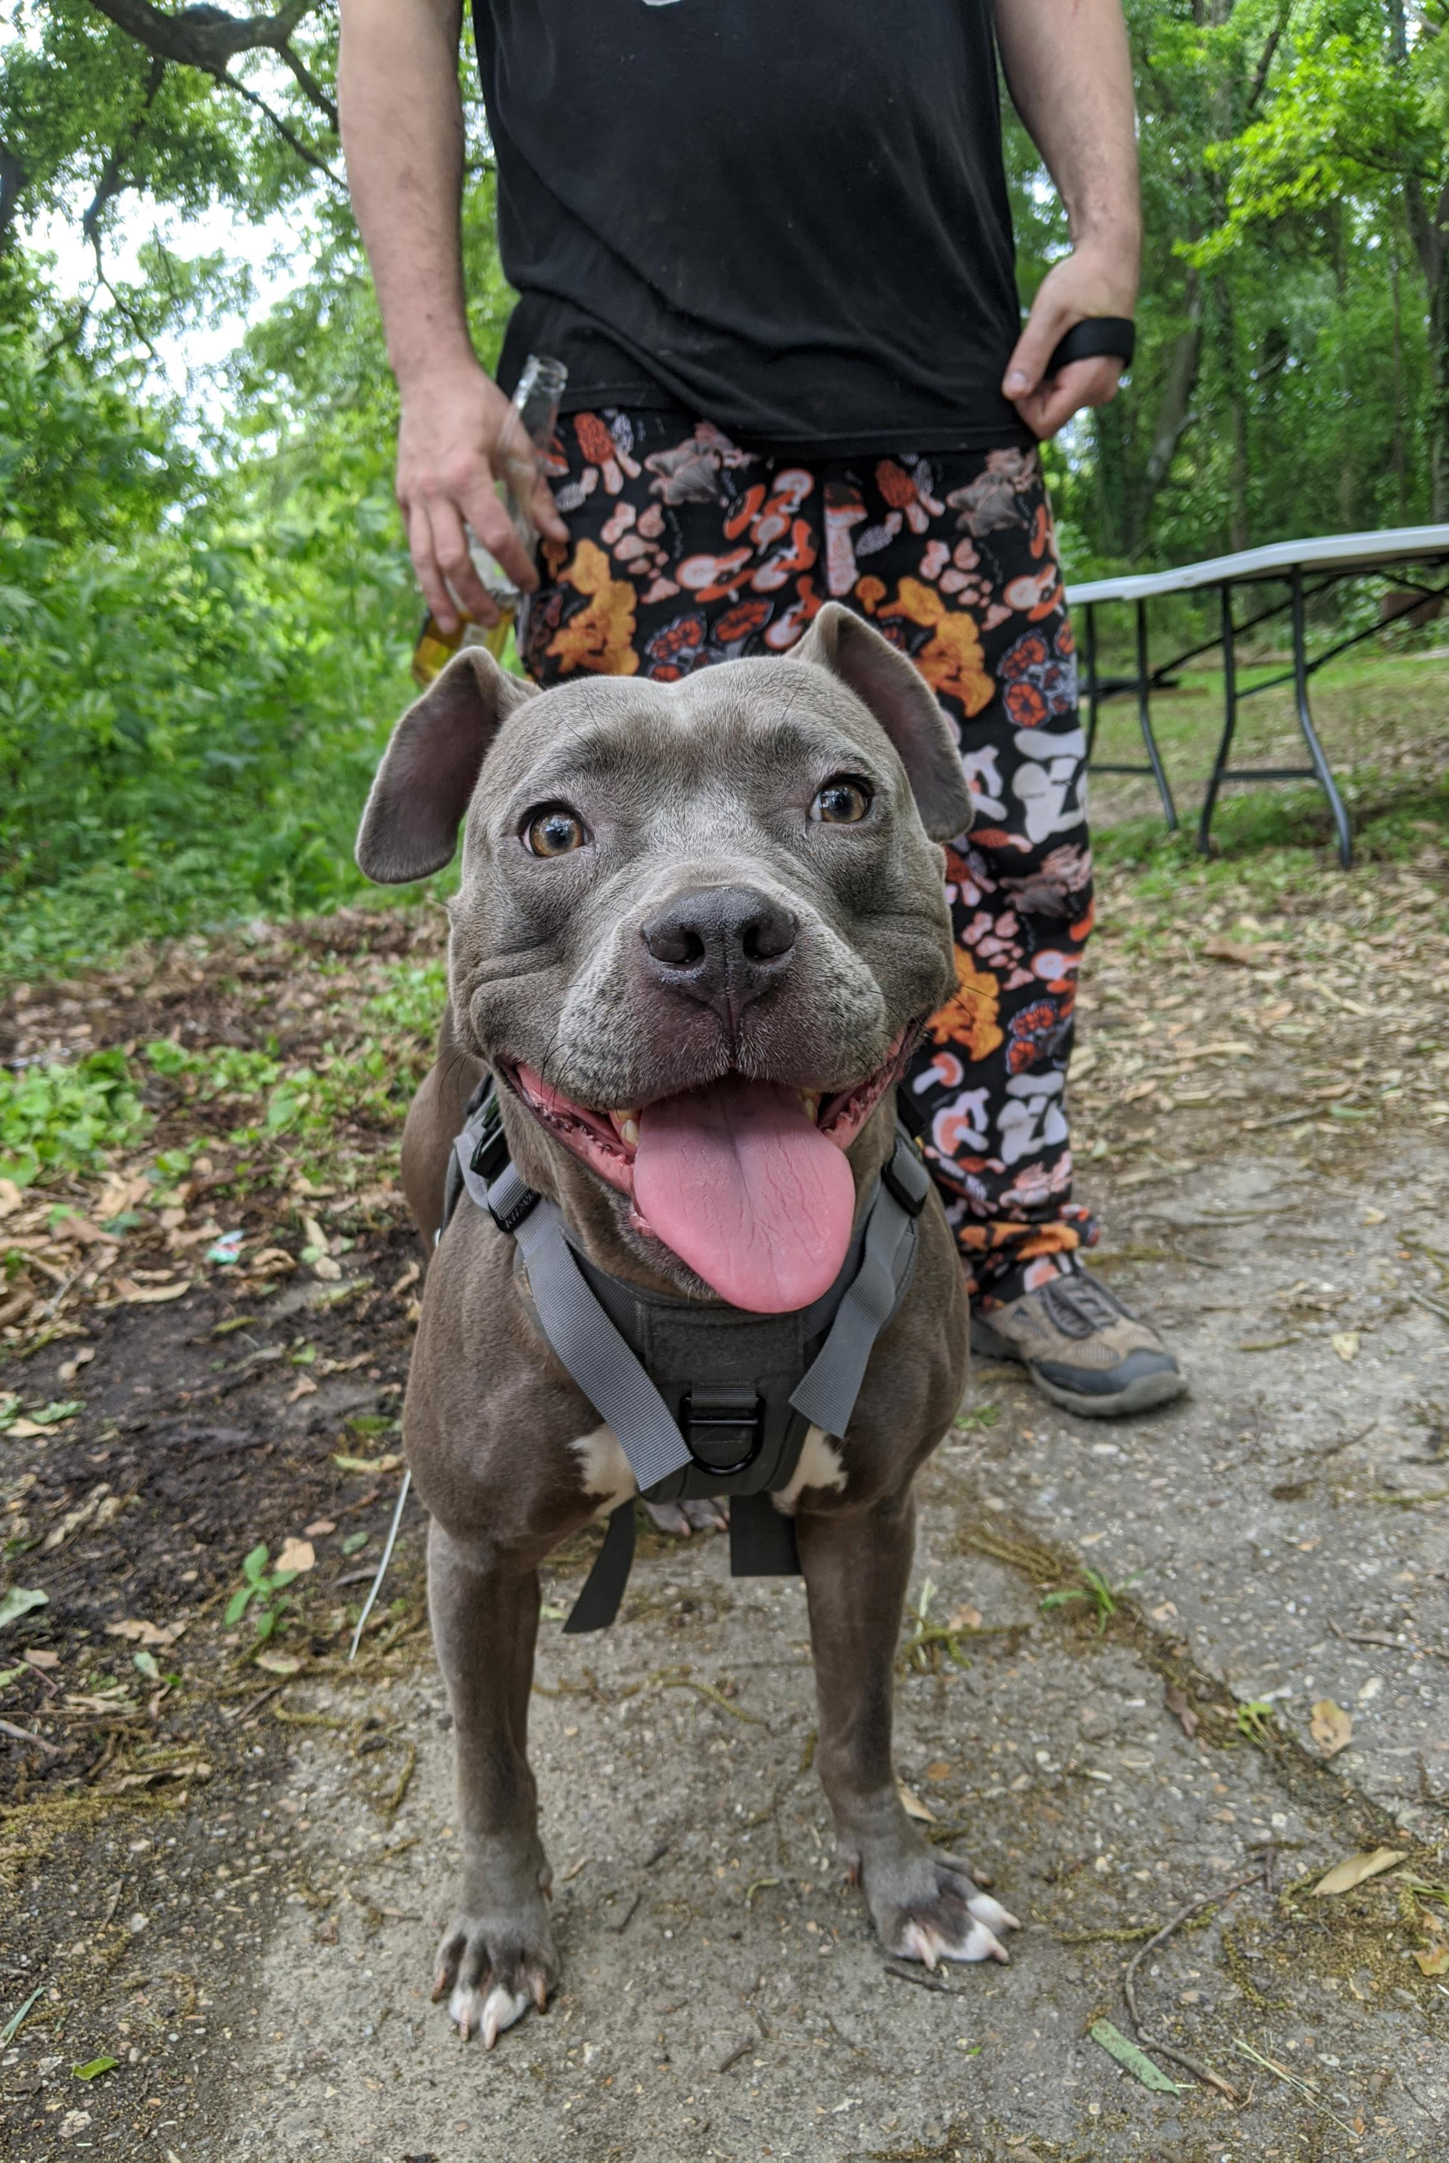
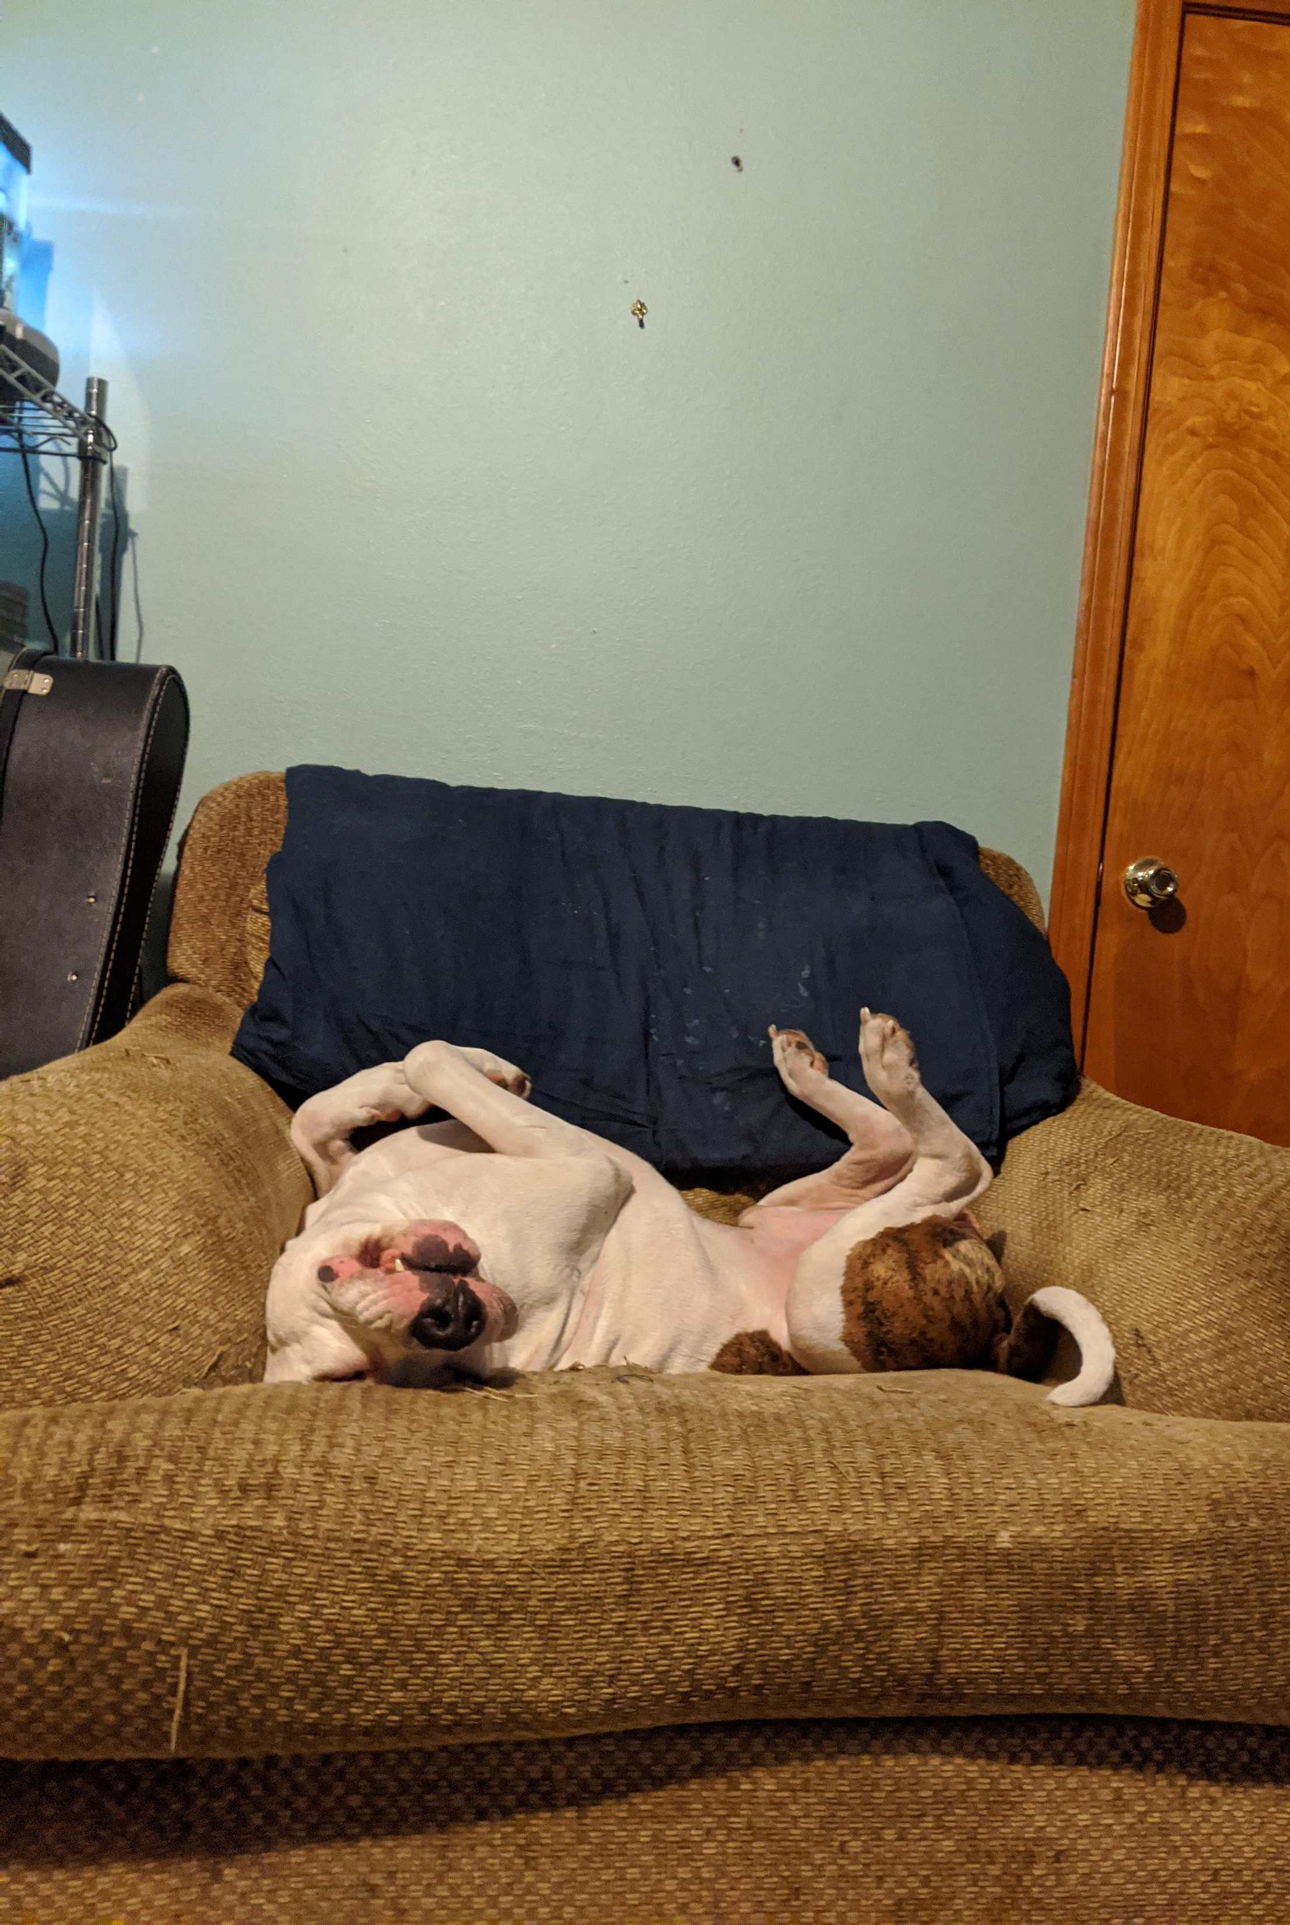
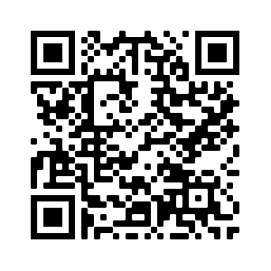
R Lab Week 7: Entering the tidyverse
Tina
American Staffordshire Terrier
Bronson
American Pitbull Terrier
L Burleigh
10/7/2022

Slide 3
Lab Objectives
Clean and organize data with tidyverse
Simple effects

Slide 4
Tidyverse
Group of packages
dplyr – data manipulation
ggplot2 – data visualization
tidyr – tidy data
purrr – functions and vectors [loops]
tibble – particular dataframe
readr – reading data
forcats – factors/categorical
stringr – strings
Pipe [%>%] – execute in sequence; feed left into right

Slide 5
Resources
Tidyverse.org [Free online book: R for data science]
Tidyr cheat sheet: https://github.com/rstudio/cheatsheets/blob/main/tidyr.pdf
Dplyr cheat sheet: https://www.rstudio.com/wp-content/uploads/2015/02/data-wrangling-cheatsheet.pdf
r-charts.com

Slide 6
Helpful Code
Task | Code
Choose rows that have ‘these’ in the ‘this-one’ column | dplyr::filter(this-one == “these”)
Sort the dataframe according to the values in the column ‘that-one’ | dplyr::arrange(that-one)
Create a column called ‘newone’ which multiplies the column ‘that-one’ by 5 | dplyr::mutate(newone = that-one * 5)
Choose the columns ‘this-one’ and ‘that-one’ | dplyr::select(this-one, that-one)
Group the data by the column ‘this-one’ | dplyr::group_by(this-one)
Report the mean of the column ‘that-one’ and call the output average | dplyr::summarize(“average” = mean(that-one))

