Slide 1

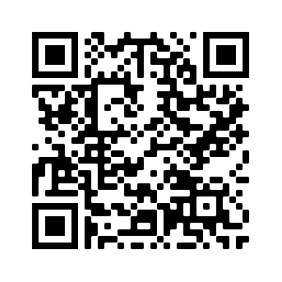
R Lab Week 3: Splitting data by Group
L Burleigh
9/9/2022
Our playlist:

Slide 2
Lab Objectives
Understand wide vs Long format
Custom functions
t.test()
G*Power

Slide 3
Wide
Long
ID | Data | Time
001 | .5 | T1
001 | .2 | T2
001 | .7 | T3
002 | .6 | T1
002 | .3 | T2
002 | .8 | T3
003 | .5 | T1
003 | .1 | T2
003 | .8 | T3
ID | T1 | T2 | T3
001 | .5 | .2 | .7
002 | .6 | .3 | .8
003 | .5 | .1 | .8

Slide 4
Helpful Code
Task | Code
Use tapply() to run a function on the data-of-interest as divided by grouping | tapply(data-of-interest, grouping, function)
Run two-tailed independent two-sample t-test on DV in df with IV denoting sample groups | t.test(DV ~ IV, data = df, paired = FALSE)

