Slide 1
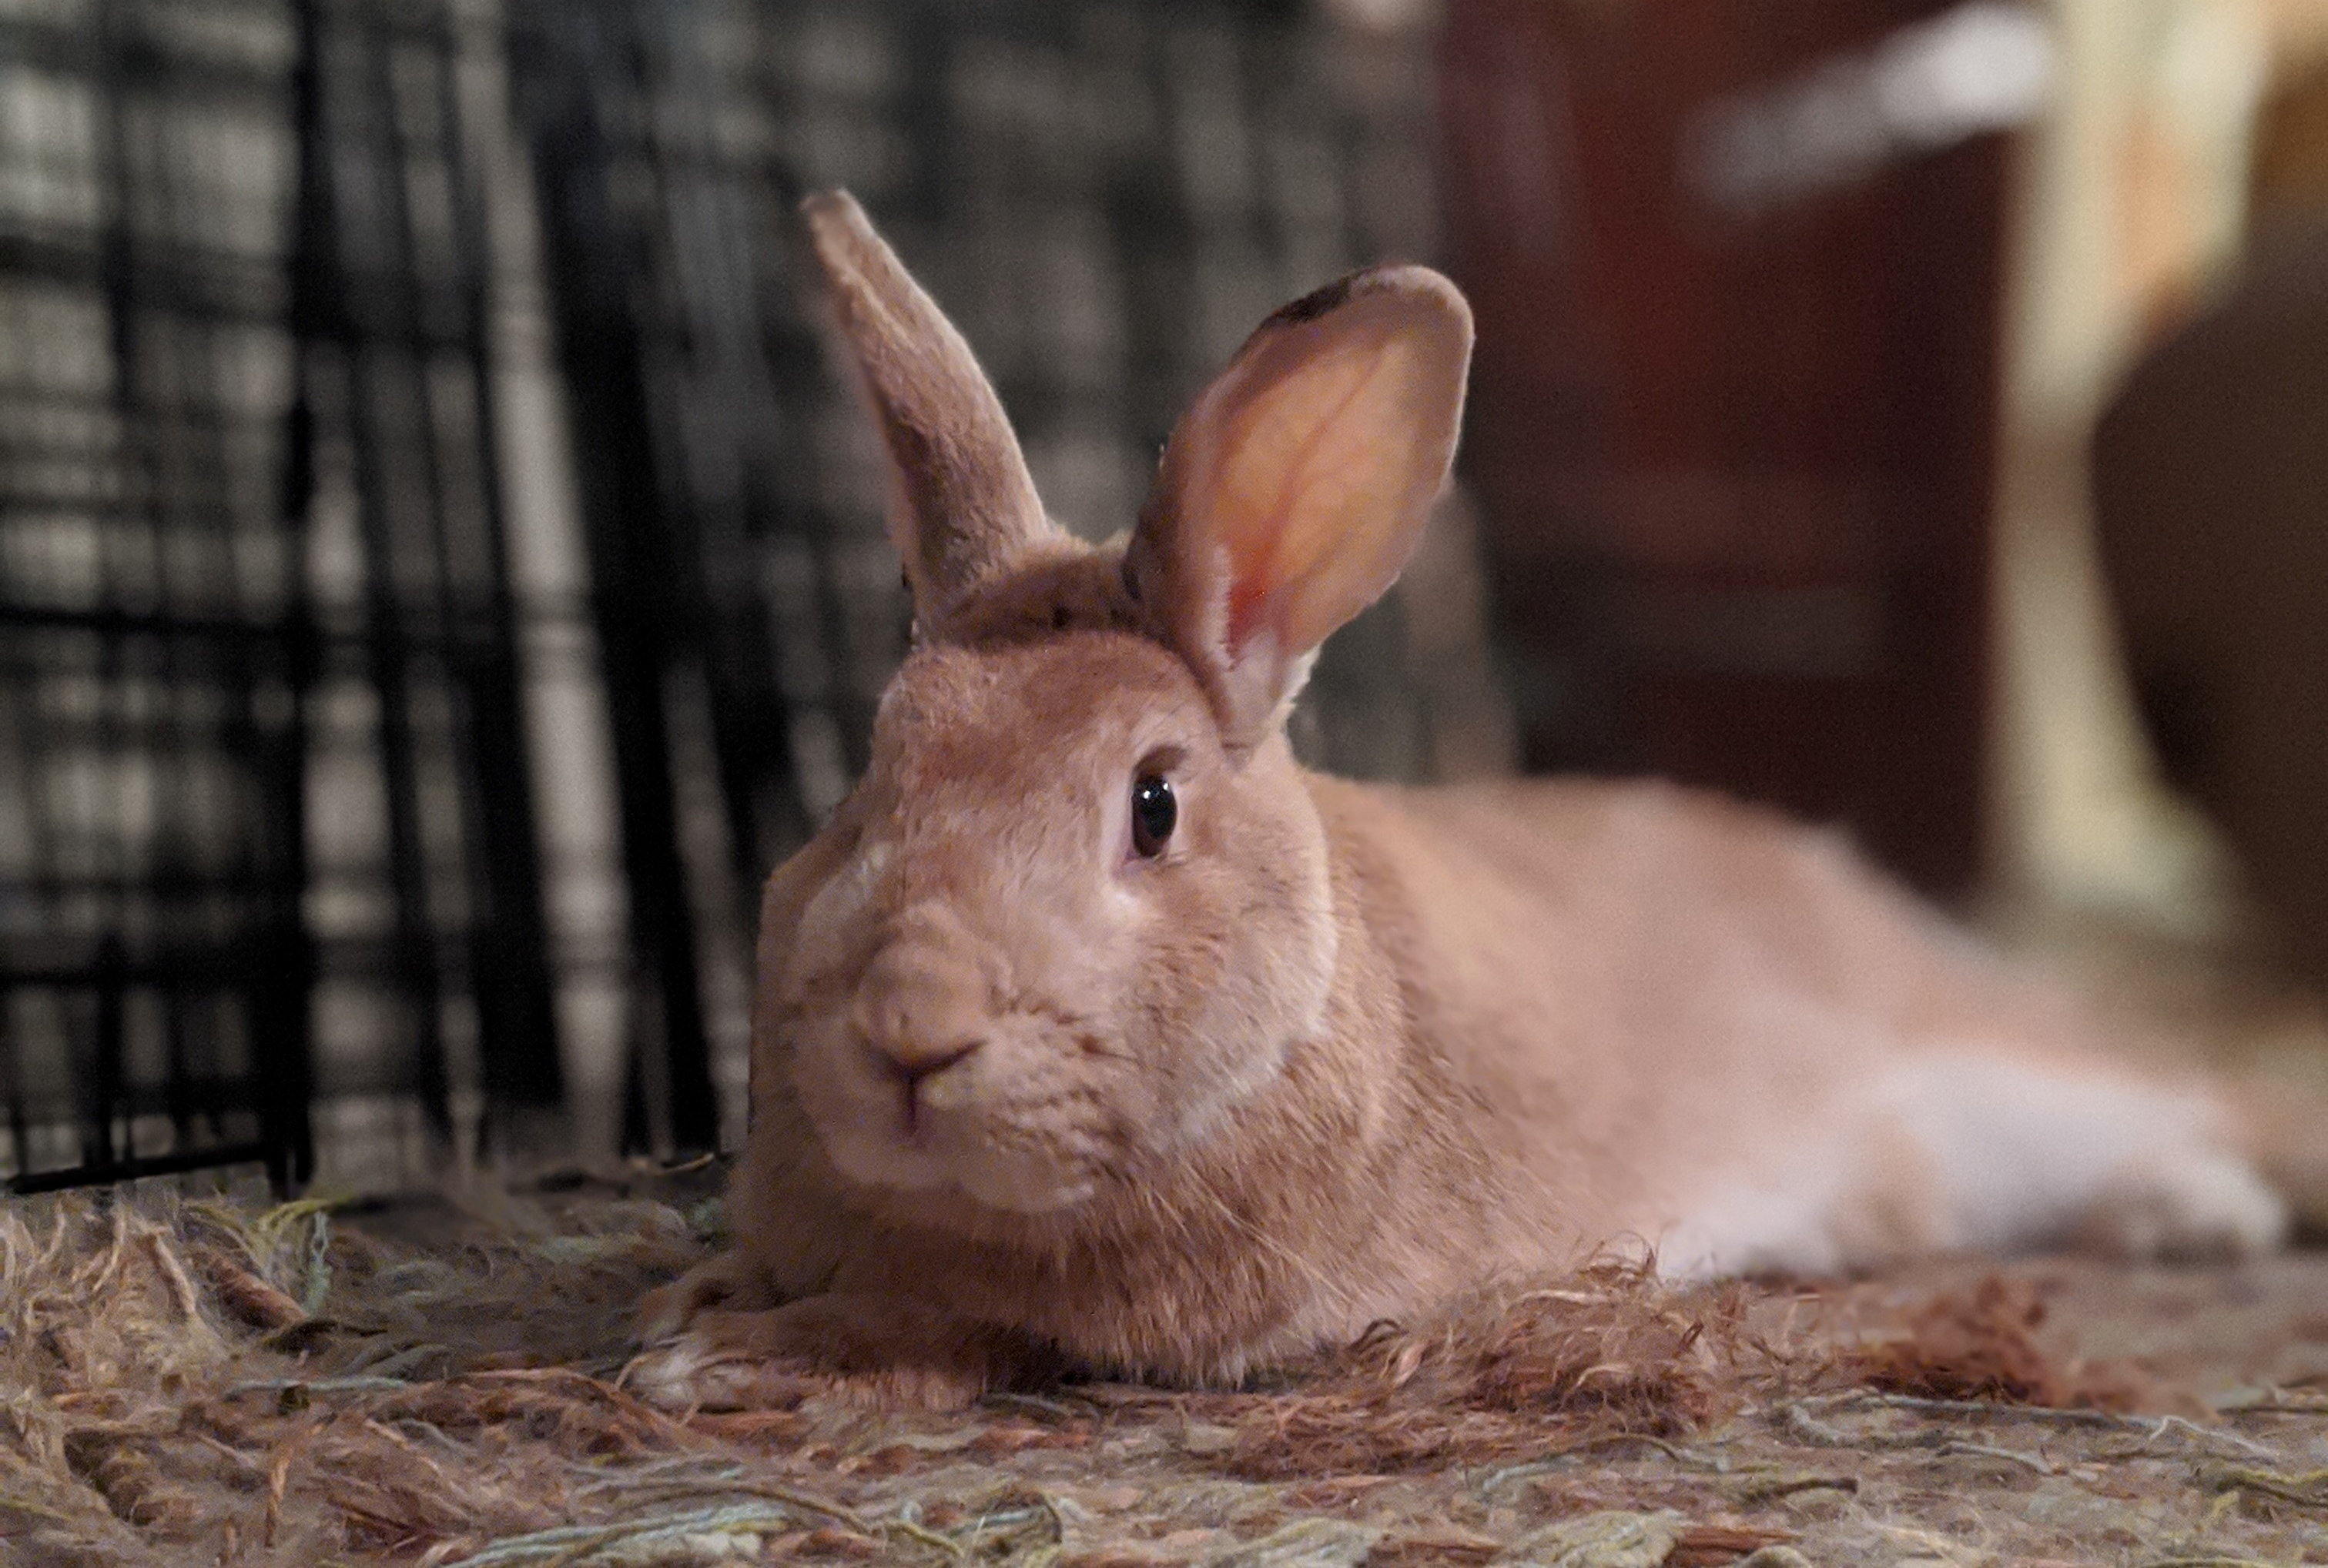
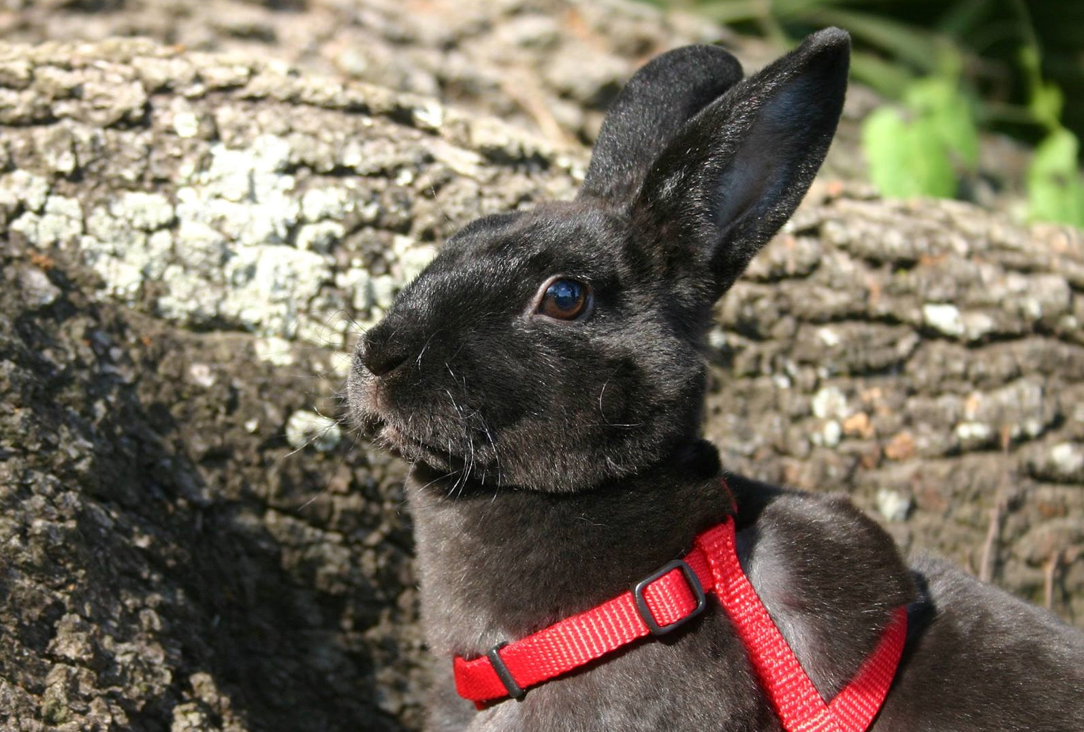

R Lab Week 4: Correlations
L Burleigh
9/9/2022
Our playlist:

Slide 2
Lab Objectives
Referencing lists
cor.test()
Making simple plots
Bivariate Regression

Slide 3
Writing Results in APA
GOAL: give a reader relevant information needed to assess the test and results
Details of what is being tested
n
Relevance/type of group/participants
Mean
Standard deviation
What test performed
Tails
Is it significant?
Test results
Italicize indicator of what result is being presented
Df in parentheses
DV
Example:
An independent sample t-test found significantly more errors made during an exam by 18 history students (M = 4.75, SD = 3.48) than 18 statistics students (M = 2.5, SD = 1.32), t(34) = 3.26, p = 0.02.

Slide 4
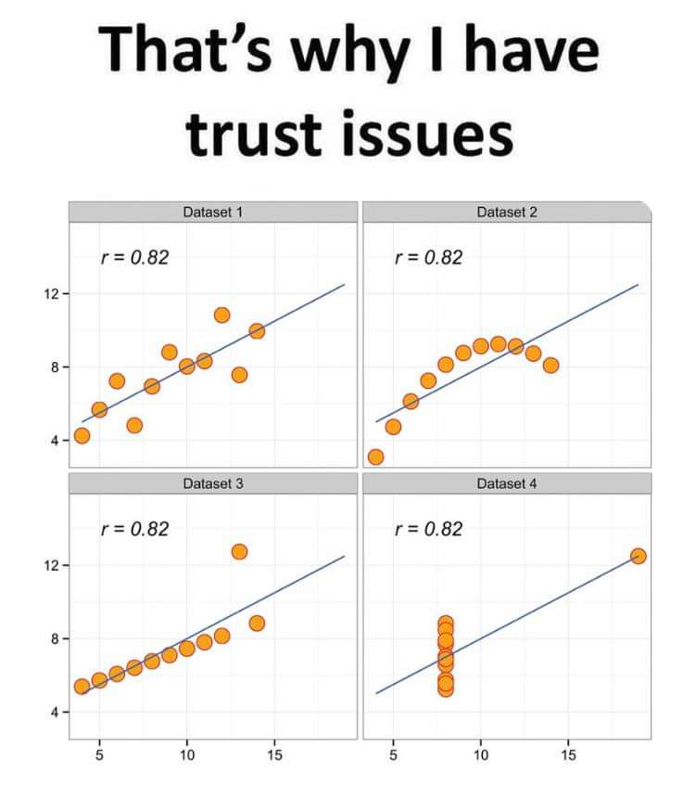
To plot or not to plot?
Plot!
Always visualize your data!

Slide 5
Helpful Code
Task | Code
Create plot with xdata on x-axis and ydata on y-axis | plot(xdata, ydata)
Draw a red line of best fit for regression x, y | abline(lm(y ~ x), col = “red”)
Call data stored as name in list | list[‘name’]
Get the correlation of x and y [default: Pearson’s R] | cor(x, y)
Run a correlation test of x and y | cor.test(x, y)
Save actively shown plot as a png in current working directory named plotname | png(“plotname.png”)

