Slide 1
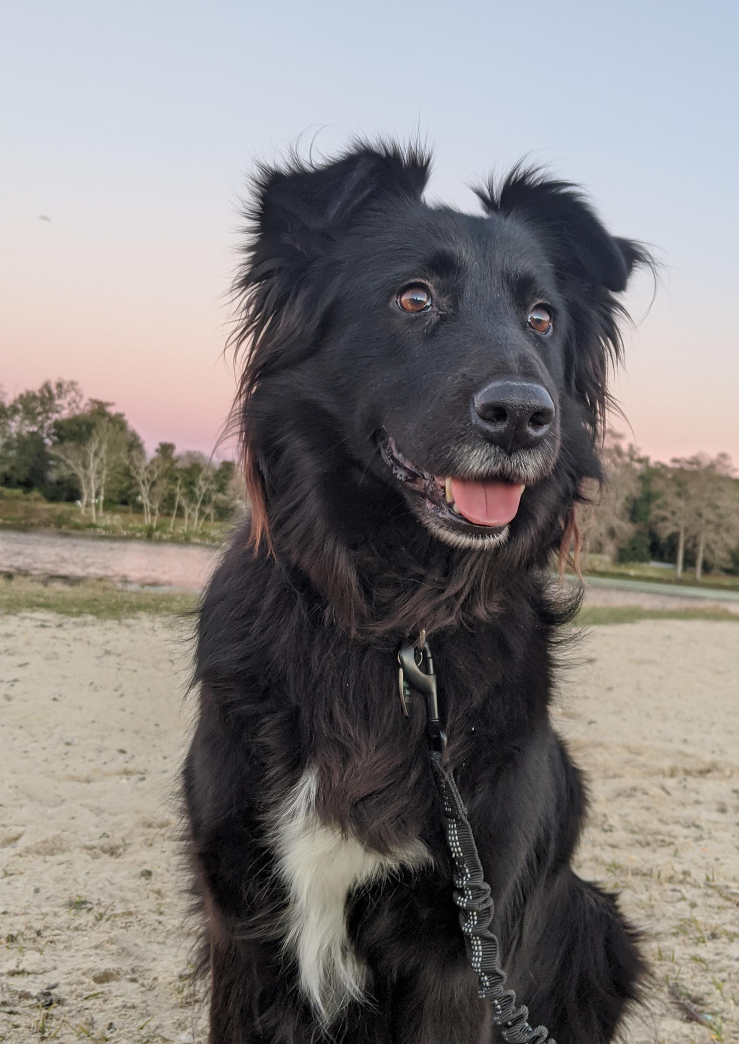
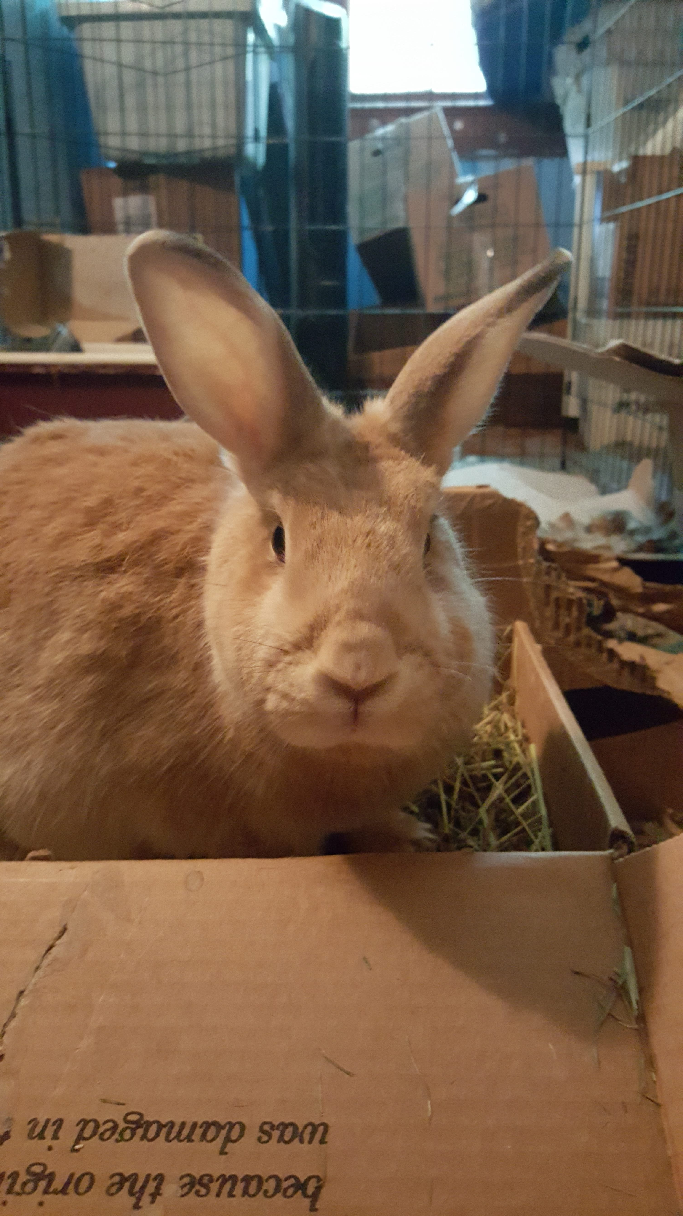

R Lab Week 8: Repeated Measures ANOVA
Roxy
Border Collie/Lab Mix
Miss Moo
Guess: New Zealand
L Burleigh
10/21/2022
Add to our playlist:
Pre-Lab Prep: Install packages
install.packages(“tidyverse”)
install.packages(“datarium”)
install.packages(“ez”)
install.packages(“apaTables”)

Slide 2
Lab Objectives
Alter dataset
Run RM ANOVA

Slide 3
Tidyverse
Group of packages
dplyr – data manipulation
ggplot2 – data visualization
tidyr – tidy data
purrr – functions and vectors [loops]
tibble – particular dataframe
readr – reading data
forcats – factors/categorical
stringr – strings
Pipe [%>%] – execute in sequence; feed left into right

Slide 4
Helpful Code
Task | Code
Turn the wide dataset ‘Wide’ to a long dataset ‘Long’ using columns ‘c1’, ‘c2’, and ‘c3’ as conditions. Name the column with these 3 cs ‘conditions’ and the column of values as ‘values’ | Long <- Wide %>% tidyr::pivot_longer(cols = c(c1, c2, c3), names_to = “conditions”, values_to = “values”)

