Slide 1

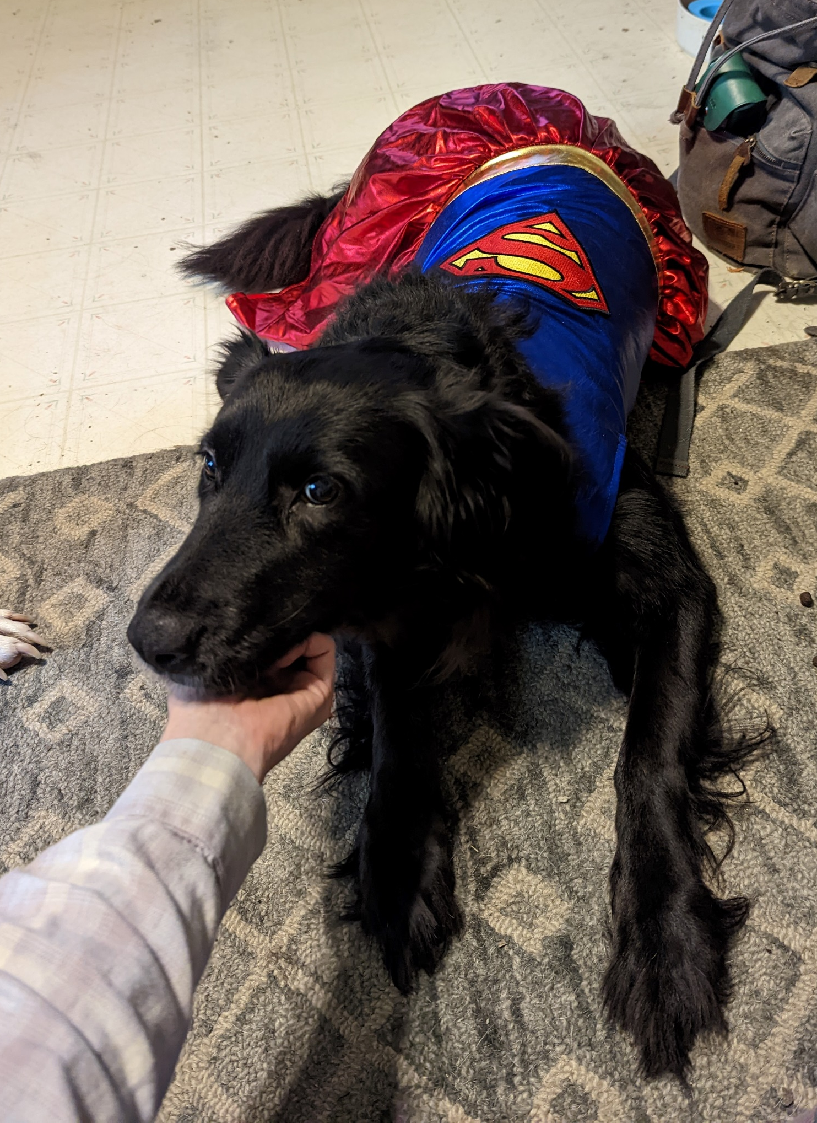

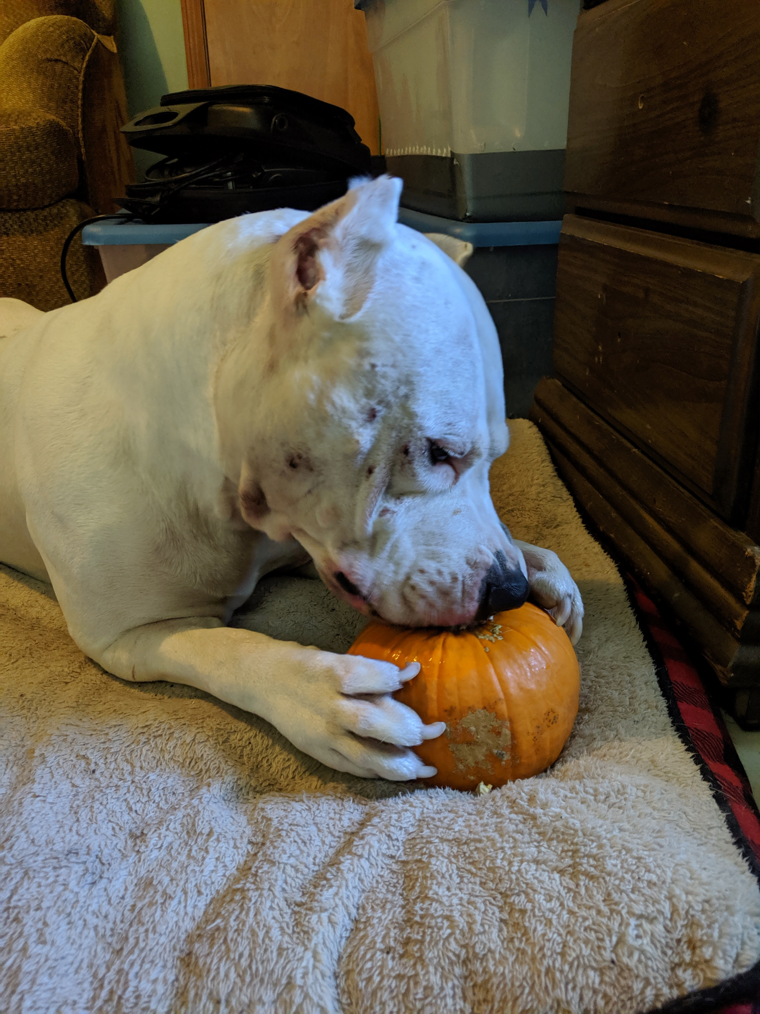
Lab 9: Mixed ANOVAs
Pre-Lab Setup:
install.packages(“rstatix”)
install.packages(“ggpubr”)
L Burleigh
10/28/22
Add to playlist:
Marley [Delaney]
Super Roxy Beagle Rat Terrier Mix Bronson

Slide 2
Lab Objectives
More tidyverse
Run a Mixed ANOVA
Assess assumptions

Slide 3
Resources
The rstatix package
https://cran.microsoft.com/snapshot/2019-07-07/web/packages/rstatix/readme/README.html

Slide 4
Helpful Code
Task | Code
Run a Mixed Effects ANOVA with aov() | aov(y ~ group * RM + Error(participant/RM, data = dataset))
Rename the column ‘ThisOne’ to be ‘YouGotIt’ in the dataset named ‘Input’ using the tidyverse | Input %>% dplyr::rename(“YouGotIt" = “ThisOne“)
Run a Mixed Effects ANOVA with the ez package | ez::ezANOVA(data = dataset, dv = y, wid = .(participant), within = .(RM), between = .(group))

