Slide 1
AUTOMATIC 2D MOSAICING
Lorenzo Busellato – VR472249
Computer Vision
Master’s degree in Computer Engineering for Robotics and Smart Industry – a.y. 2022/2023

Slide 2
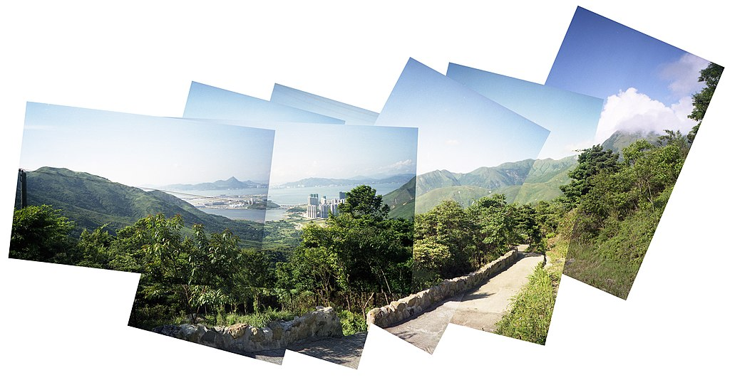
PROBLEM STATEMENT
Set of images with overlapping fields of view Segmented panorama

Slide 3
OBJECTIVE
Implement the automatic 2D mosaicing pipeline:
  Feature point extraction with SIFT
  Matching of the features
  Statistically robust estimation of homographies with RANSAC
  Image warping
  Image blending

Slide 4
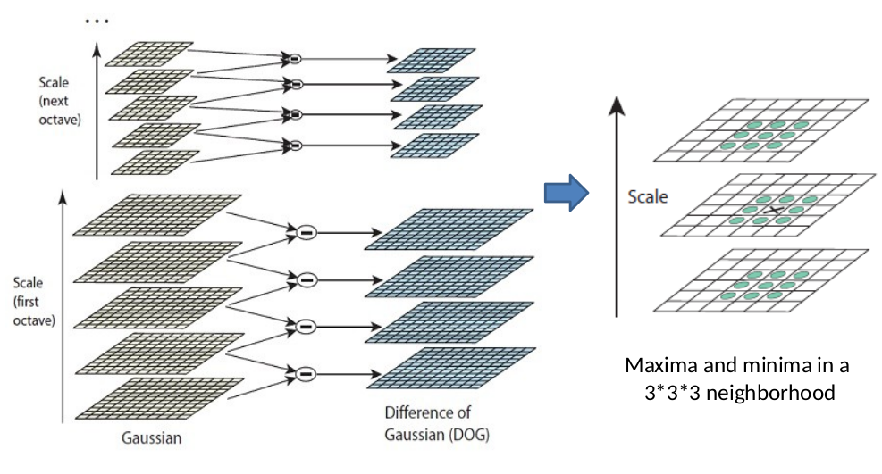
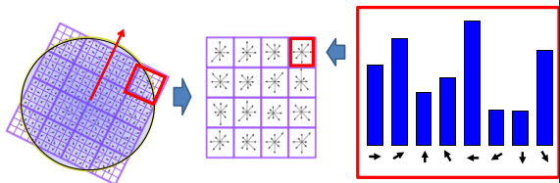
SIFT
Feature localization
Feature descriptor

Slide 5
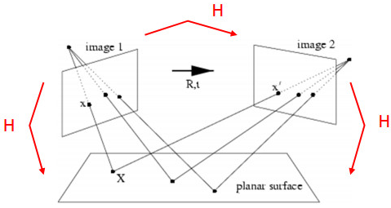

HOMOGRAPHY
Multiple conjugate points
Estimation with SVD

Slide 6
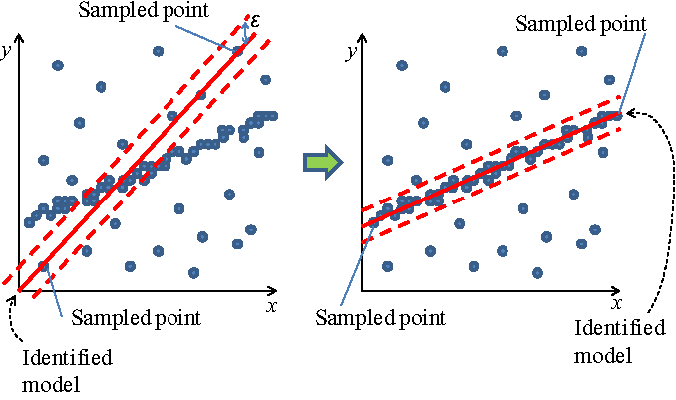
RANSAC

Slide 7
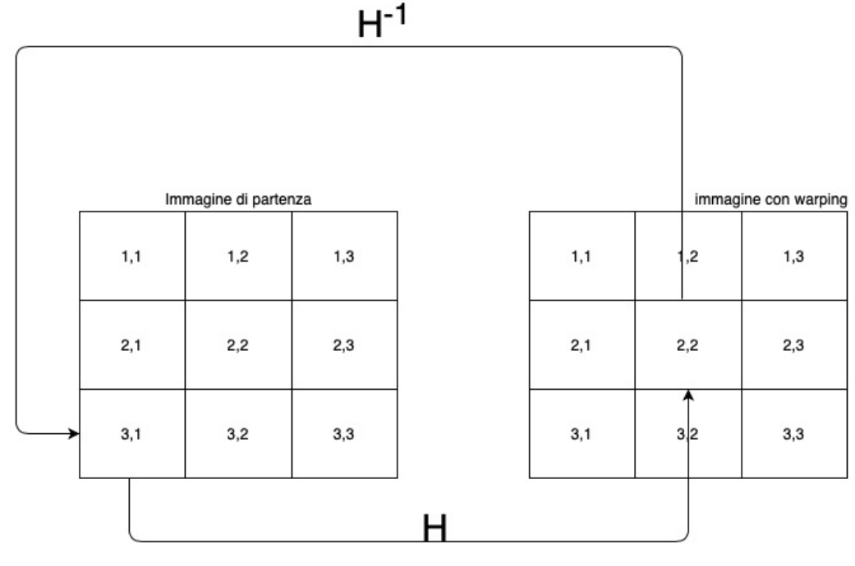
WARPING

Slide 8


BLENDING
Average blending
Linear alpha blending
I(mask) = 0.5*(I1(mask) + I2(mask))
I(x,y) = α(x,y)*I1(x,y) + (1-α(x,y))*I2(x,y)

Slide 9
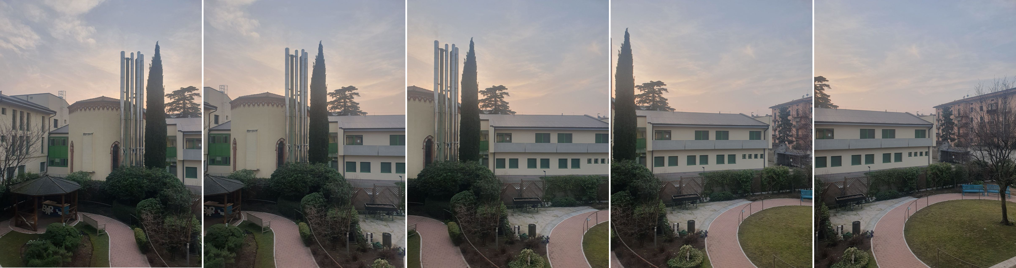
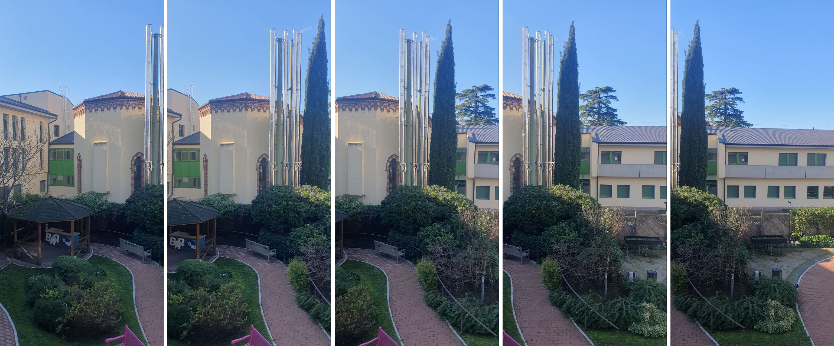
IMAGE SETS

Slide 10
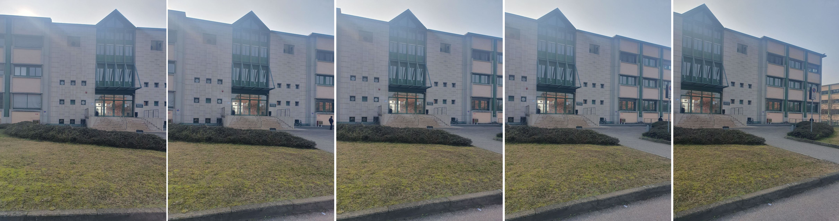
IMAGE SETS

Slide 11
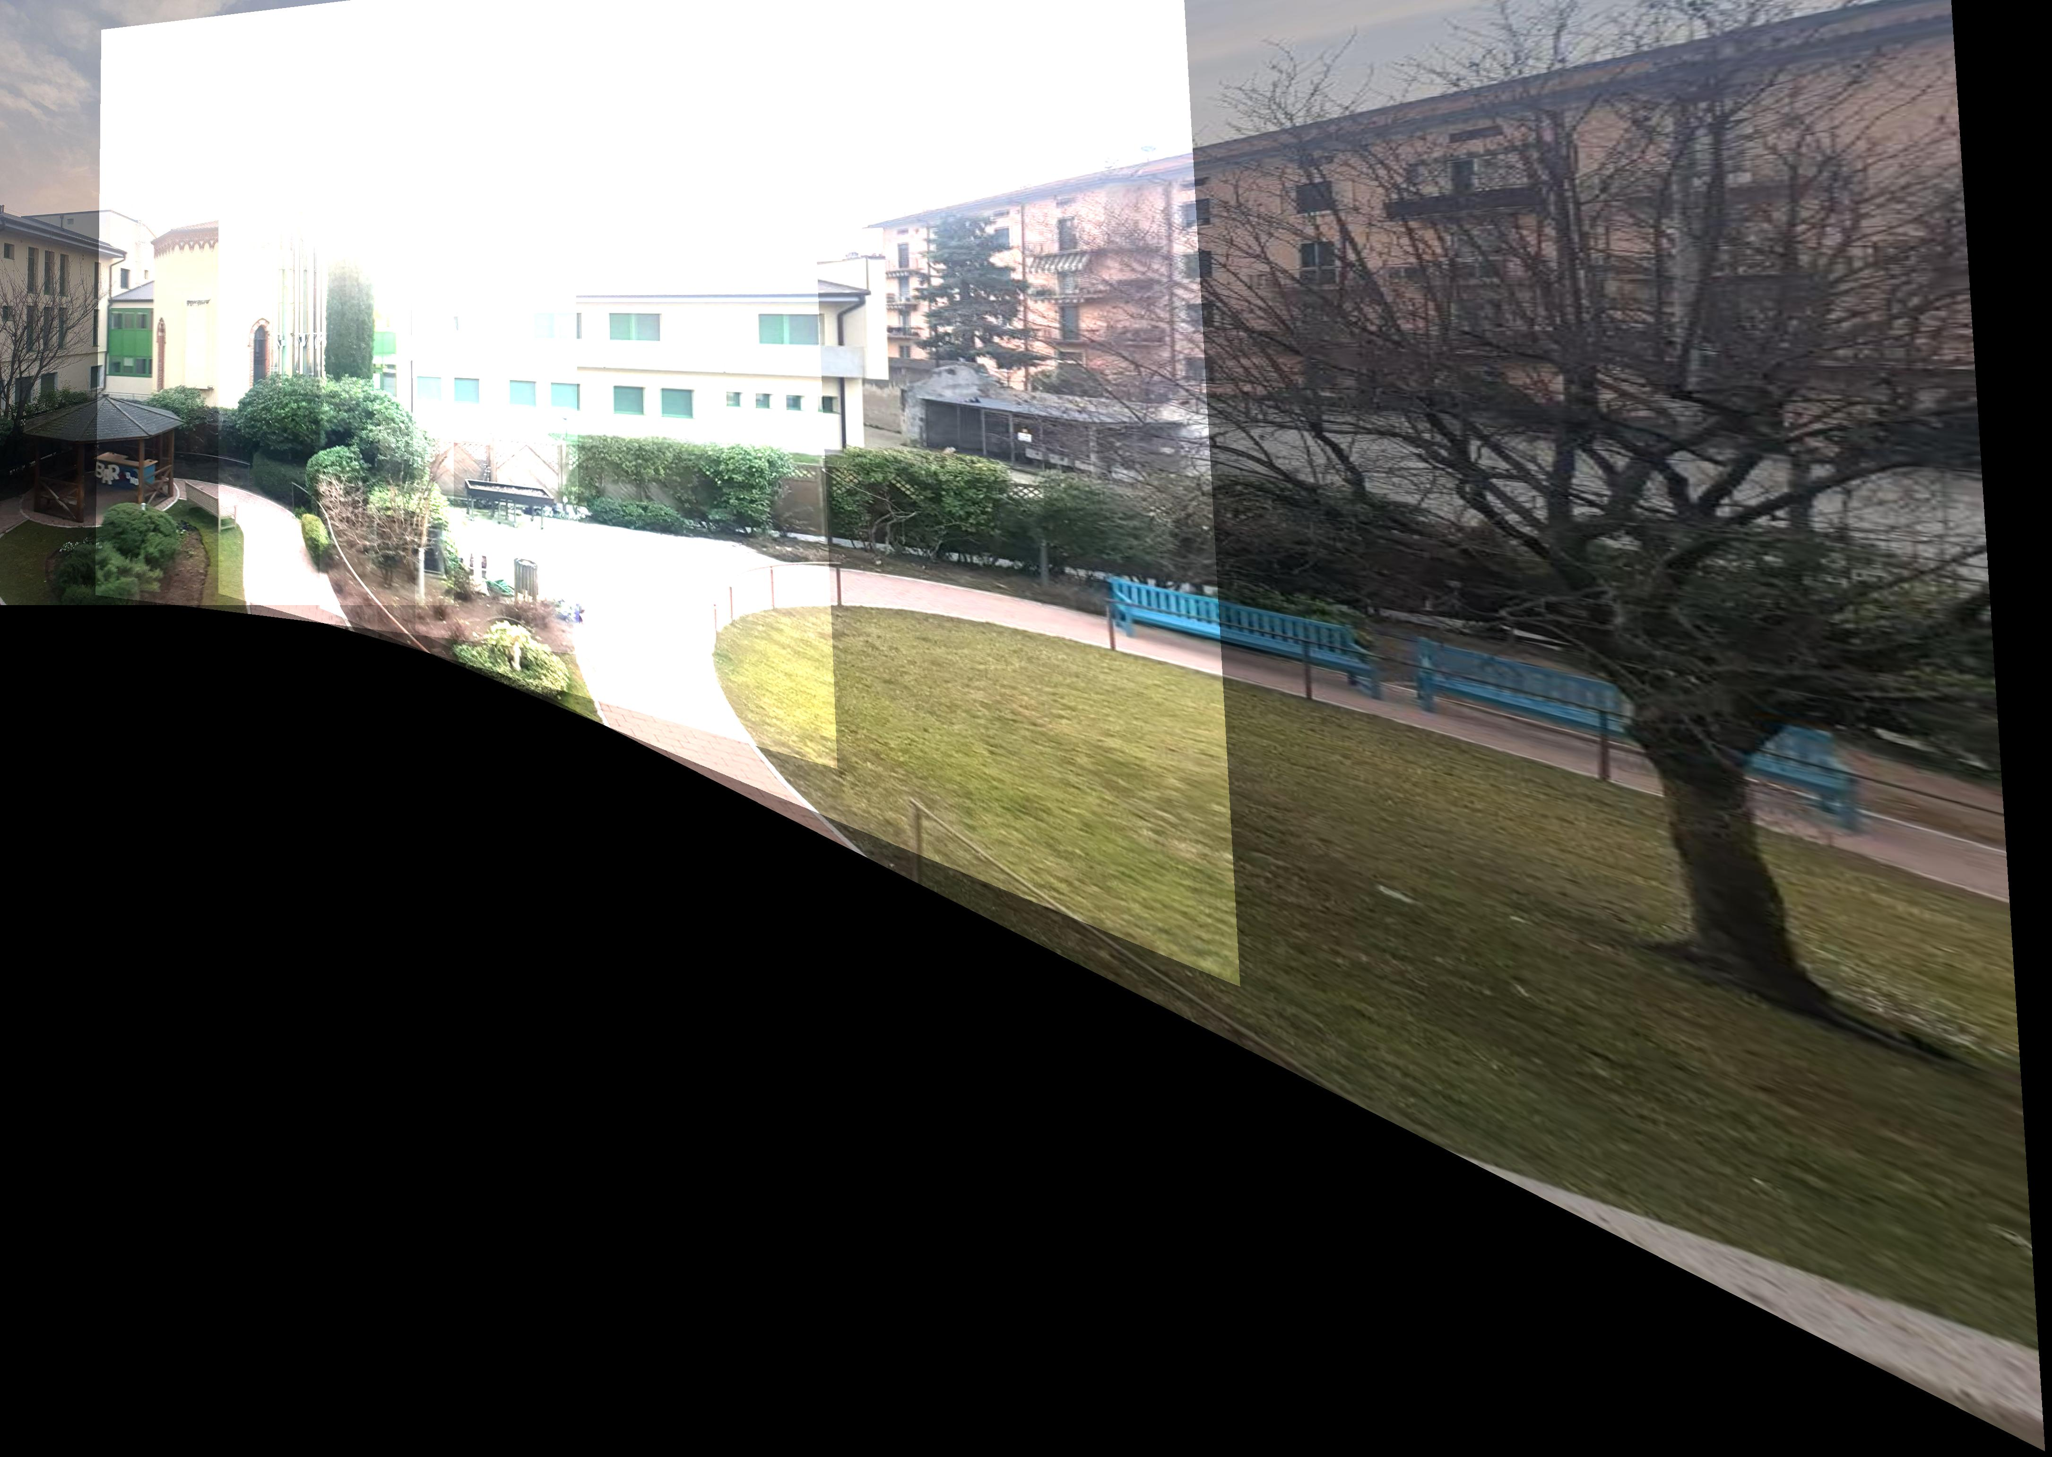
TEST 1
No blending

Slide 12
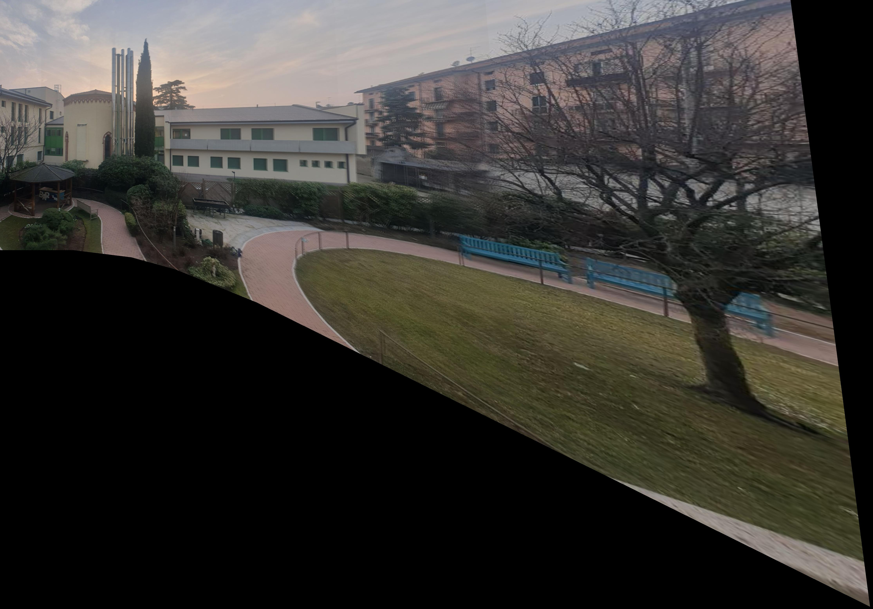
TEST 2
Average blending

Slide 13
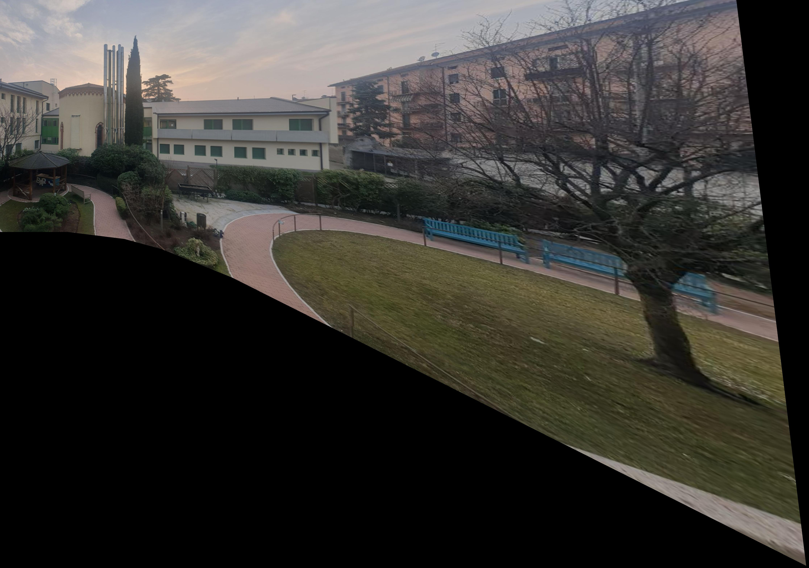
TEST 3
Linear blending

Slide 14
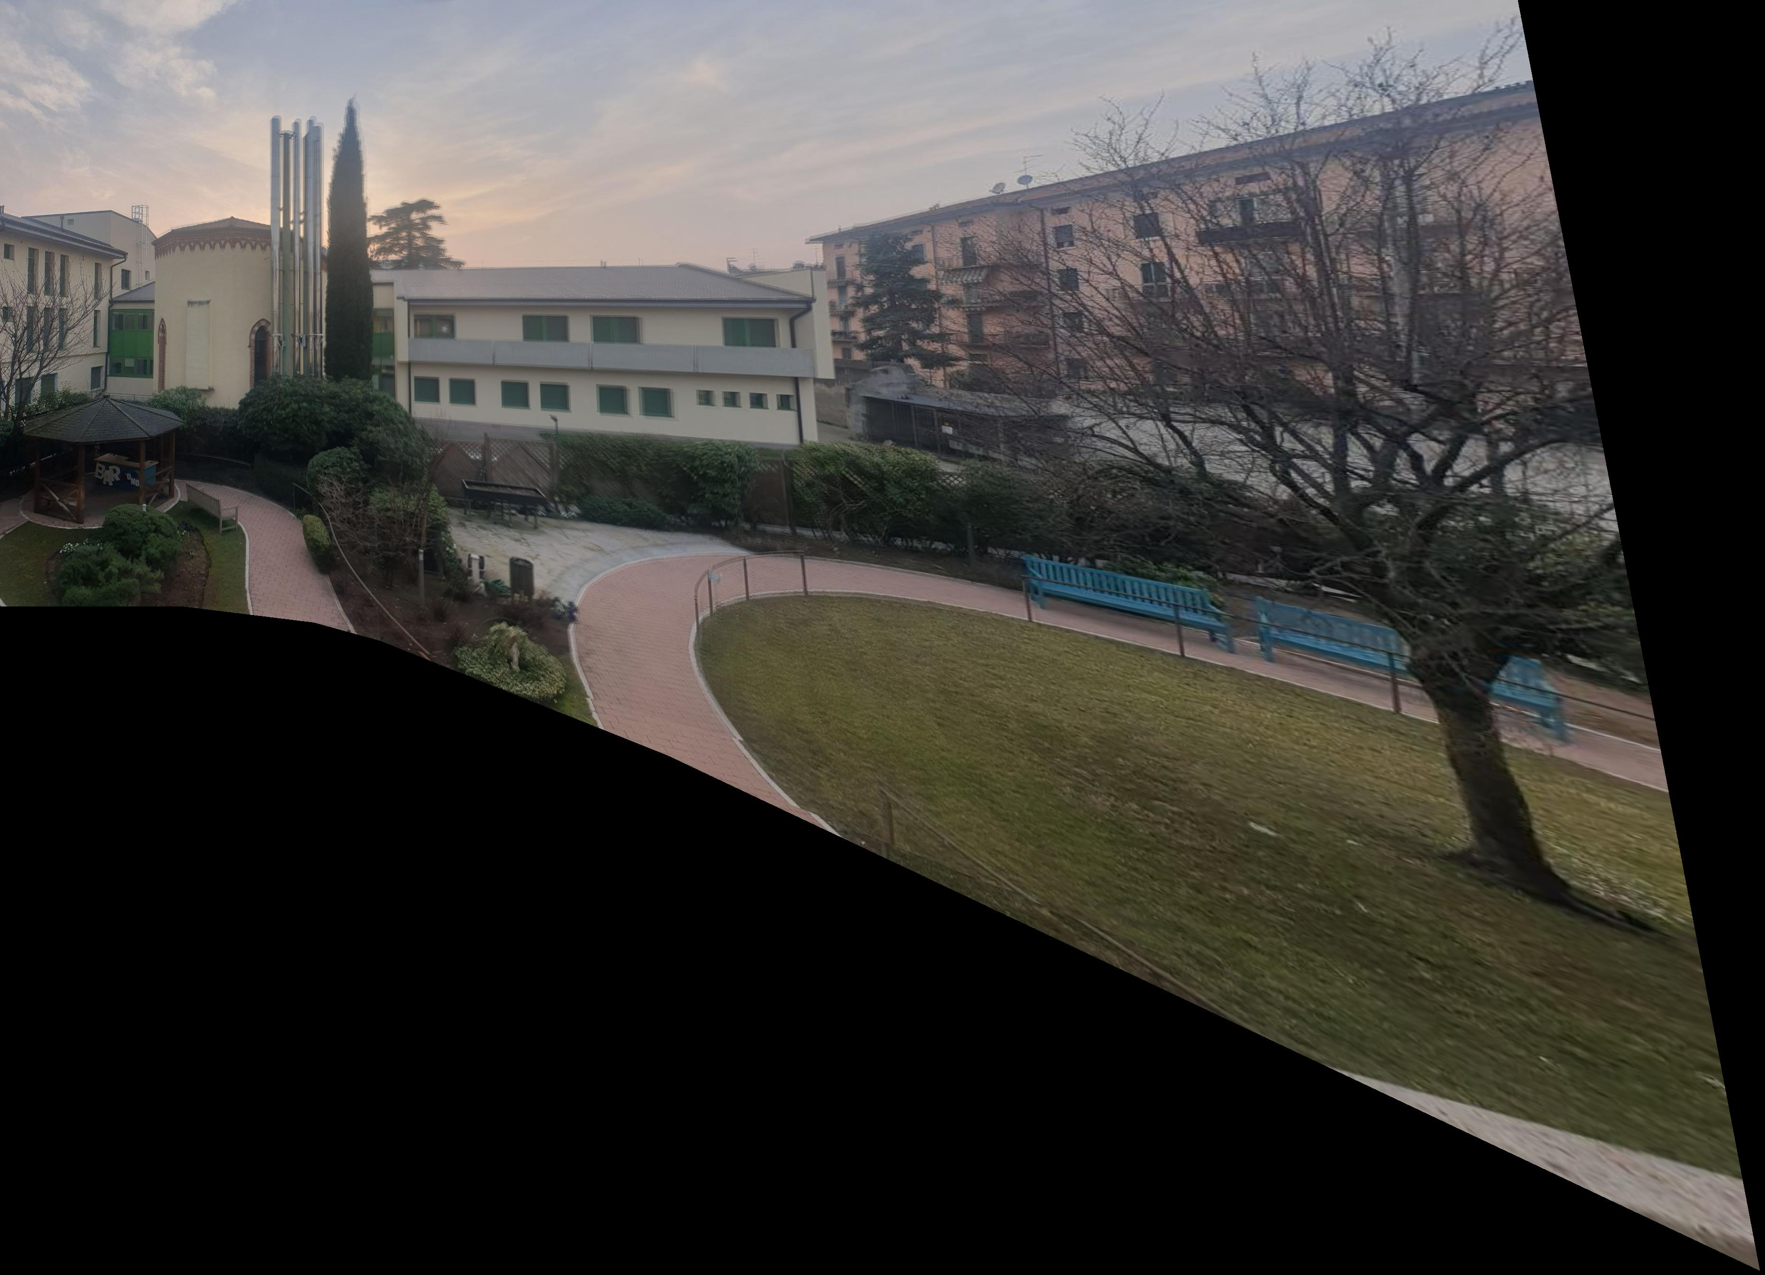
TEST 4
Increased pixel tolerance for RANSAC

Slide 15
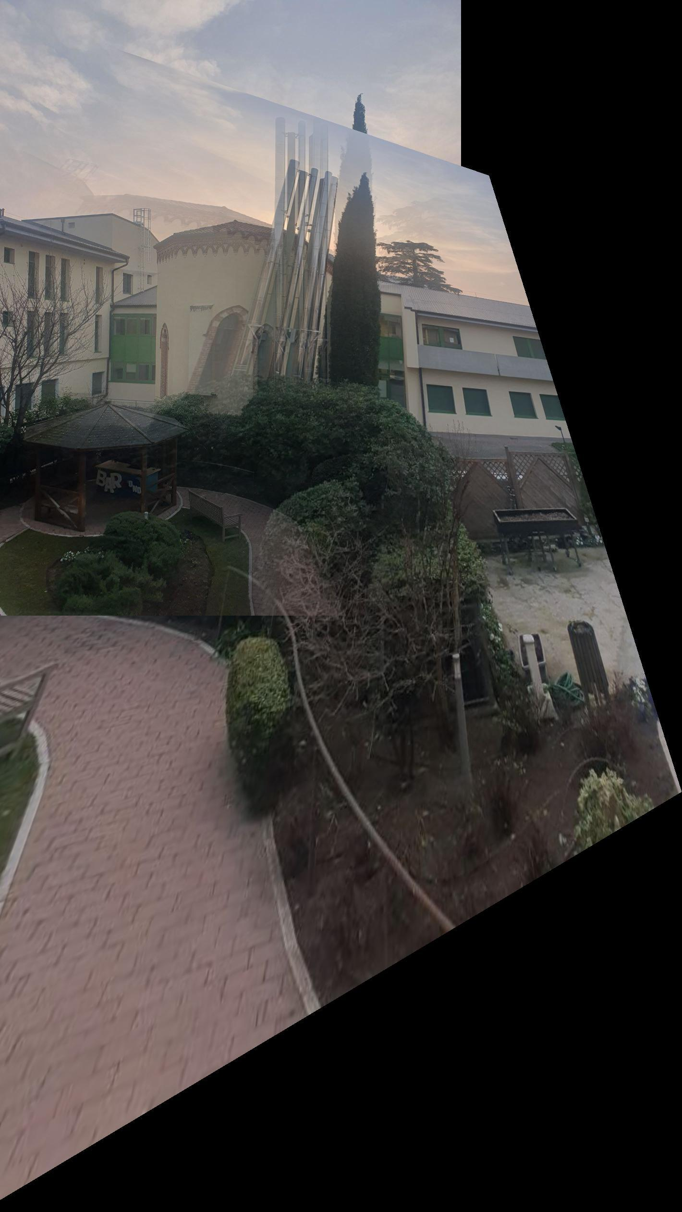
TEST 5
No RANSAC for homography estimation

Slide 16
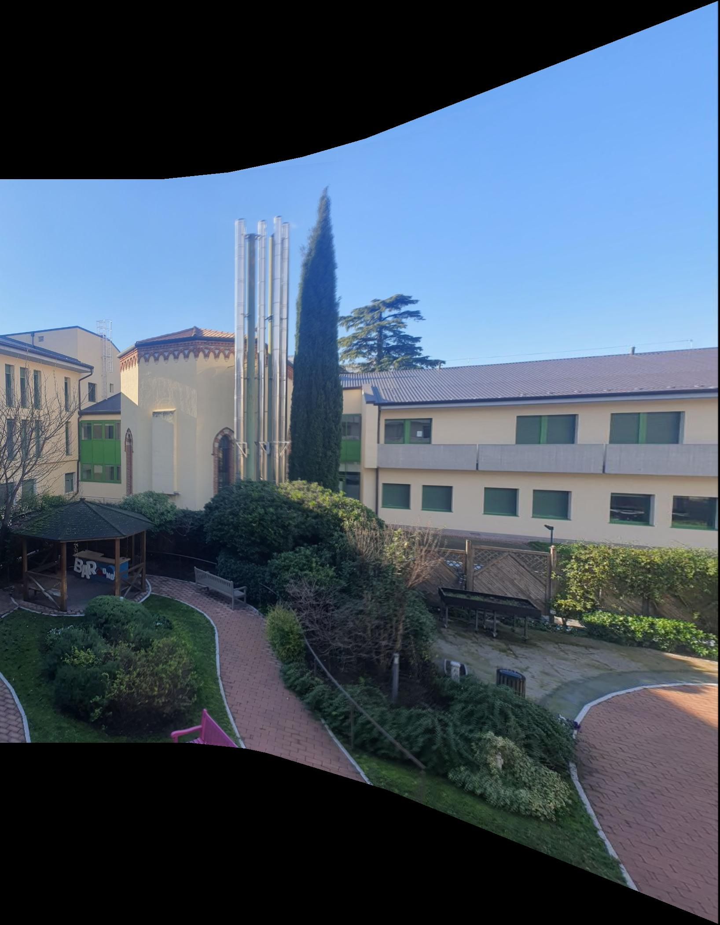
TEST 6
Mosaicing of set 2

Slide 17
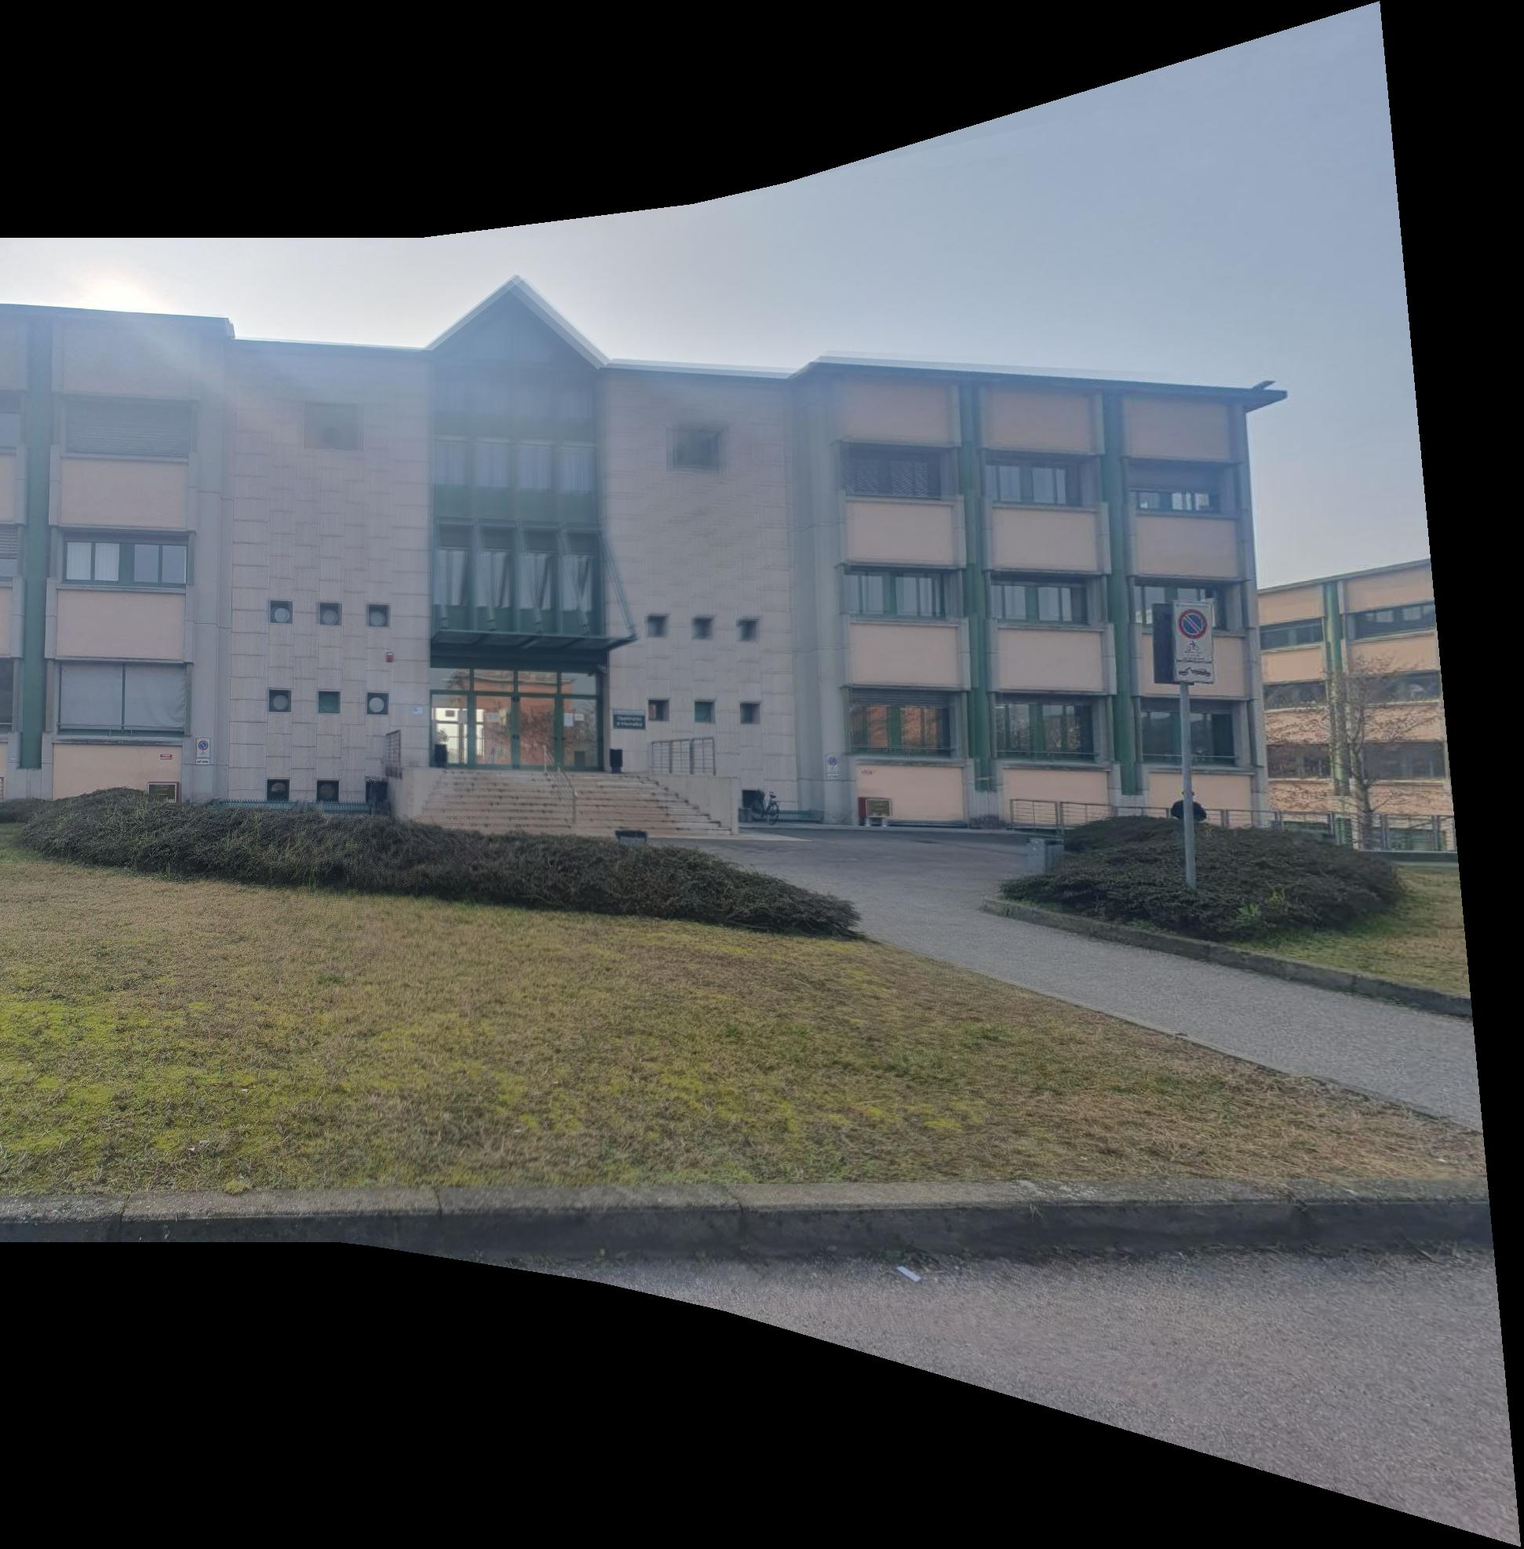
TEST 7
Mosaicing of set 3

Slide 18
THANK YOU FOR YOUR ATTENTION

