Slide 1
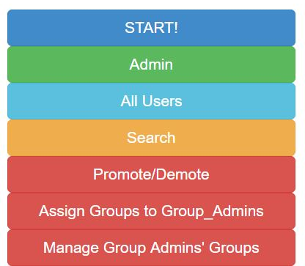
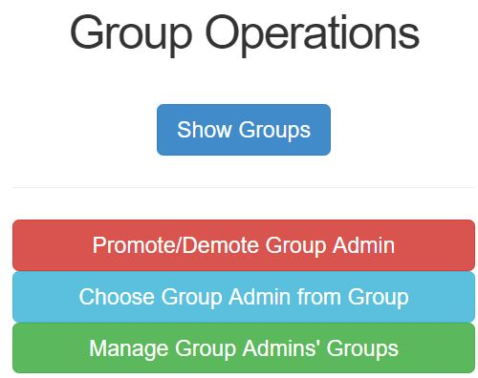
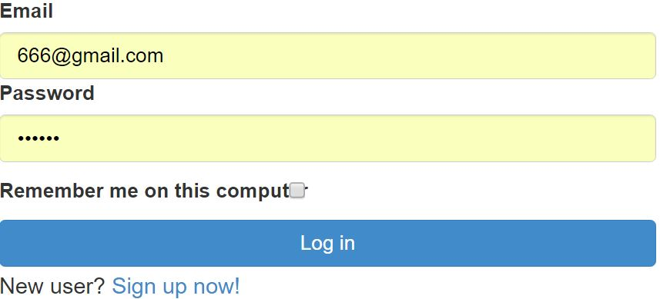


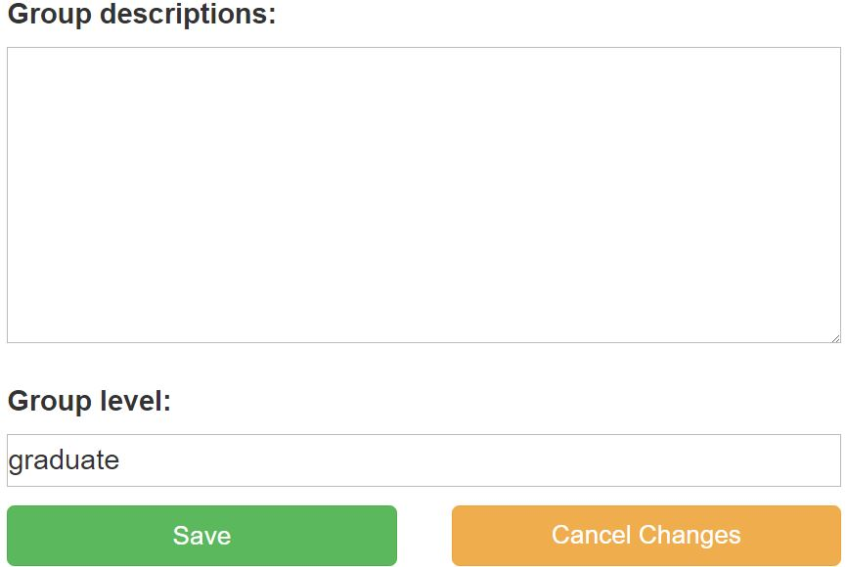
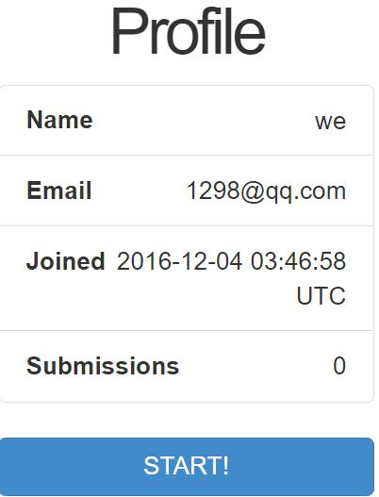
Crowdsourcing of biodata curation
Xiaopei Xu, Jianyu Zuo, Wenrui Zhang, Lang feng, Yinan Zhu, and Bowen Li
Dept. of Electrical and Computer Engineering, Dept. of Computer Science and Engineering, Texas A&M University
Introduction
Overall Function
Administrator functions
The recently advances have
enabled the generation of a large
amount of gene expression data.
Data in these public repositories are
neither well organized making it
difficult to fully unleash the power
of these data.
We will design website which
serves as a basic framework for
crowdsourcing of biodata curation.
Group
Admin
Group
Admin
Promote
Admin
Promote
Demote
Admin
Demote
User
Group Admin1
Group
Admin2
Group construction
Group
Admin1
Each group administrator manages one or more groups.
Each user belongs to one or more groups.
Delete
Add
Admin
Group
Group
Admin1
Group
Admin2
Group
Admin8
Group
Admin9
Group
Admin
Group1
Group2
Group7
Group10
Group11
Delete
Add
User1
User2
User3
User4
...
User5
User6
User1
User3
...
User40
User41
User42
User43
...
User60
User61
User62
User41
...
User35
User37
User60
User61
...
User1
User2
Login
Question & Answer
Search
Database
Users
Group Creation
User Information
Select
Database
Receive
Database
Write
Question
Receive
Question
Select
Group
Answer
Quesiton
Submit
Submit

