Slide 1
October 7, 2004
Introduction to
Computer Security
Lecture 5
Integrity Policies

Slide 2
Overview
Requirements
  Very different than confidentiality policies
Biba’s models
  Low-Water-Mark policy
  Ring policy
  Strict Integrity policy
Lipner’s model
  Combines Bell-LaPadula, Biba
Clark-Wilson model

Slide 3
Requirements of Commercial Integrity Policies (Lipner)
Users will not write their own programs, but will use existing production programs and databases.
Programmers will develop and test programs on a nonproduction system; if they need access to actual data, they will be given production data via a special process, but will use it on their development system.
A special process must be followed to install a program from the development system onto the production system.
The special process in requirement 3 must be controlled and audited.
The managers and auditors must have access to both the system state and the system logs that are generated.

Slide 4
Integrity Policy: Principles of operation
Requirements induce principles of operation:
  Separation of Duty: Single person should not be allowed to carry out all steps of a critical function
    Moving a program from Dev. to Prod. system
    Developer and Certifier (installer) of a program
    Authorizing checks and cashing it
  Separation of function
    Do not process production data on development system
  Auditing
    Emphasis on recovery and accountability
    Controlled/audited process for updating code on production system

Slide 5
Biba’s Integrity Policy Model
Based on Bell-LaPadula
  Subject, Objects
  Integrity Levels with dominance relation
    Higher levels
      more reliable/trustworthy
      More accurate
Information transfer path:
Sequence of subjects, objects where
  s_{i} r o_{i}
  s_{i} w o_{i+1}

Slide 6
Policies
Low-Water-Mark Policy
  s w o ⇔ i(o) ≤ i(s) prevents writing to higher level
  s r o ⇒ i’(s) = min(i(s), i(o)) drops subject’s level
  s₁ x s₂ ⇔ i(s₂) ≤ i(s₁) prevents executing higher level objects
Ring Policy
  s r o allows any subject to read any object
  s w o ⇔ i(o) ≤ i(s) (same as above)
  s₁ x s₂ ⇔ i(s₂) ≤ i(s₁)
Biba’s Model: Strict Integrity Policy (dual of Bell-LaPadula)
  s r o ⇔ i(s) ≤ i(o) (no read-down)
  s w o ⇔ i(o) ≤ i(s) (no write-up)
  s₁ x s₂ ⇔ i(s₂) ≤ i(s₁)
Theorem for each:
  If there is an information transfer path from object o₁ to object o_{n+1}, then the enforcement of the policy requires that i(o_{n+1}) ≤ i(o₁) for all n>1

Slide 7
LOCUS and Biba
Goal:
  prevent untrusted software from altering data or other software (limit execution domain)
Approach: make levels of trust explicit
  credibility rating based on estimate of software’s trustworthiness (0 untrusted, n highly trusted)
  trusted file systems contain software with a single credibility level
  User/process has risk level or highest credibility level at which process can execute
  Must use run-untrusted command to run software at lower credibility level

Slide 8
Lipner: Integrity Matrix
BLP + Biba to conform to commercial requirement
Security Levels
  Audit: AM
    Audit/management functions
  System Low: SL
    Everything else; any process can read information at this level
Categories
  Development (not yet in production use)
  Production Code (production processes and programs)
  Production Data (data covered by the integrity policy)
  System Development (system programs under development)
  Software Tools (programs in production system not related to sensitive/protected data)
Follow Bell-LaPadula security properties

Slide 9
Lipner: Integrity Matrix
Users: Clearance
  Ordinary (SL,{PC, PD})
  Developers (SL,{D,T})
  System Programmers (SL,{SD, T})
  System Managers/Aud. (AM,{D,PC,PD,SD,T})
  Controllers (SL,{D,PC,PD,SD,T} + downgrade prv
Objects Classification
  Development code/data (SL,{D,T})
  Production code (SL,{PC})
  Production data (SL,{PC,PD})
  Tools (SL,{T})
  System Programs (SL,∅)
  System Program update (SL,{SD,T})
  Logs (AM, {…})

Slide 10
Check against the requirement
Users will not write their own programs, but will use existing production programs and databases.
  Users have no access to T, so cannot write their own programs
Programmers will develop and test programs on a non production system; if they need access to actual data, they will be given production data via a special process, but will use it on their development system.
  Applications programmers have no access to PD, so cannot access production data; if needed, it must be put into D (downgrade), requiring the system controller to intervene

Slide 11
Check against the requirement
A special process must be followed to install a program from the development system onto the production system.
  Installing a program requires downgrade procedure (from D to PC), so only system controllers can do it
The special process in requirement 3 must be controlled and audited.
  Control: only system controllers can downgrade; audit: any such downgrading must be logged
The managers and auditors must have access to both the system state and the system logs that are generated.
  System management and audit users are in AM and so have access to system state and logs

Slide 12
Problem
Too inflexible
  System managers cannot run programs for repairing inconsistent or erroneous production database
  A program for repairing an inconsistent database cannot be application level software
    An integrity issue
So add more …

Slide 13
Lipner’s full model
Introduce integrity levels
Integrity classifications (highest to lowest)
  ISP (System Program): for system programs
  IO (Operational): production programs, development software
  ISL (System Low): users get this on log in
Integrity categories (distinguish between development and production)
  ID (Development): development entities
  IP (Production): production entities

Slide 14
Simplify Bell-LaPadula
Reduce security categories to 3:
  SP (Production): production code, data
  SD (Development): same as D
  SSD (System Development): same as old SD
    Remove T
      Earlier category T allowed application developers and system programmers to use the same programs without being able to alter those programs.
      The new integrity categories distinguish between development and production, so they serve the purpose of software tools category
    Collapse PC and PD into SP category

Slide 15
Users and Levels
Subjects | Security Level (same as before) | Integrity Level
Ordinary users | (SL, { SP }) | (ISL, { IP })
Application developers | (SL, { SD }) | (ISL, { ID })
System programmers | (SL, { SSD }) | (ISL, { ID })
System managers and auditors | (AM, { SP, SD, SSD }) | (ISL, { IP, ID})
System controllers | (SL, { SP, SD }) and downgrade privilege | (ISP, { IP, ID})
Repair | (SL, { SP }) | (ISL, { IP })

Slide 16
Users and Levels
Subjects | Security Level (same as before) | Integrity Level
Ordinary users | (SL, { SP }) | (ISL, { IP })
Application developers | (SL, { SD }) | (ISL, { ID })
System programmers | (SL, { SSD }) | (ISL, { ID })
System managers and auditors | (AM, { SP, SD, SSD }) | (ISP, ∅)
System controllers | (SL, { SP, SD }) and downgrade privilege | (ISP, {IP, ID})
Repair | (SL, { SP }) | (ISL, { IP })

Slide 17
Key Ideas for Assigning
Integrity Levels to Objects
Security clearances of subjects same as without integrity levels
Ordinary users need to modify production data, so ordinary users must have write access to integrity category IP
Ordinary users must be able to write production data but not production code; integrity classes allow this

Slide 18
Objects and Classifications
Objects | Security Level (earlier category) | Integrity Level
Development code/test data | (SL, { SD }) (D, T) | (ISL, { IP} )
Production code | (SL, { SP }) (PC) | (IO, { IP }) ?
Production data | (SL, { SP }) (PC, PD) | (ISL, { IP }) ?
Software tools | (SL, ∅ ) (T) | (IO, { ID })
System programs | (SL, ∅ ) ∅ | (ISP, { IP, ID })
System programs in modification | (SL, { SSD }) (SD, T) | (ISL, { ID })
System and application logs | (AM, { appropriate }) | (ISL, ∅ )
Repair | (SL, {SP}) | (ISL, { IP })

Slide 19
Objects and Classifications
Objects | Security Level (earlier category) | Integrity Level
Development code/test data | (SL, { SD }) (D, T) | (ISL, { ID} )
Production code | (SL, { SP }) (PC) | (IO, { IP }) ?
Production data | (SL, { SP }) (PC, PD) | (ISL, { IP }) ?
Software tools | (SL, ∅ ) (T) | (IO, { ID })
System programs | (SL, ∅ ) ∅ | (ISP, { IP, ID })
System programs in modification | (SL, { SSD }) (SD, T) | (ISL, { ID })
System and application logs | (AM, { appropriate }) | (ISL, ∅ )
Repair | (SL, {SP}) | (ISP, { IP })

Slide 20
What can an ordinary user do?
Ordinary users can : (SL, { SP }) (ISL, { IP })
  Read and write production data (same security integrity levels)
  Read production code
    same classification &
    (IO, IP) dom (ISL, {IP})
  System program
    (SL, {SP}) dom (SL, ∅) &
    (ISP, {IP,ID}) dom {ISL, {IP})
  Repair objects (same levels)
  Write (not read) the system and application log
    (AM, {SP}) dom (SL, {SP}) &
    (ISL, {IP}) dom {ISL, ∅})

Slide 21
Clark-Wilson Integrity Model
Transactions as the basic operation
Integrity defined by a set of constraints
  Data in a consistent or valid state when it satisfies these
Example: Bank
  D today’s deposits, W withdrawals, YB yesterday’s balance, TB today’s balance
  Integrity constraint: D + YB –W
Well-formed transaction
  A series of operations that move system from one consistent state to another
  State before transaction consistent ⇒ state after transaction consistent
Issue: who examines, certifies transactions done correctly?
  Separation of duty is crucial

Slide 22
Clark/Wilson Model Entities
Constrained Data Items (CDI) : data subject to Integrity Control
  Eg. Account balances
  Integrity constraints constrain the values of the CDIs
Unconstrained Data Items (UDI): data not subject to IC
  Eg. Gifts given to the account holders
Integrity Verification Procedures (IVP)
  Test CDIs’ conformance to integrity constraints at the time IVPs are run (checking that accounts balance)
Transformation Procedures (TP); E.g.,
  Depositing money
  Withdrawing money
  Money transfer etc.

Slide 23
Clark/Wilson:
Certification/Enforcement Rules
C1: When any IVP is run, it must ensure all CDIs are in valid state
C2: A TP must transform a set of CDIs from a valid state to another valid state
  TR must not be used on CDIs it is not certified for
E1: System must maintain certified relations
  TP/CDI sets enforced
E2: System must control users
  user/TP/CDI mappings enforced

Slide 24
Clark/Wilson:
Certification/Enforcement Rules
C3: Relations between (user, TP, {CDI}) must support separation of duty
E3: Users must be authenticated to execute TP
  Note, unauthenticated users may manipulate UDIs
C4: All TPs must log undo information to append-only CDI (to reconstruct an operation)
C5: A TP taking a UDI as input must either reject it or transform it to a CDI
E4: Only certifier of a TP may change the list of entities associated with that TP
  Enforces separation of duty: if a user could create a TP and associate some set of entities and himself with that TP, he could have the TP perform some unauthorized act

Slide 25
Requirements of Commercial Integrity Policies (Lipner)
Users will not write their own programs, but will use existing production programs and databases.
Programmers will develop and test programs on a nonproduction system; if they need access to actual data, they will be given production data via a special process, but will use it on their development system.
A special process must be followed to install a program from the development system onto the production system.
The special process in requirement 3 must be controlled and audited.
The managers and auditors must have access to both the system state and the system logs that are generated.

Slide 26
Comparison With Requirements
Users can’t (only trusted personnel can) certify TPs, so CR5 and ER4 enforce this
Procedural, so model doesn’t directly cover it; but special process corresponds to using TP
  No technical controls can prevent programmer from developing program on production system; usual control is to delete software tools
TP does the installation, trusted personnel do certification

Slide 27
Comparison With Requirements
4. CR4 provides logging; ER3 authenticates trusted personnel doing installation; CR5, ER4 control installation procedure
  New program is UDI before certification, CDI (and TP) after
Log is CDI, so appropriate TP can provide managers, auditors access
  Access to state handled similarly

Slide 28
Summary
Integrity policies deal with trust
  As trust is hard to quantify, these policies are hard to evaluate completely
  Look for assumptions and trusted users to find possible weak points in their implementation
Biba, Lipner based on multilevel integrity
Clark-Wilson introduce new ideas
  Commercial firms do not classify data using multilevel scheme and they enforce separation of duty
  Notion of certification is different from enforcement;
    enforcement rules can be enforced,
    certification rules need outside intervention, and
    process of certification is complex and error prone

Slide 29
Hybrid Policies

Slide 30
Chinese Wall Model
Supports confidentiality and integrity
  Information can’t flow between items in a Conflict of Interest set
  Applicable to environment of stock exchange or investment house
Models conflict of interest
  Objects: items of information related to a company
  Company dataset (CD): contains objects related to a single company
    Written CD(O)
  Conflict of interest class (COI): contains datasets of companies in competition
    Written COI(O)
    Assume: each object belongs to exactly one COI class

Slide 31
Example
Bank COI Class
Gasoline Company COI Class
Bank of America
Shell Oil
Standard Oil
a
Bank of the
West
Union ’76
ARCO
Citibank
a

Slide 32
CW-Simple Security Property
(Read rule)
CW-Simple Security Property
  s can read o ⇔ one of the following holds
    ∃ o’ ∈ PR(s) such that CD(o’) = CD(o)
    ∀ o’, o’ ∈ PR(s) ⇒ COI(o’) ≠ COI(o), or
    o has been “sanitized”
    (o’ ∈ PR(s) indicates o’ has been previously read by s)
  Public information may belong to a CD
    As is publicly available, no conflicts of interest arise
    So, should not affect ability of analysts to read
    Typically, all sensitive data removed from such information before it is released publicly (called sanitization)

Slide 33
Writing
Anthony, Susan work in same trading house
Anthony can read BankOfAmercia’s CD,
Susan can read Bank CitiBanks’s CD,
Both can read ARCO’s CD
If Anthony could write to Gas’ CD, Susan can read it
  Hence, indirectly, she can read information from BankOfAmercia’s CD, a clear conflict of interest

Slide 34
CW-*-Property (Write rule)
CW-*- Property
  s can read o ⇔ the following holds
    The CW-simple security condition permits S to read O.
    For all unsanitized objects o’, s can read o’ ⇒ CD(o’) = CD(o)
    Says that s can write to an object if all the (unsanitized) objects it can read are in the same dataset
  Anthony can read both CDs hence condition 1 is met
  He can read unsanitized objects of BankOfAmercia, hence condition 2 is false
    Hence Anthony can’t write to objects in ARCO’s CD.

Slide 35
Compare to Bell-LaPadula
Fundamentally different
  CW has no security labels, B-LP does
  CW has notion of past accesses, B-LP does not
Bell-LaPadula can capture state at any time
  Each (COI, CD) pair gets security category
  Two clearances, S (sanitized) and U (unsanitized) such that (S dom U)
  Subjects assigned clearance for compartments without multiple categories corresponding to CDs in same COI class
    eg. If Susan can read the BankOfAmerica and ARCO CDs, her process would get clearance for compartment (U, {a, n})

Slide 36
Compare to Bell-LaPadula
Bell-LaPadula cannot track changes over time
  Susan becomes ill, Anna needs to take over
    C-W history lets Anna know if she can
    No way for Bell-LaPadula to capture this
Access constraints change over time
  Initially, subjects in C-W can read any object
  Bell-LaPadula constrains set of objects that a subject can access
    Can’t clear all subjects for all categories, because this violates CW-simple security condition

Slide 37
Compare to Clark-Wilson
Clark-Wilson Model covers integrity, CW consider only access control aspects
If “subjects” and “processes” are interchangeable, a single person could use multiple processes to violate CW-simple security condition
If “subject” is a specific person and includes all processes the subject executes, then consistent with Clark-Wilson Model

Slide 38
Clinical Information Systems
Security Policy (Anderson)
Intended for medical records
  Conflict of interest not critical problem
  Patient confidentiality, authentication of records and annotators, and integrity are
Entities:
  Patient: subject of medical records (or agent)
  Personal health information: data about patient’s health or treatment enabling identification of patient
  Clinician: health-care professional with access to personal health information while doing job

Slide 39
Assumptions and Principles
Assumes health information involves 1 person at a time
  Not always true; OB/GYN involves father as well as mother
Principles derived from medical ethics of various societies, and from practicing clinicians

Slide 40
Access
Principle 1: Each medical record has an access control list naming the individuals or groups who may read and append information to the record. The system must restrict access to those identified on the access control list.
  Idea is that clinicians need access, but no-one else. Auditors get access to copies, so they cannot alter records

Slide 41
Access
Principle 2: One of the clinicians on the access control list must have the right to add other clinicians to the access control list.
  Called the responsible clinician

Slide 42
Access
Principle 3: The responsible clinician must notify the patient of the names on the access control list whenever the patient’s medical record is opened. Except for situations given in statutes, or in cases of emergency, the responsible clinician must obtain the patient’s consent.
  Patient must consent to all treatment, and must know of violations of security

Slide 43
Access
Principle 4: The name of the clinician, the date, and the time of the access of a medical record must be recorded. Similar information must be kept for deletions.
  This is for auditing. Don’t delete information; update it (last part is for deletion of records after death, for example, or deletion of information when required by statute). Record information about all accesses.

Slide 44
Creation
Principle: A clinician may open a record, with the clinician and the patient on the access control list. If the record is opened as a result of a referral, the referring clinician may also be on the access control list.
  Creating clinician needs access, and patient should get it. If created from a referral, referring clinician needs access to get results of referral.

Slide 45
Deletion
Principle: Clinical information cannot be deleted from a medical record until the appropriate time has passed.
  This varies with circumstances.

Slide 46
Confinement
Principle: Information from one medical record may be appended to a different medical record if and only if the access control list of the second record is a subset of the access control list of the first.
  This keeps information from leaking to unauthorized users. All users have to be on the access control list.

Slide 47
Aggregation
Principle: Measures for preventing the aggregation of patient data must be effective. In particular, a patient must be notified if anyone is to be added to the access control list for the patient’s record and if that person has access to a large number of medical records.
  Fear here is that a corrupt investigator may obtain access to a large number of records, correlate them, and discover private information about individuals which can then be used for nefarious purposes (such as blackmail)

Slide 48
Enforcement
Principle: Any computer system that handles medical records must have a subsystem that enforces the preceding principles. The effectiveness of this enforcement must be subject to evaluation by independent auditors.
  This policy has to be enforced, and the enforcement mechanisms must be auditable (and audited)

Slide 49
Compare to Bell-LaPadula
Confinement Principle imposes lattice structure on entities in model
  Similar to Bell-LaPadula
CISS focuses on objects being accessed; B-LP on the subjects accessing the objects
  May matter when looking for insiders in the medical environment

Slide 50
Compare to Clark-Wilson
  CDIs are medical records
  TPs are functions updating records, access control lists
  IVPs certify:
    A person identified as a clinician is a clinician;
    A clinician validates, or has validated, information in the medical record;
    When someone is to be notified of an event, such notification occurs; and
    When someone must give consent, the operation cannot proceed until the consent is obtained
  Auditing (CR4) requirement: make all records append-only, notify patient when access control list changed

Slide 51
ORCON
Problem: organization creating document wants to control its dissemination
  Example: Secretary of Defense writes a memo for distribution to her immediate subordinates, and she must give permission for it to be disseminated further. This is “originator controlled” (here, the “originator” is a person).

Slide 52
Requirements
Subject s ∈ S marks object o ∈ O as ORCON on behalf of organization X. X allows o to be disclosed to subjects acting on behalf of organization Y with the following restrictions:
  o cannot be released to subjects acting on behalf of other organizations without X’s permission; and
  Any copies of o must have the same restrictions placed on it.
DAC fails
  Owner can set any desired permissions
    This makes 2 unenforceable

Slide 53
MAC Fails
First problem: category explosion
  Category C contains o, X, Y, and nothing else.
  If a subject y ∈ Y wants to read o, x ∈ X makes a copy o´.
  Note o´ has category C. If y wants to give z ∈ Z a copy, z must be in Y—by definition, it’s not.
  If x wants to let w ∈ W see the document, need a new category C´ containing o, X, W.
Second problem: abstraction
  MAC classification, categories centrally controlled, and access controlled by a centralized policy
  ORCON controlled locally

Slide 54
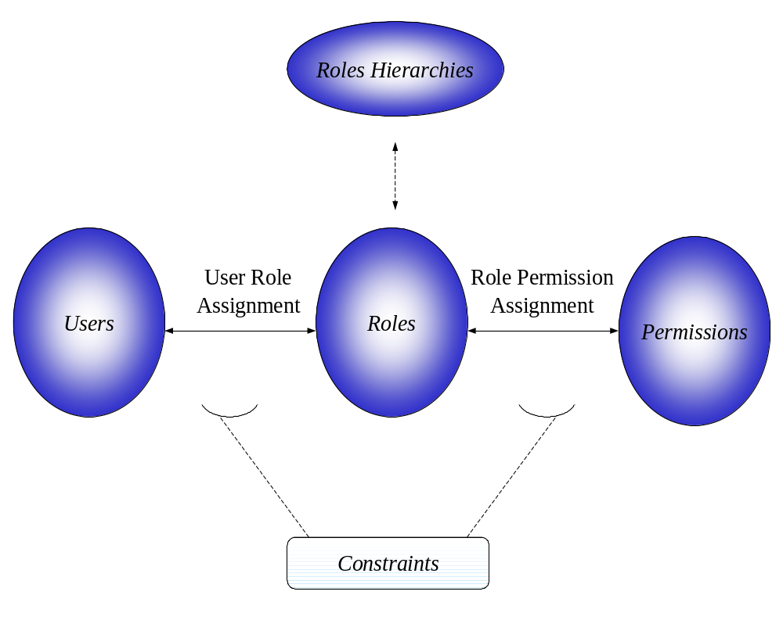
Role Based Access Control (RBAC)
Access control in organizations is based on “roles that individual users take on as part of the organization”
A role is “is a collection of permissions”

Slide 55
RBAC
Access depends on function, not identity
  Example: Allison is bookkeeper for Math Dept. She has access to financial records. If she leaves and Betty is hired as the new bookkeeper, Betty now has access to those records. The role of “bookkeeper” dictates access, not the identity of the individual.

Slide 56
Advantages of RBAC
Allows Efficient Security Management
  Administrative roles, Role hierarchy
Principle of least privilege allows minimizing damage
Separation of Duties constraints to prevent fraud
Allows grouping of objects
Policy-neutral - Provides generality
Encompasses DAC and MAC policies

Slide 57
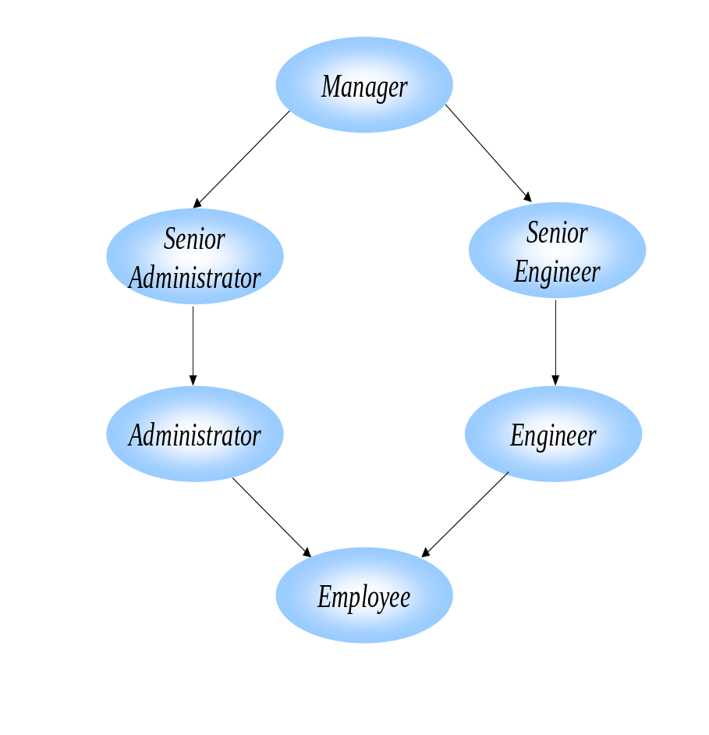
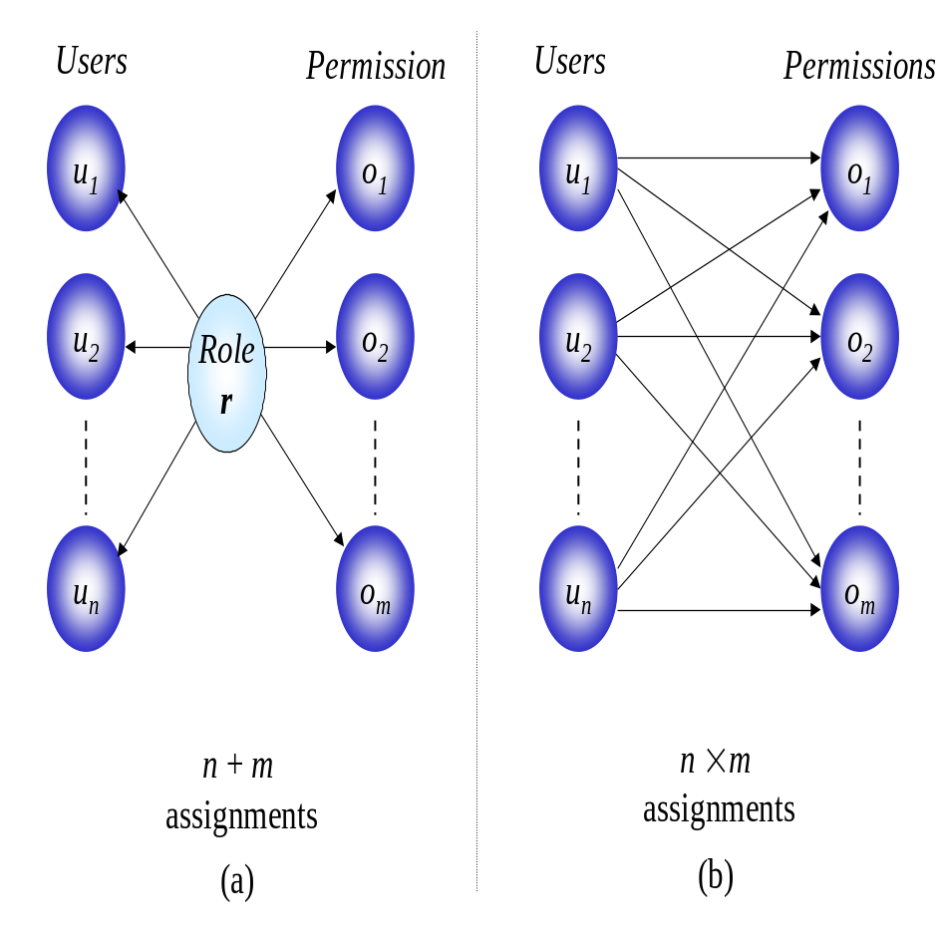
RBAC

